Slide 1
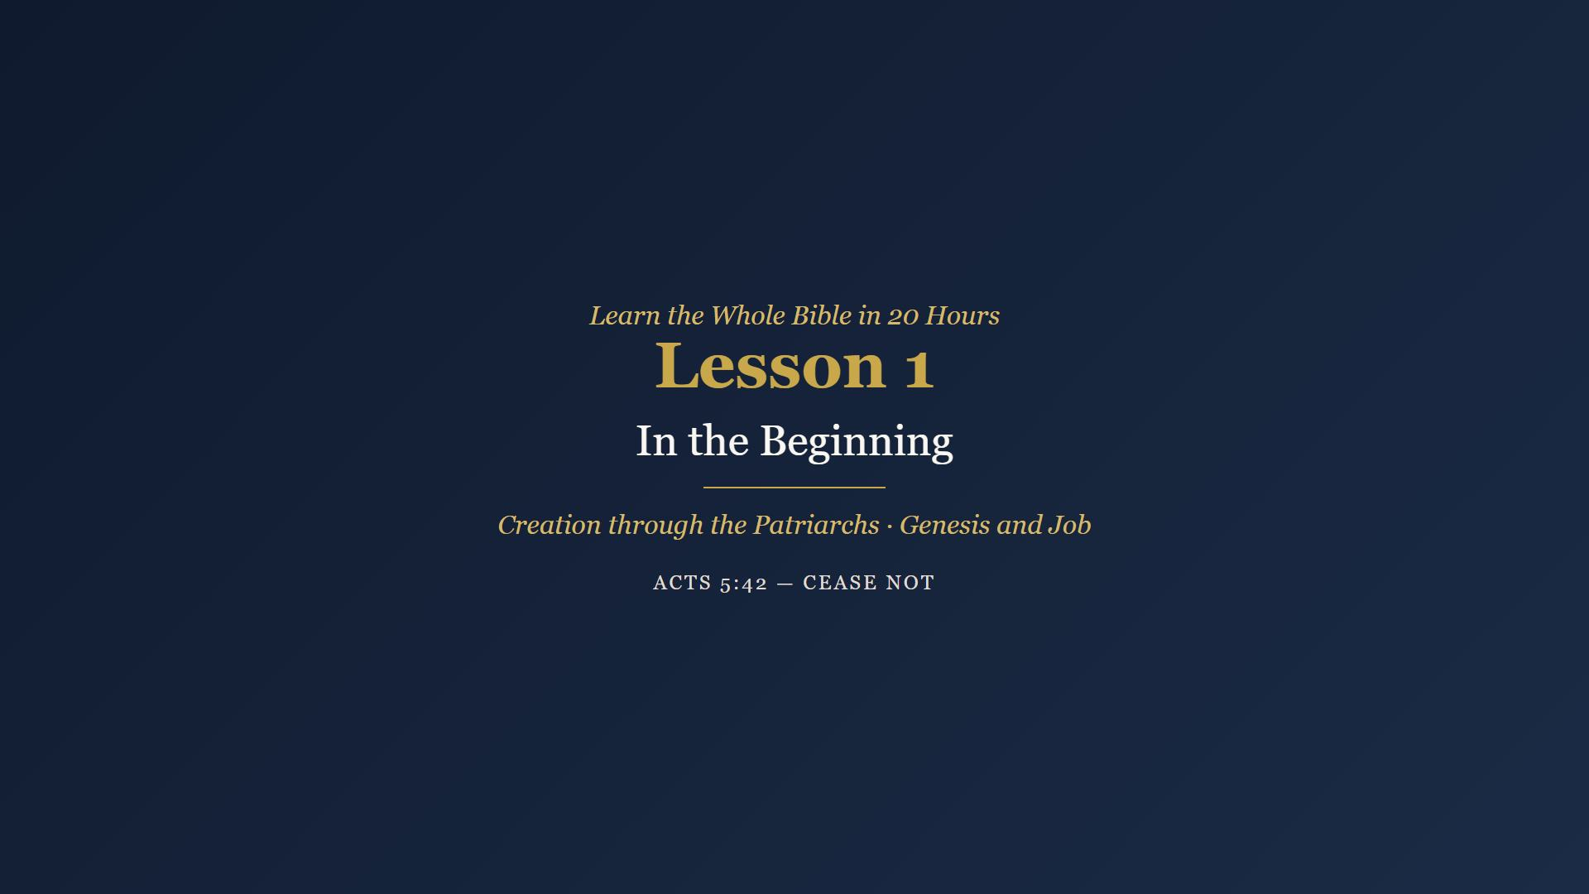
Notes:
Welcome. Introductions. Opening prayer. 10 minutes.

Slide 2
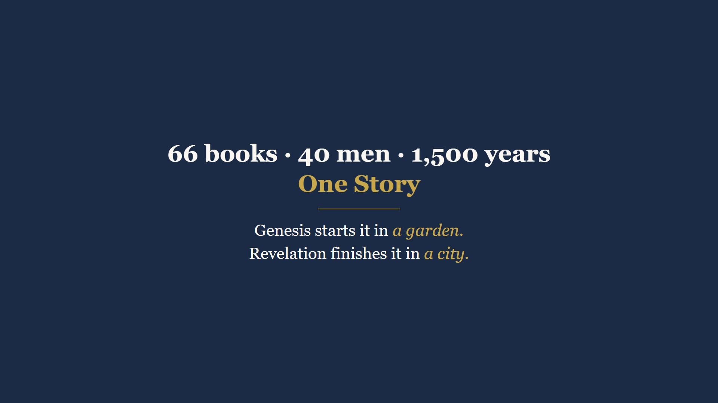
Notes:
Hold your Bible. 66 books, ~40 men, ~1500 years - one story. Genesis starts it in a garden, Revelation finishes it in a city. A dispensation is God dealing with man different ways at different times - not different ways of salvation, different house rules.

Slide 3
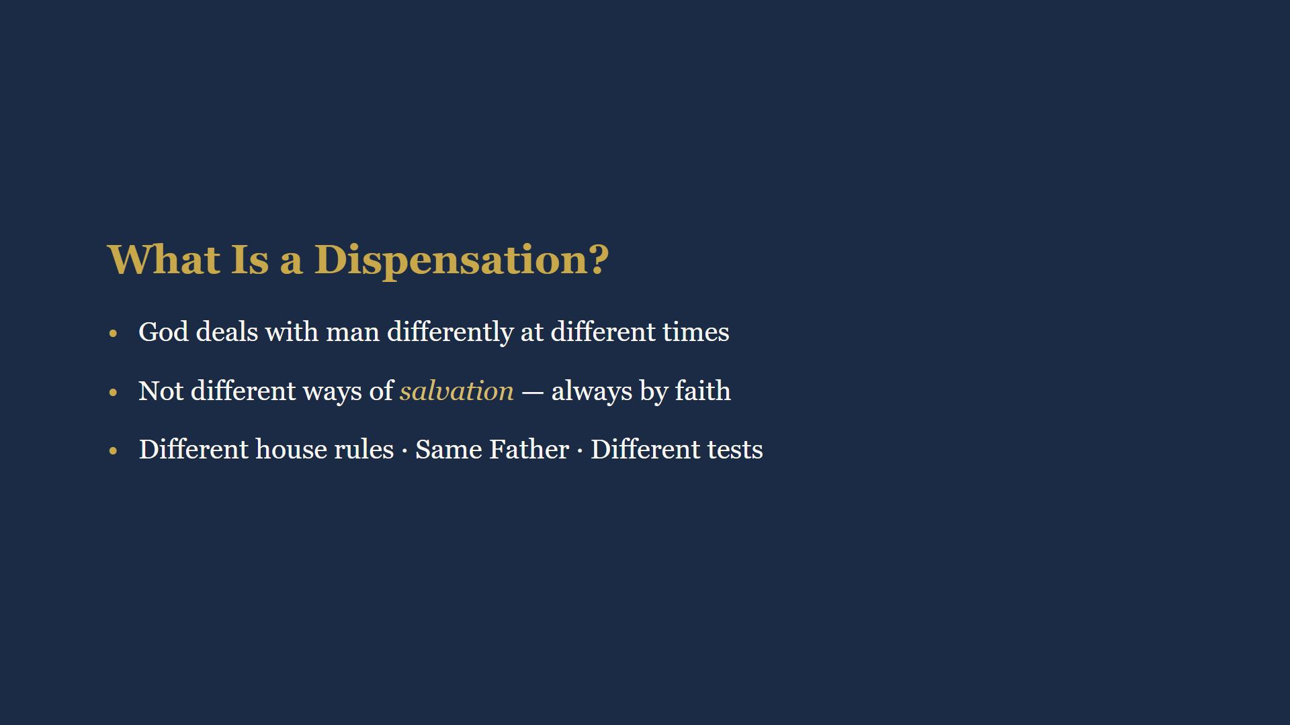
Notes:
Different house rules for different seasons. Same Father, same love, different tests. Seven across your Bible. Today we cross four.

Slide 4
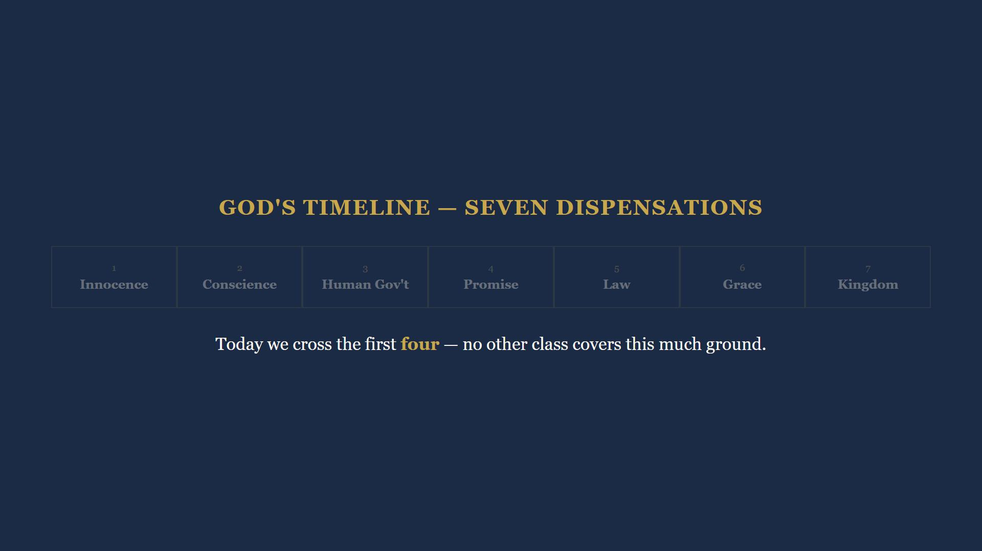
Notes:
Today we walk the first four dispensations. No other class covers this much ground.

Slide 5
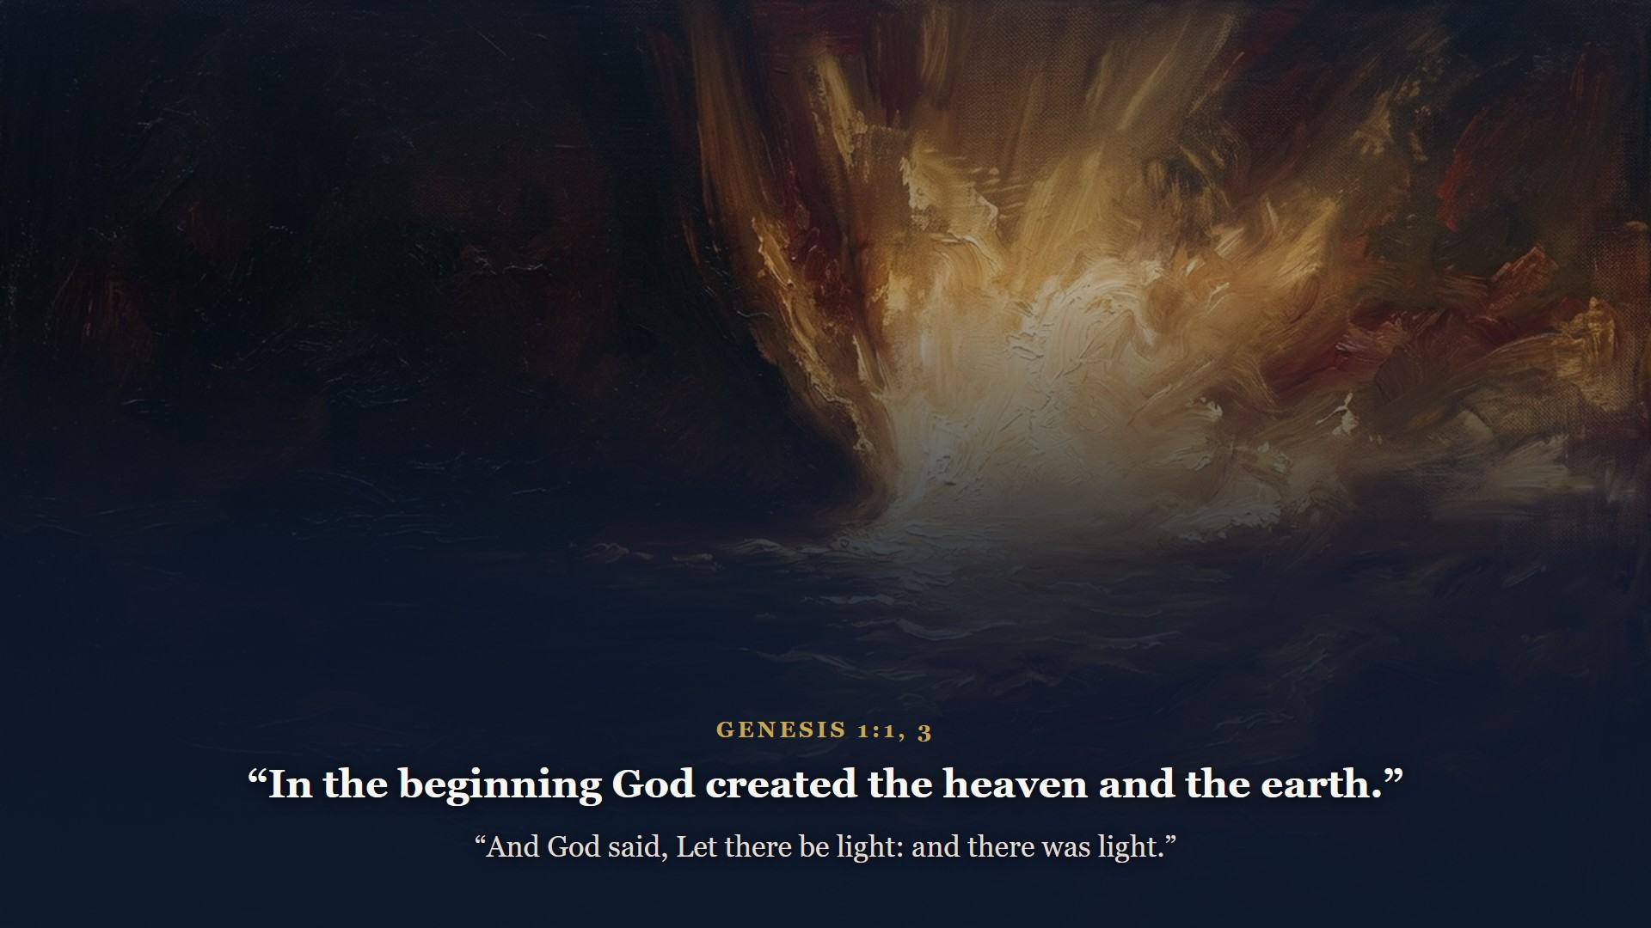
Notes:
The Bible does not argue for God's existence. It opens with God already there, already working. Six days - God speaks and it stands fast.

Slide 6
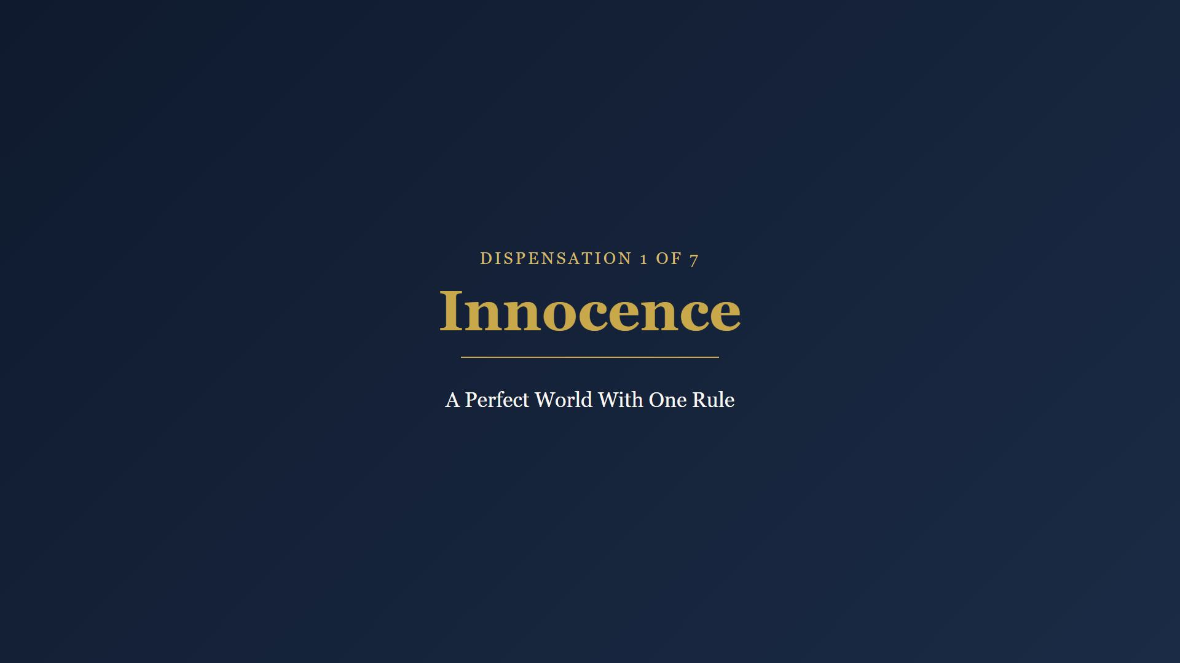
Notes:
First dispensation. A perfect world with one rule.

Slide 7
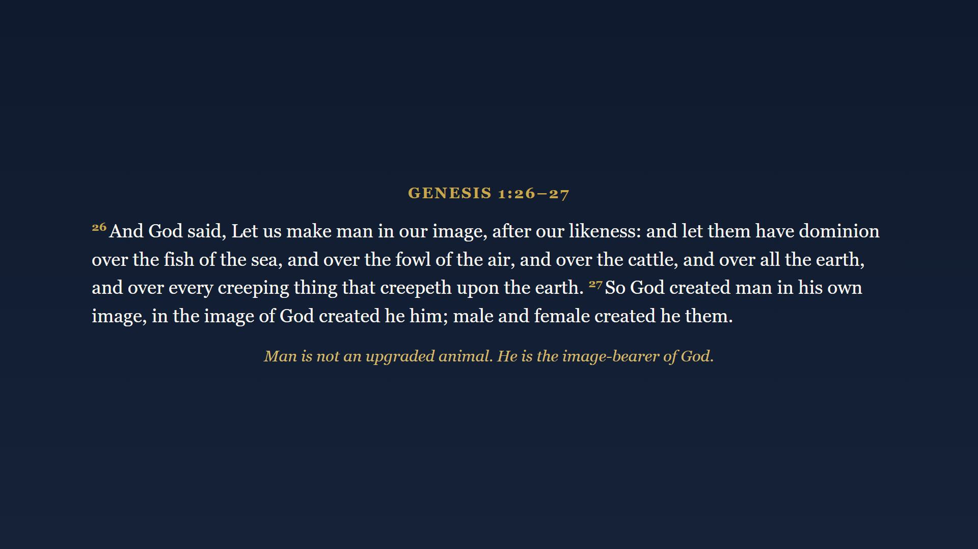
Notes:
Let US make man - Father, Son, and Spirit on page one. Man is not an upgraded animal. He is the image-bearer of God.

Slide 8
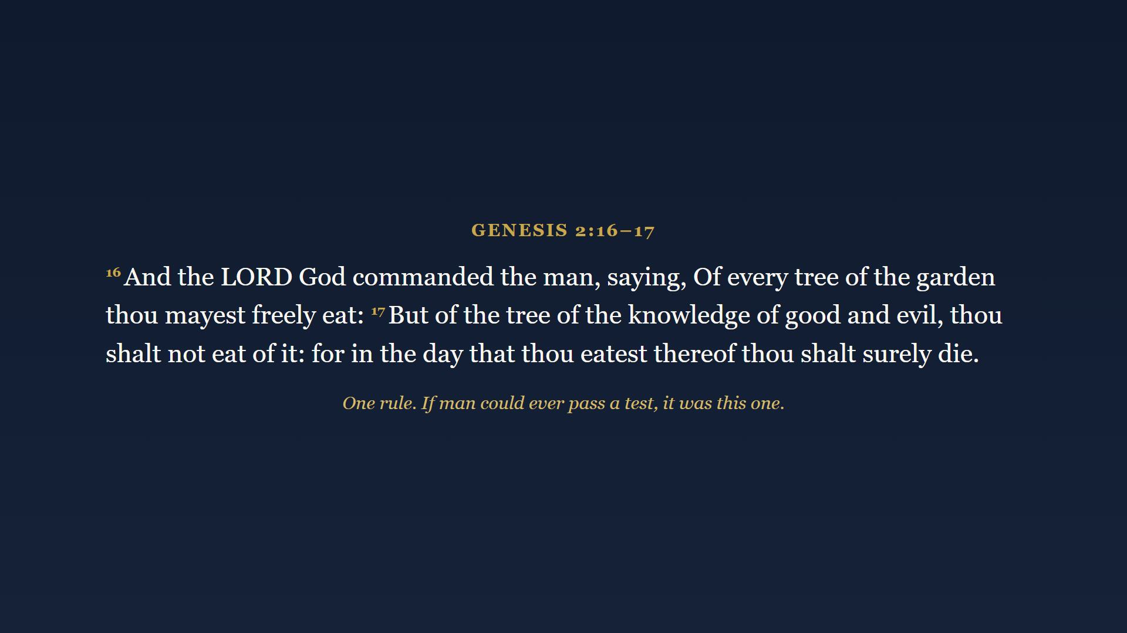
Notes:
One rule. Every tree but one. No sin nature, no bad neighborhood, no excuses. If man could ever pass a test, it was this one.

Slide 9
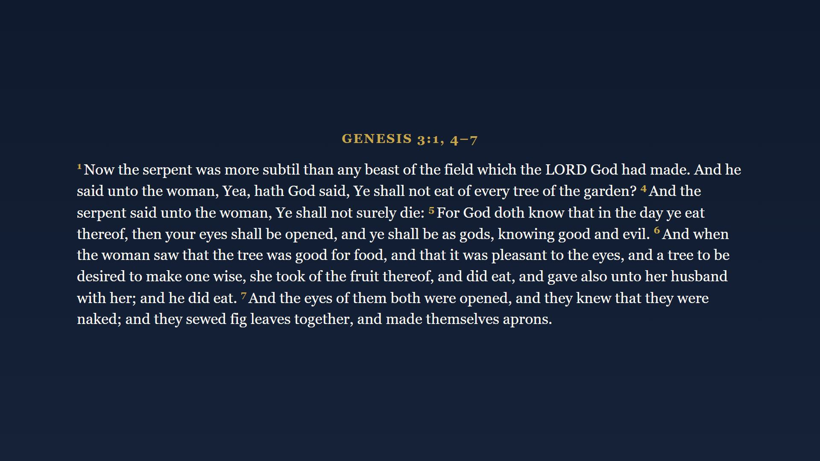
Notes:
Watch the serpent's method. First he questions God's word, then flatly denies it, then slanders God's motives. And man fell. Fig leaves - man's first religion, covering himself by his own works.

Slide 10
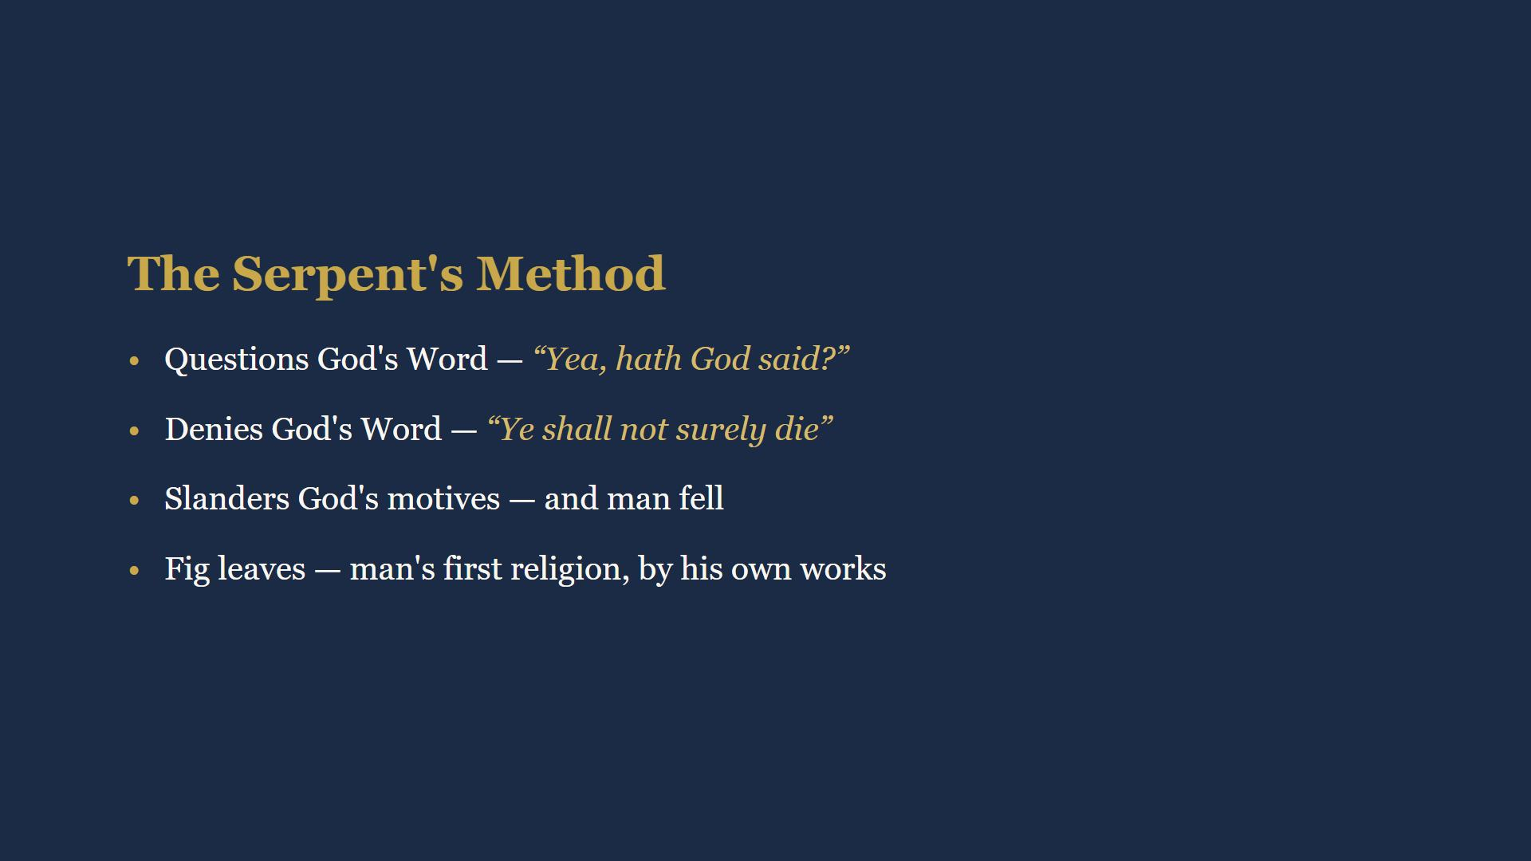
Notes:
He has not changed this playbook since. Fig leaves - man's first religion. It did not work then. It has not worked since.

Slide 11
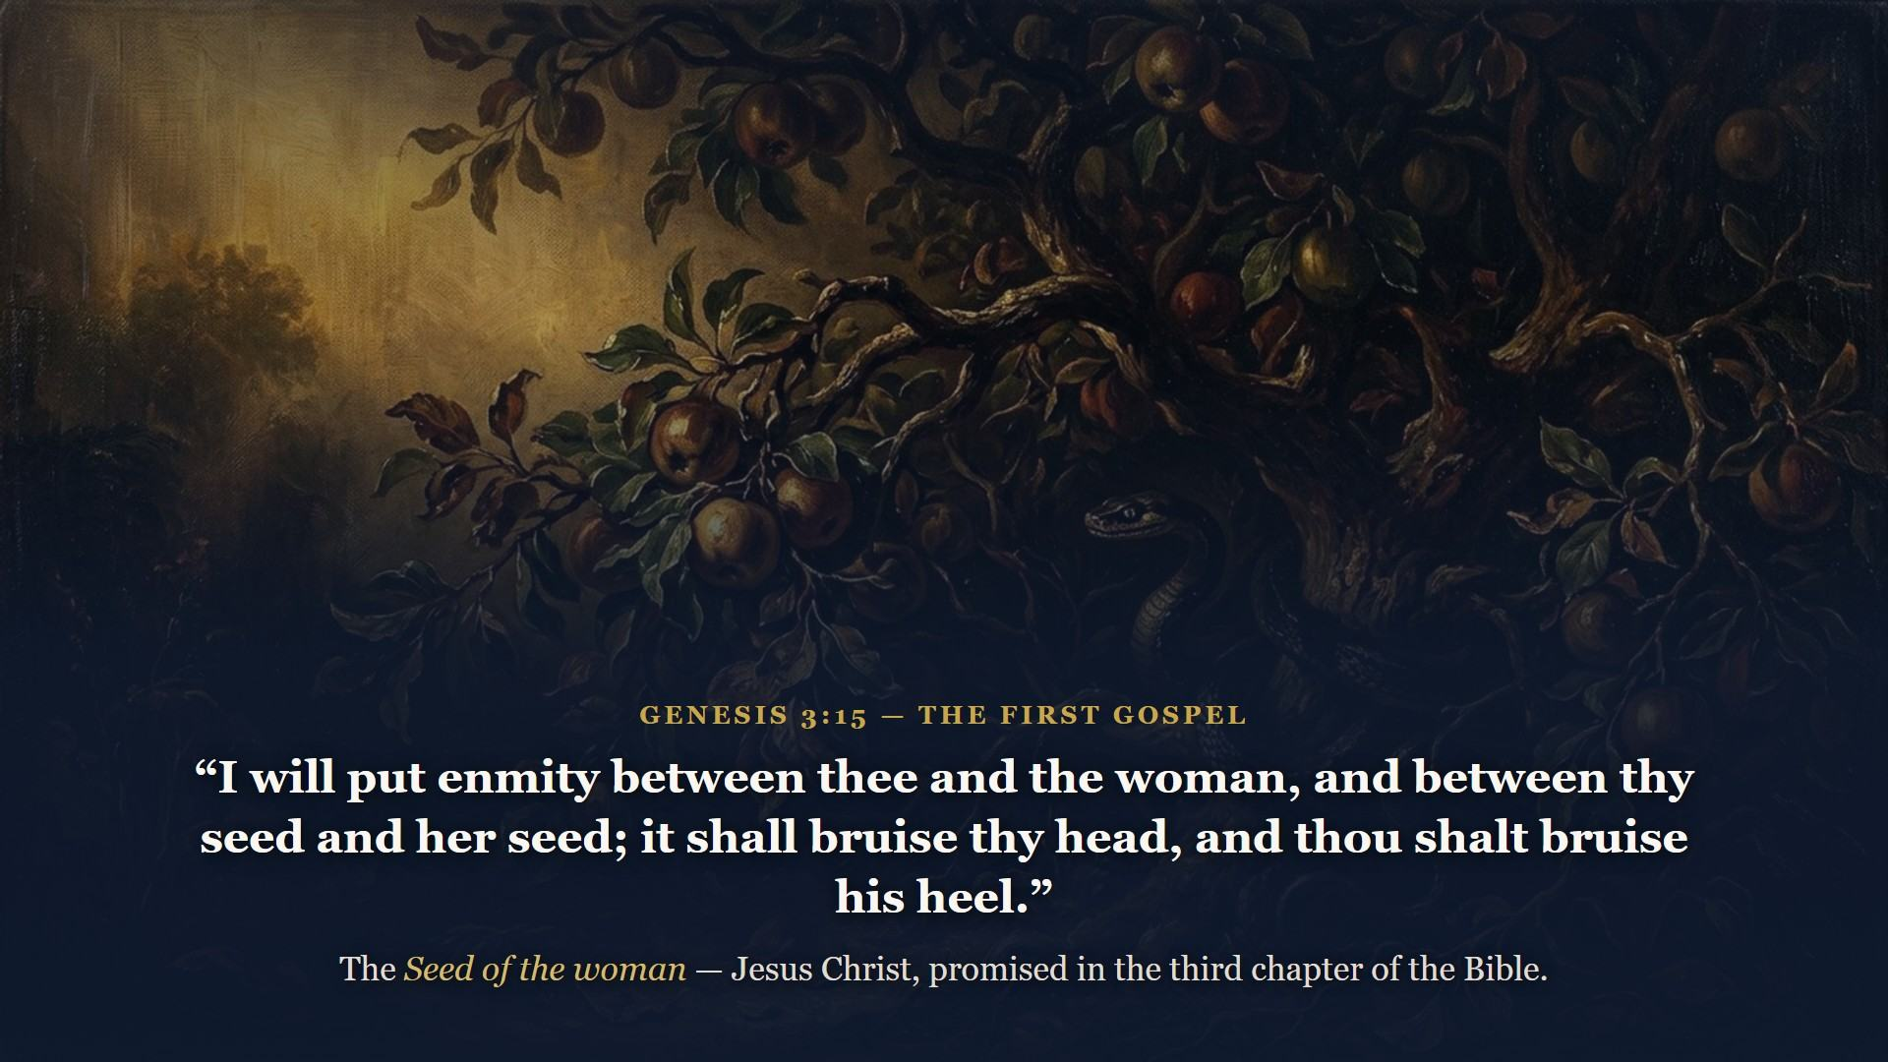
Notes:
Before God ever pronounced judgment on Adam, He made a promise. This is the first gospel preaching in the Bible and God Himself is the preacher. Seed of the WOMAN, not of the man. Mark that.

Slide 12
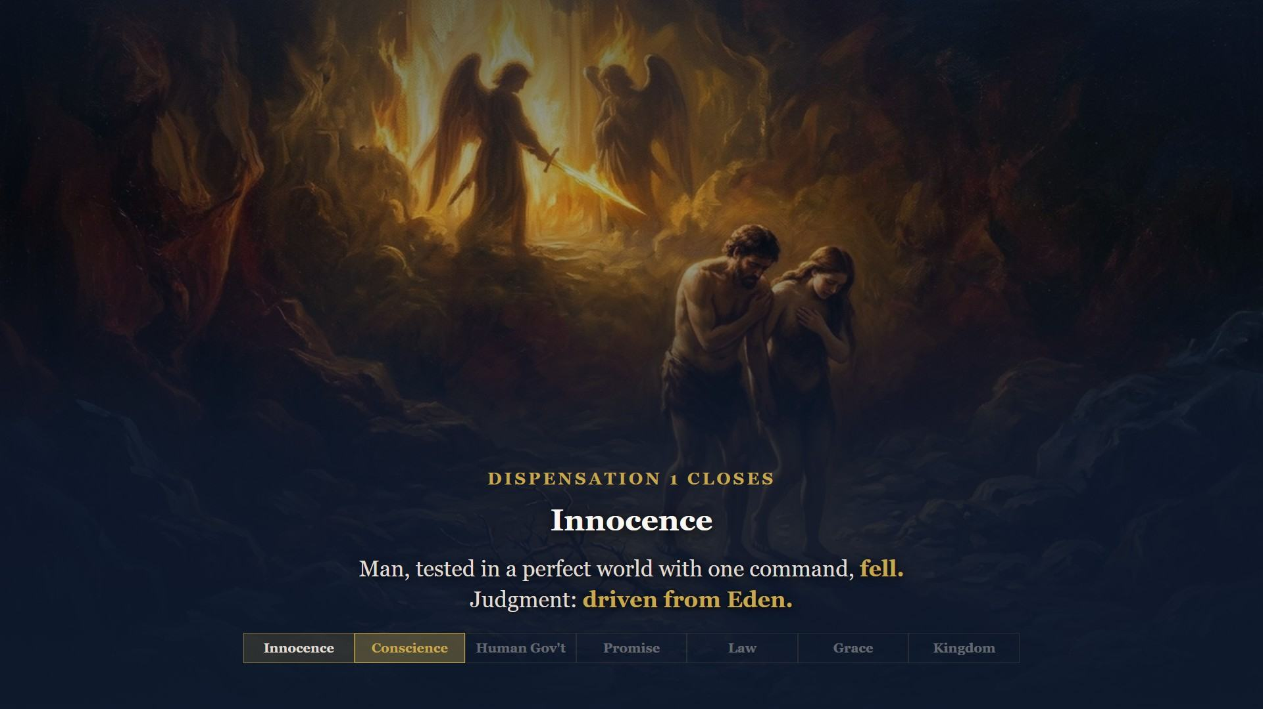
Notes:
Genesis 3:24 - He drove out the man, and placed Cherubims and a flaming sword to keep the way of the tree of life.

Slide 13
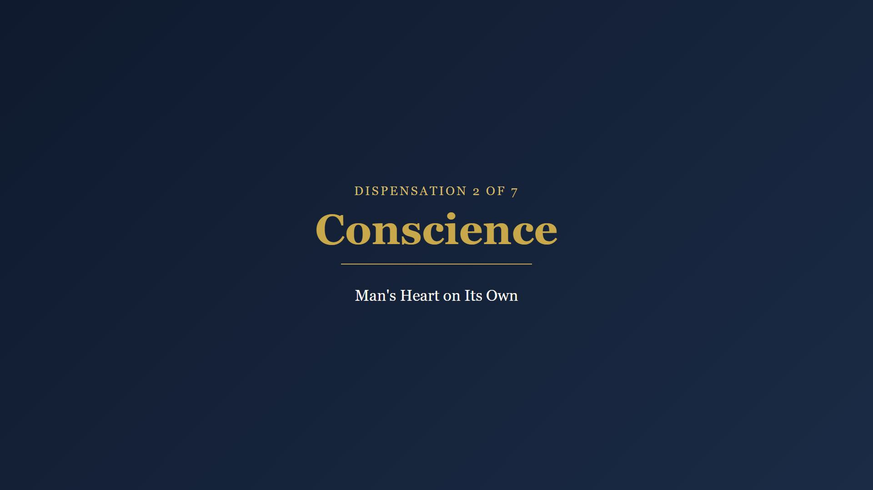
Notes:
East of Eden the rules change. Man carries the knowledge of good and evil inside him. The test: will he follow it? Fall to flood.

Slide 14
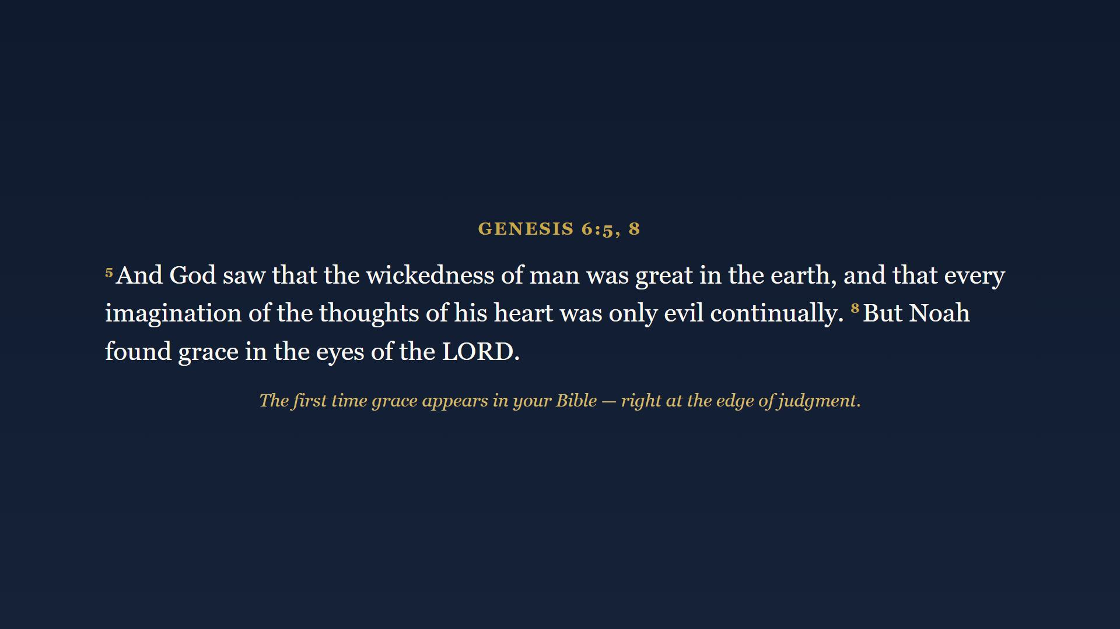
Notes:
Cain murdered Abel in the first generation - over worship. By Noah's day, sixteen centuries in, here is God's verdict. Every imagination, only evil, continually. And yet - verse 8. Grace. First time it appears in your Bible, right at the edge of judgment.

Slide 15
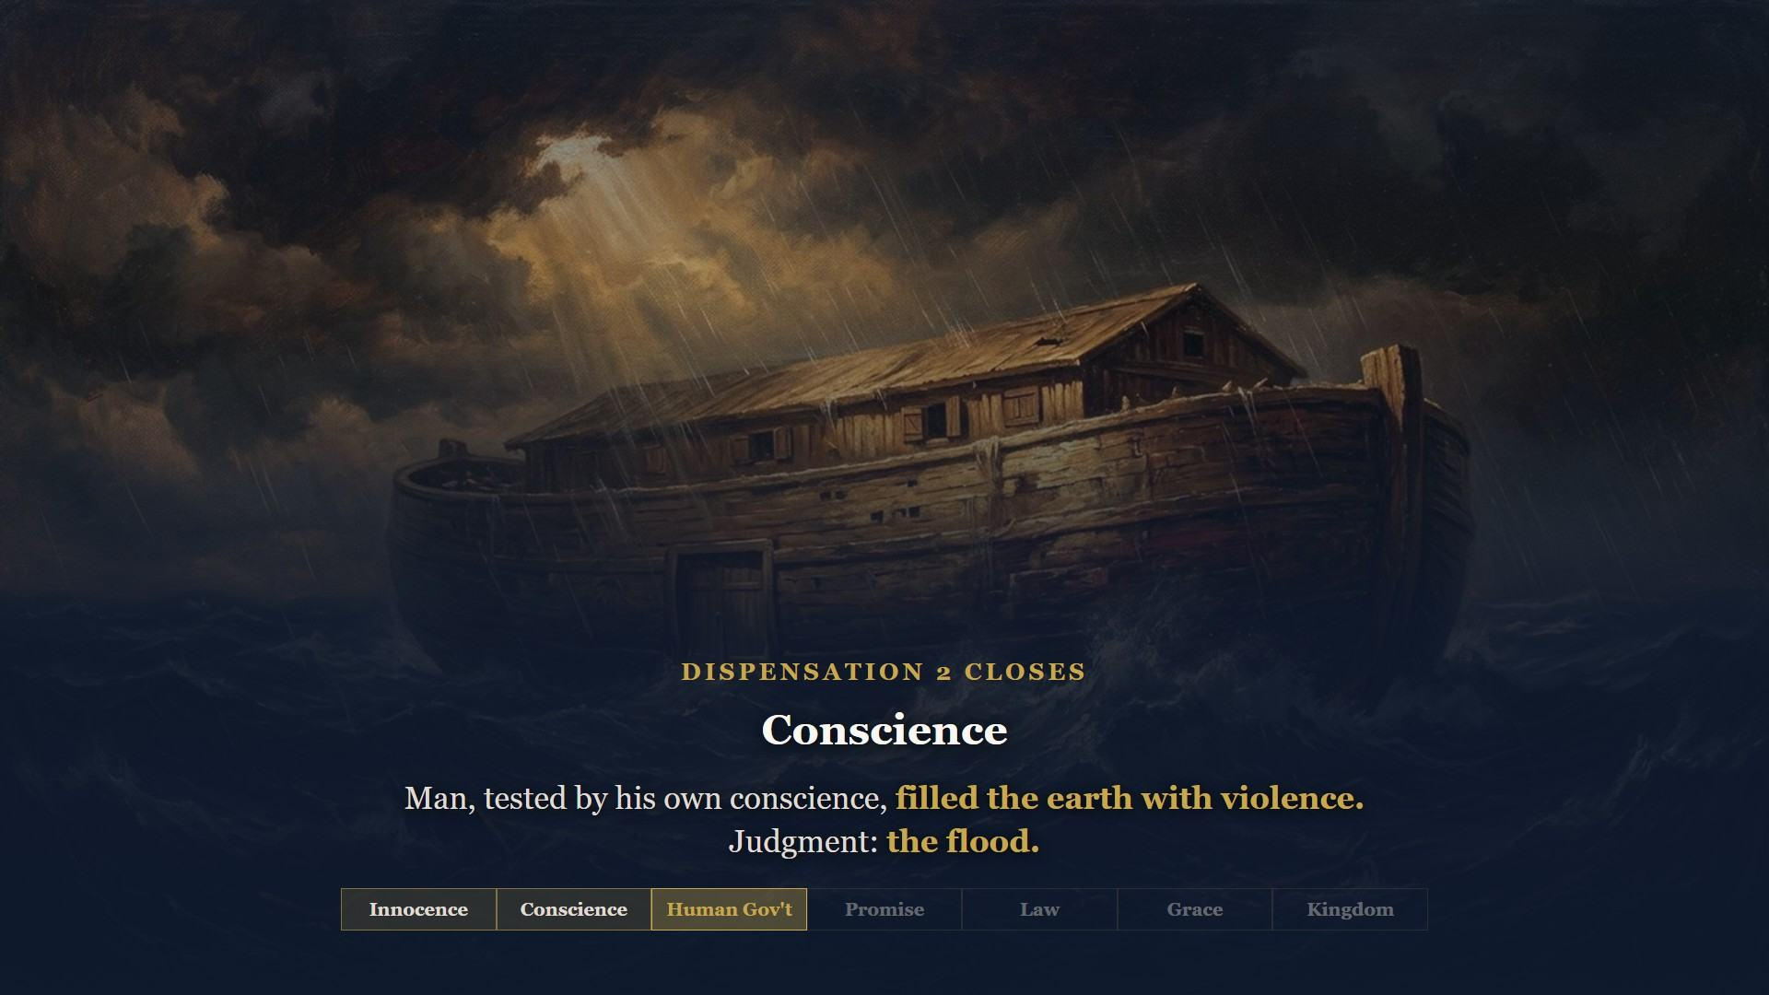
Notes:
Eight souls rode it out in an ark with one door, sealed by God Himself. One way in. One way of safety. That picture will preach until the Lord comes back.

Slide 16
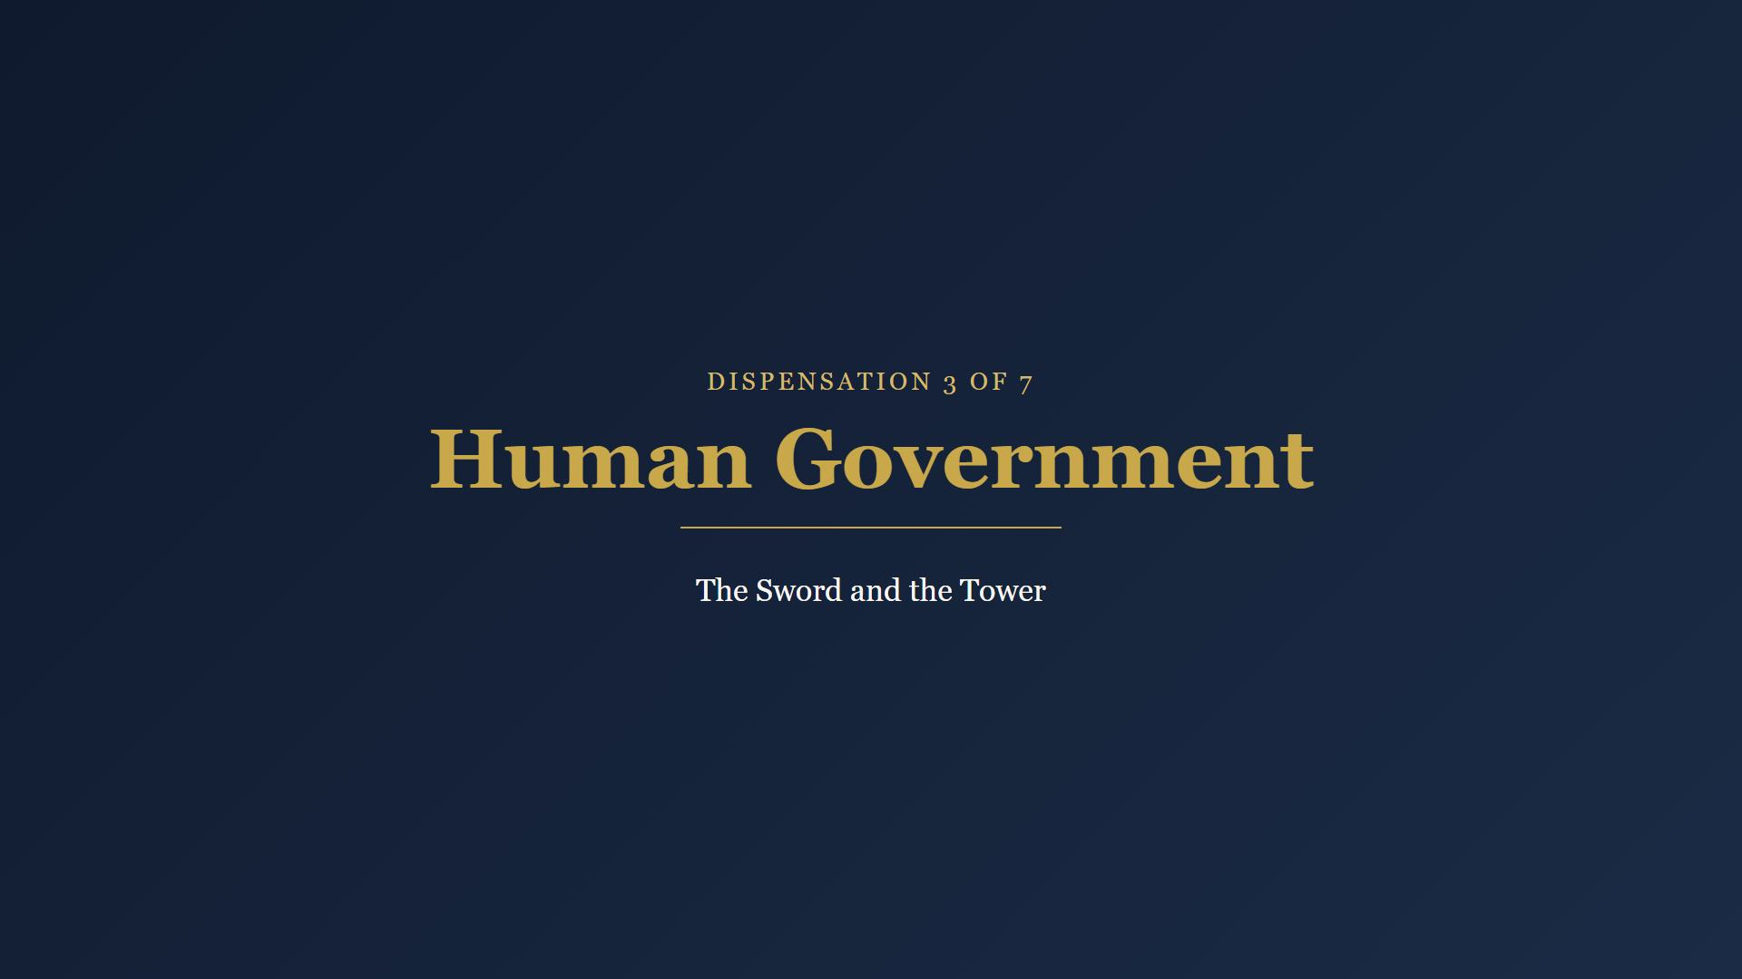
Notes:
Noah steps off the ark. For the first time man is formally responsible to govern man.

Slide 17
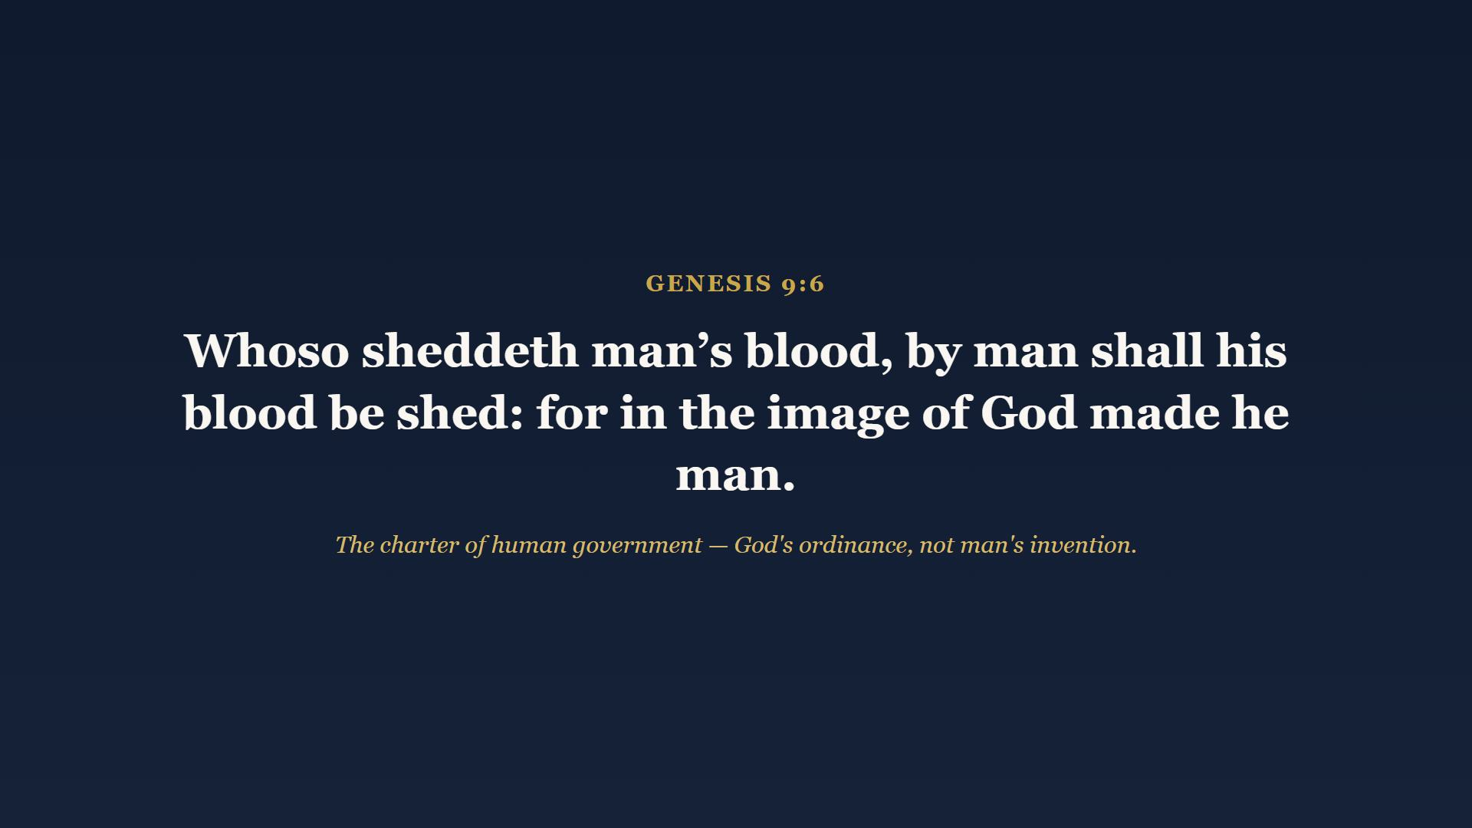
Notes:
The charter of human government - capital justice for murder, because man bears God's image. Government is not man's invention. It is God's ordinance, and it stands to this day. Paul says so in Romans 13 - Class 5 territory.

Slide 18
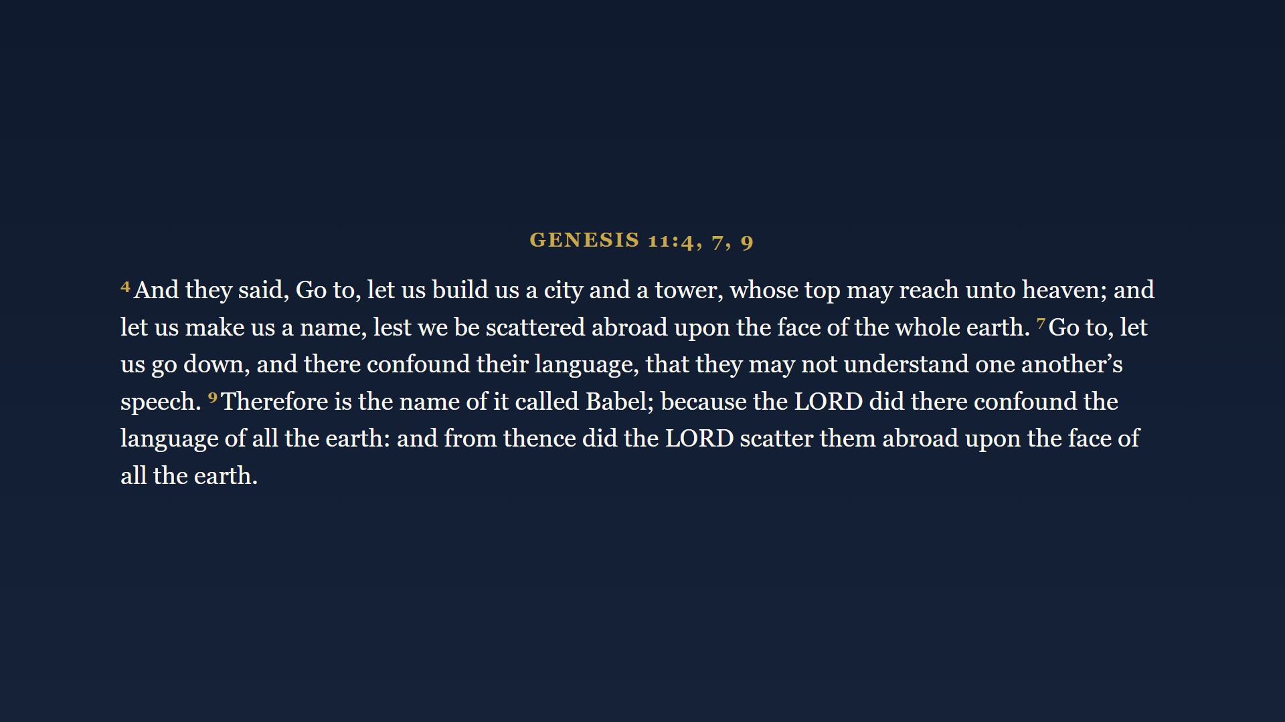
Notes:
God said spread out and fill the earth. Man said let's huddle up and build a monument to ourselves. Let us make us a NAME - the whole spirit of the age, four words long. Every language barrier on earth today is a standing monument to dispensation three. And Babel - Babylon - keeps showing up clear to Revelation.

Slide 19
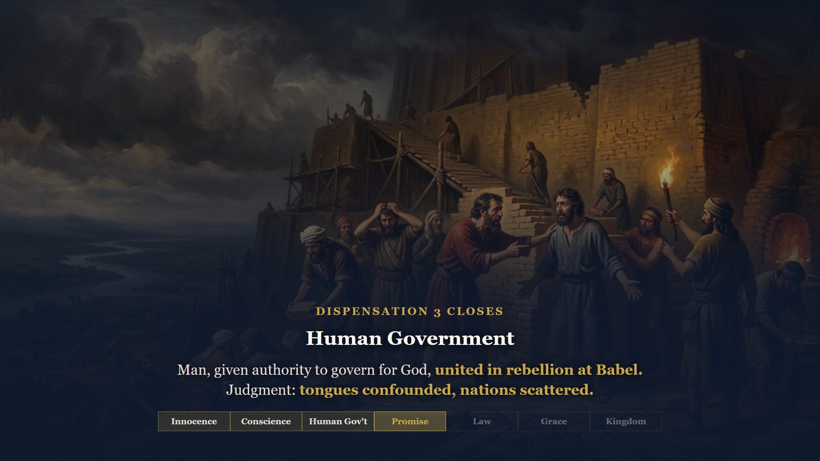
Notes:
Let us make us a NAME. Babel is man united against God, and God graciously broke it up before it ripened.

Slide 20
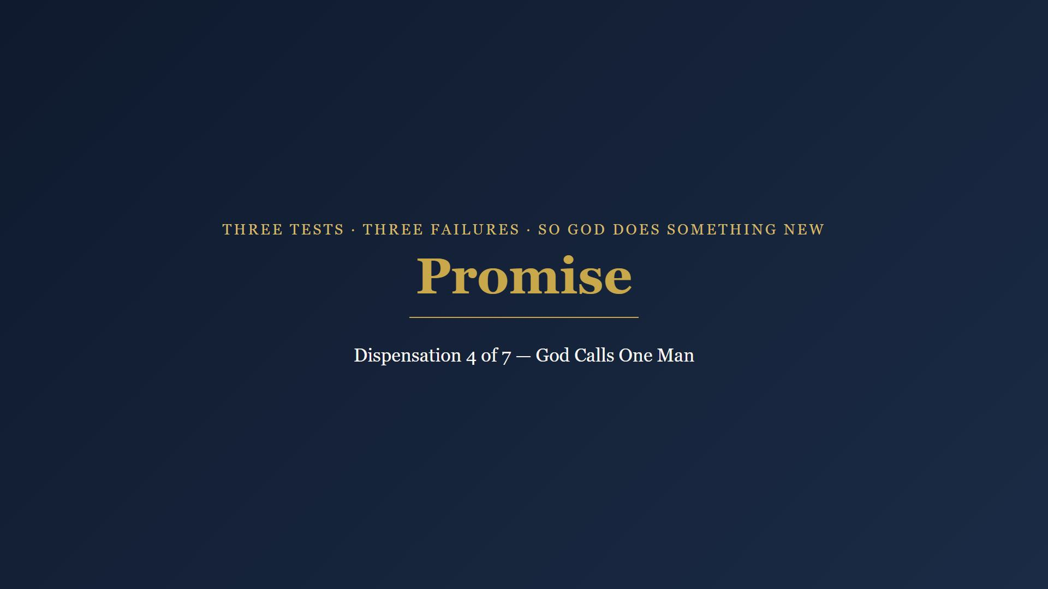
Notes:
Three tests. Three failures. Perfect garden, man's conscience, man's government - all failed. So God does something new. Out of the scattered nations He reaches to one pagan city, Ur of the Chaldees, and calls one man.

Slide 21
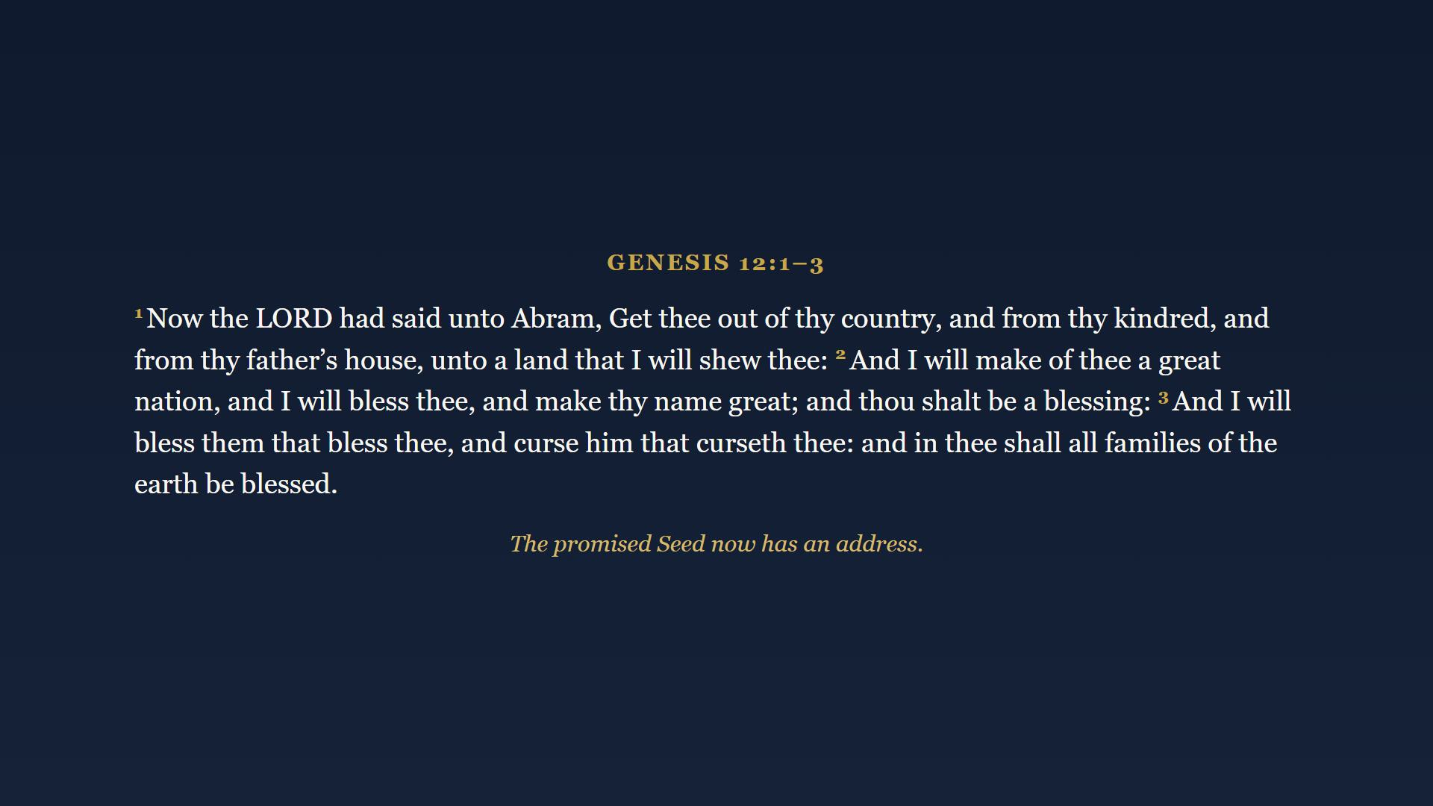
Notes:
Read verse 3 slowly: in thee shall ALL FAMILIES of the earth be blessed. That includes you. The promised Seed of Genesis 3:15 now has an address - He will come through Abram's family.

Slide 22
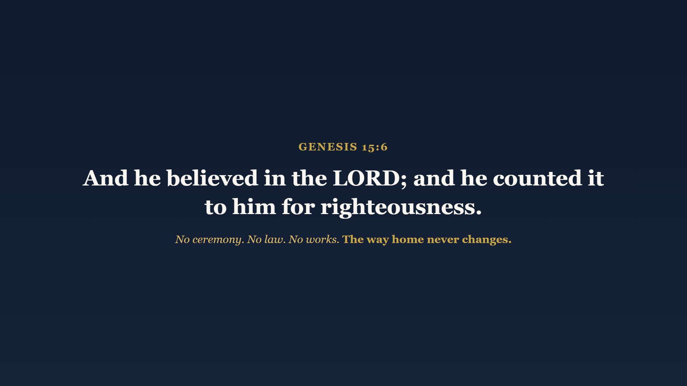
Notes:
The most important verse in this class. Maybe the most important verse in the Old Testament for understanding how a man gets right with God. No ceremony. No law - the Law is 400 years away. No works. Abram took God at His word and God put righteousness on Abram's account. That is how salvation has worked in EVERY dispensation. The tests change; the way home never does. Paul quotes this exact verse in Romans - Class 5.

Slide 23
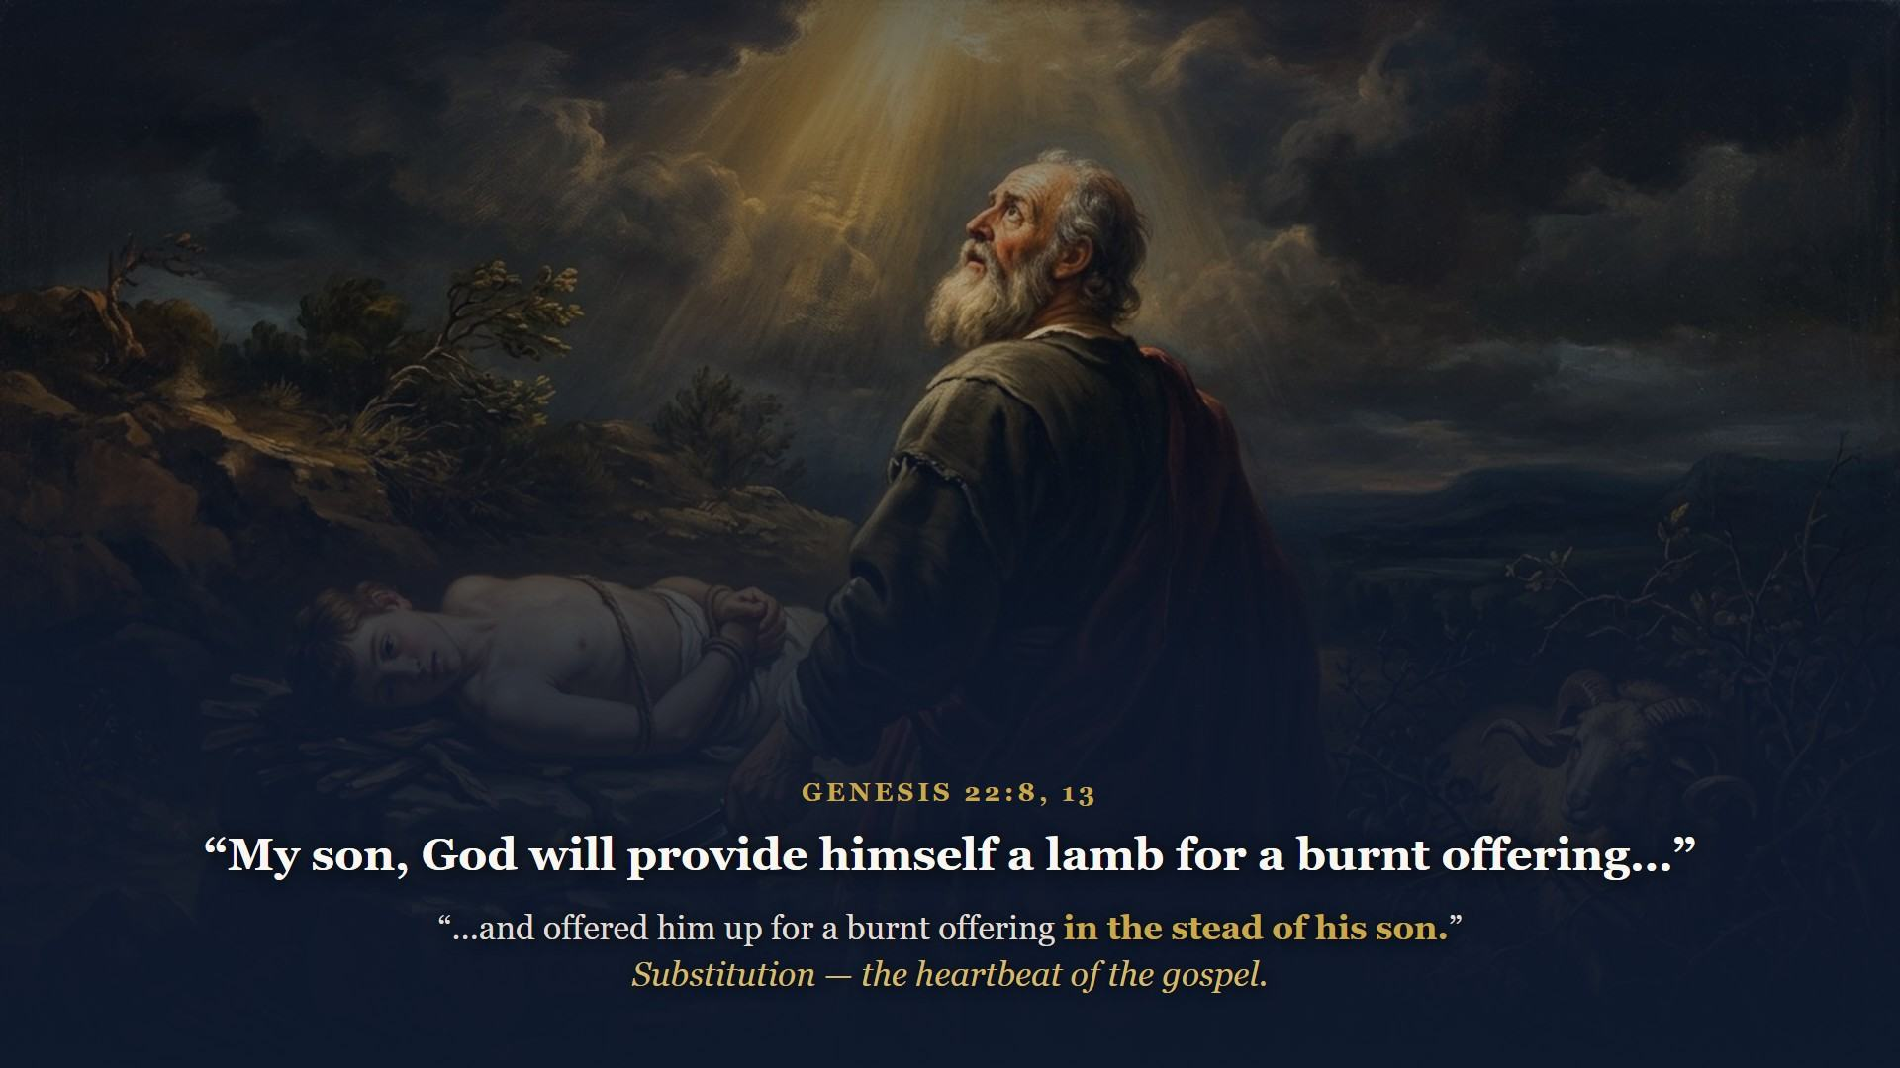
Notes:
God tests Abraham with the unthinkable. The ram died IN THE STEAD OF the son. That word is substitution. Two thousand years later, on that same ridge of hills, God's own Son carried the wood up the slope. Next time somebody says the Old and New Testaments tell different stories, take them to Genesis 22.

Slide 24
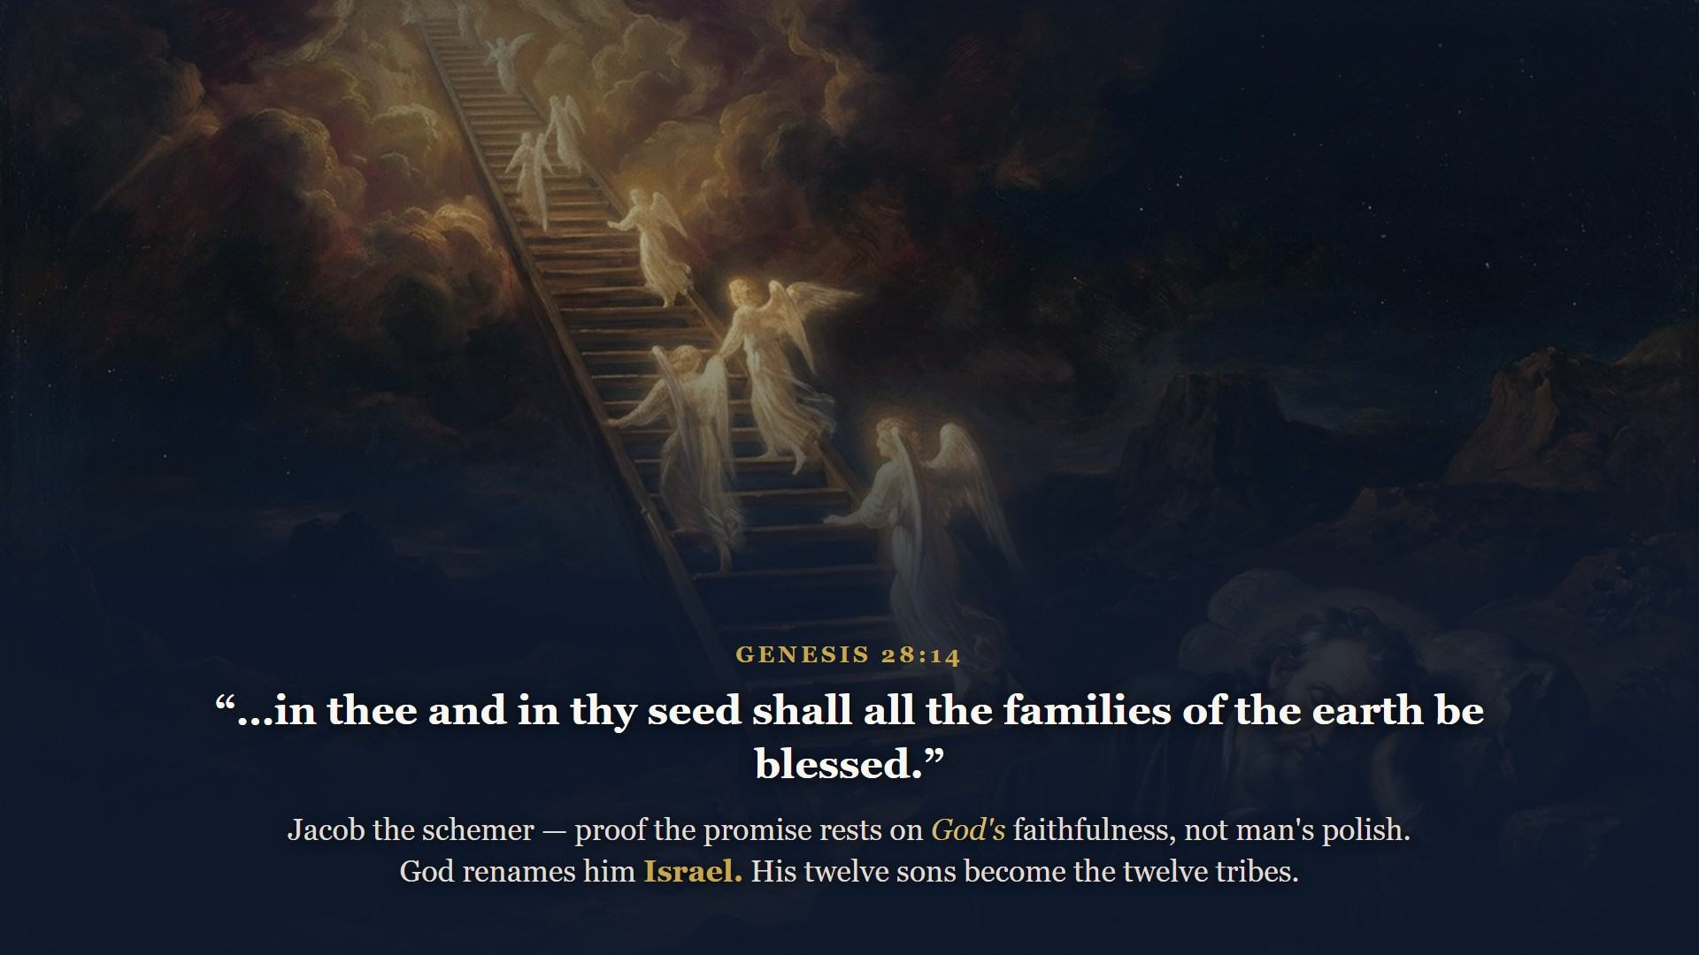
Notes:
Running for his life with a rock for a pillow, Jacob dreams of a ladder reaching to heaven and God renews the whole promise. Now you know where the nation gets its name. Keep those twelve in mind - you will meet them for the rest of the course.

Slide 25
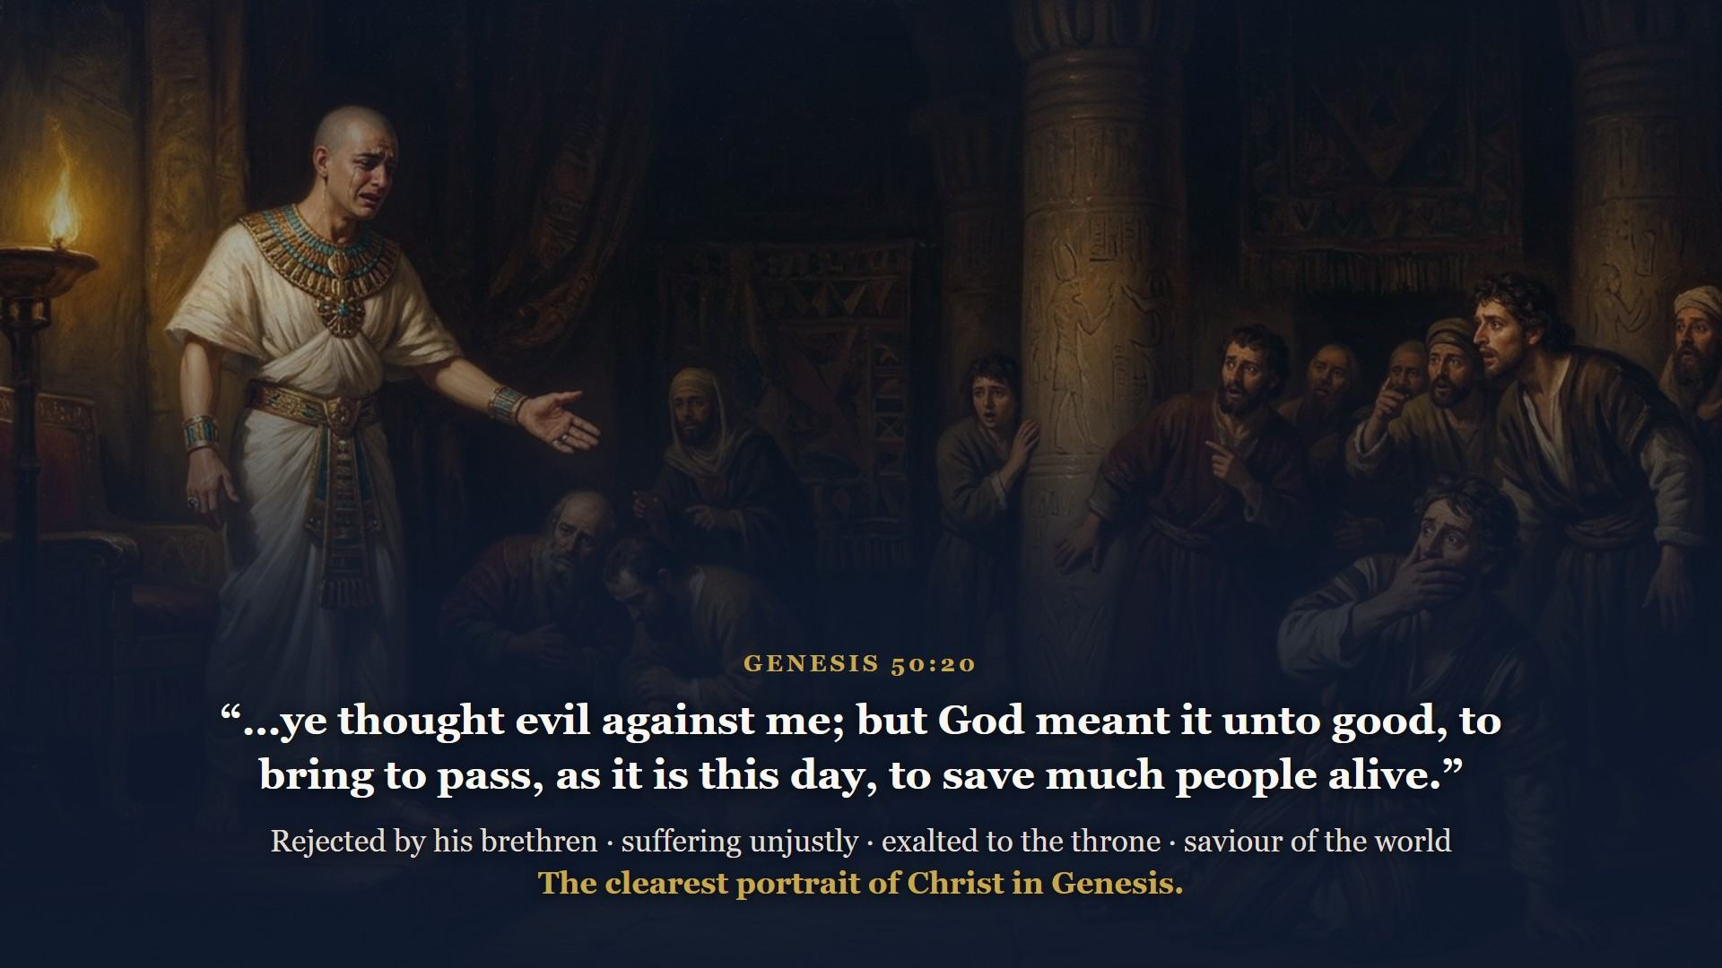
Notes:
Sold by his own brothers, slandered, forgotten in prison - raised in one day to the right hand of Pharaoh. Write that verse over every dark chapter of your own life, and over the darkest one of all: a cross outside Jerusalem, where men meant evil and God meant the salvation of the world.

Slide 26
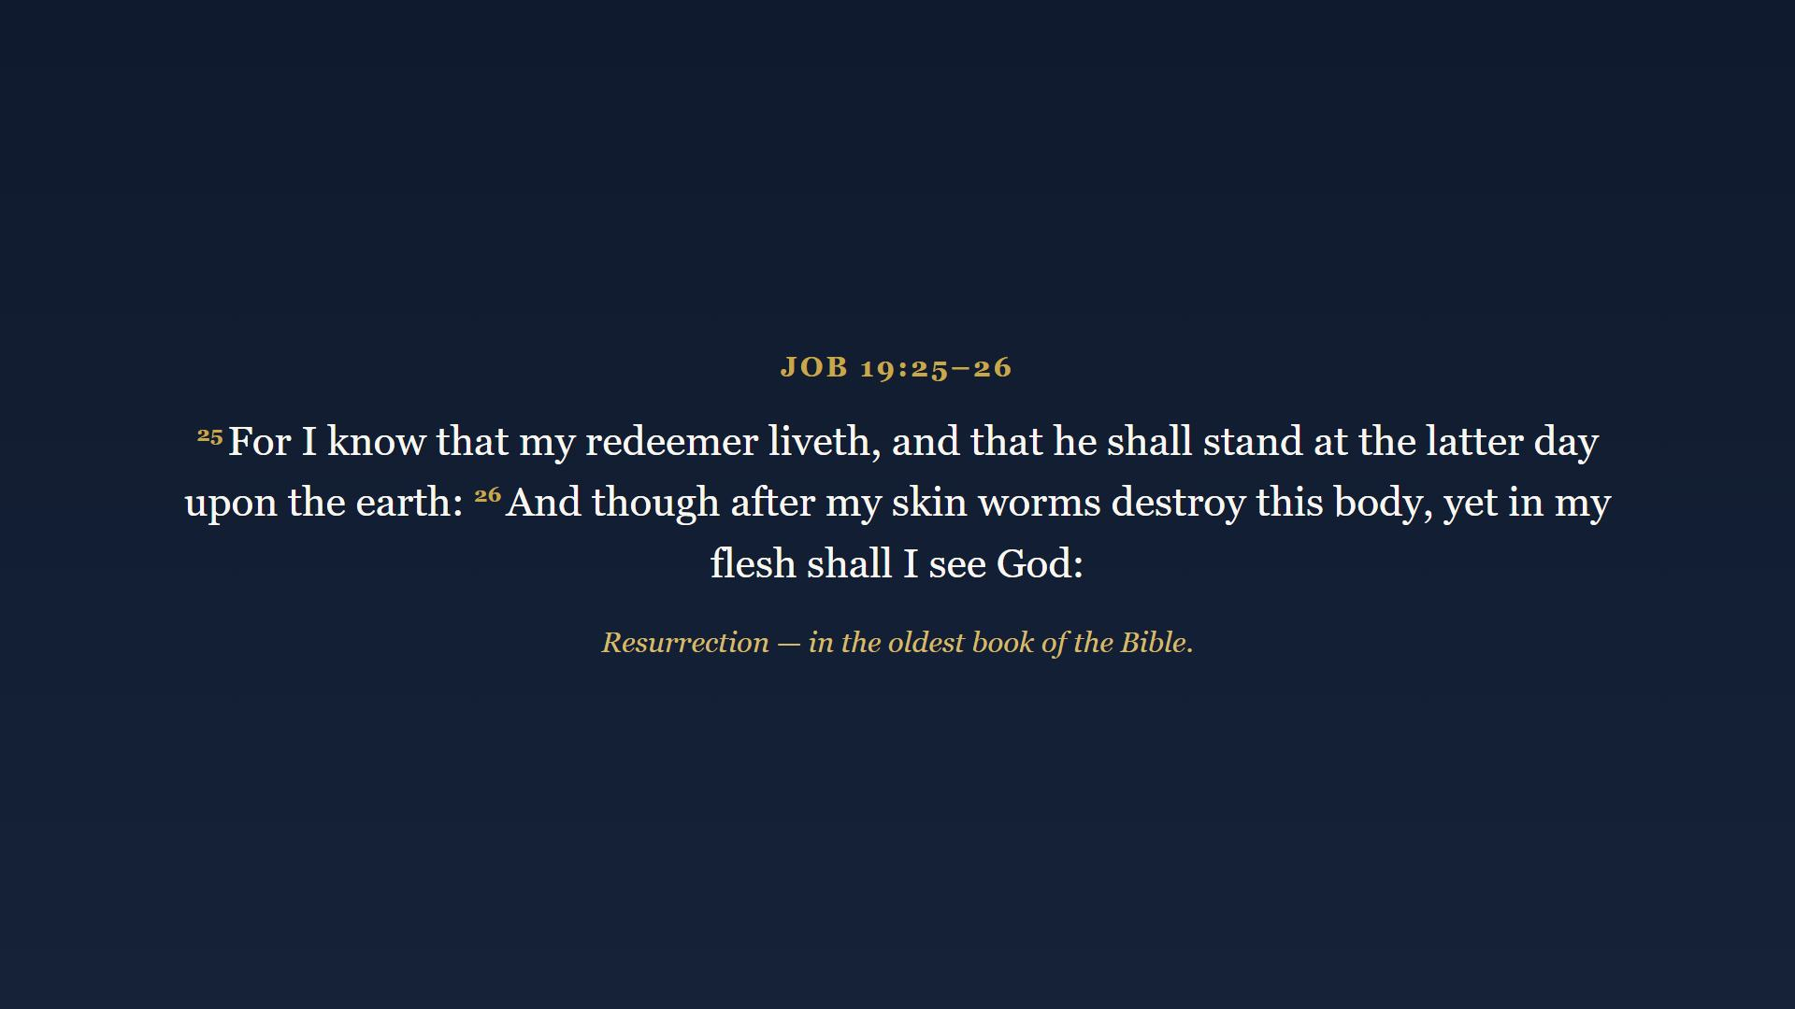
Notes:
Job lived in this same patriarch age - his book is likely the oldest written book in your Bible. A blameless man loses everything and asks the question every honest heart eventually asks: how can a mortal man be right with God? Stripped of everything, sitting in ashes, he grabs the answer by faith. Resurrection, seen from four thousand years out. The question of Job is the question this whole course answers - and the answer has a name.

Slide 27
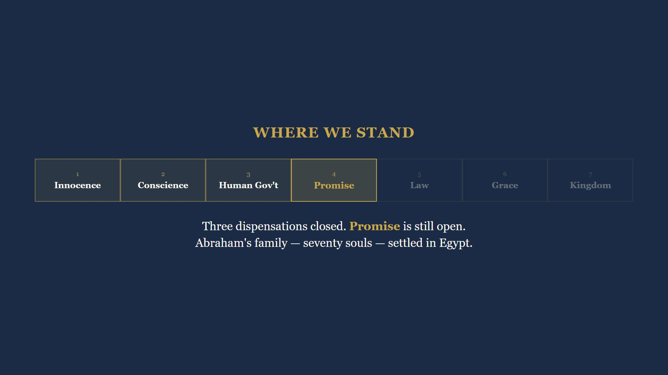
Notes:
A perfect garden, a promised Seed, a flood, a tower, one man counted righteous for believing, a ram in a thicket, a ladder, a throne in Egypt, and a sufferer who saw his Redeemer. Promise is still open as Genesis ends.

Slide 28
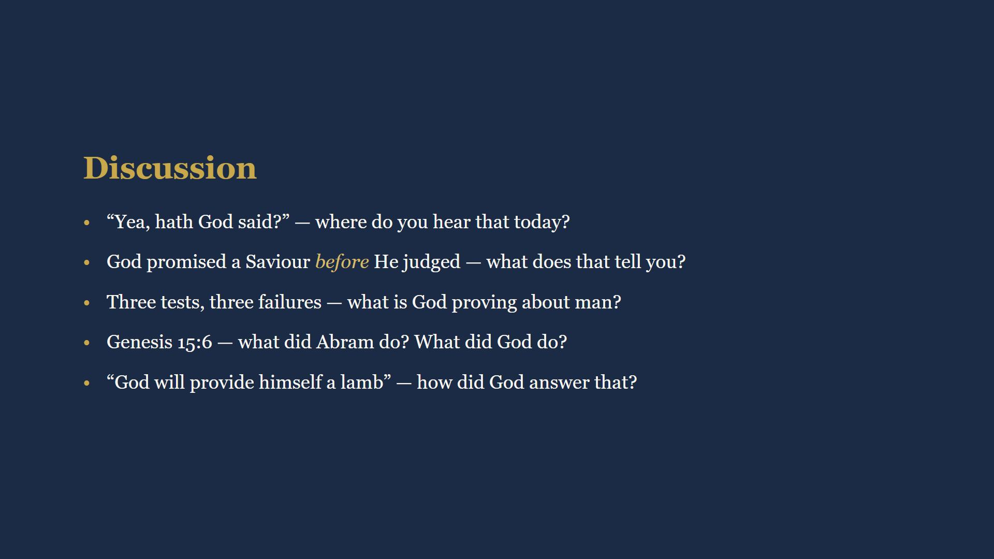
Notes:
15 minutes. Full wording is in their workbooks. Q1: doubt is the entry point for every false teaching. Q2: grace before judgment - that is His heart. Q3: man cannot save himself under any arrangement. Q4: Abram believed, God counted - God did all the saving. Q5: the ram that day, His own Son 2000 years later.

Slide 29
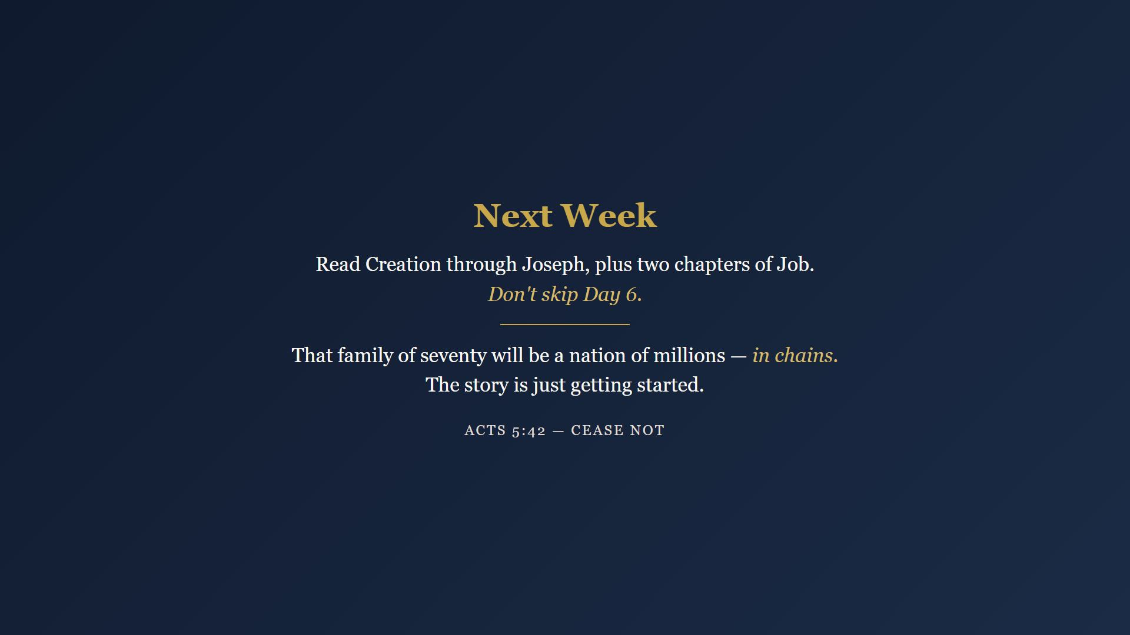
Notes:
Creation to Joseph plus two chapters of Job. 35-40 minutes a day, six days. Don't skip Day 6 - it puts Joseph's God meant it unto good beside Job's I know that my redeemer liveth. Next week that family of seventy becomes a nation of millions, in chains. Closing prayer.

