Slide 1
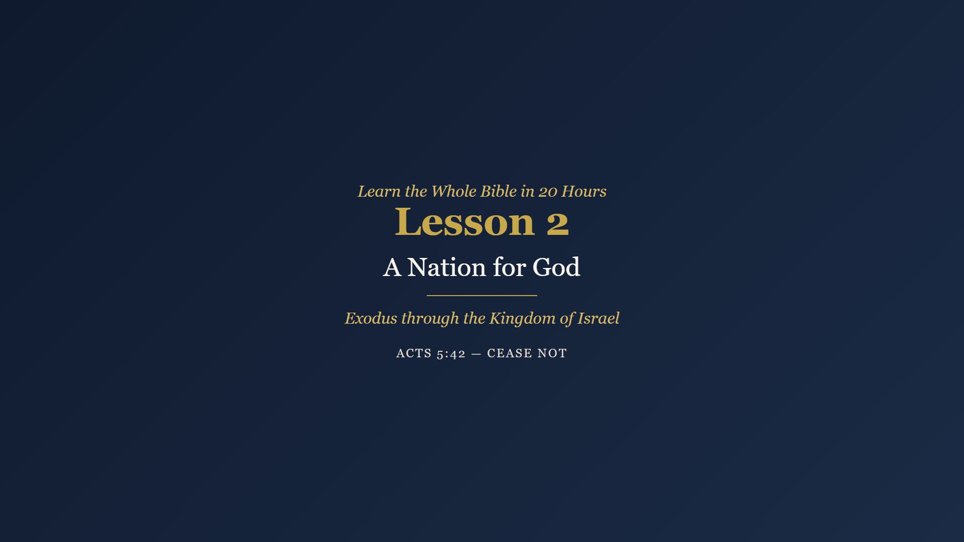
Notes:
Welcome. Review Week 1 reading - ask who will share their starred verse. Take two or three. Then: Seventy souls went down into Egypt; let us go see what four hundred years did. Pray.

Slide 2
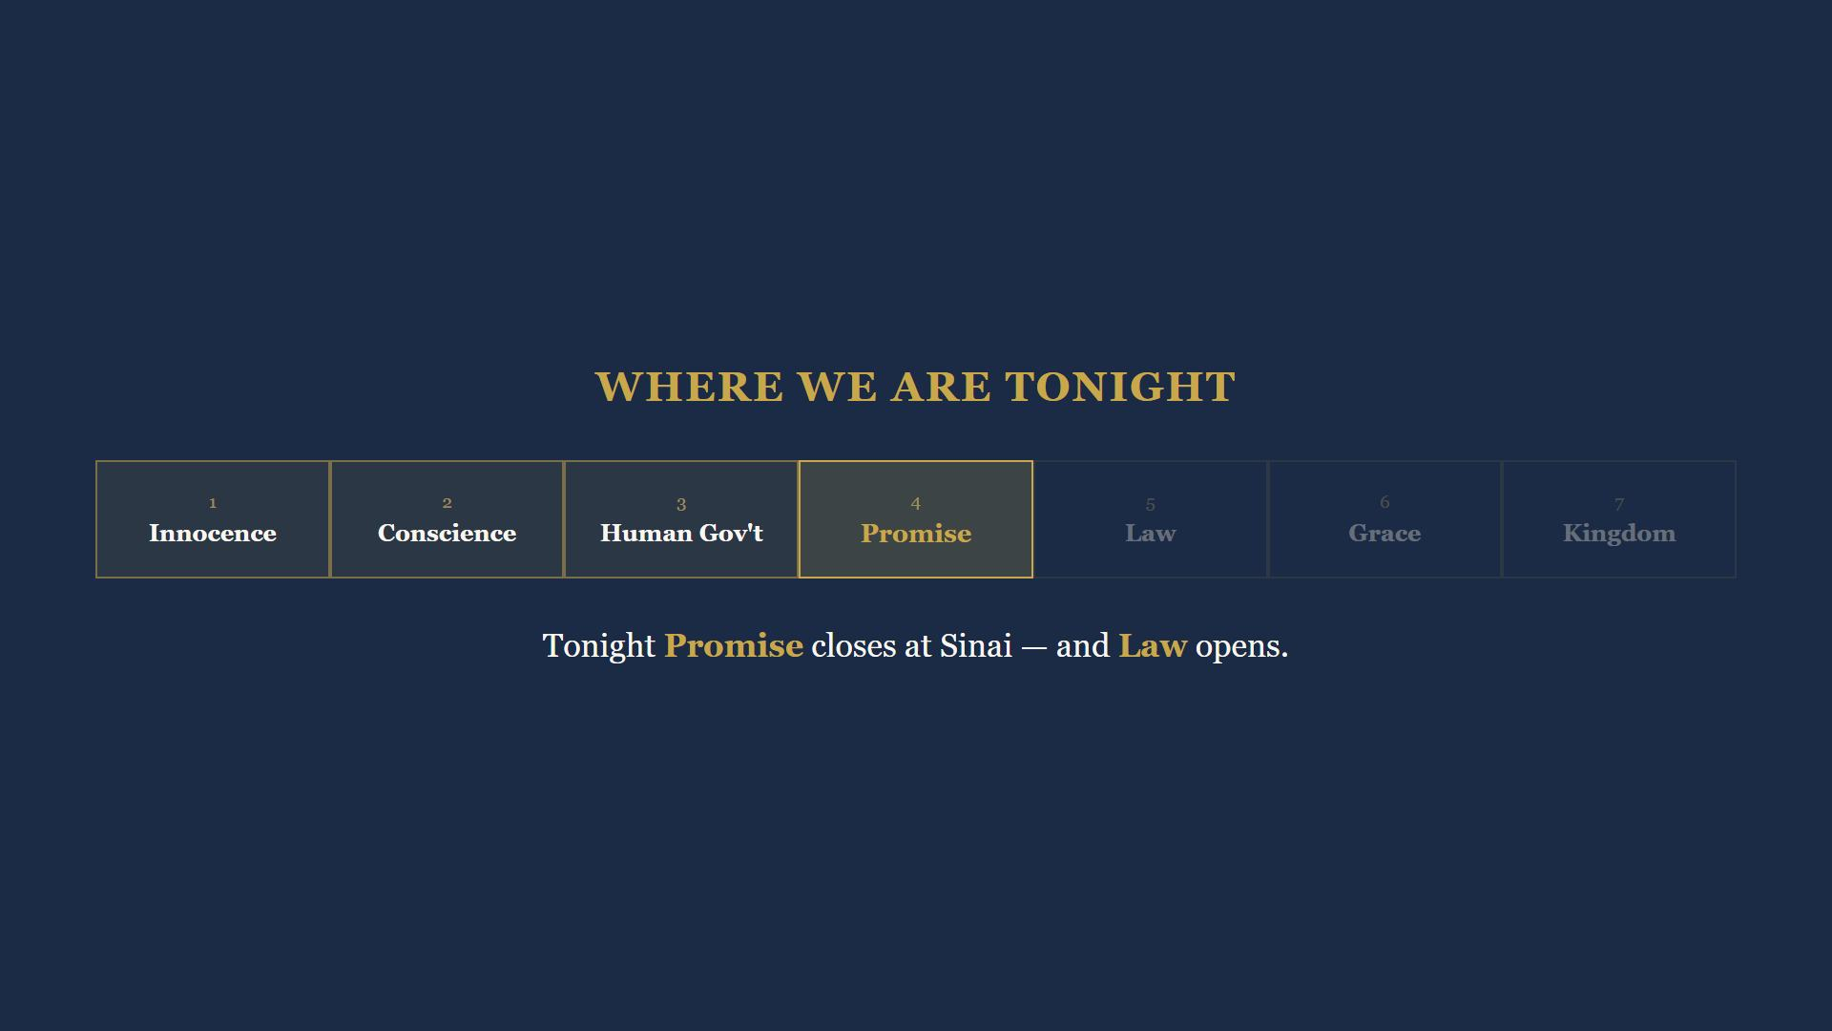
Notes:
Tonight we close Promise at Sinai and open Law. Three already struck through from last week.

Slide 3
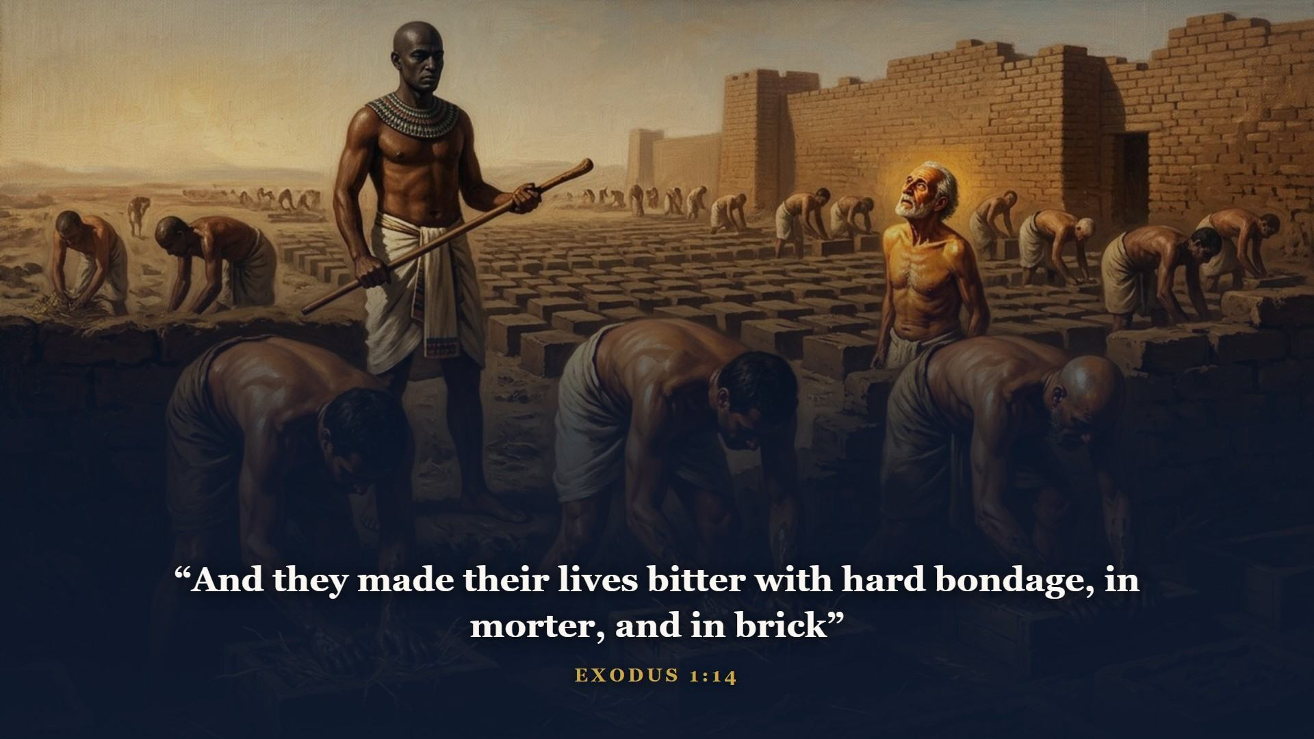
Notes:
Genesis ended with seventy souls, honored guests. Exodus opens 400 years later - the family is a nation, two or three million, and there is a new king which knew not Joseph. The honored guests are slaves. And none of it caught God napping - He told Abram in Genesis 15:13, four hundred years, on the calendar, in advance.

Slide 4
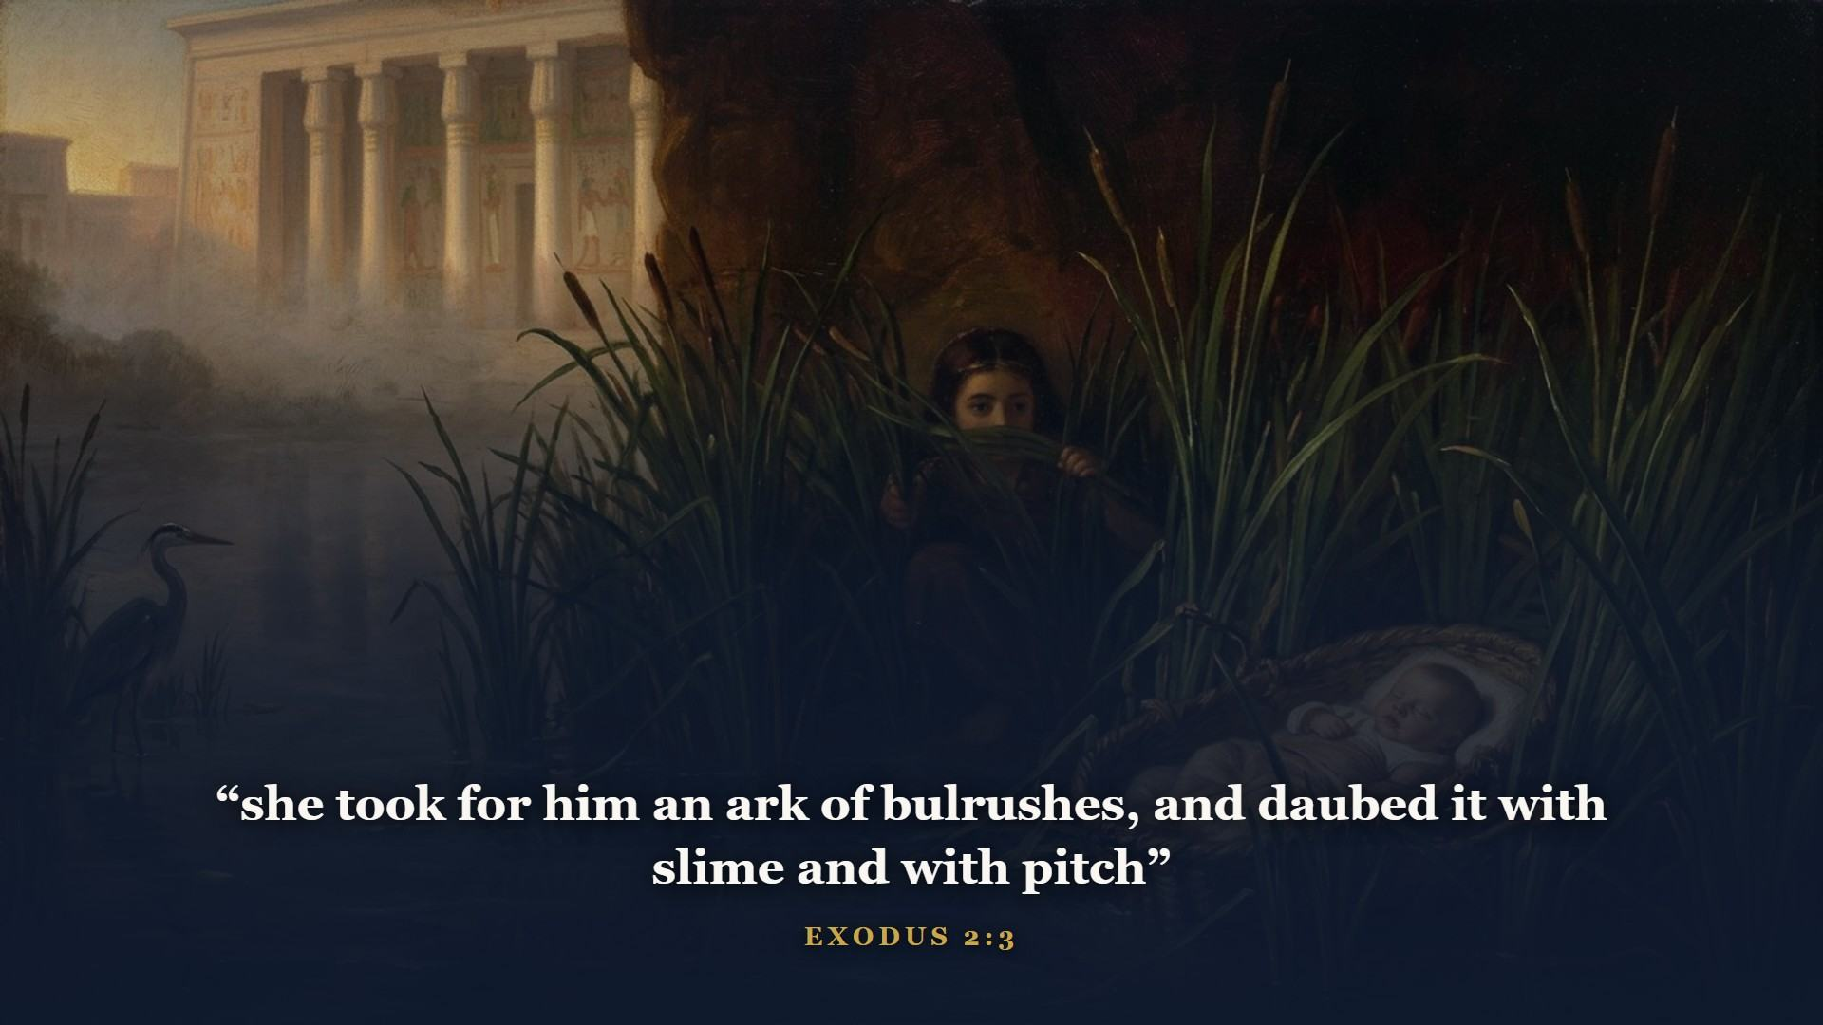
Notes:
Pharaoh ordered the Hebrew baby boys drowned in the Nile. God floated one of them right into Pharaoh's own household and had Pharaoh's daughter raise him as a prince. You have to love how God works.

Slide 5
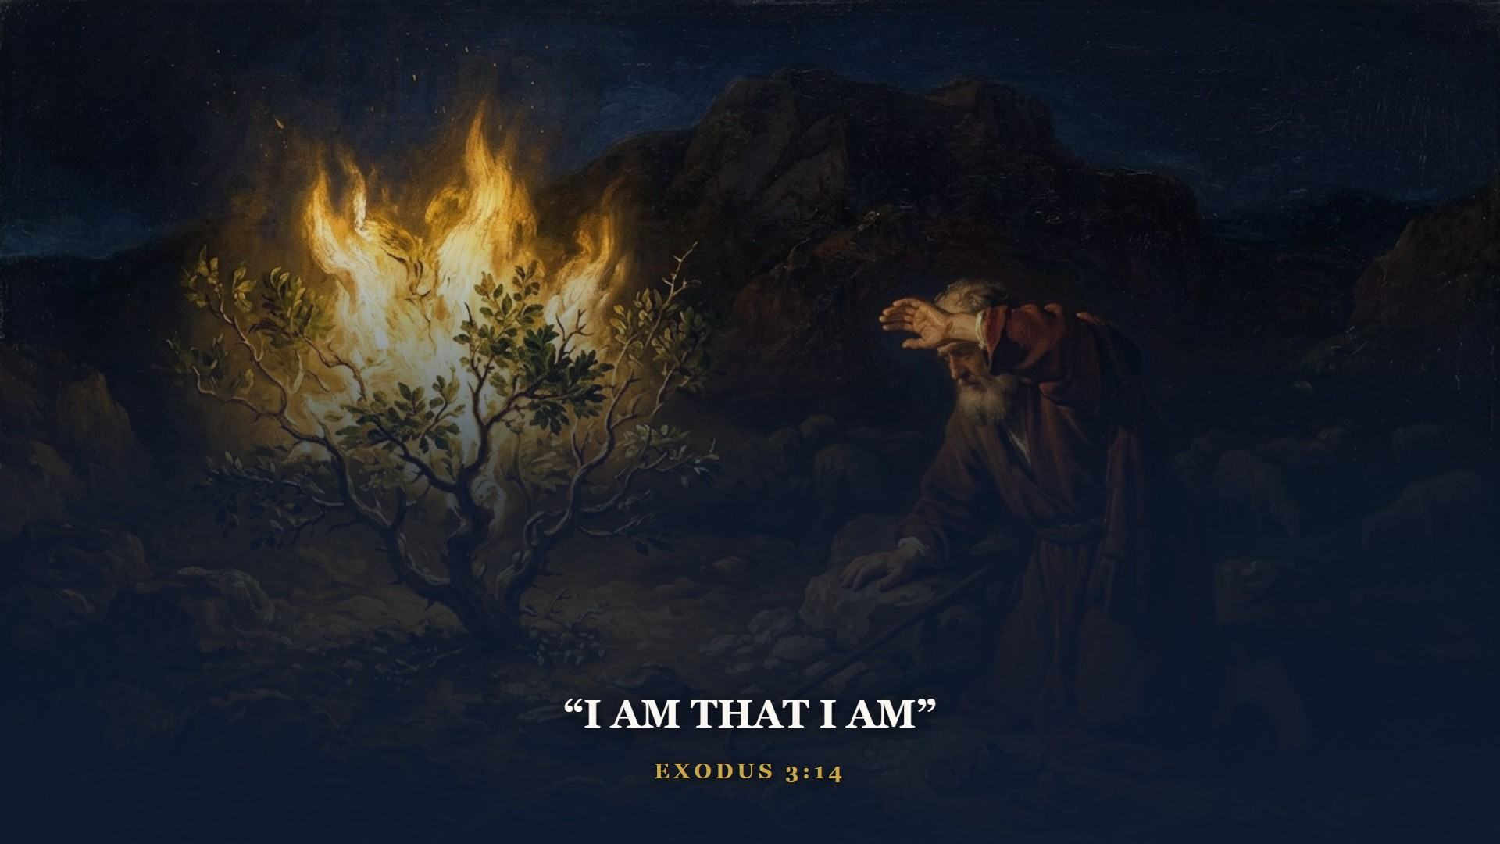
Notes:
Forty years a prince, forty years a shepherd - and at eighty, when Moses figured he was finished, God lit a bush and would not let it burn up. I AM. Not I was. Not I am becoming. File that name away - in John 8 a carpenter from Nazareth says Before Abraham was, I am. And they picked up stones, because they knew exactly what He was claiming.

Slide 6
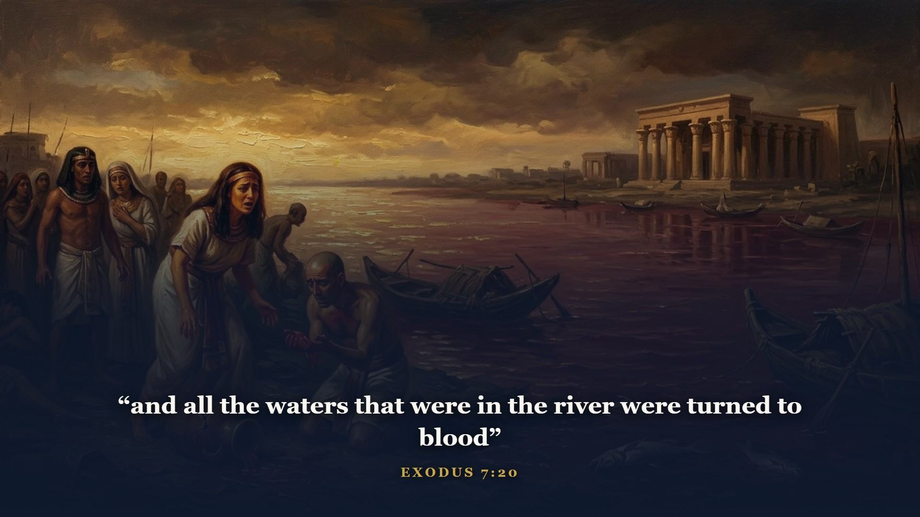
Notes:
Nine plagues fall on Egypt. Every one a public humiliation of some god Egypt trusted - and the Nile was worshipped. Pharaoh's heart just gets harder. There is a sermon in that all by itself.

Slide 7
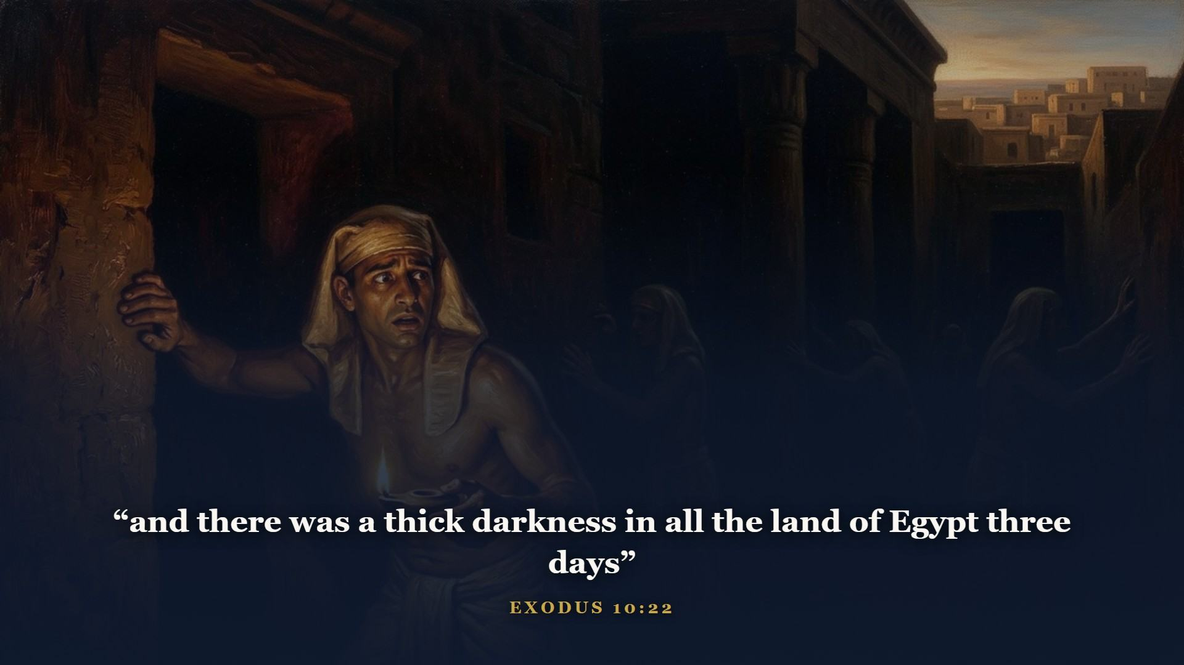
Notes:
Three days of darkness you could feel - and light in the dwellings of Israel. Egypt worshipped the sun. God turned it off.

Slide 8
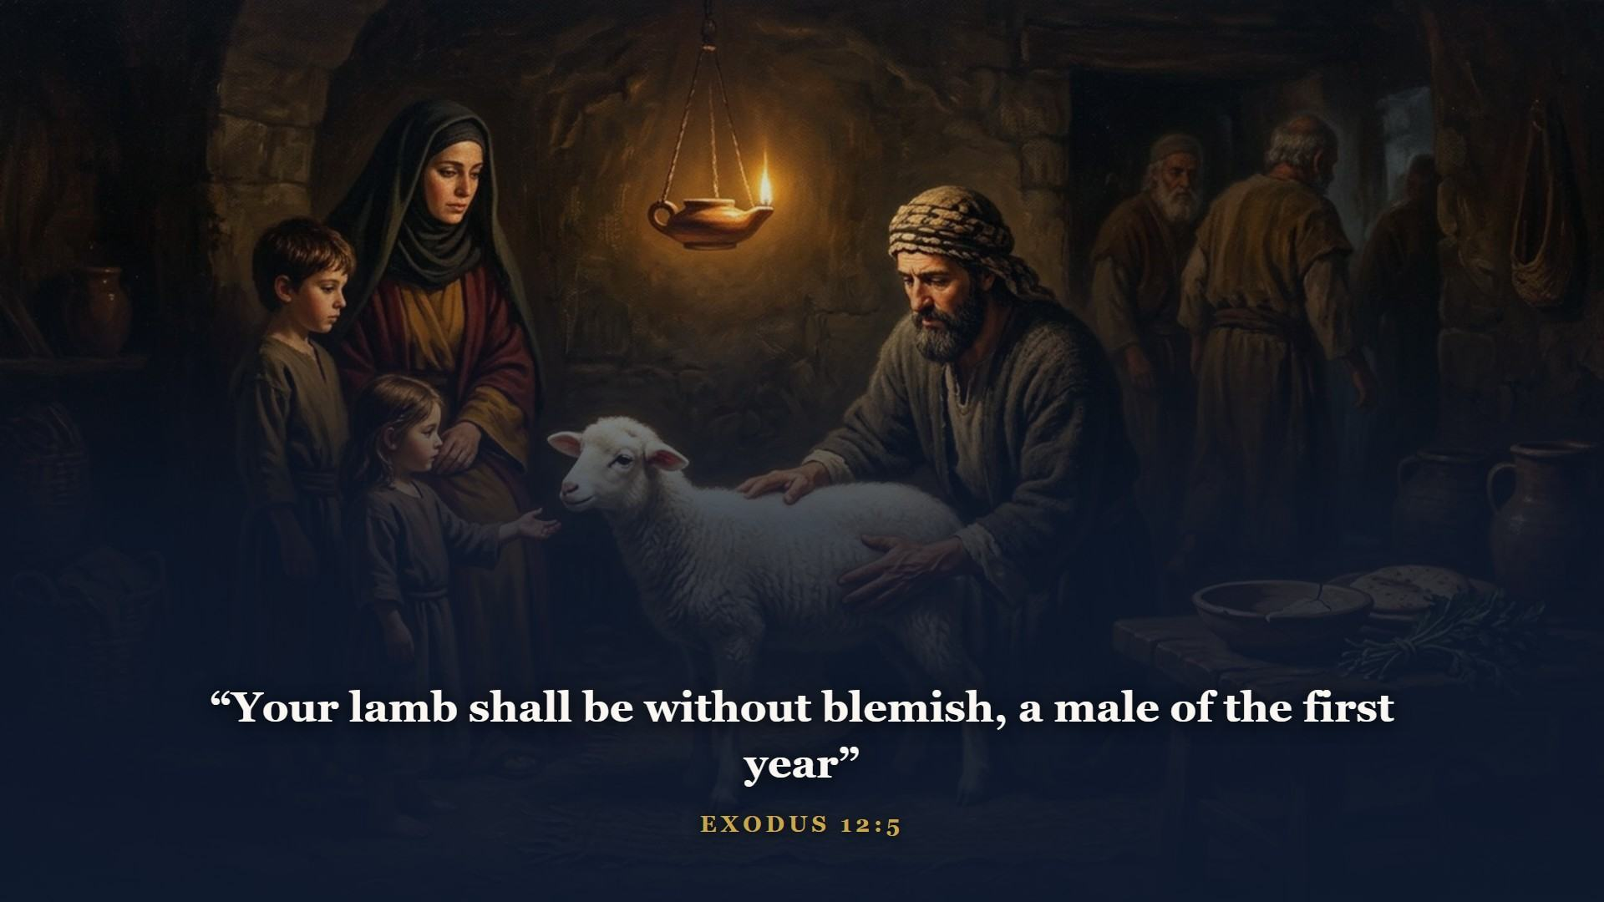
Notes:
Plague ten announced: the death of every firstborn. But for His people God prescribes a way of escape - this is the gospel preached twelve hundred years before Bethlehem. A LAMB - not a bull, not gold, not a resume. WITHOUT BLEMISH - nothing of its own to pay for. It had to DIE.

Slide 9
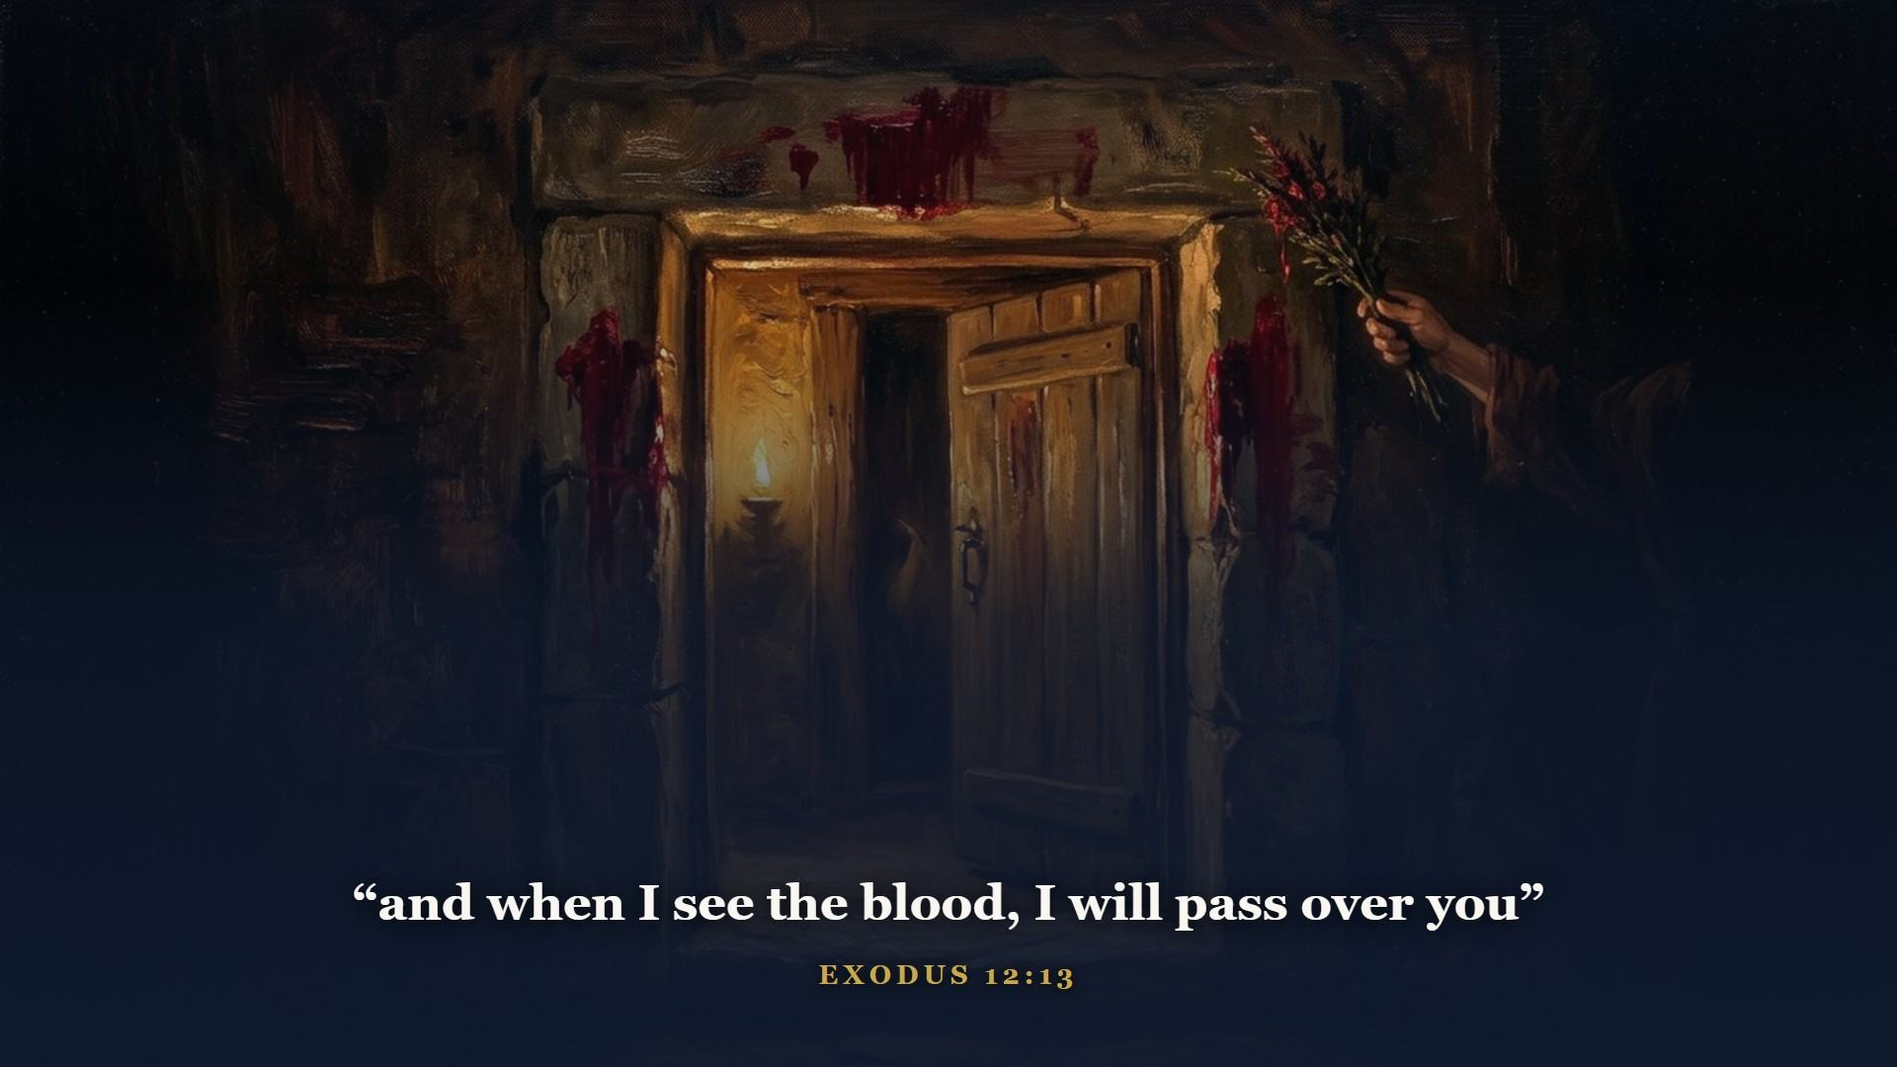
Notes:
The blood had to be APPLIED. A live lamb penned in the yard saved nobody that night. A lamb admired saved nobody. Not when I see your sincerity, not your family name, not your church attendance. THE BLOOD. Twelve hundred years later John points at Jesus: Behold the Lamb of God. The question of this whole course: is the blood applied to YOUR door? [Mark the doorframe on the board.]

Slide 10
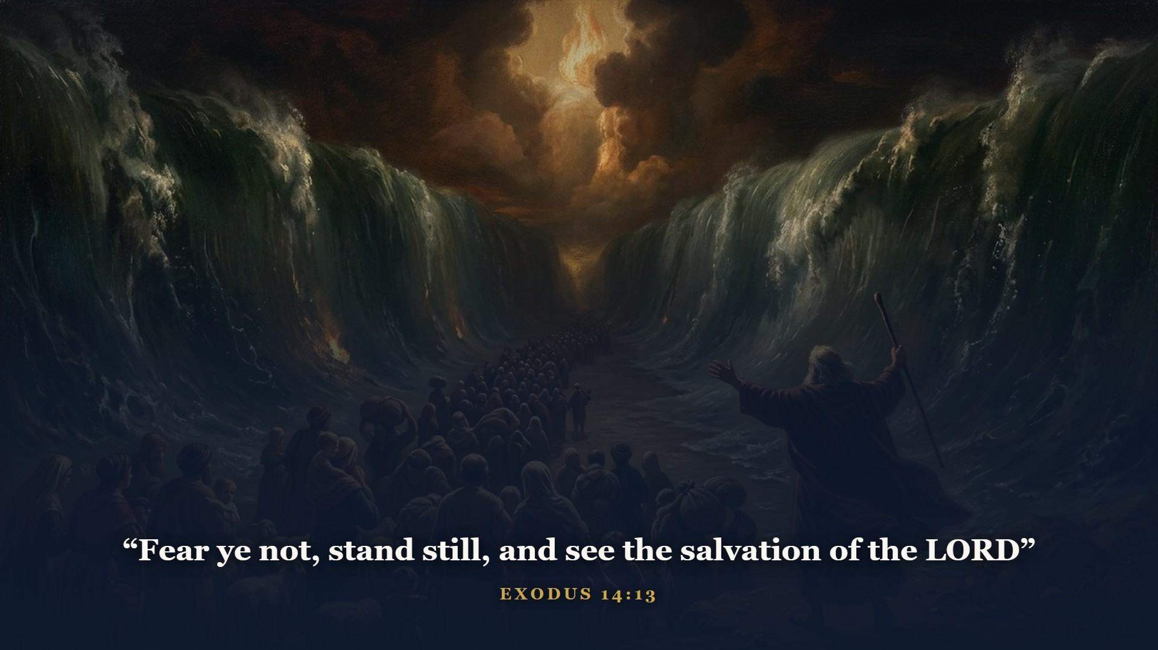
Notes:
Chariots behind, sea in front, nowhere to go. The sea opens, two million walk through on dry ground, Egypt's army drowns behind them. Mark the order - it never reverses: redeemed by BLOOD first, delivered by POWER second. God does not part seas for people still in Egypt.

Slide 11
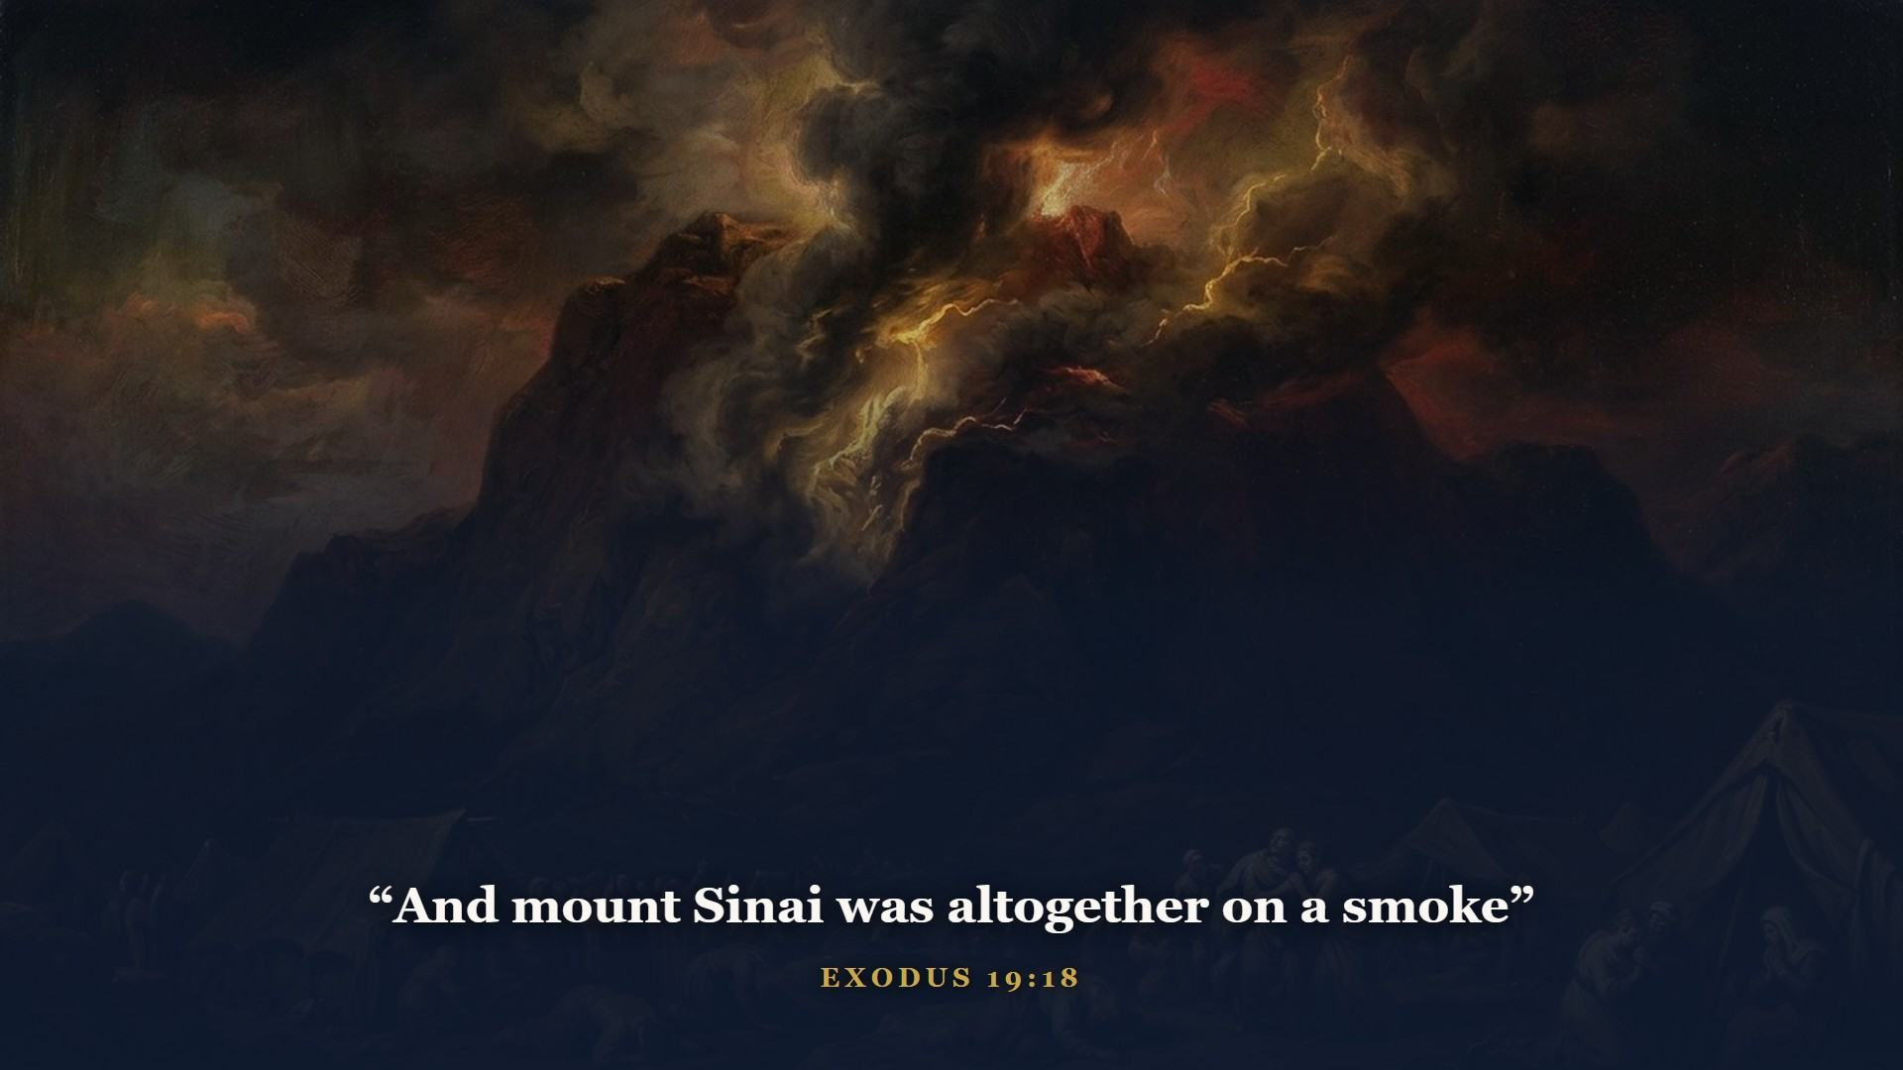
Notes:
Three months out, the nation camps at the foot of the mountain. Fire, smoke, and a trumpet that made the people tremble.

Slide 12
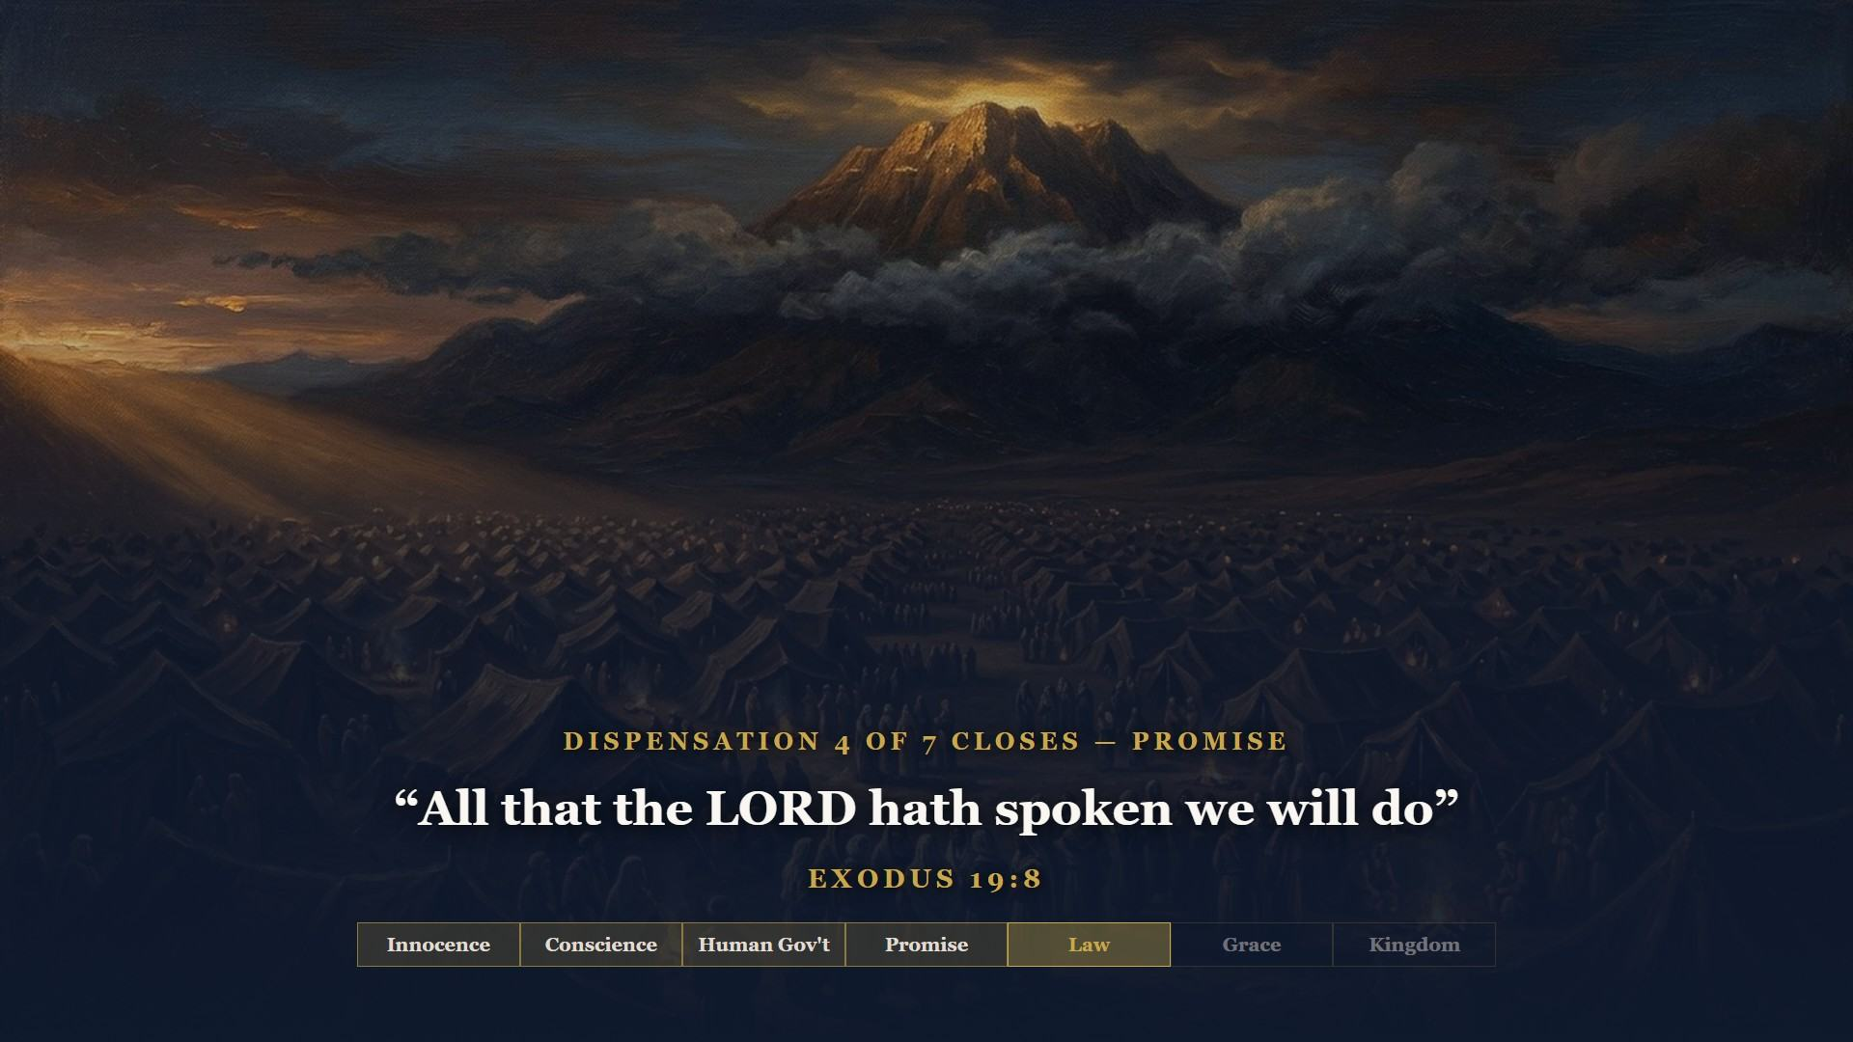
Notes:
THE HINGE OF TONIGHT. Ever since Genesis 12 God dealt with this family on one basis: promise. I will, I will, I will. Now at the mountain the people shoulder it themselves - WE WILL DO. The basis just changed from God's I will to man's we will. That sentence closes Promise and opens Law. [Strike PROMISE on the board.] Four down.

Slide 13
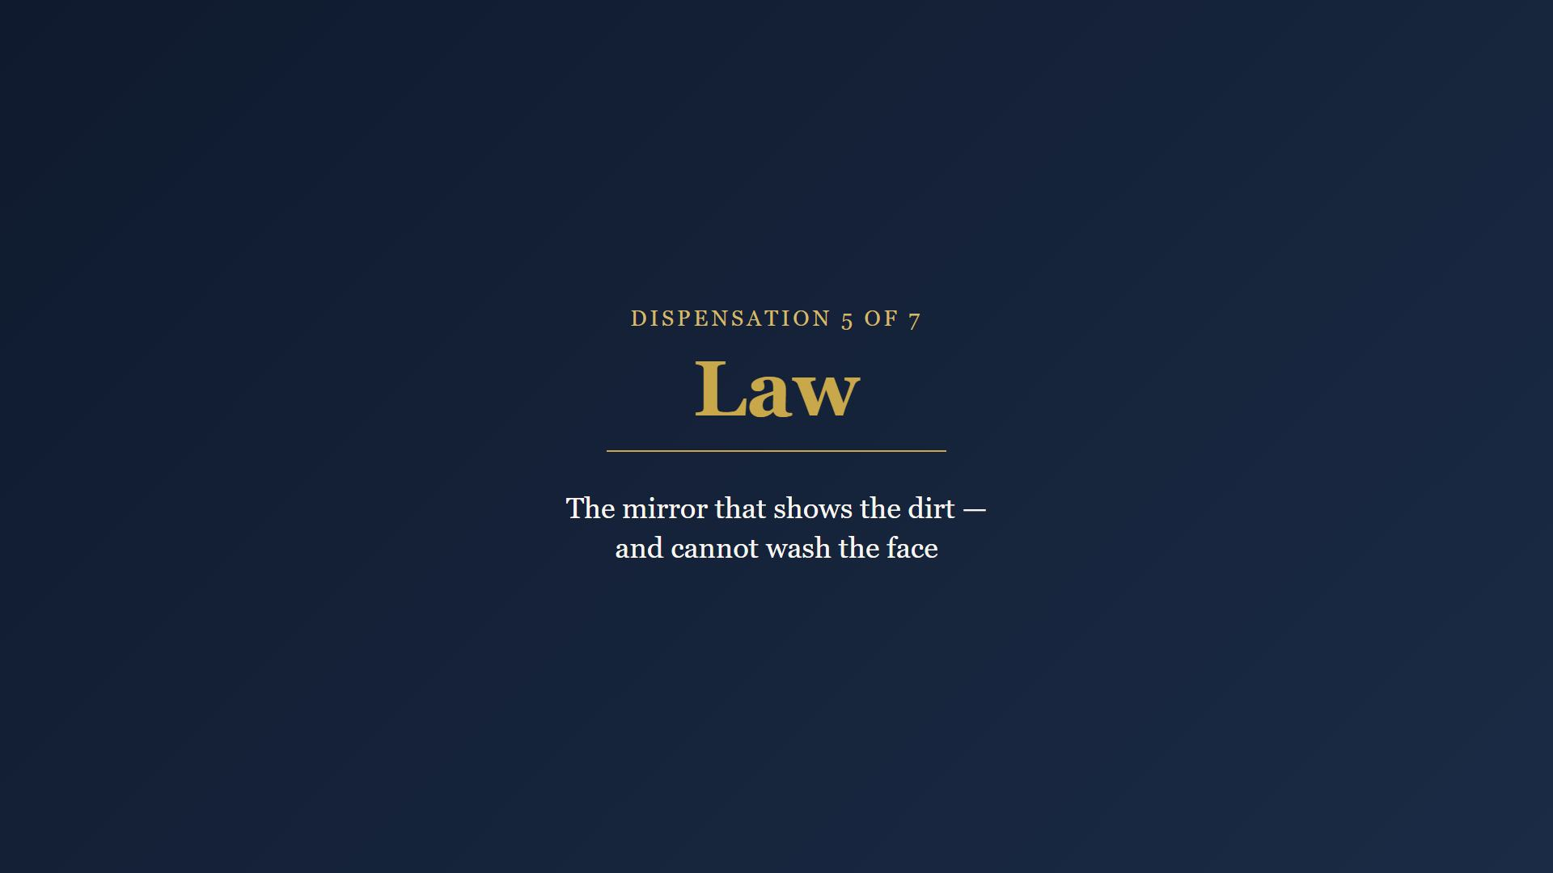
Notes:
Dispensation 5. The Law is holy, just and good - and it was never given to save anybody. It is a mirror. A mirror shows you the dirt; it cannot wash your face.

Slide 14
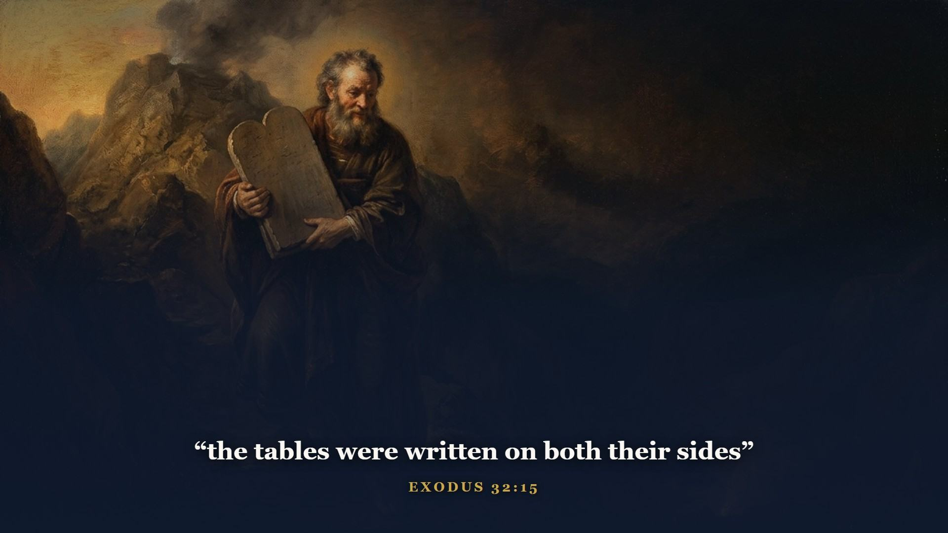
Notes:
Ten words that have never stopped echoing. The Law is holy, just, and good - and it was never given to save anybody. It was given so that every mouth may be stopped and all the world become guilty before God, so guilty men would quit polishing their own righteousness and run to the Substitute.

Slide 15
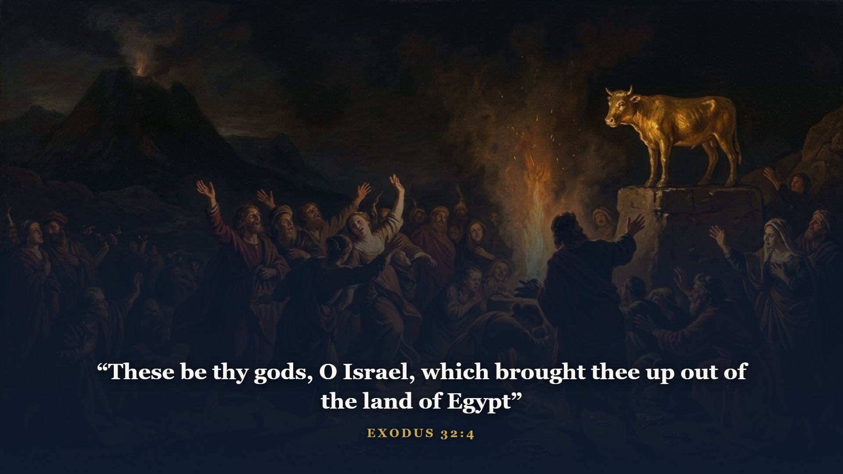
Notes:
How long did we will do last? About forty days. Moses came down carrying the tablets and walked into a camp dancing around a golden calf. Good intentions are not a changed heart.

Slide 16
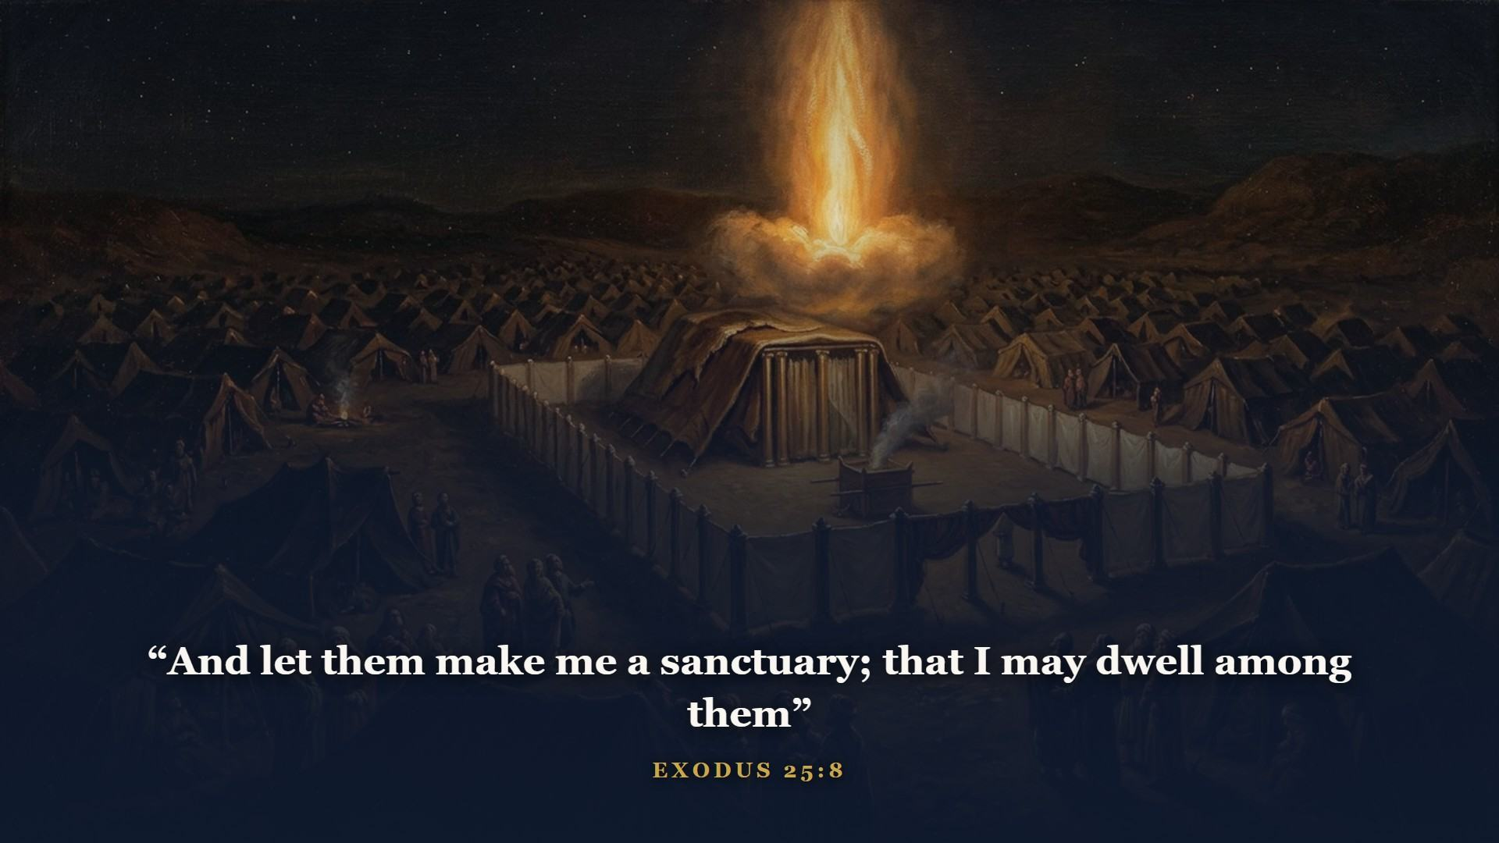
Notes:
The same God who gave the Law also gave the tabernacle - God's dwelling in the middle of the camp, and a walking gospel lesson. ONE gate, not ten - one way in, remember the ark's one door. Inside the gate the first thing you met was the altar: blood, before anything else.

Slide 17
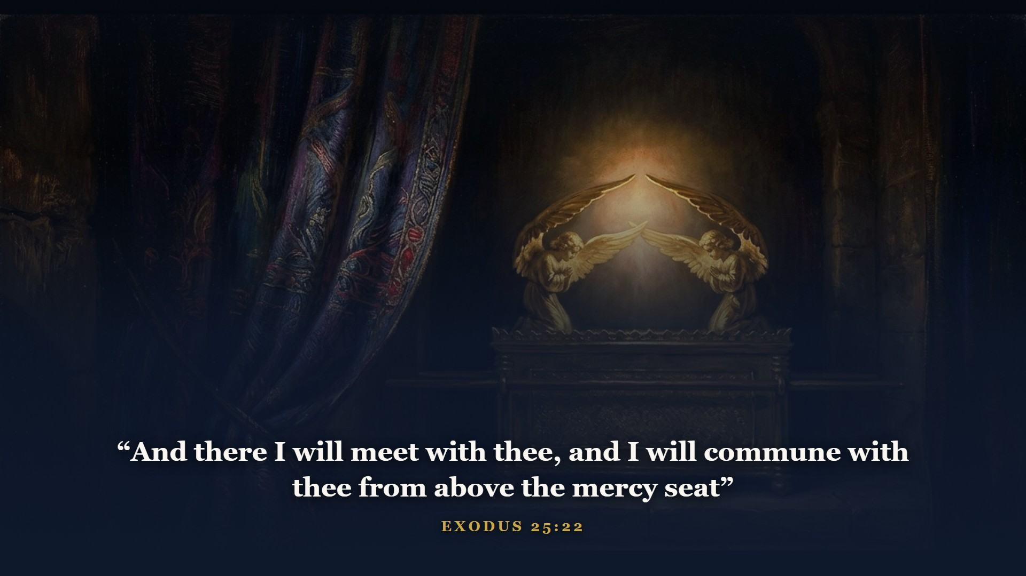
Notes:
Behind a thick veil, God's glory over the mercy seat - where one man went one day a year, never without blood. Every piece preaches Christ. Keep that veil in mind: in Class 4, the moment Jesus dies, something happens to it that tells you the whole age has changed.

Slide 18
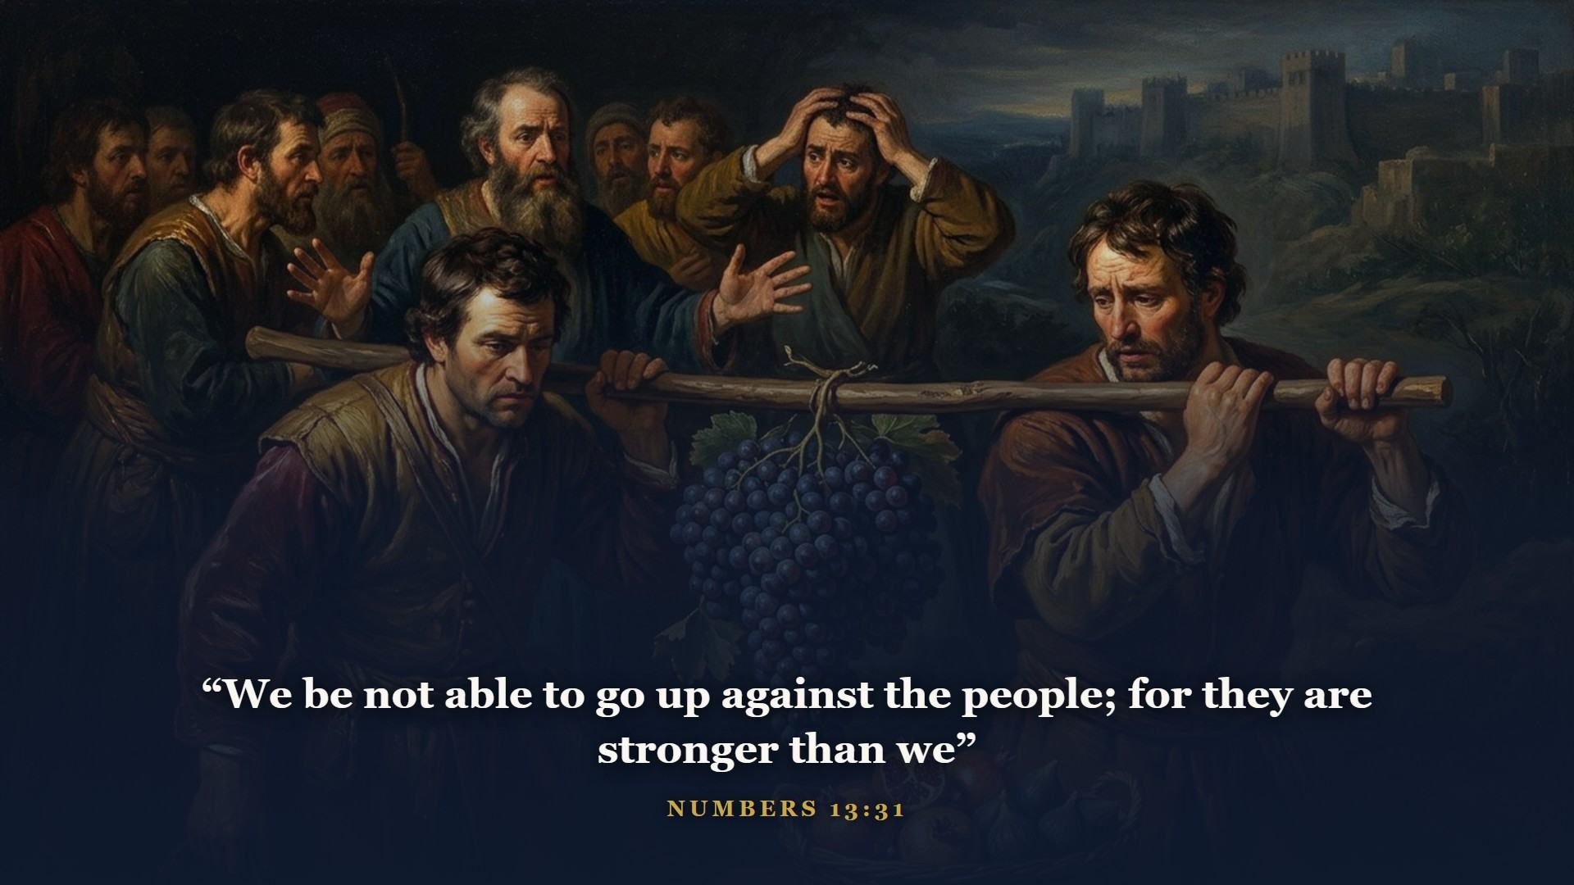
Notes:
A year out, God brings them to the doorstep and says go in. Twelve spies; ten come back rattled - walled cities, giants. The people chose the ten over God.

Slide 19
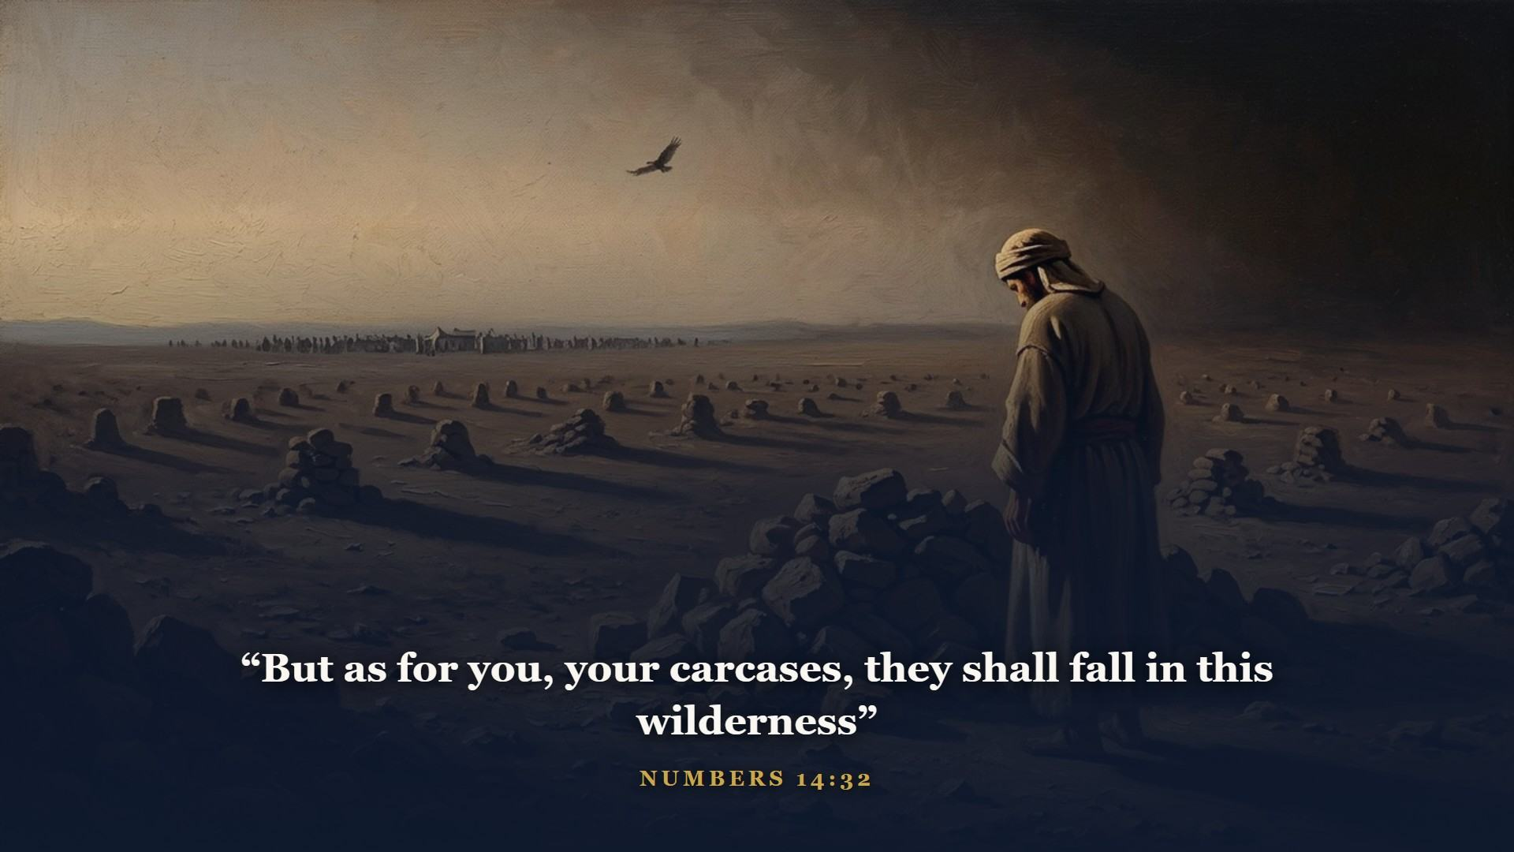
Notes:
The doorstep generation died in the wilderness. Forty years of funerals, while their children grew up to inherit what their parents refused. Unbelief is expensive. It always is.

Slide 20
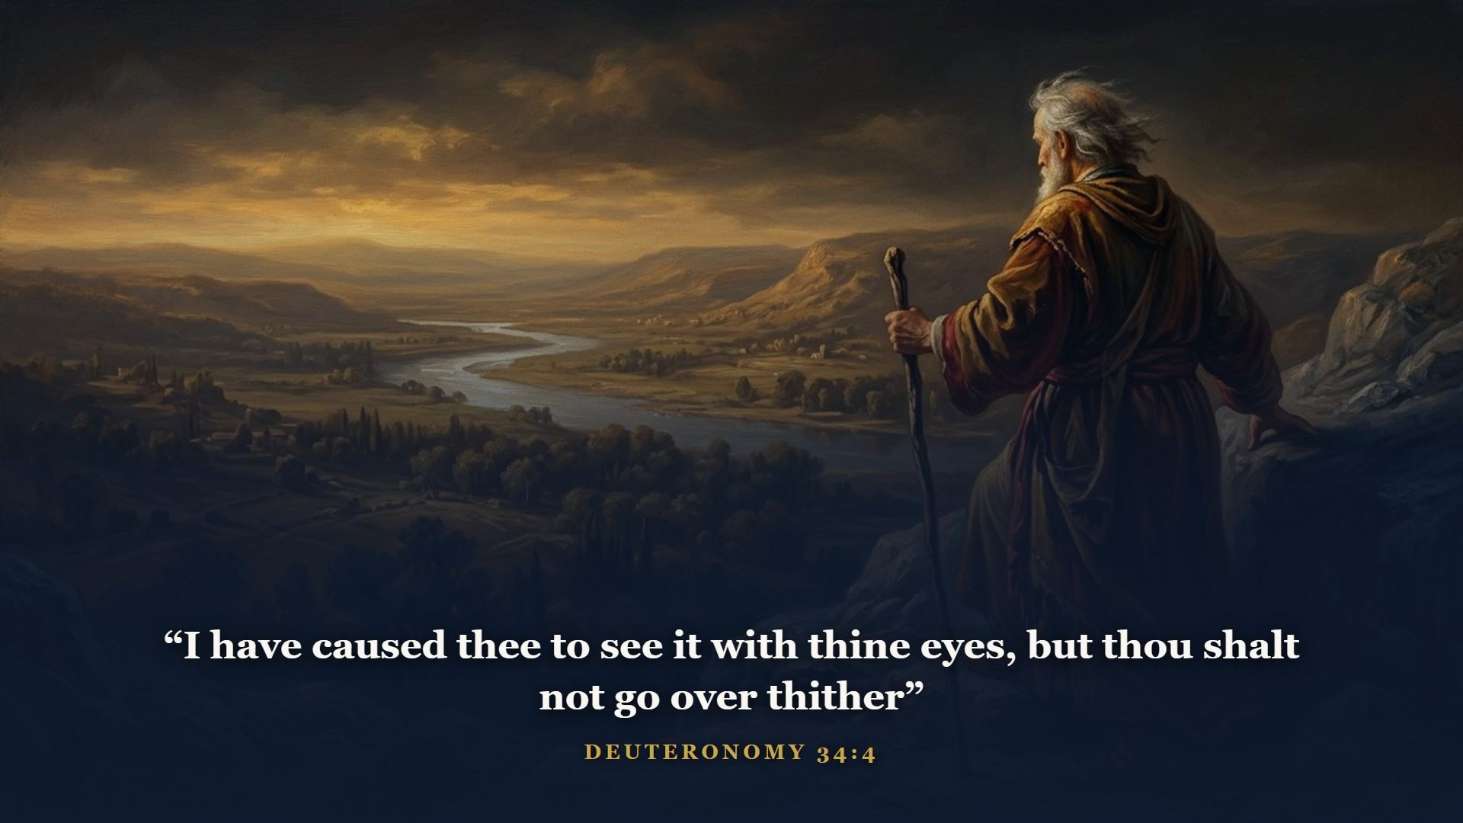
Notes:
Moses preached Deuteronomy on the plains of Moab and gave Israel the Shema - hear O Israel, the LORD our God is one LORD - the verse Jesus quotes when asked the greatest commandment. The heart of the Law was never ritual. It was love. Moses died on Nebo, and God Himself buried him.

Slide 21
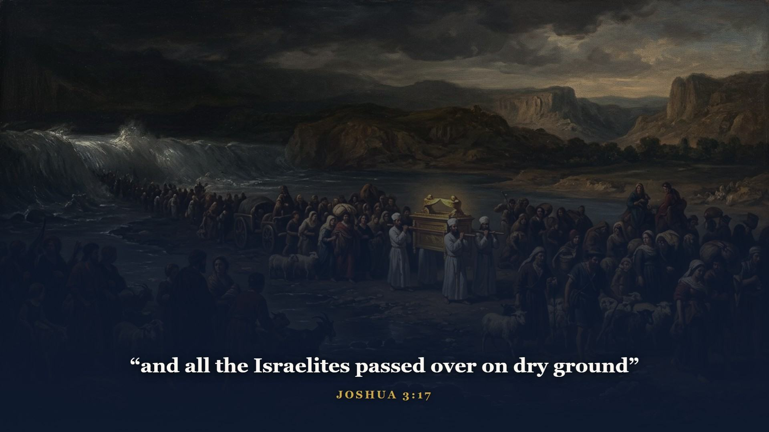
Notes:
God's marching orders to Joshua: this book of the law shall not depart out of thy mouth. Be strong and of a good courage. The Jordan opened like the Red Sea had.

Slide 22
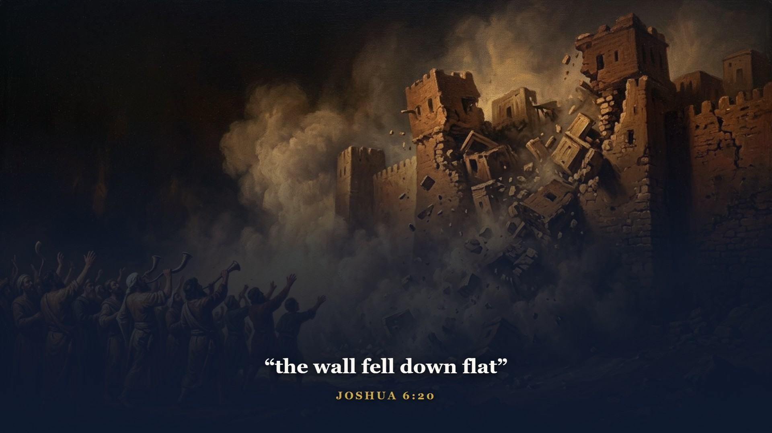
Notes:
Seven days, seven priests, seven trumpets - and a shout. The walls went down flat. Seven years of campaigning and the tribes settled into their inheritance.

Slide 23
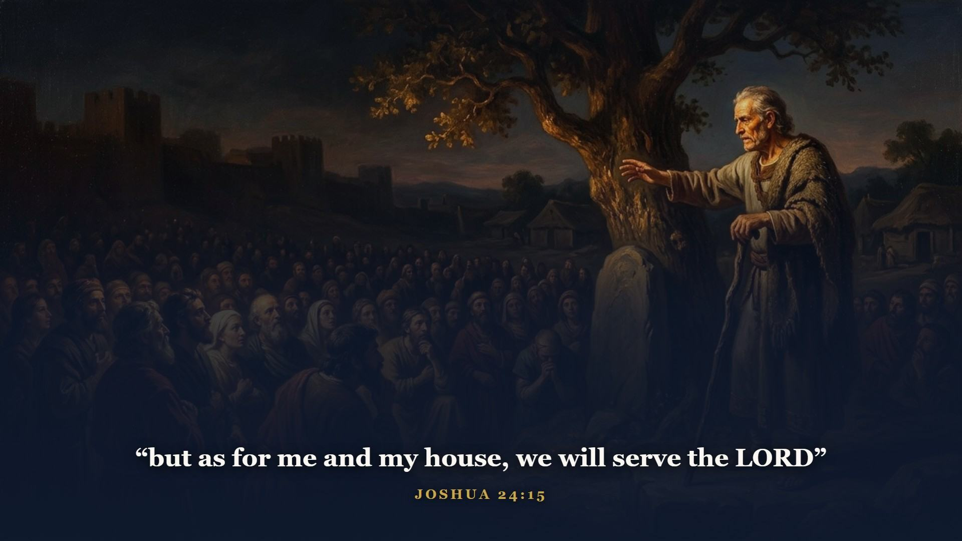
Notes:
An old Joshua gathers the nation one last time and throws down the challenge that has named a thousand wall plaques since - and earned every one of them. Choose you this day.

Slide 24
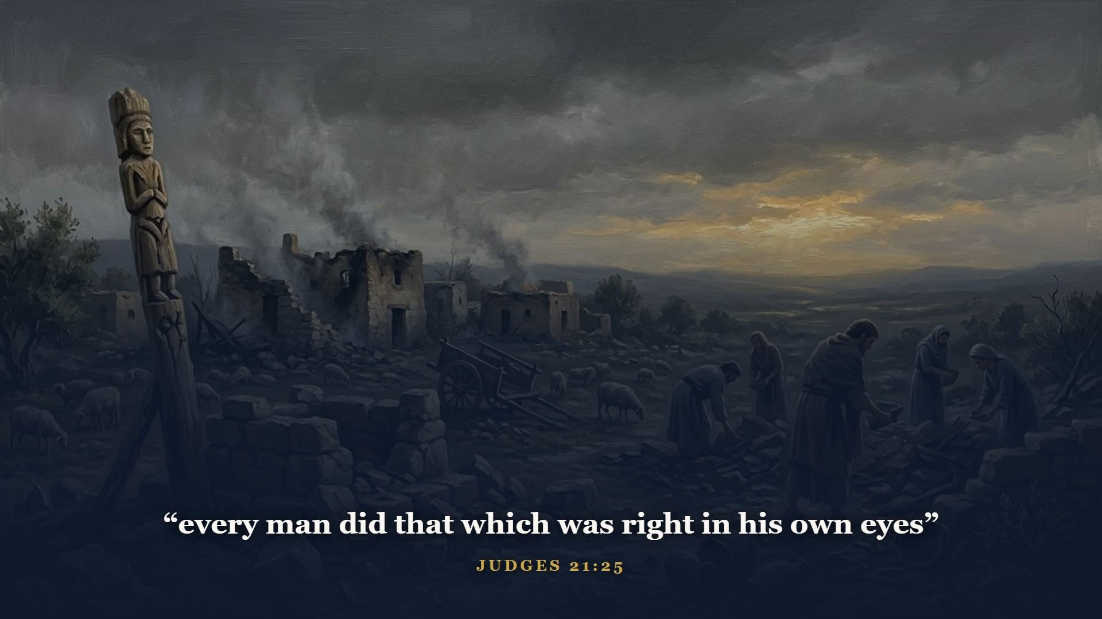
Notes:
The bleakest stretch in your Old Testament. A dreary spiral repeated seven times - Israel forgets God, an enemy moves in, Israel cries out, God raises a deliverer, the land rests, Israel forgets again. Sound familiar? It sounds like the evening news. Man under Law was doing no better than man under conscience.

Slide 25
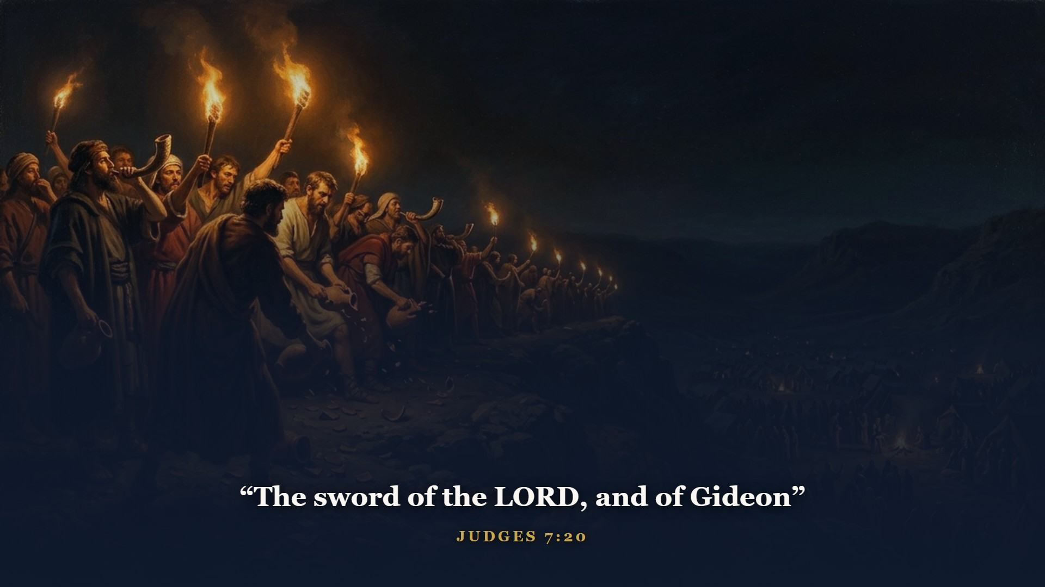
Notes:
God whittled Gideon's army from thirty-two thousand down to three hundred, so nobody could claim the credit. Pitchers smashed, torches blazing, trumpets blowing. Little is much when God is in it.

Slide 26
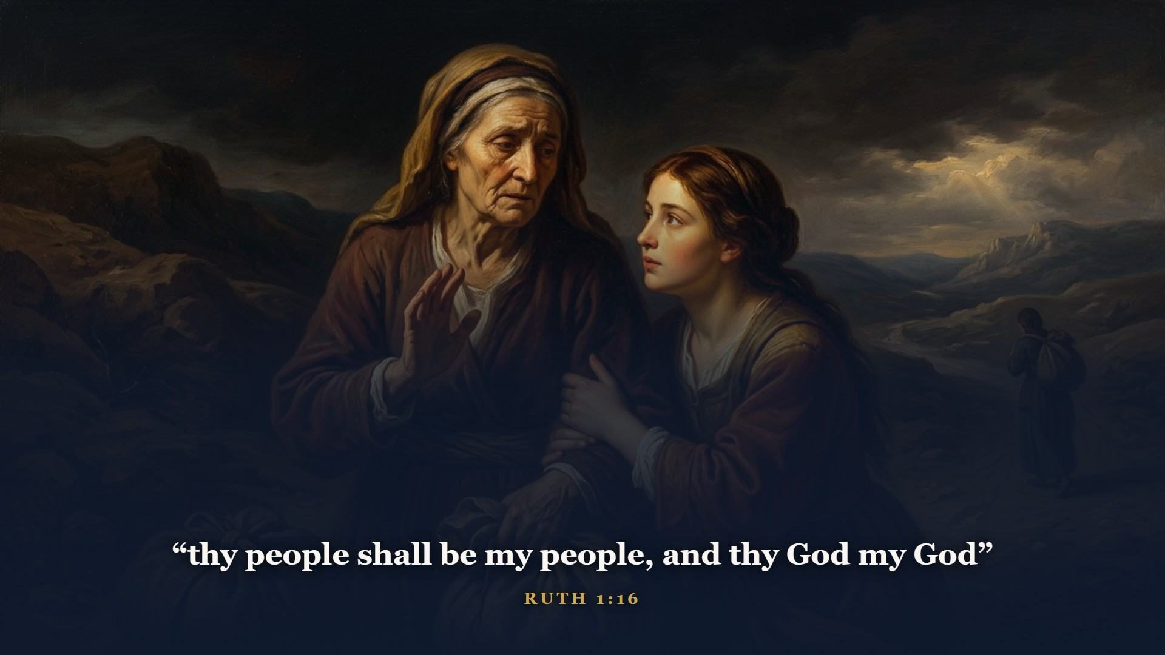
Notes:
But God always keeps a candle burning. During those same dark years a Moabite widow glued herself to her broken Israelite mother-in-law with one of the most beautiful confessions of faith ever spoken.

Slide 27
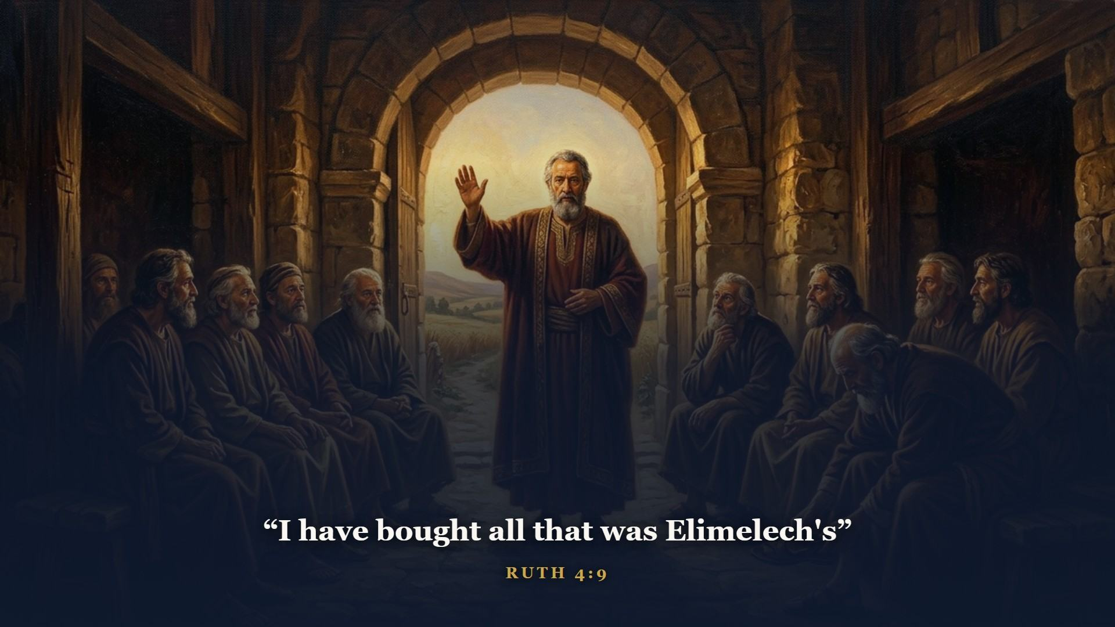
Notes:
Boaz - the KINSMAN REDEEMER, the relative with the right and the riches to redeem what was forfeited. If you want to know why the Son of God had to become a man, kin to us, before He could redeem us, Ruth is your answer in four short chapters. And the surprise ending: their great-grandson is David. A Gentile believer in the Messiah's own family line. All families of the earth was never small print.

Slide 28
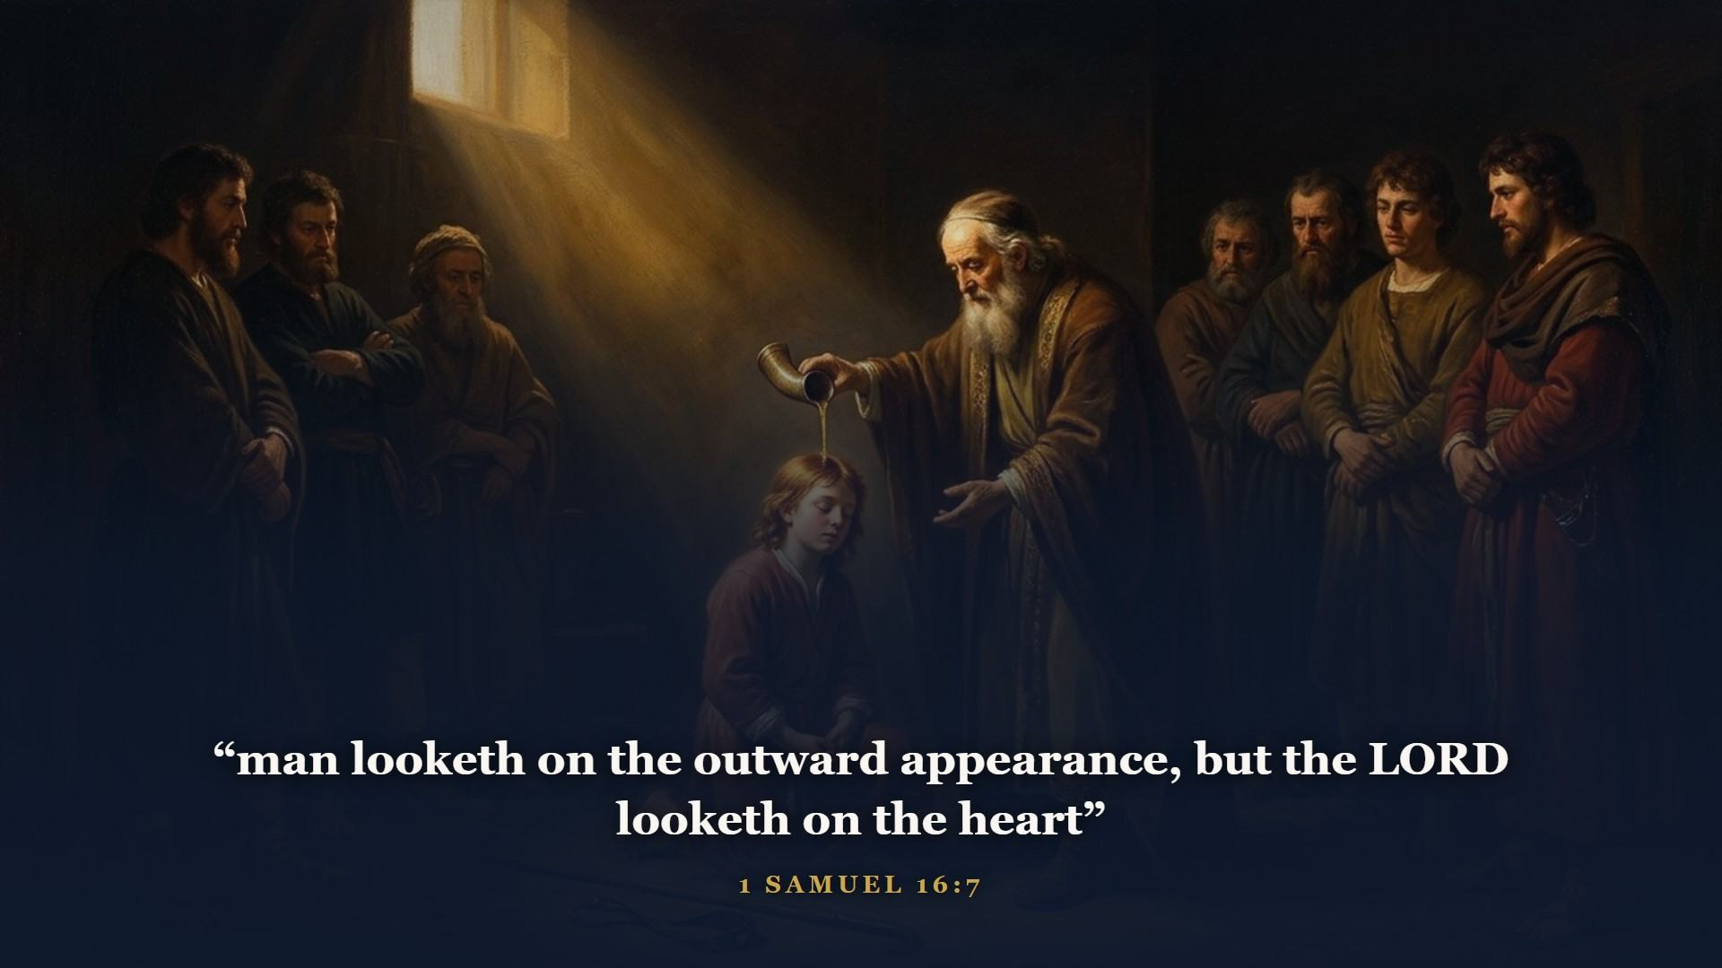
Notes:
Israel demanded a king like all the nations and got exactly what they asked for - Saul, head and shoulders above everybody, and hollow inside. When God sent Samuel to Jesse's house, even the old prophet needed his eyes recalibrated. The one God wanted was out keeping sheep.

Slide 29
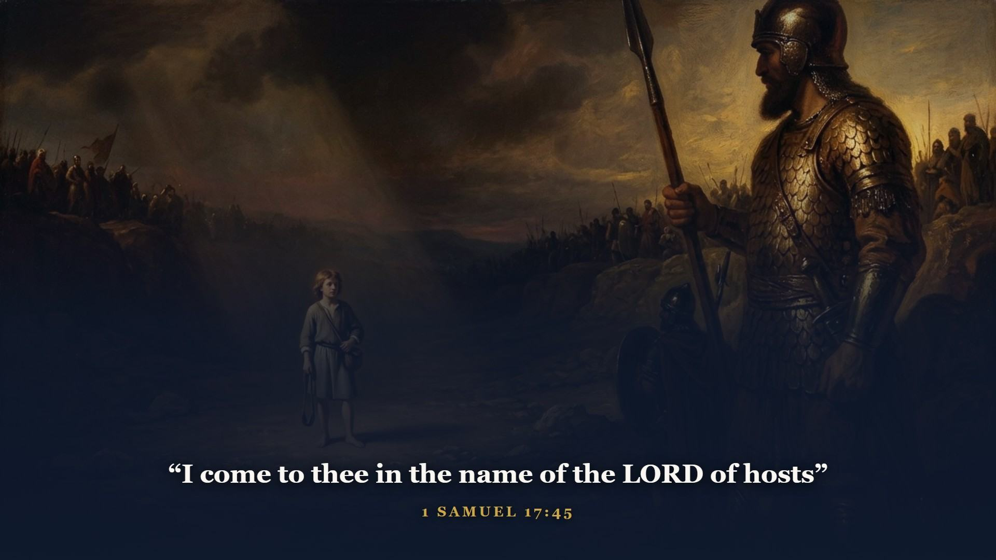
Notes:
Goliath bellowing in the valley of Elah, an army of grown soldiers hiding, and a shepherd boy with a sling and five smooth stones who asked: who is this uncircumcised Philistine, that he should defy the armies of the living God? One stone settled it.

Slide 30
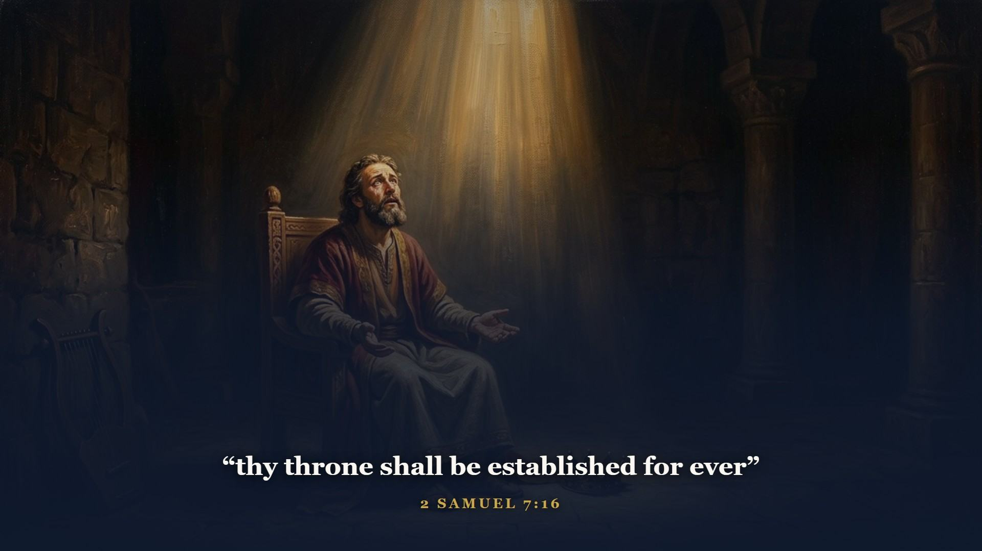
Notes:
David proposed to build God a house; God turned it around and promised to build DAVID a house. A throne established FOR EVER - the Davidic covenant, a load-bearing beam of the whole Bible. No merely human king fulfills for ever. In Class 4 listen to Gabriel: the Lord God shall give unto him the throne of his father David. The track runs: Seed of the woman, through Abraham, through Judah, through David's house. The address keeps getting more specific.

Slide 31
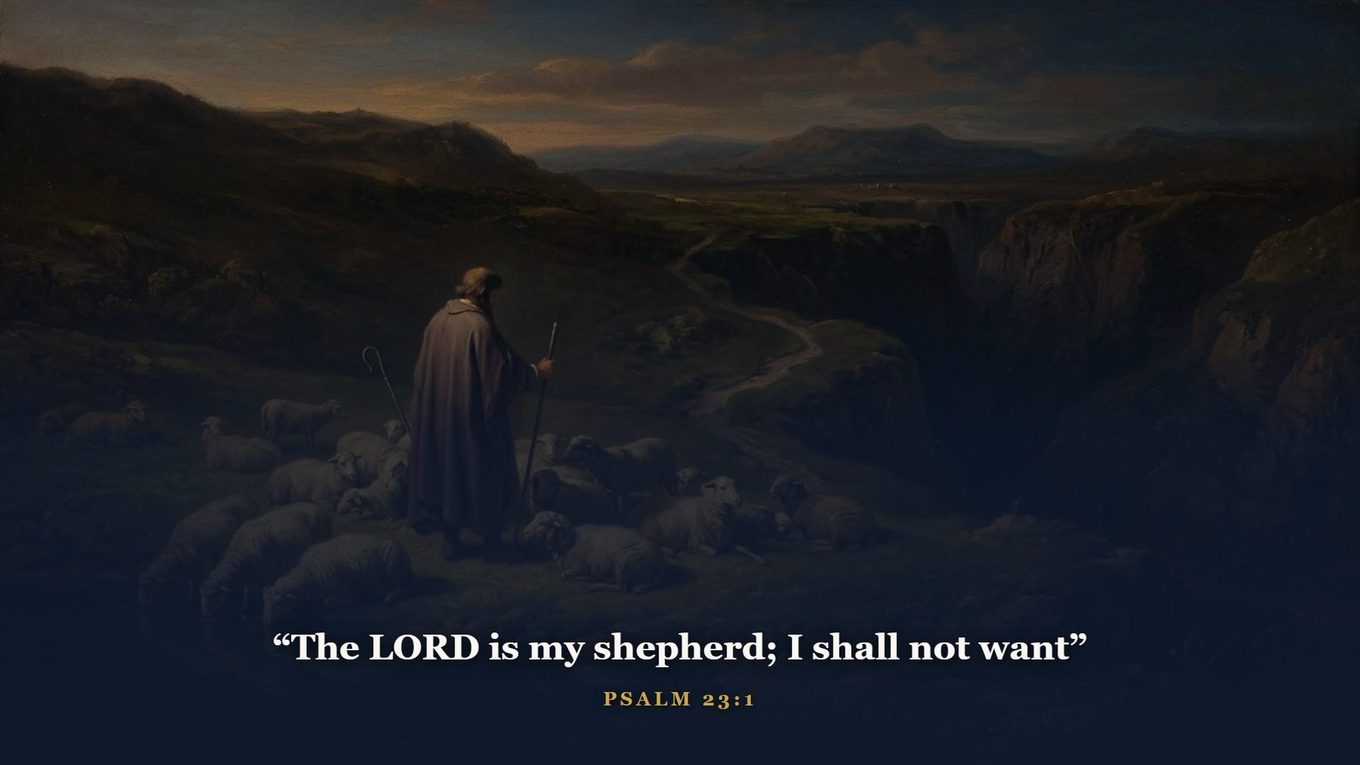
Notes:
Out of all his psalms, the one the whole world knows - the shepherd's psalm, by the shepherd-king, about the Shepherd LORD. [Note box - one verse to remember. Give them a minute.]

Slide 32
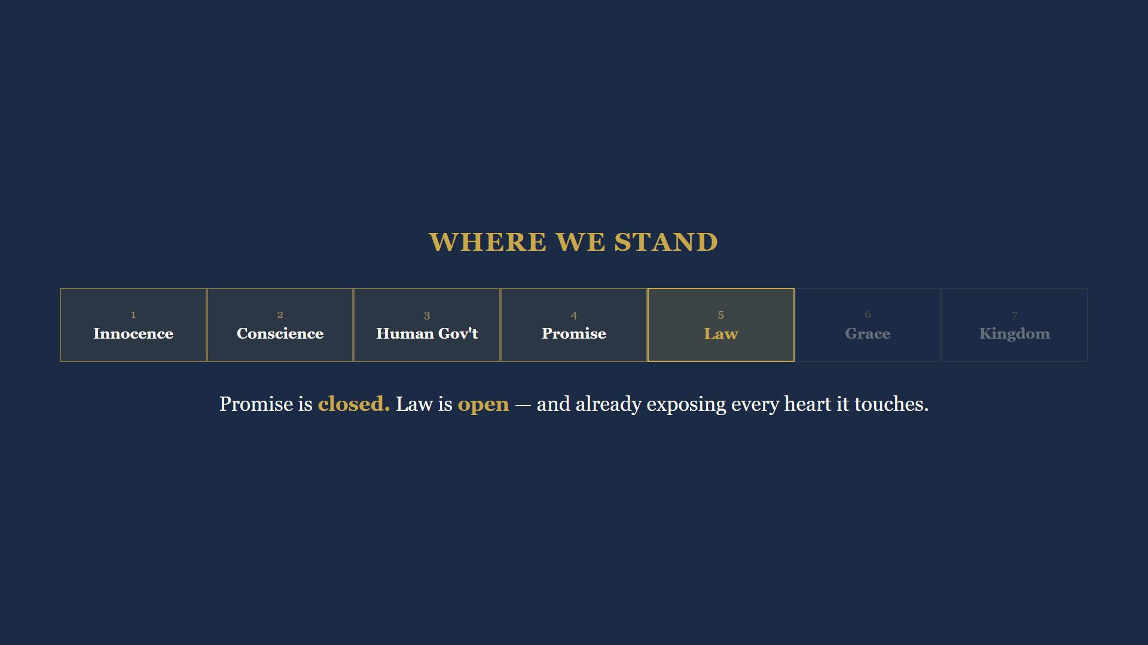
Notes:
Run the tape back: a slave nation redeemed by blood, a sea split open, a mountain on fire, we will do, a golden calf forty days later, a mirror and a tent, a wilderness of graves, walls falling flat, the long spiral down, a Moabite great-grandmother in Messiah's family tree, and a shepherd boy promised a throne that outlasts the world.

Slide 33
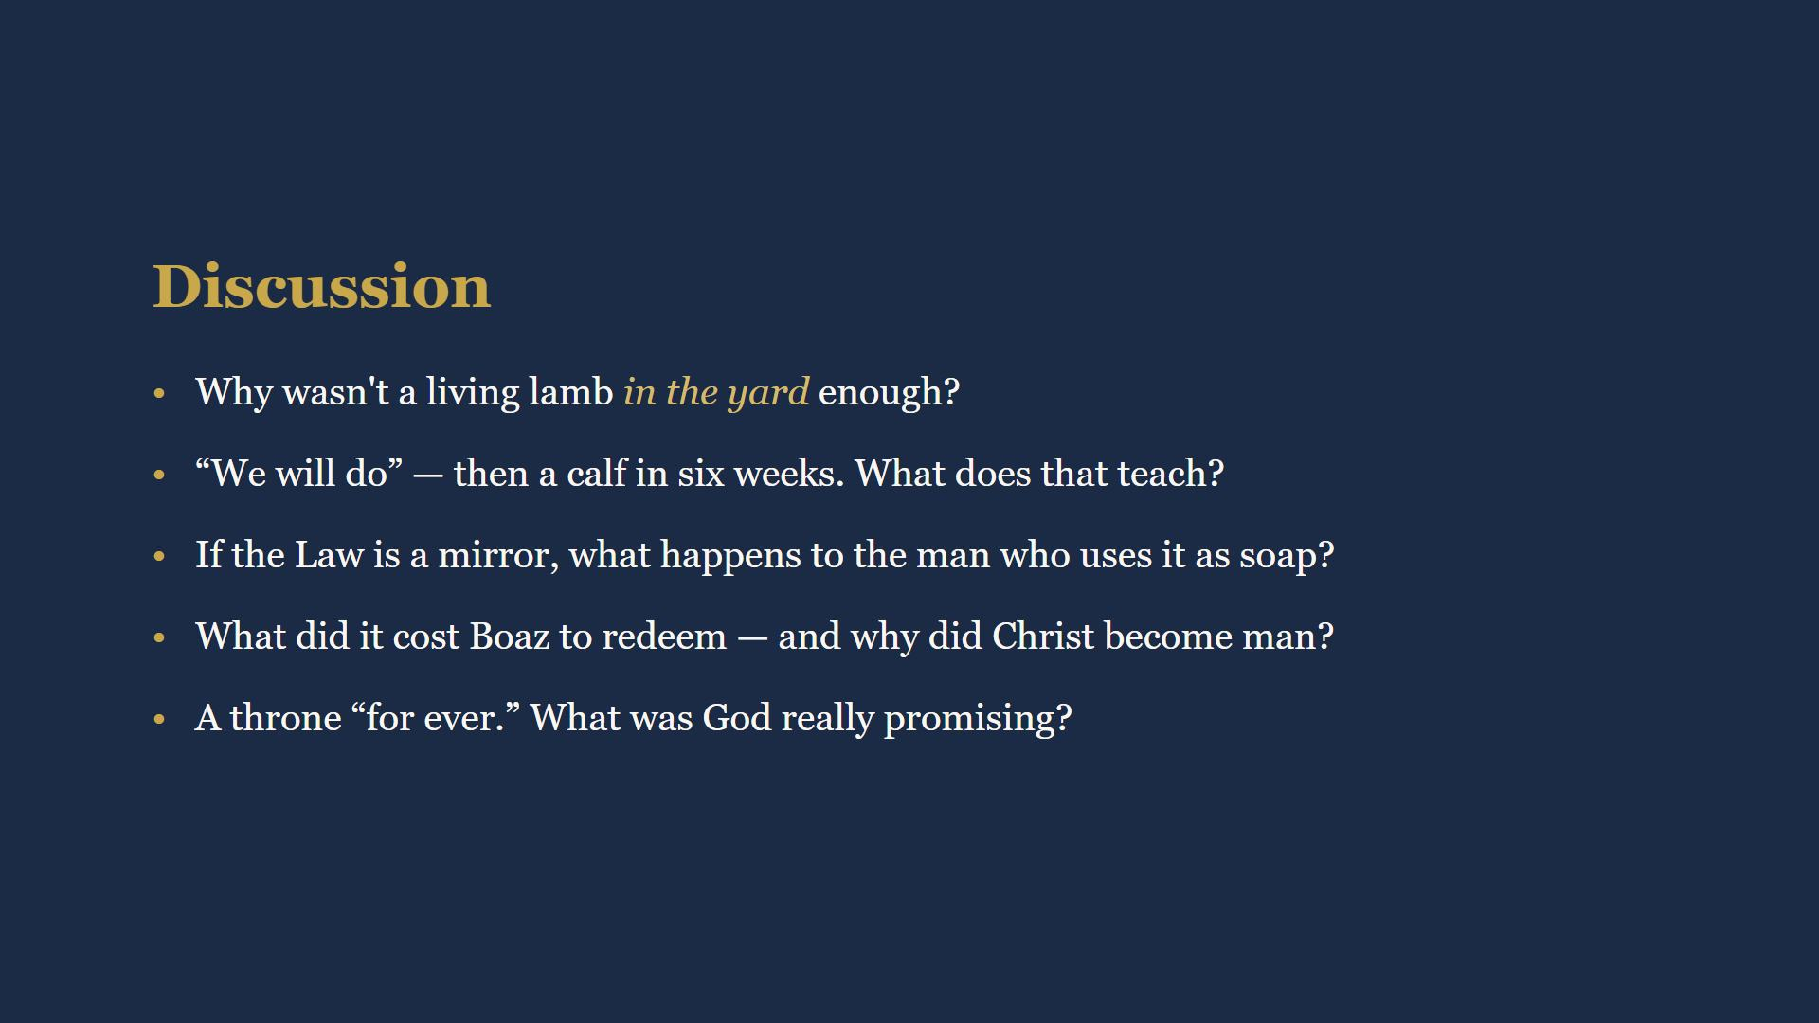
Notes:
15 minutes. Full wording is in their workbooks. Q1: safety came from the blood applied, not the lamb admired. Q2: good intentions are not a changed heart. Q3: the mirror shows sin, it cannot wash - it drives us to the Substitute. Q4: Boaz paid the price himself; Christ became kin to redeem us. Q5: God promised an everlasting throne - His promises to Israel did not quietly expire.

Slide 34
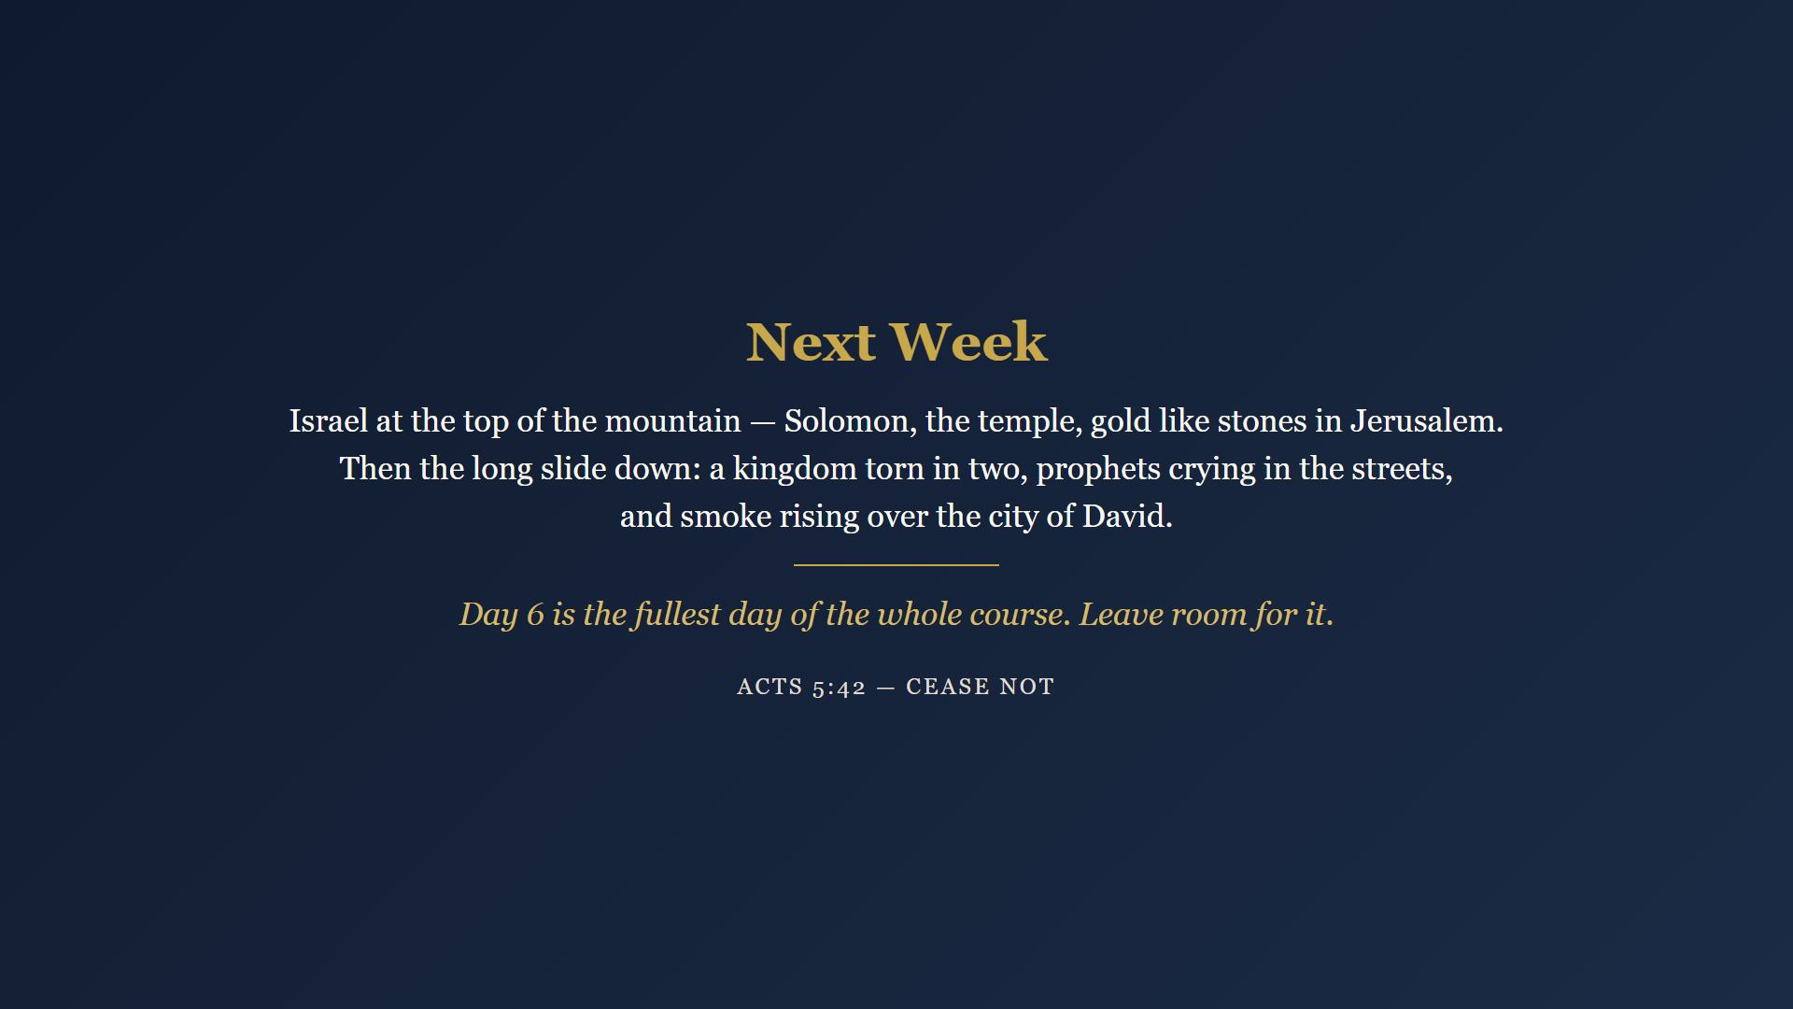
Notes:
Six days of reading, 35-40 minutes budgeted each. Day 6 is the fullest day of the whole course - David anointed, Goliath felled, the throne promised, all in one sitting. Leave room for it. Next week: Solomon, the temple, gold like stones - and then the long slide down. Closing prayer.

