Slide 1
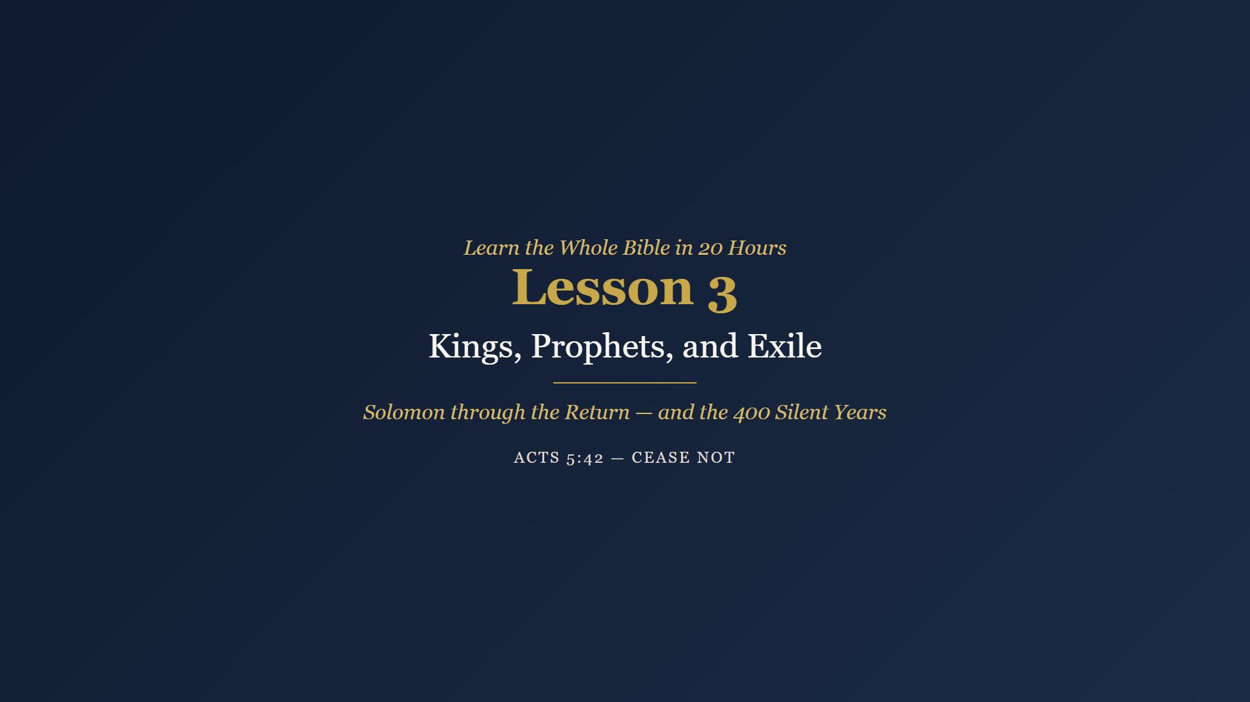
Notes:
Welcome. Review Week 2 reading - ask: what did the Passover lamb and the day of atonement have in common? Take two or three answers. Then pray.

Slide 2
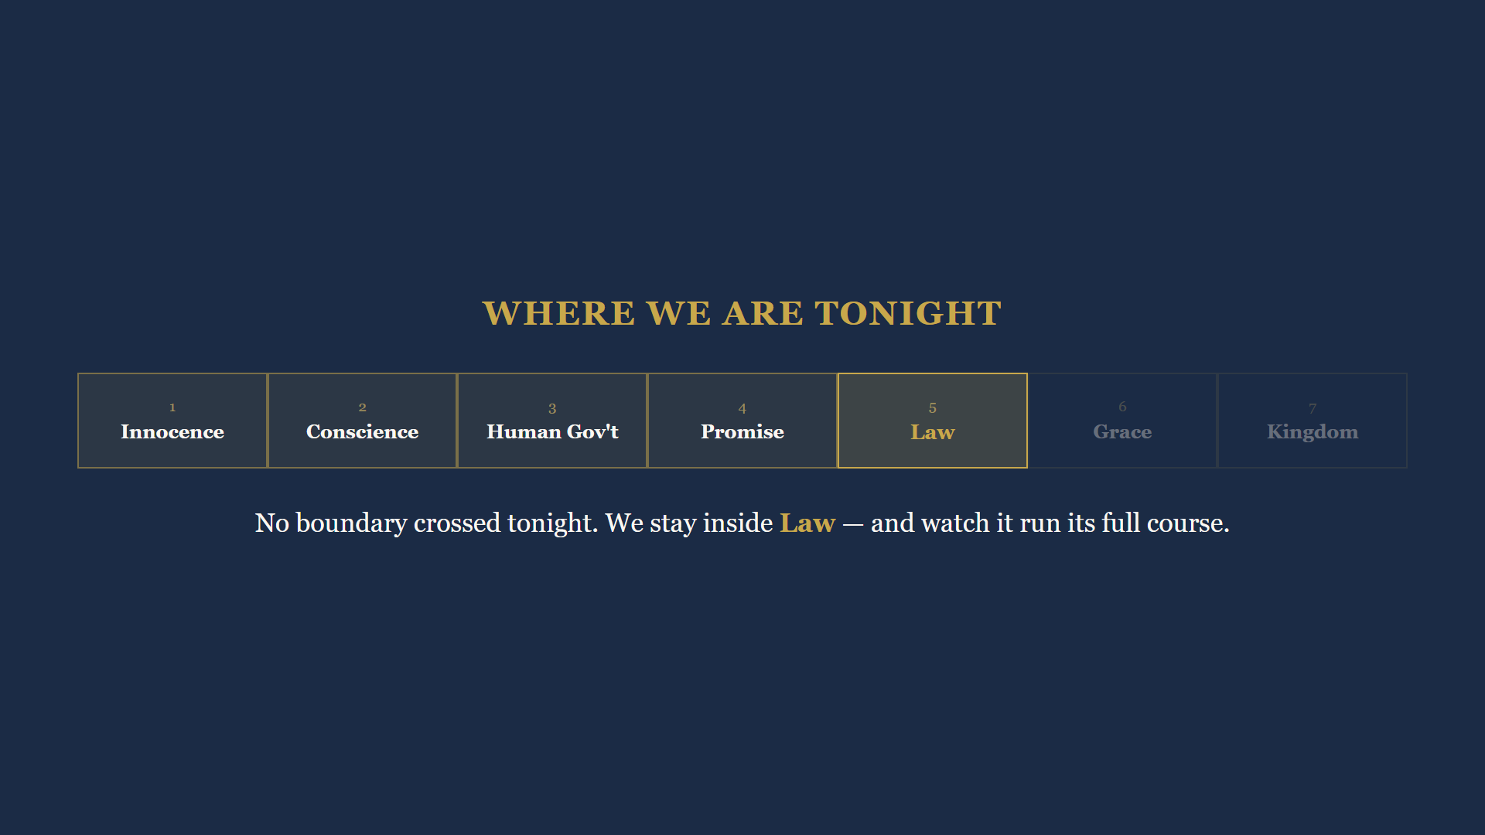
Notes:
No dispensation boundary is crossed today. We stay deep inside the age of Law and watch it run its full course - and watch the prophets point past it to Someone better. Today covers more years than any other class: six hundred years of history plus four hundred of silence.

Slide 3
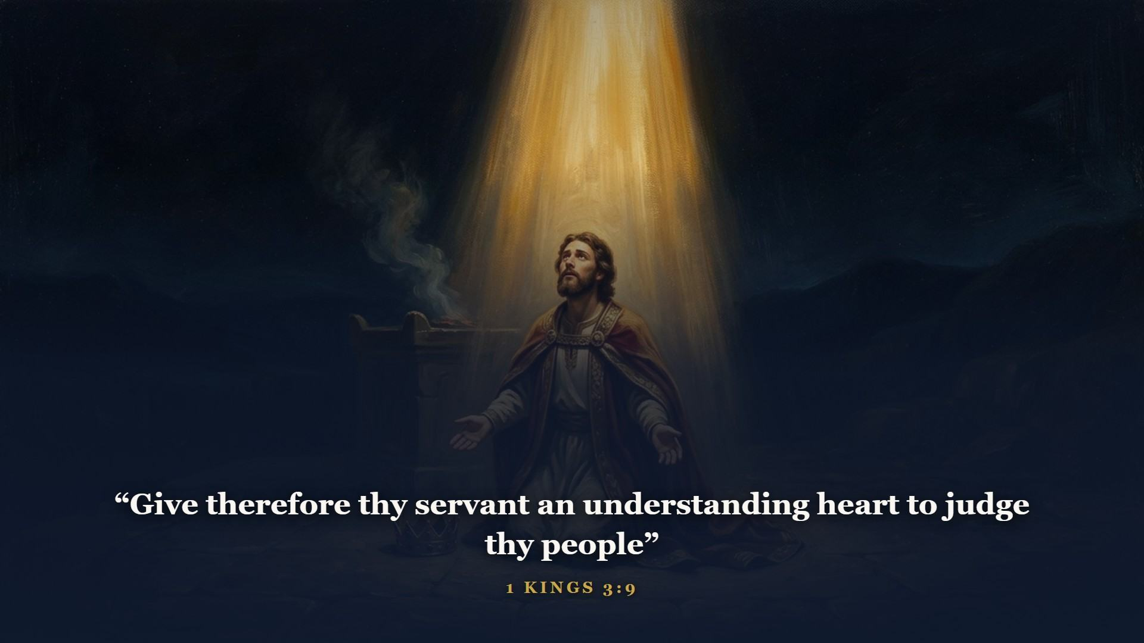
Notes:
David died and Solomon inherited a kingdom at peace. At Gibeon God said: ask what I shall give thee. One of the best prayers a leader ever prayed - he asked for wisdom, and God threw in the riches and honour he had not asked for.

Slide 4
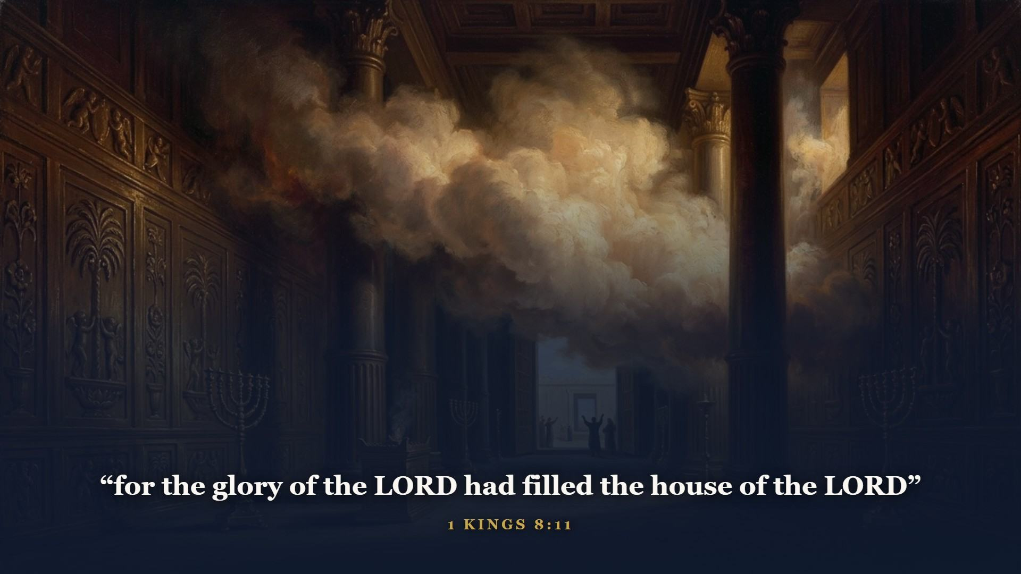
Notes:
Solomon built the temple - the permanent house that replaced the tabernacle tent. At its dedication the glory fell so thick the priests could not stand to minister.

Slide 5
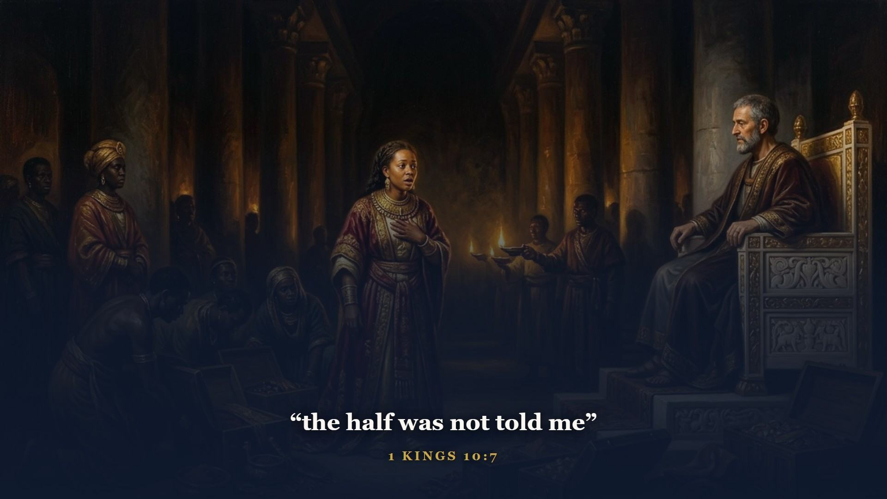
Notes:
Gold became as common in Jerusalem as stones. The queen of Sheba came from the ends of the earth to see it. This is also where your wisdom books sit - Proverbs, Ecclesiastes, Song of Solomon. Set them on the shelf right here in Solomon's reign and they stop floating loose in your mind.

Slide 6
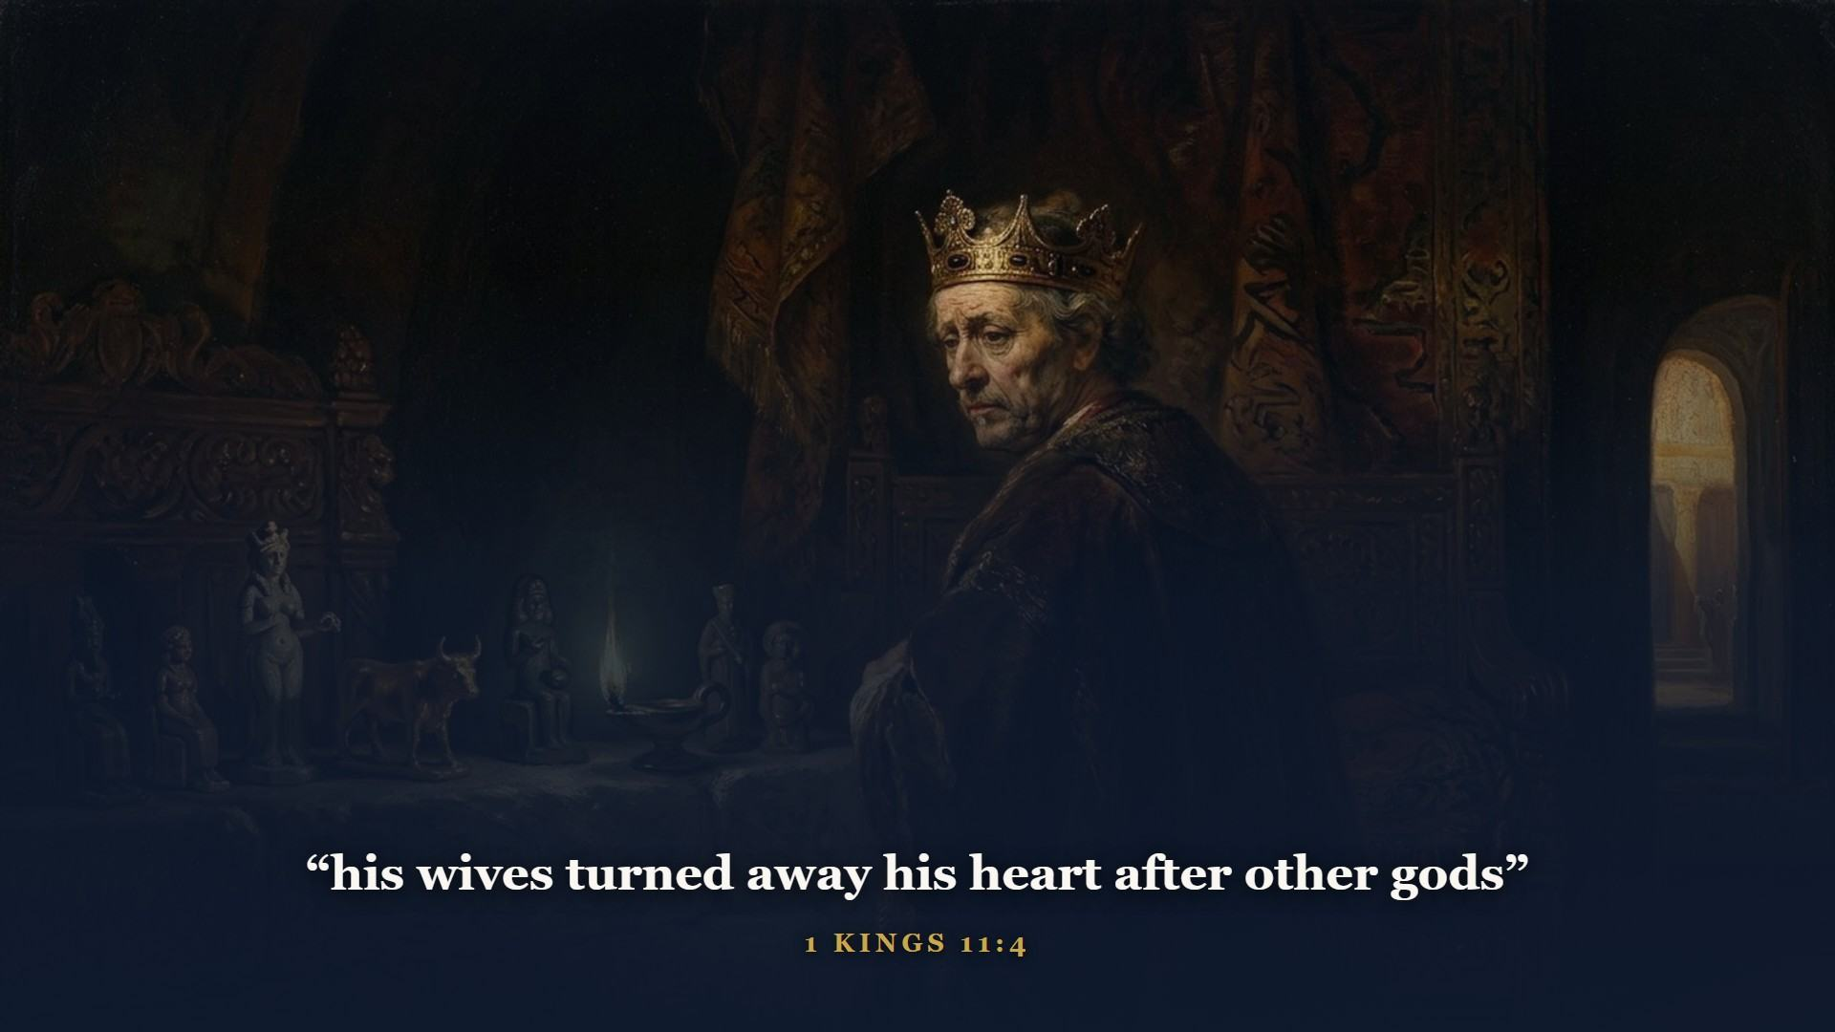
Notes:
The saddest BUT in the Old Testament. Turned by foreign wives, by their gods, by the sheer weight of his own success. The wisest man who ever lived ended up bowing to idols his own father would have wept over.

Slide 7
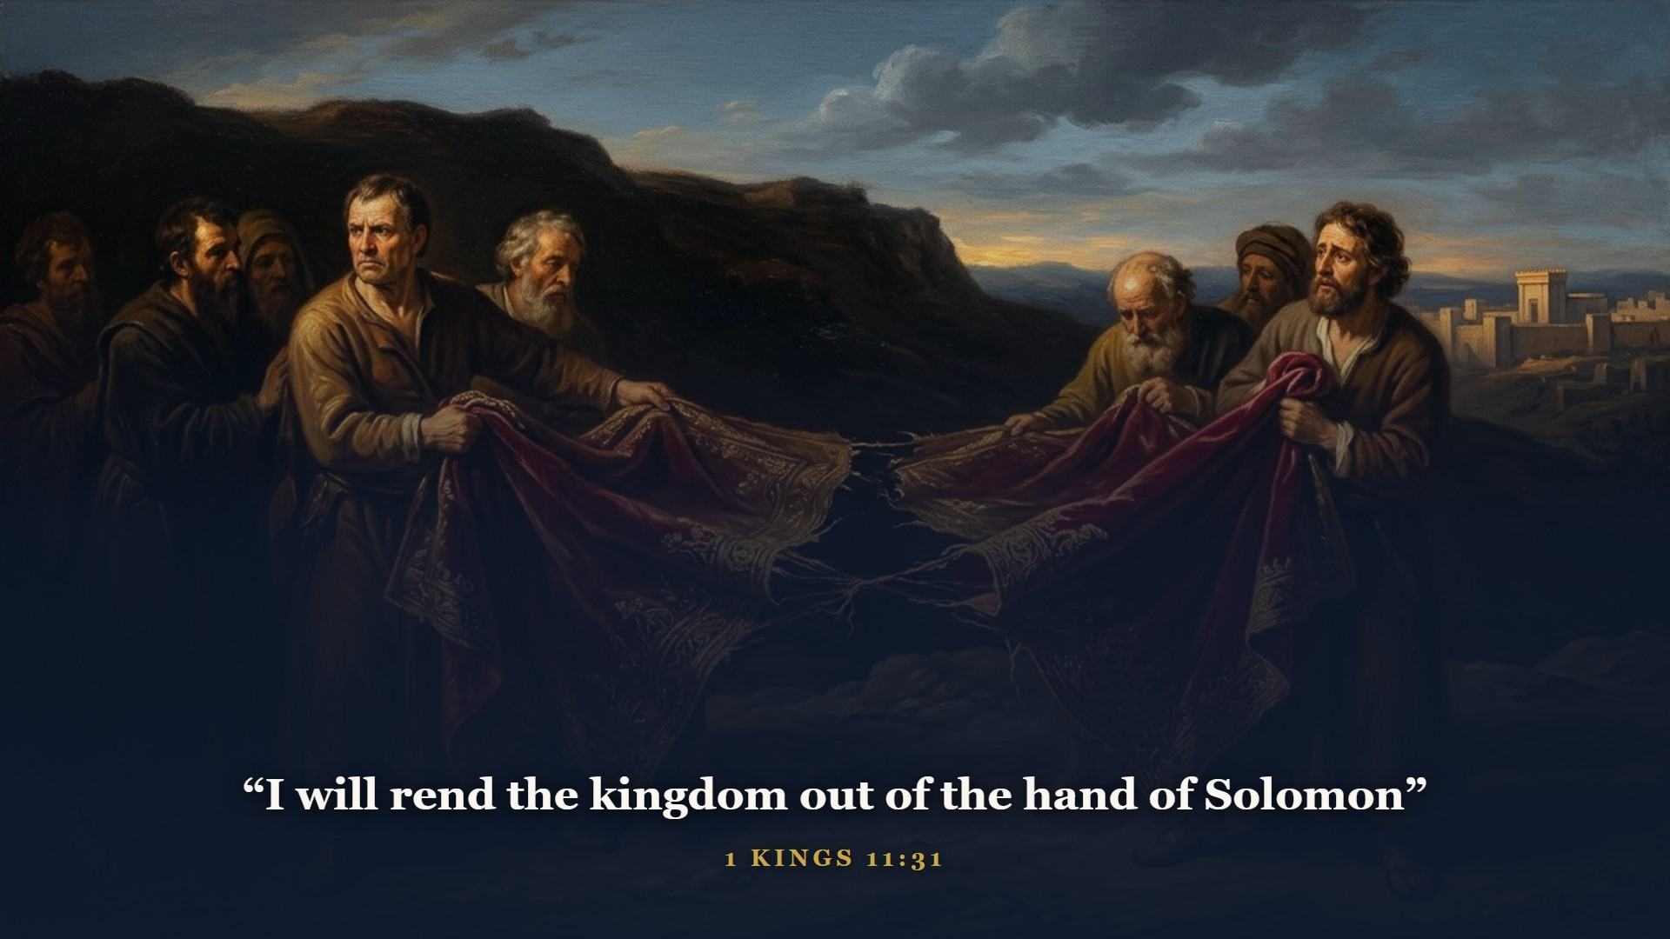
Notes:
When Solomon died, ten northern tribes split off under Jeroboam and kept the name ISRAEL. The south - Judah and Benjamin - stayed with David's line in Jerusalem as JUDAH. Keep them straight from here on: the north never had one godly king in two hundred years; the south had a handful of bright spots - Asa, Jehoshaphat, Hezekiah, Josiah - between long runs of decline.

Slide 8
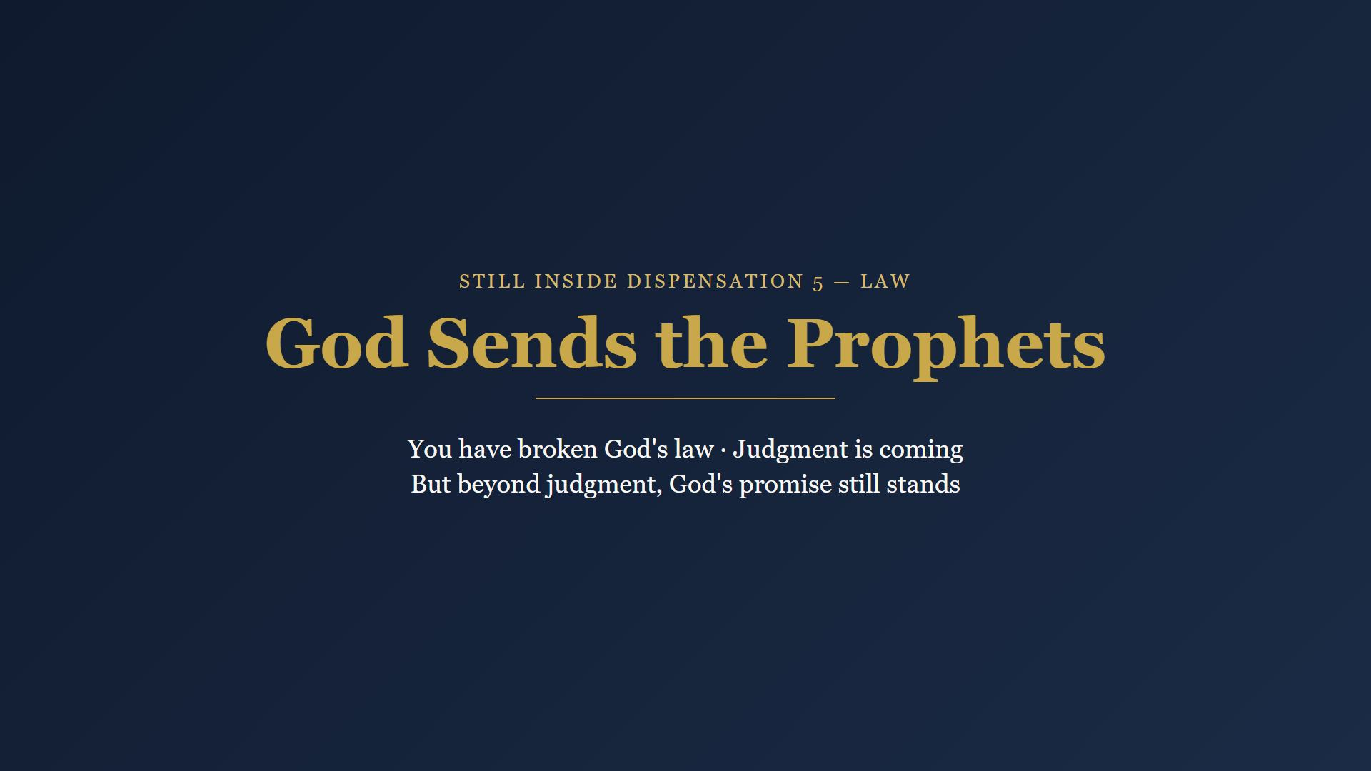
Notes:
What does a holy God do with a covenant nation sliding into idolatry? He does not go silent and He does not strike first. He sends prophets. A prophet is not mainly a fortune-teller - he is a covenant prosecutor.

Slide 9
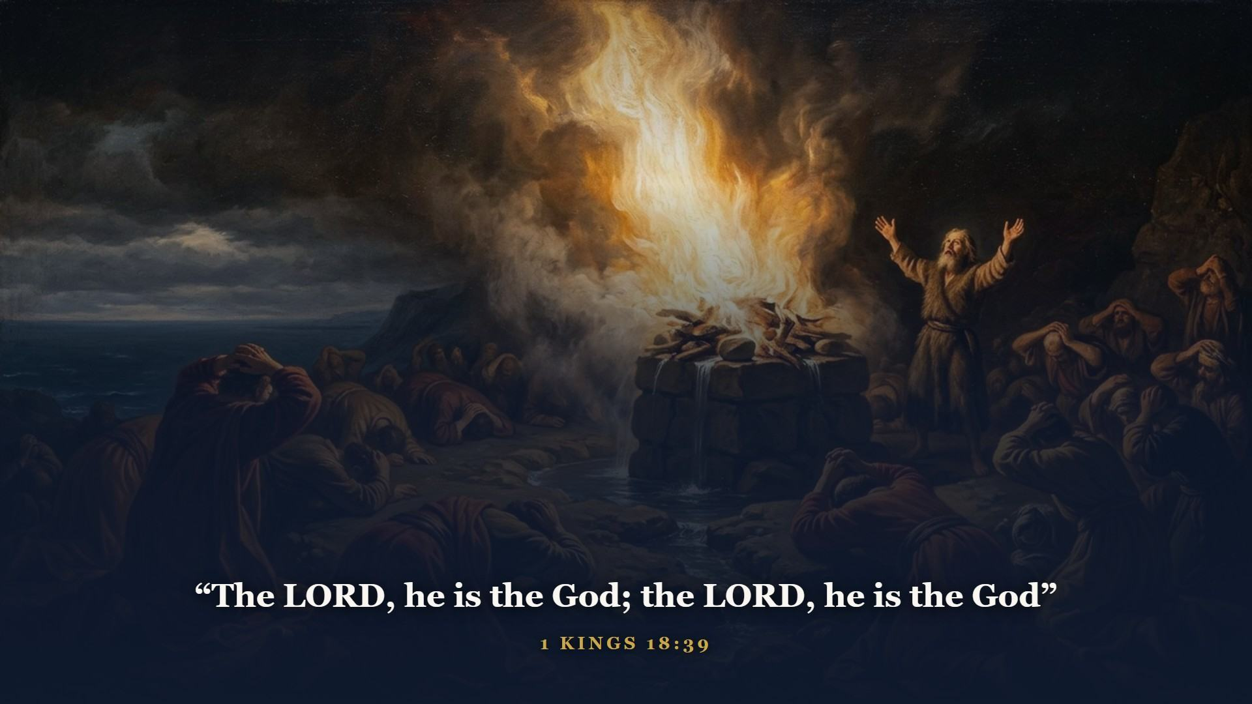
Notes:
Elijah, sent to the worst of the northern kings - Ahab, with his Baal-pushing queen Jezebel. Mount Carmel: 850 false prophets against one true one. The God that answereth by fire, let him be God. Baal's men leaped and cut themselves from morning till evening - no voice, nor any that answered. Elijah soaked his altar three times over and prayed sixty-three words.

Slide 10
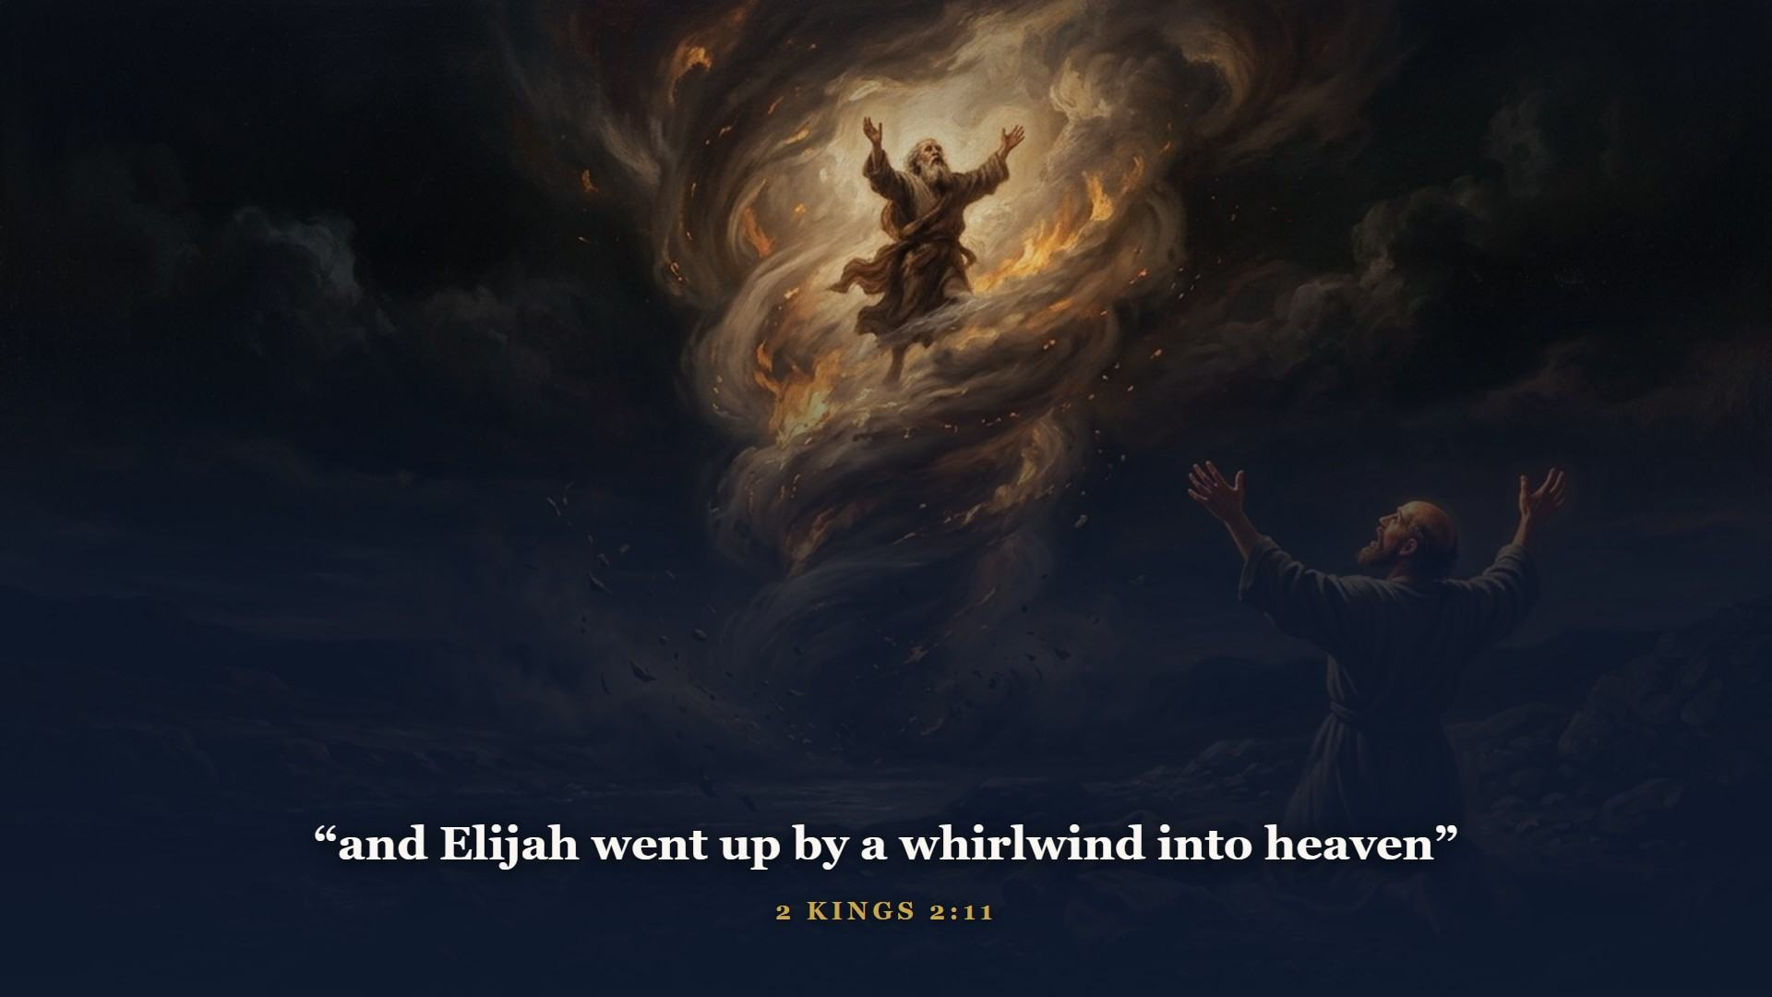
Notes:
Elijah never died. God took him up, and his apprentice Elisha carried on with a double portion of his spirit. Keep Elijah's name handy - the Old Testament is going to end on it, in about twenty minutes.

Slide 11
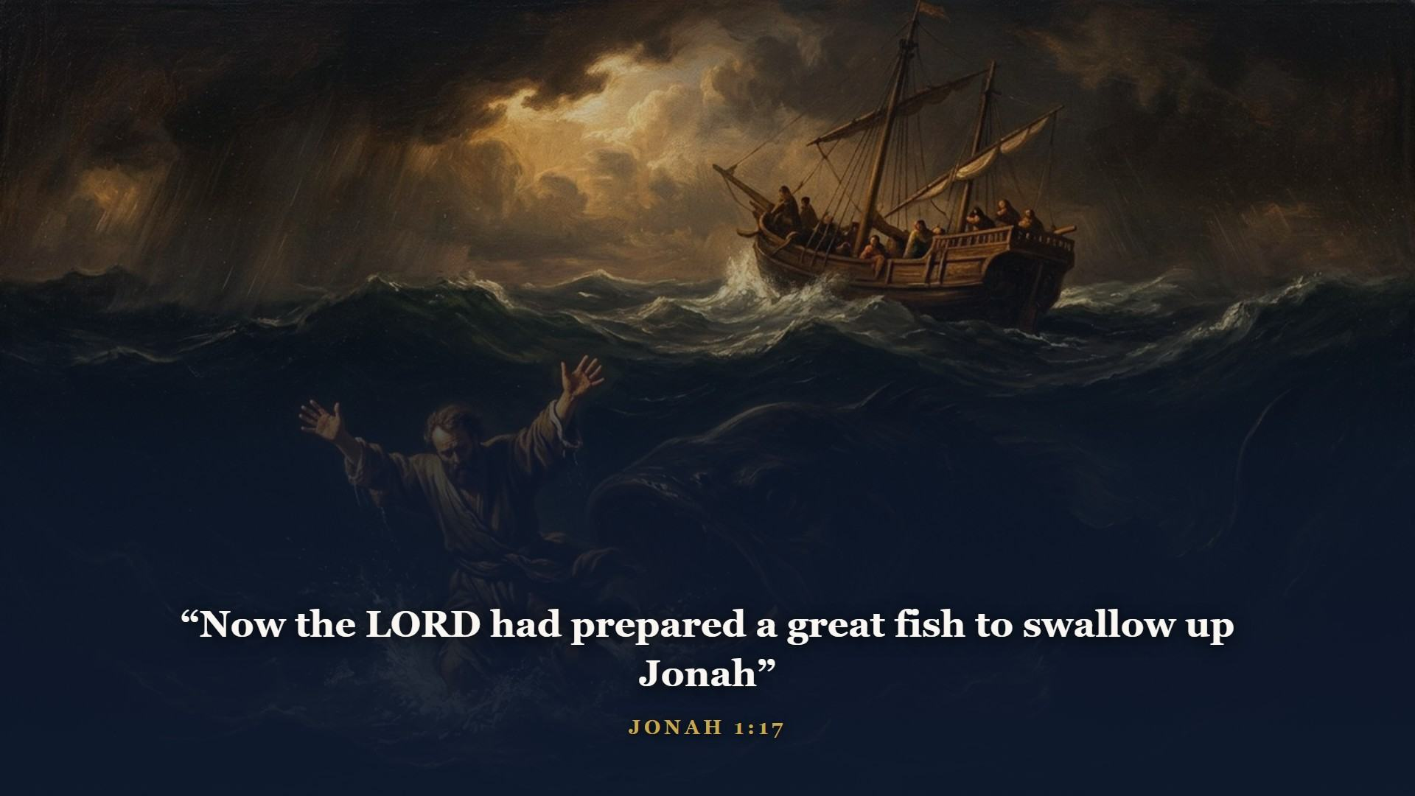
Notes:
God even sent a prophet to Israel's enemies. Jonah ran the opposite direction - not because he feared Nineveh would refuse, but because he feared they would repent and God would spare them. Jesus stamped this story as history AND as a picture of His own burial and resurrection.

Slide 12
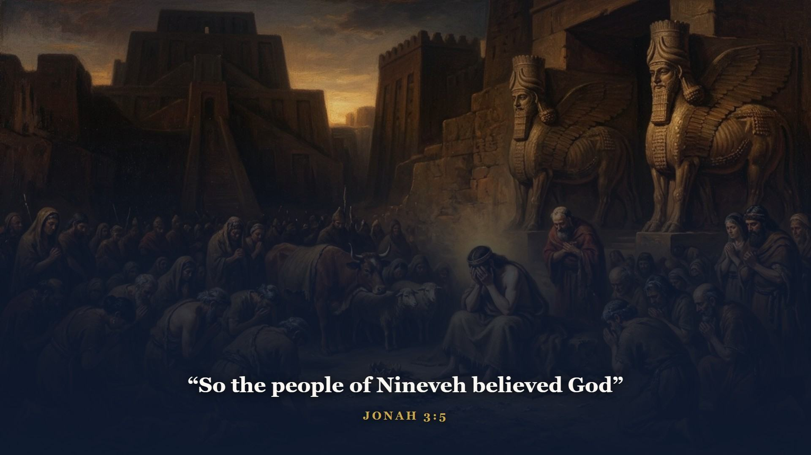
Notes:
Nineveh repented, king to cattle, and God spared them. The book ends with God gently schooling His pouting prophet: should not I spare Nineveh? God's heart for the outsider did not start in the New Testament.

Slide 13
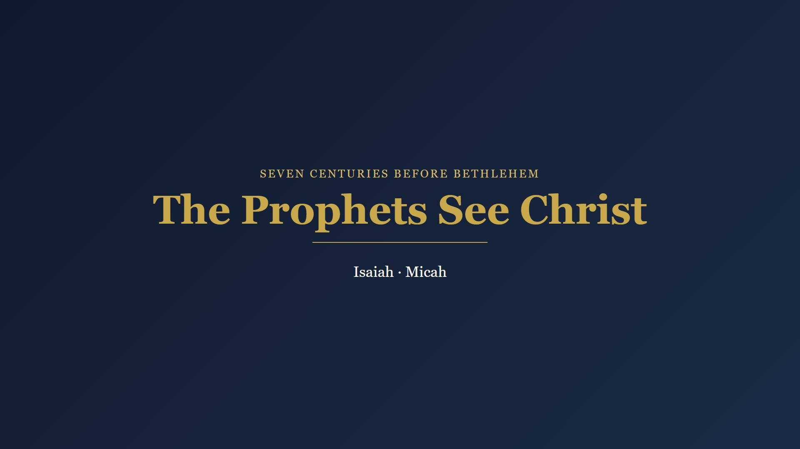
Notes:
Here is the astonishing thing about these men. While they prosecuted their own generation, God kept pulling their eyes up over the horizon - and what they saw, in detail, centuries ahead of time, was Christ.

Slide 14
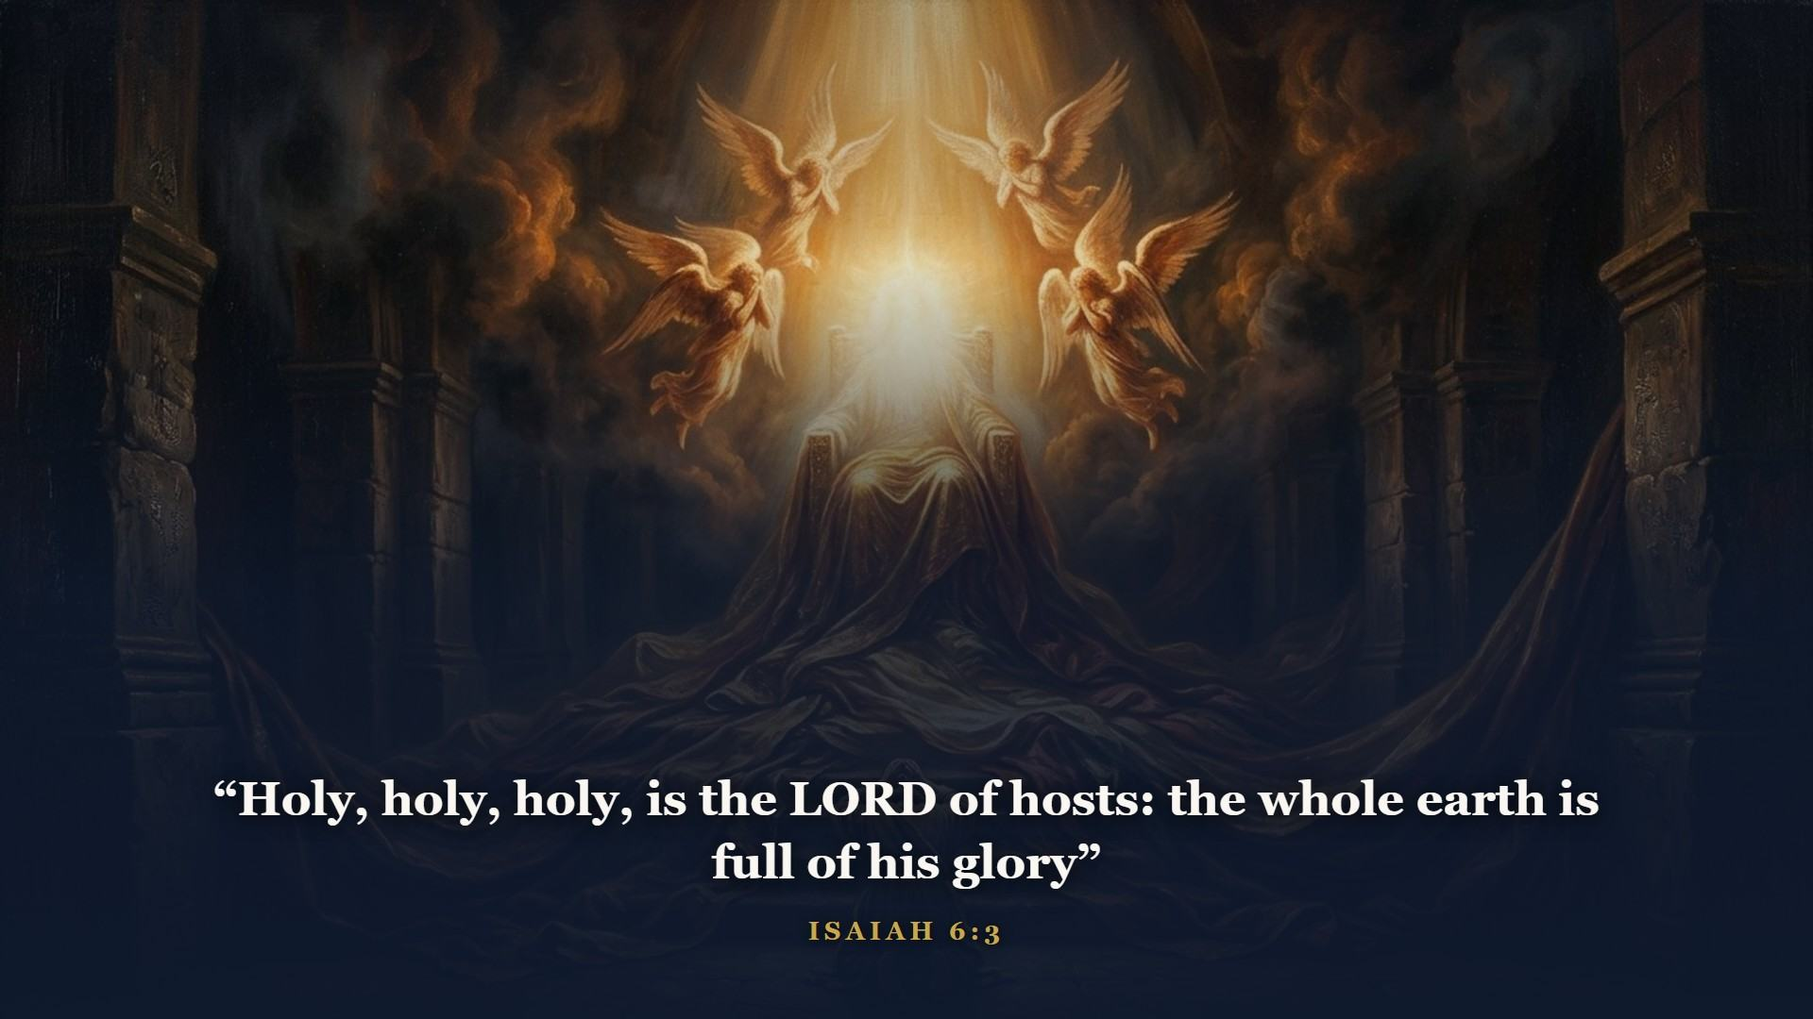
Notes:
Isaiah's call - the throne room itself. In the year that king Uzziah died. The posts of the door moved at the voice of him that cried, and the house was filled with smoke.

Slide 15
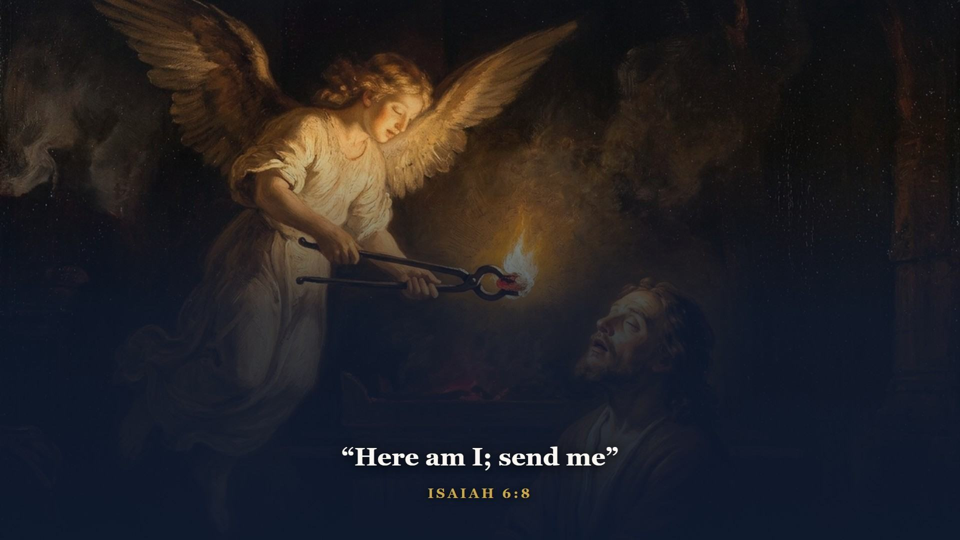
Notes:
Mark the order - it never changes: see God high and holy, see yourself undone, be cleansed from the altar, THEN be sent. Woe is me, for I am undone - a man of unclean lips. The coal came from the altar. Cleansing always does.

Slide 16
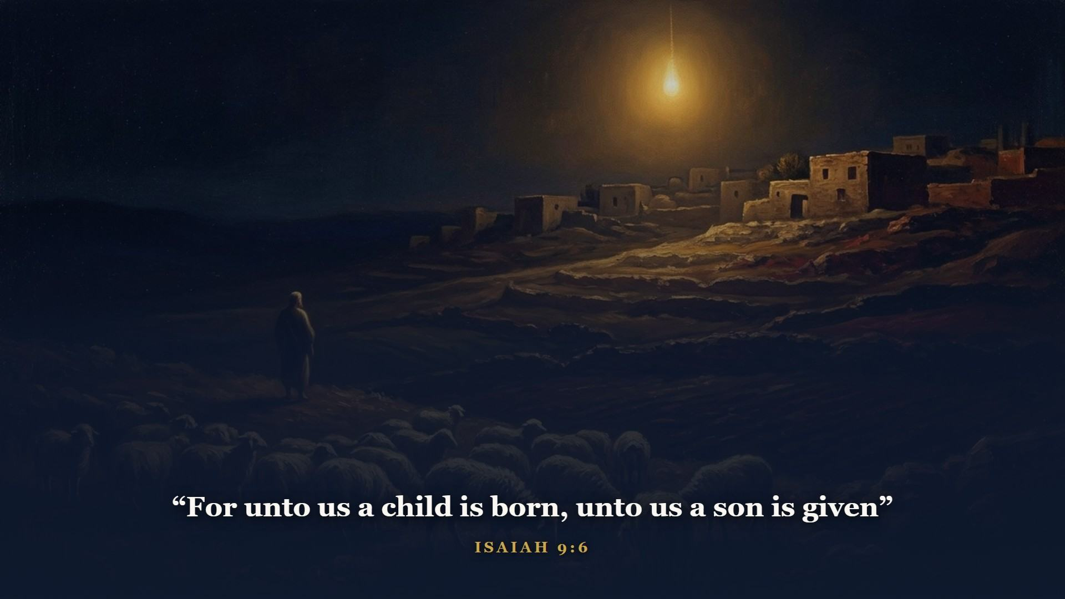
Notes:
A child BORN - His humanity. A son GIVEN - He already existed to be given. And His name: Wonderful, Counsellor, The mighty God, The everlasting Father, The Prince of Peace. Upon the throne of DAVID - there is 2 Samuel 7 again, the covenant compounding interest.

Slide 17
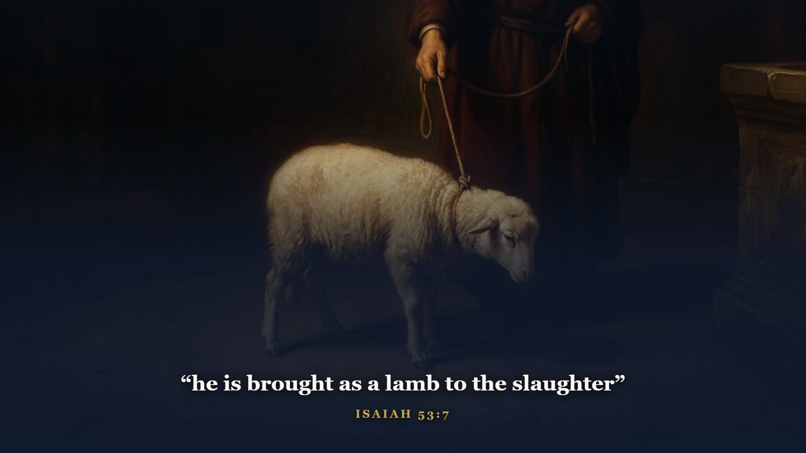
Notes:
Isaiah 53 - the high-water mark of Old Testament prophecy. The crucifixion written like an eyewitness account, seven centuries in advance. Wounded for our transgressions. Bruised for our iniquities. The LORD hath laid on him the iniquity of us all. There is the lamb of Exodus 12 and the ram of Genesis 22, given a face. When we stand at the cross next week, this chapter goes with us.

Slide 18
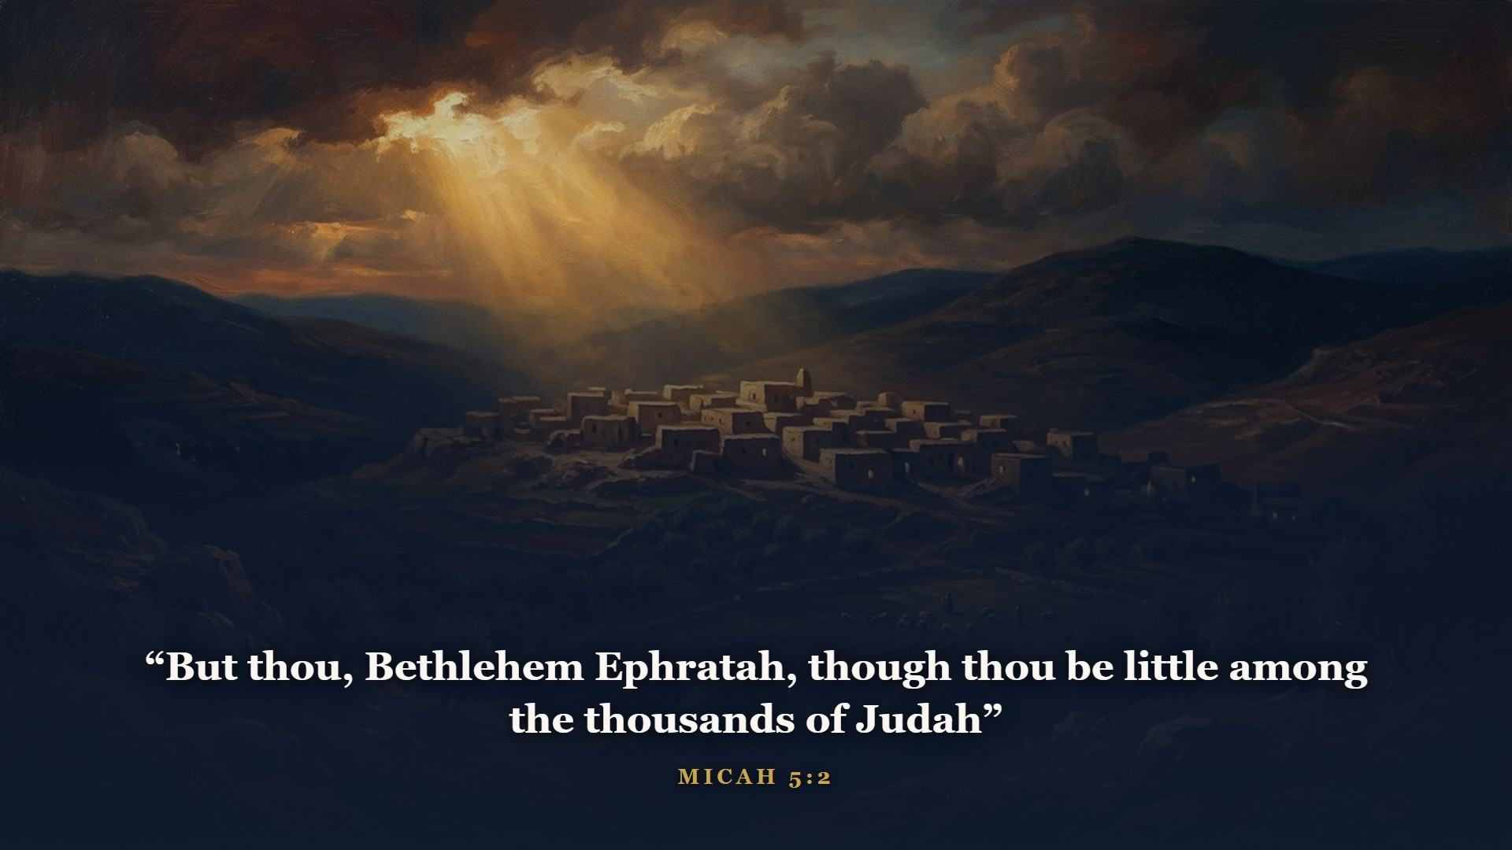
Notes:
Isaiah's contemporary Micah supplied the street address. Born in Bethlehem - yet His goings forth are from of old, from EVERLASTING. One verse, two natures: man and God.

Slide 19
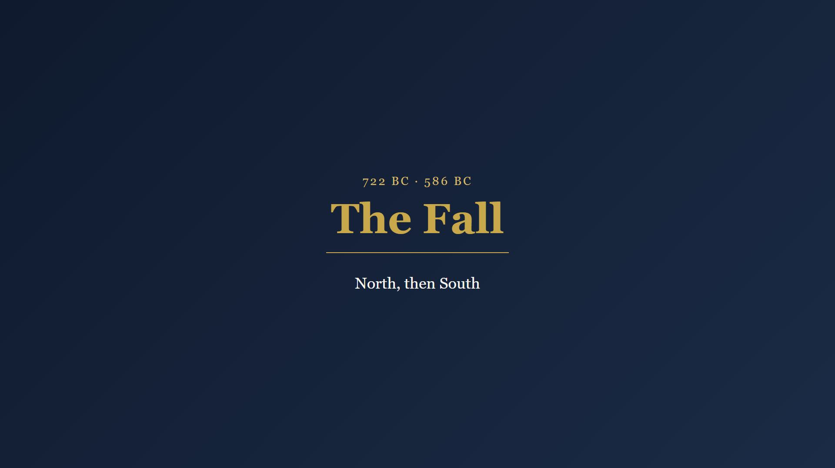
Notes:
The prophets warned, and the kings would not hear.

Slide 20
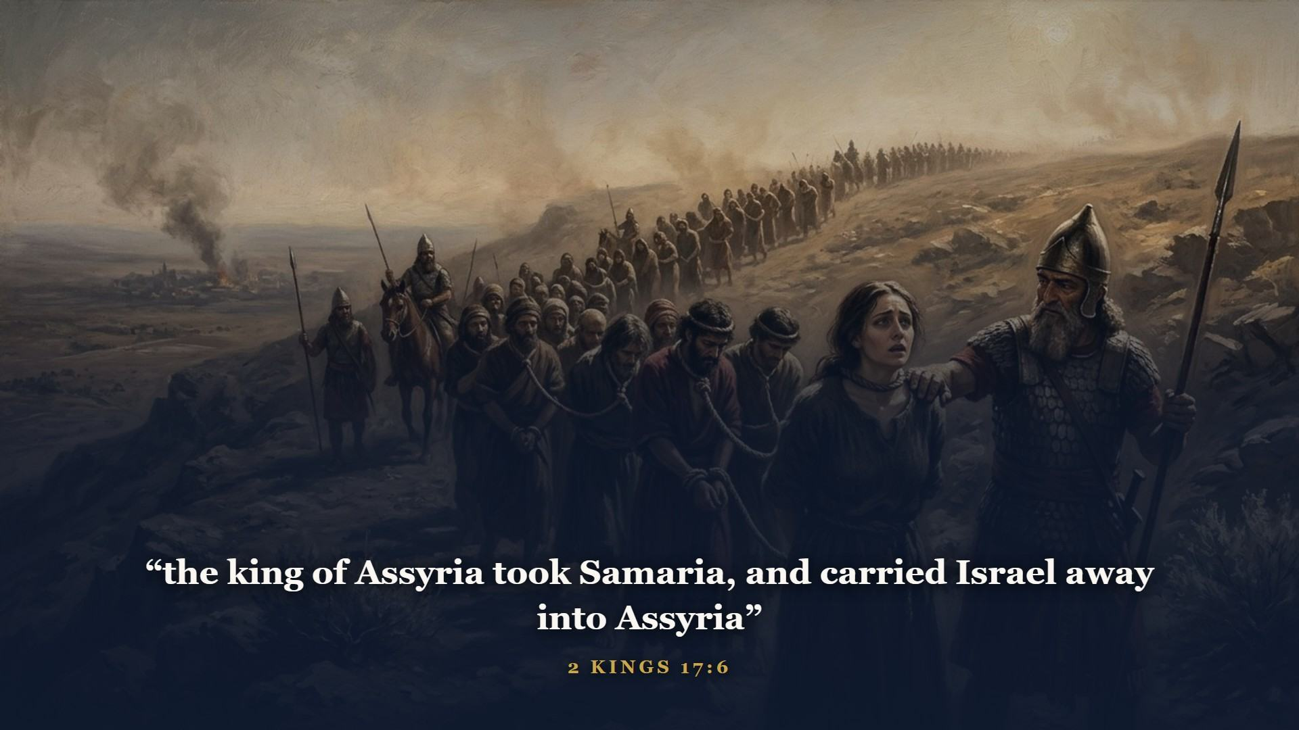
Notes:
722 BC. Assyria - the very empire Jonah preached to - swallowed the northern kingdom whole and scattered the ten tribes. The north never came home.

Slide 21
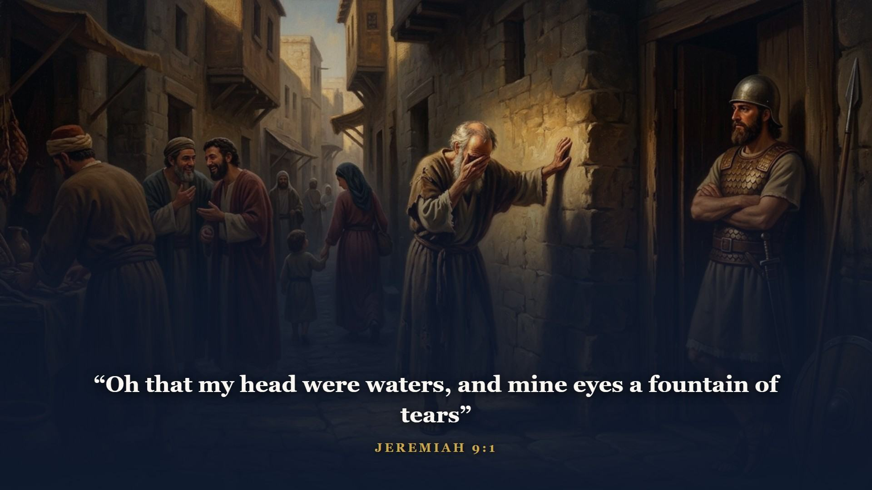
Notes:
Judah got another hundred and thirty-six years of mercy and spent most of them the same way. God raised up Jeremiah - the weeping prophet - to walk Jerusalem's streets for forty years, pleading with the city while invasion gathered like a storm out of the north.

Slide 22
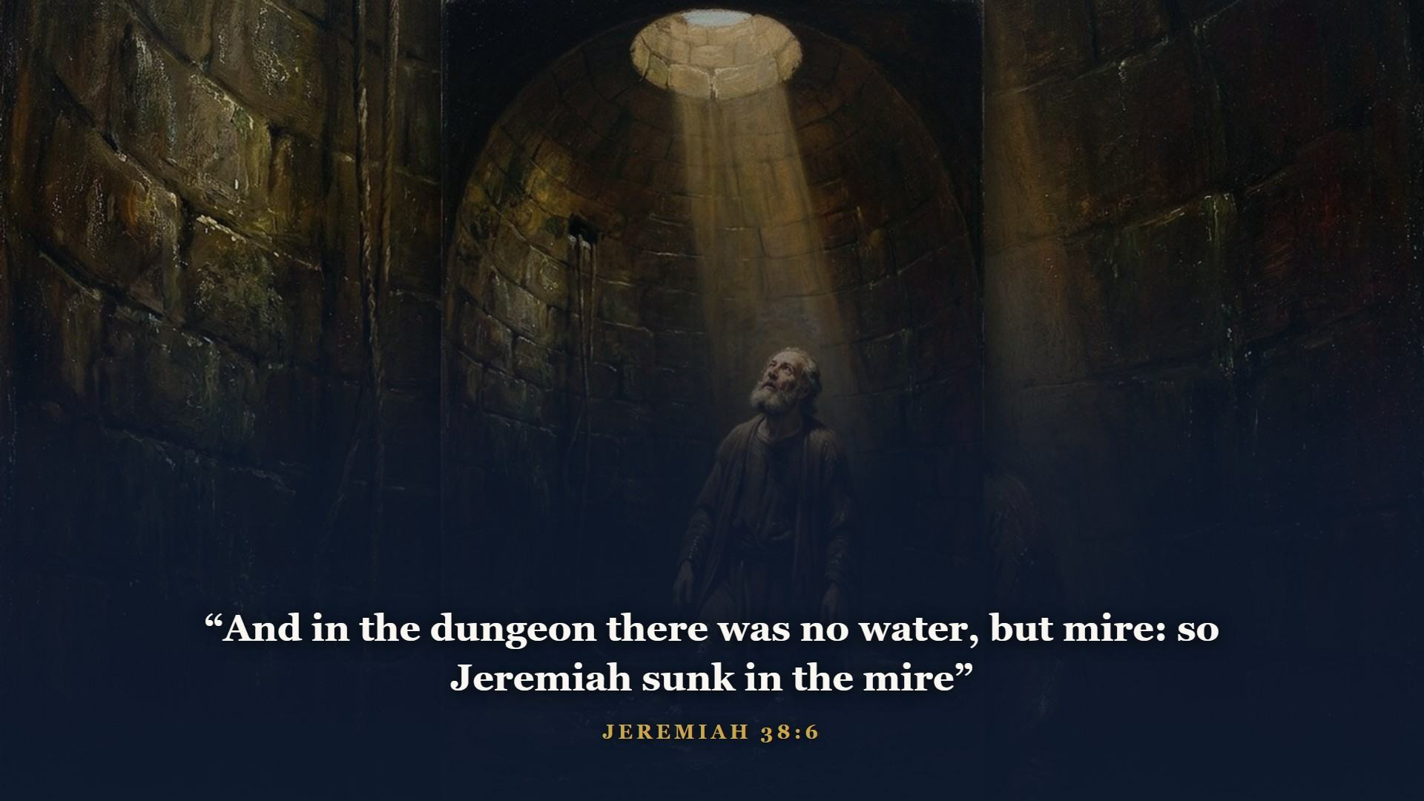
Notes:
They put him in the stocks. They threw him down a well. They sliced up his scroll with a penknife and burned it page by page. Faithfulness is not always rewarded in this life.

Slide 23
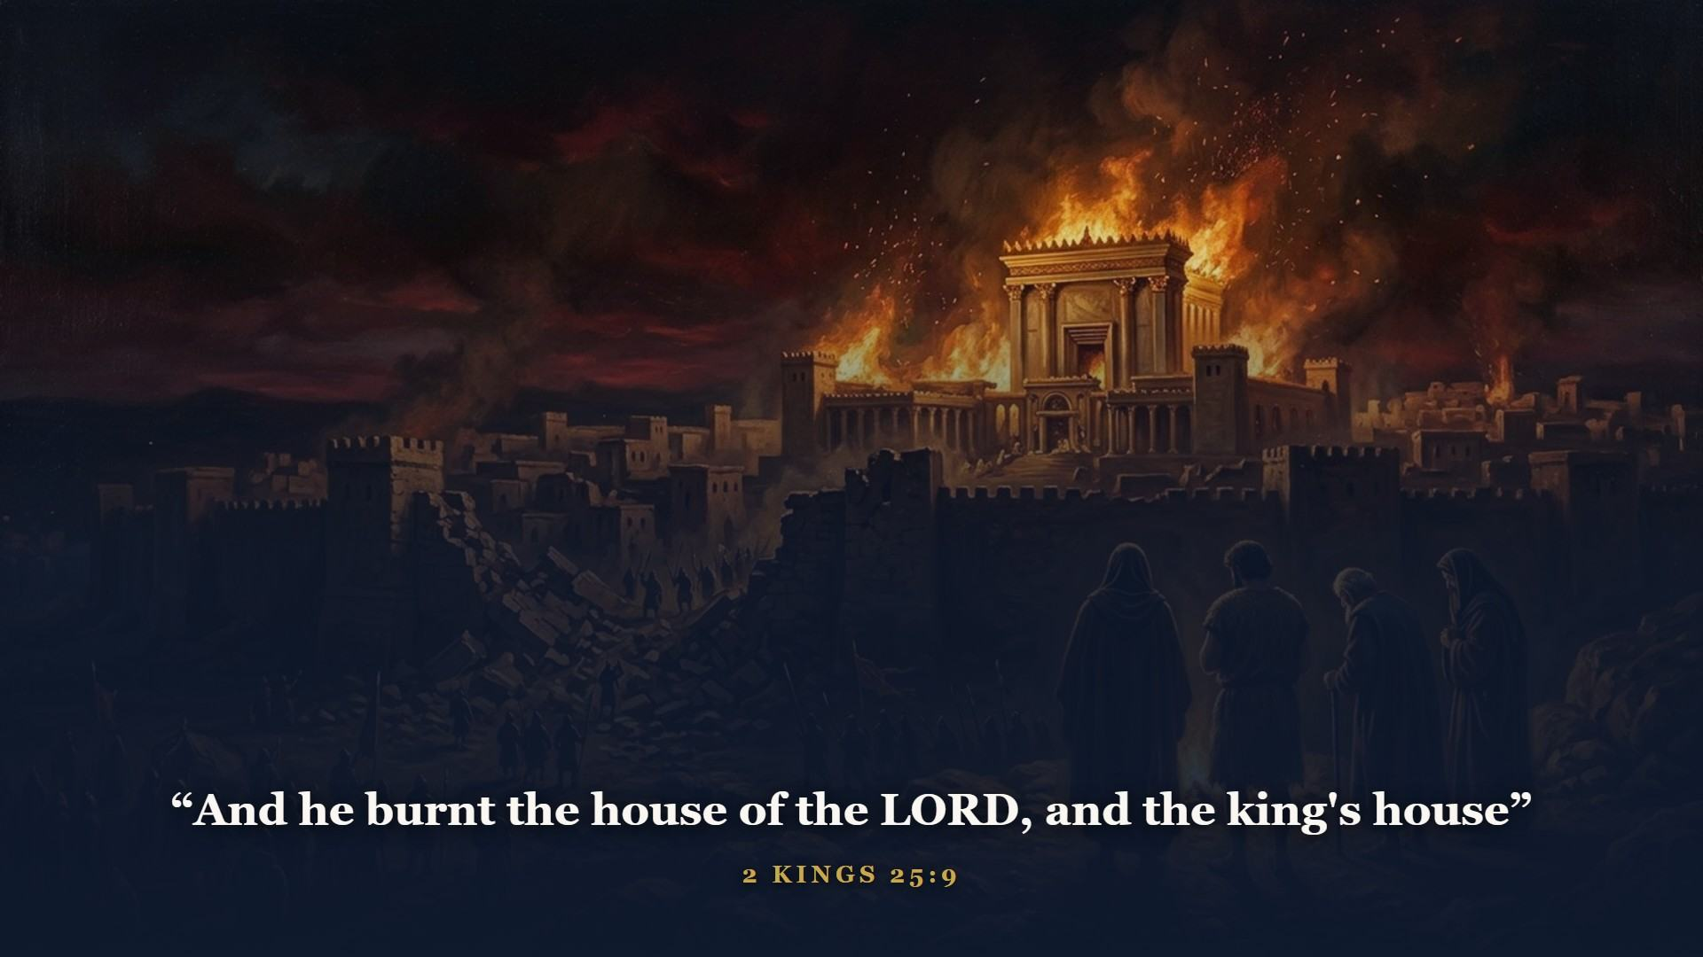
Notes:
586 BC. Nebuchadnezzar breached the walls, burned the temple Solomon built, put out King Zedekiah's eyes, and marched Judah into exile in chains. The unthinkable: no land, no temple, no throne. Had God's promise failed?

Slide 24
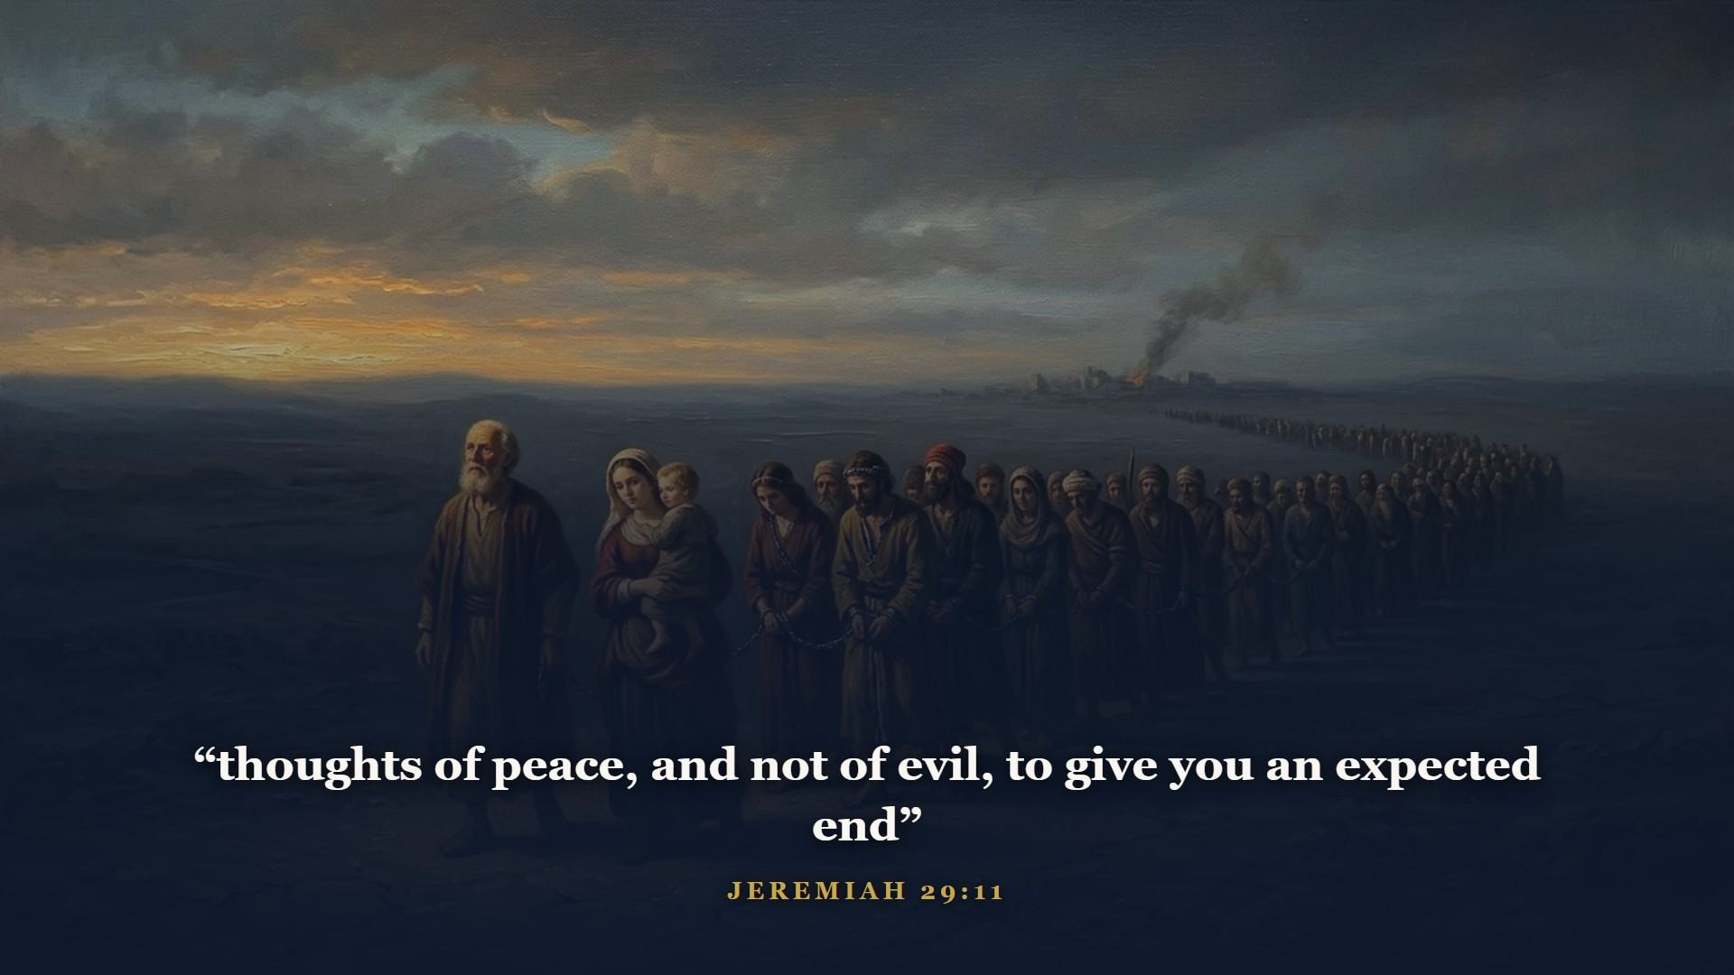
Notes:
Listen to what God sent the exiles by the hand of that same Jeremiah - a letter to broken people in a foreign land. Thoughts of peace, and an expected end - spoken into the rubble. Judgment, with the prophets, is NEVER the last word.

Slide 25
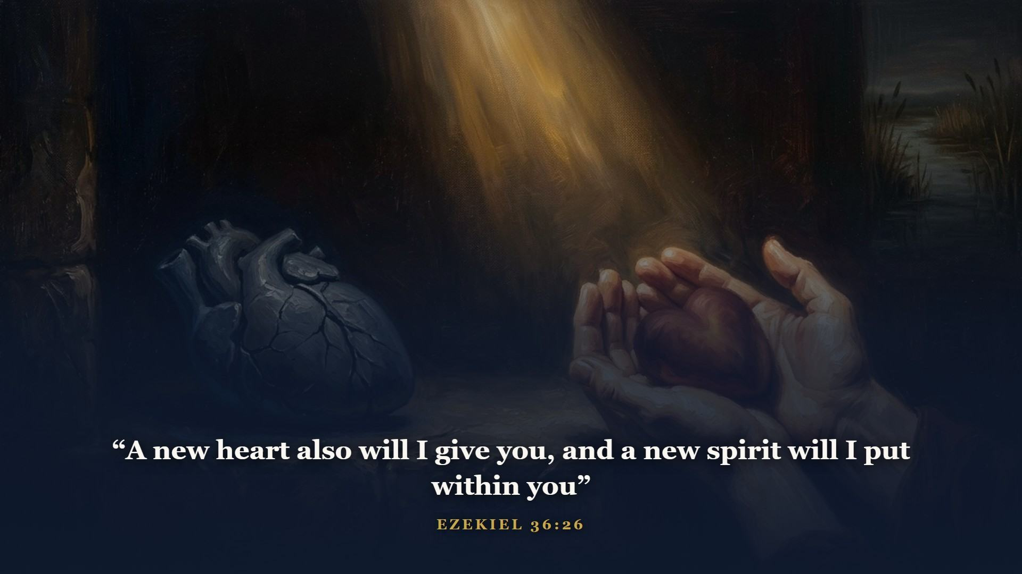
Notes:
Out among the exiles by the river Chebar, God showed Ezekiel what He intended to do about the deepest problem of all - not Israel's geography, but Israel's heart. A new heart. Not a patched one. Law said DO; this promise says I WILL DO. Remember this when Jesus tells a religious leader: ye must be born again.

Slide 26

Notes:
Meanwhile, in the palace at Babylon, a young Judean captive was given the master key to the rest of world history.

Slide 27
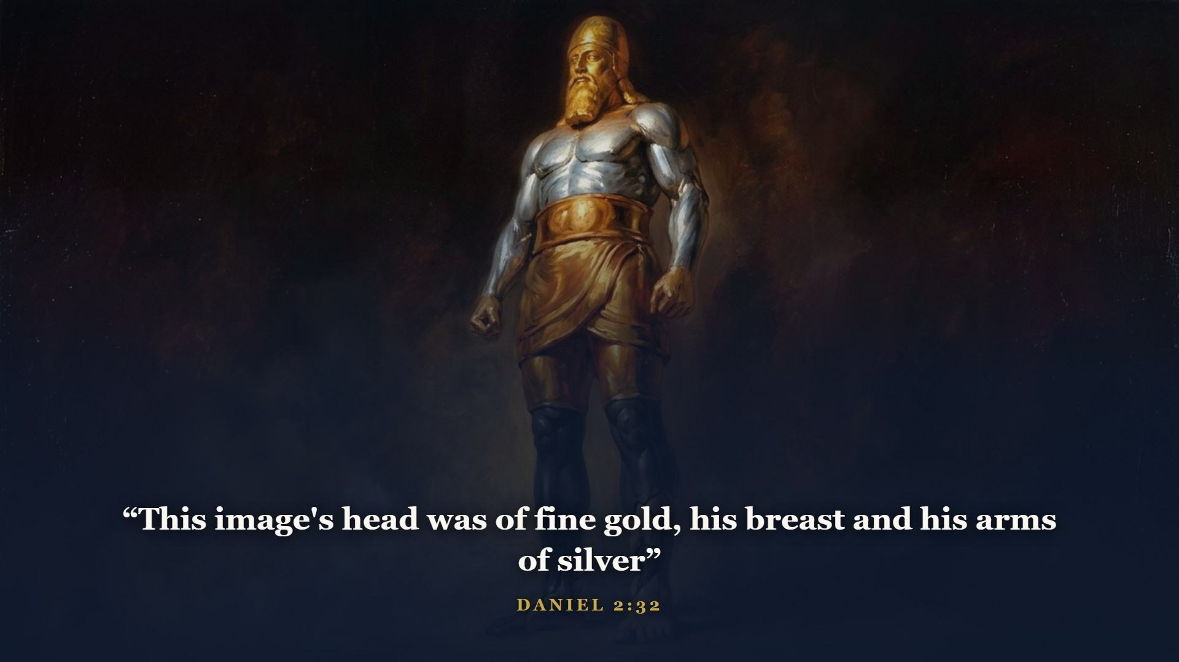
Notes:
One statue, four metals, four empires IN ORDER. The head of gold is Babylon - Daniel says so to the king's face, thou art this head of gold. The silver, Medo-Persia, which took Babylon in a night. The brass, Greece under Alexander. The iron legs, Rome. And iron mixed with clay in the feet - a final fractured form still ahead.

Slide 28
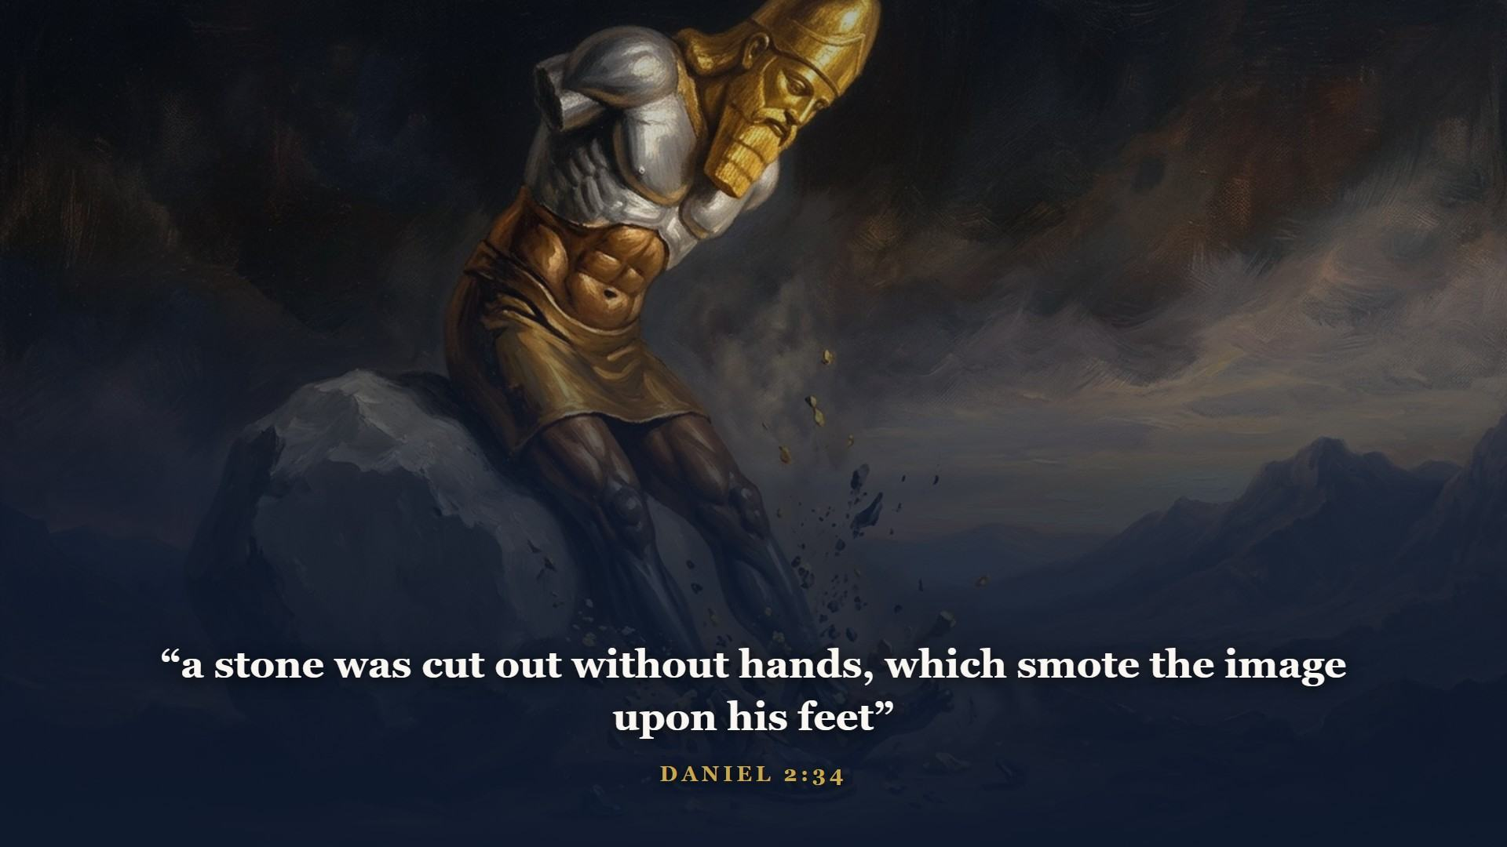
Notes:
This whole stretch - Gentile empires holding power over Jerusalem - is what the Bible calls the times of the Gentiles. And hear this: WE ARE STILL LIVING IN THE DAYS OF THAT STATUE. The stone cut out without hands, a kingdom not built by man, has not struck yet. When Class 5 opens Revelation we are simply watching that stone fall. This one prophecy welds your Bible's end to its middle.

Slide 29
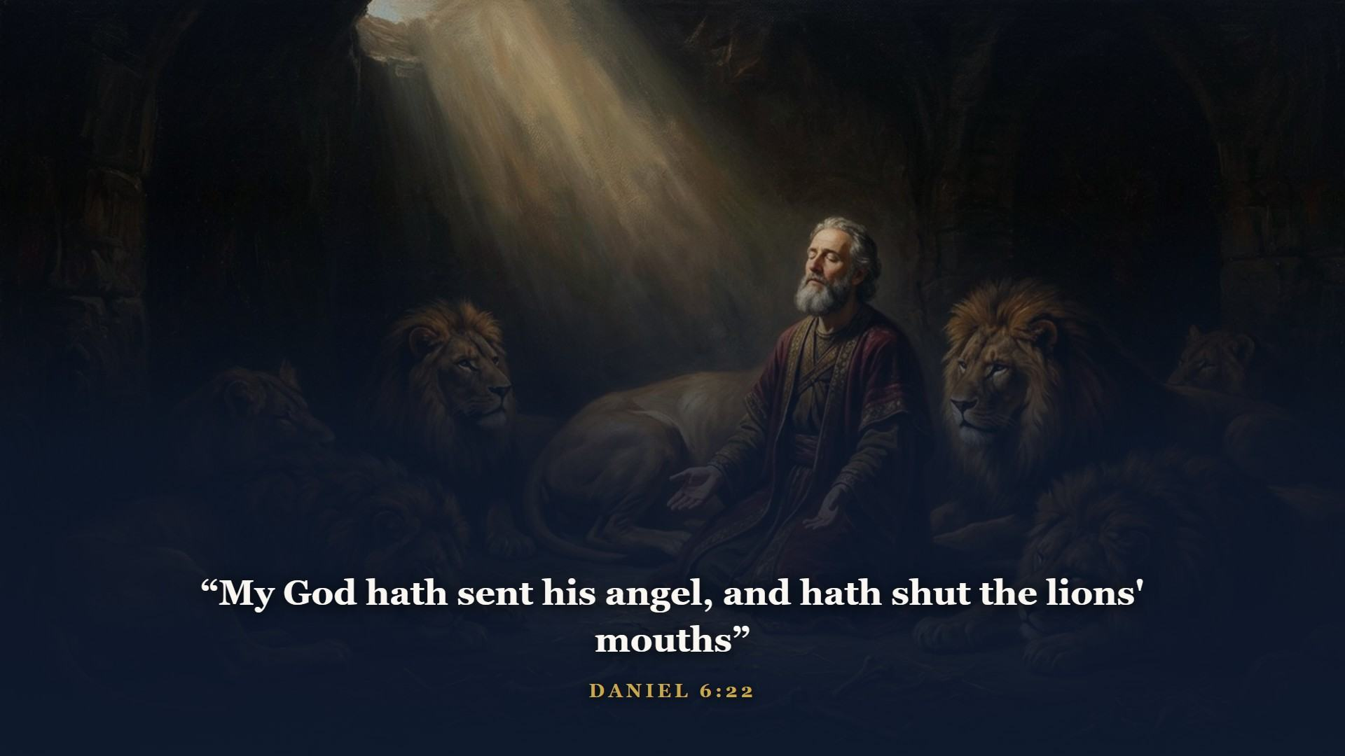
Notes:
Kosher in the king's court as a young man, faithful in the lions' den decades later. Daniel outlasted the empire that captured him.

Slide 30
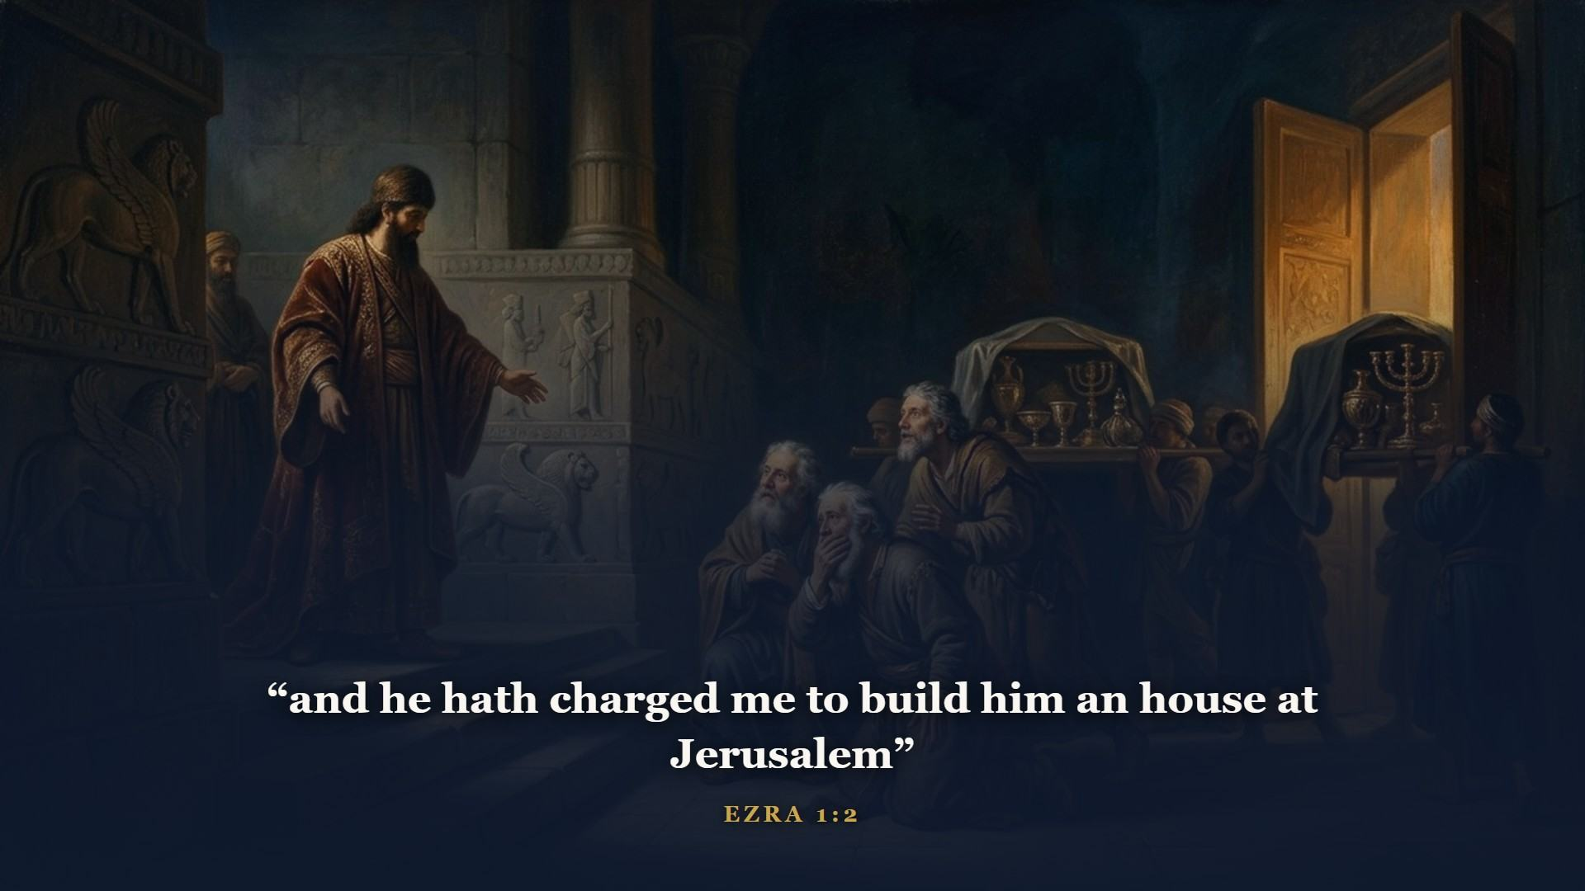
Notes:
Babylon fell to Persia right on schedule, and God stirred the spirit of Cyrus to do what no empire did: send captives HOME, with funding, to rebuild their God's house. Isaiah had named Cyrus in writing more than a century before he was born - look up Isaiah 44:28 this week. About fifty thousand went back with Zerubbabel.

Slide 31
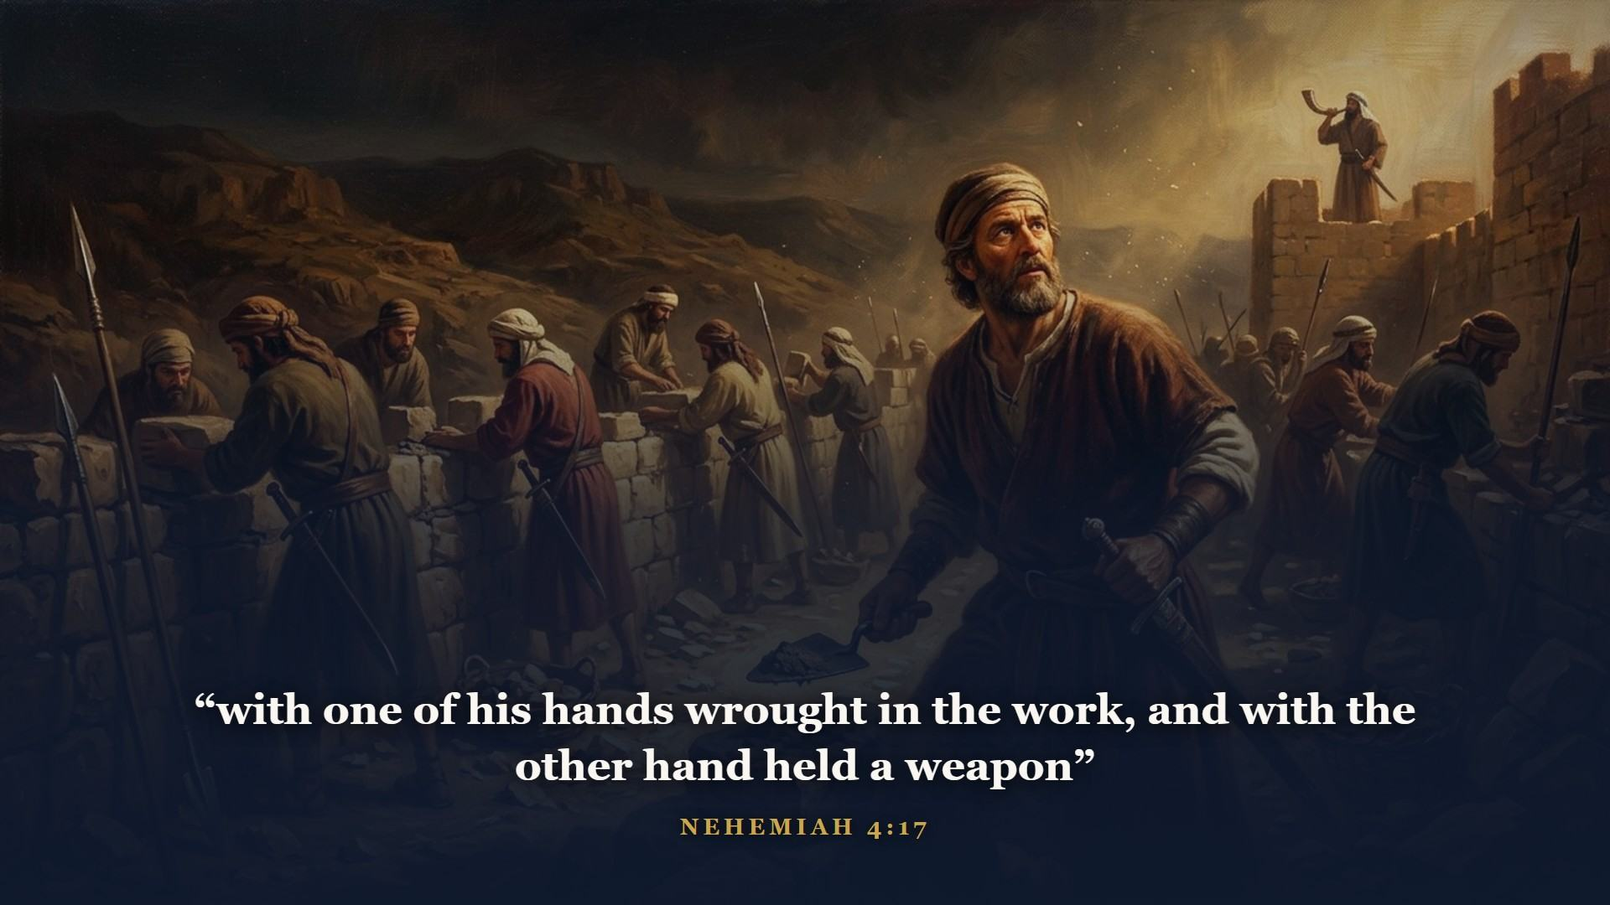
Notes:
Haggai kicked the stalled temple project back to life. Nehemiah rebuilt Jerusalem's walls in fifty-two days with a trowel in one hand and a sword in the other.

Slide 32
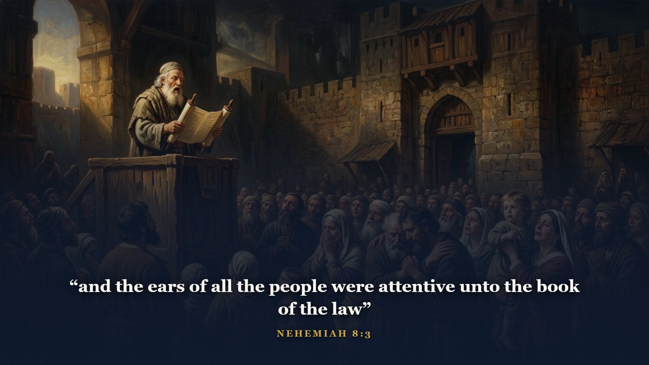
Notes:
When Ezra opened the law before the water gate and read it aloud, the whole nation stood up and wept in the street. Revival, every time it has ever come, has come exactly that way: the Book, opened, read, and received.

Slide 33
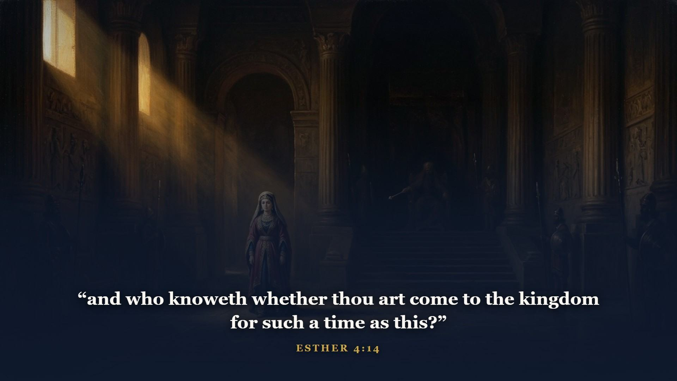
Notes:
And those who never came home? Esther shows God minding His scattered people in Persia - a Jewish orphan girl raised to the queen's crown just in time to stand between her nation and a genocide. Esther is the one book in your Bible that never names God, and THAT is the sermon: even where His name is hidden, His hand never is.

Slide 34
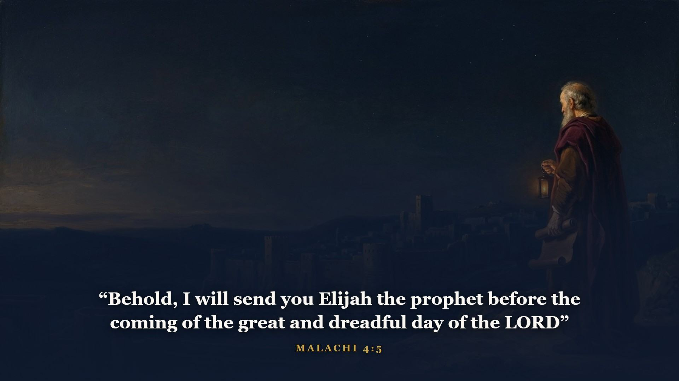
Notes:
The last prophet leaves Israel waiting on a final promise - and notice whose name it leans on. Then FOUR HUNDRED YEARS with no prophet's voice. But God's hand kept moving the furniture: Persia gave way to Greece, giving the world one common language - Greek, the language of your New Testament. Greece gave way to Rome, which built the roads the gospel would travel and the peace it would travel under. The silence was not absence. It was a stage being set.

Slide 35
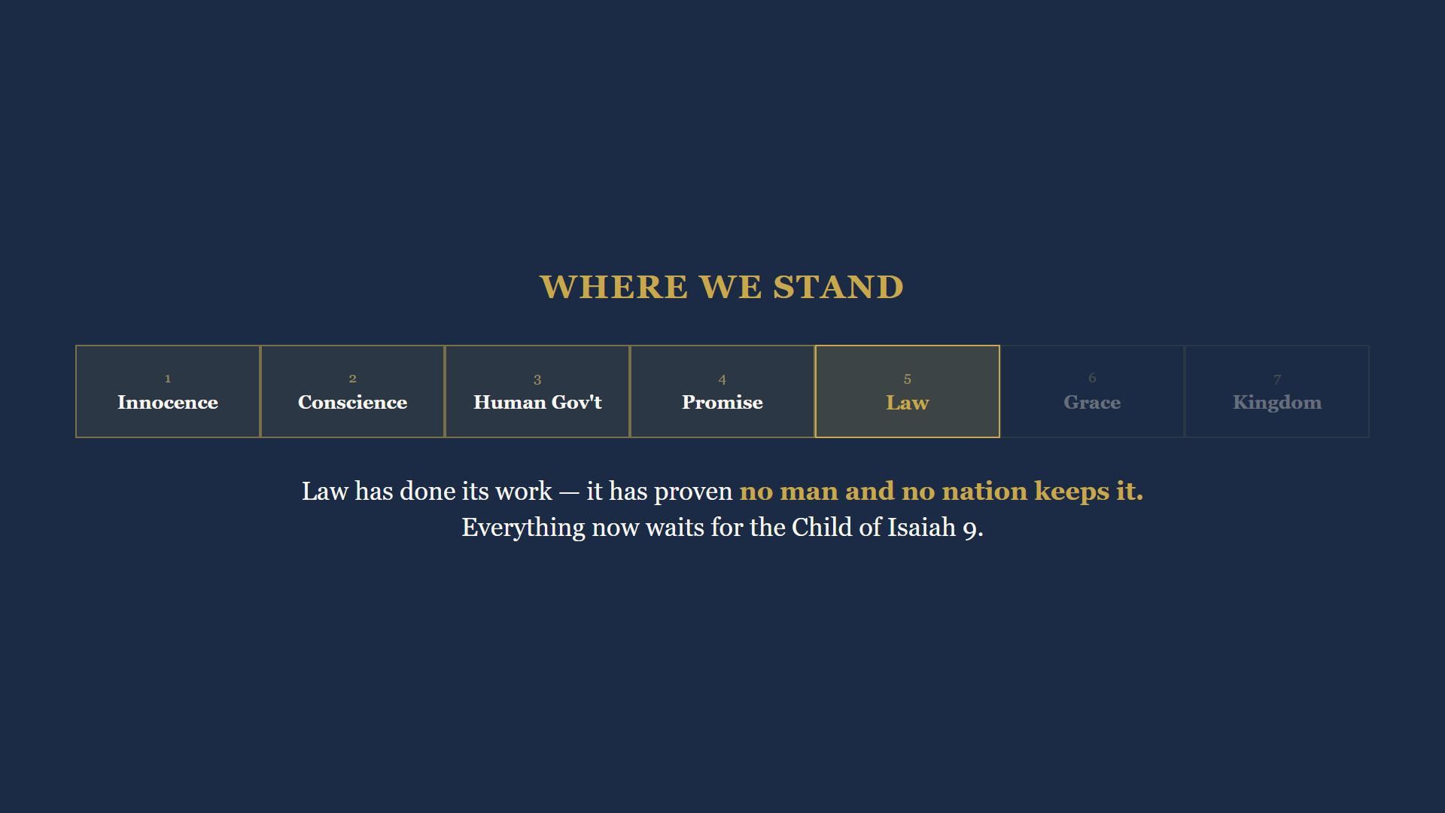
Notes:
Six hundred years in thirty minutes. The age of Law has done its work - it has proven, from palace to plow, that no man and no nation keeps it. Everything now waits for the Child of Isaiah 9, the Sufferer of Isaiah 53, born in Micah's Bethlehem.

Slide 36
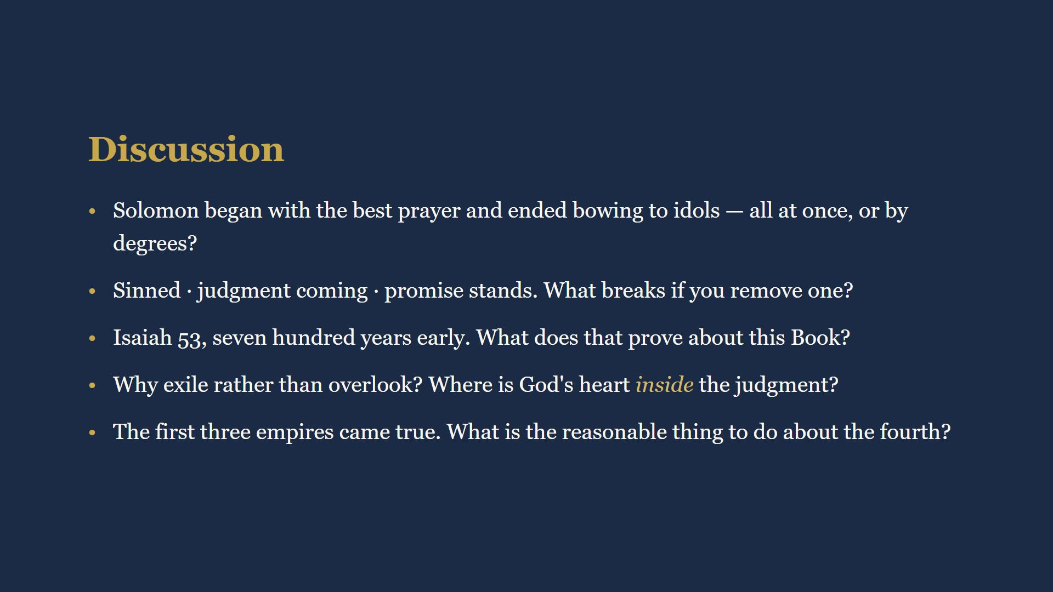
Notes:
15 minutes. Full wording in their workbooks. Q1: hearts turn by degrees, not all at once. Q2: remove any rail and the message becomes despair, or license, or sentiment. Q3: fulfilled prophecy is evidence you can check. Q4: exile was surgery, not abandonment. Q5: if three empires rose and fell exactly as written, believe the part that has not happened yet.

Slide 37
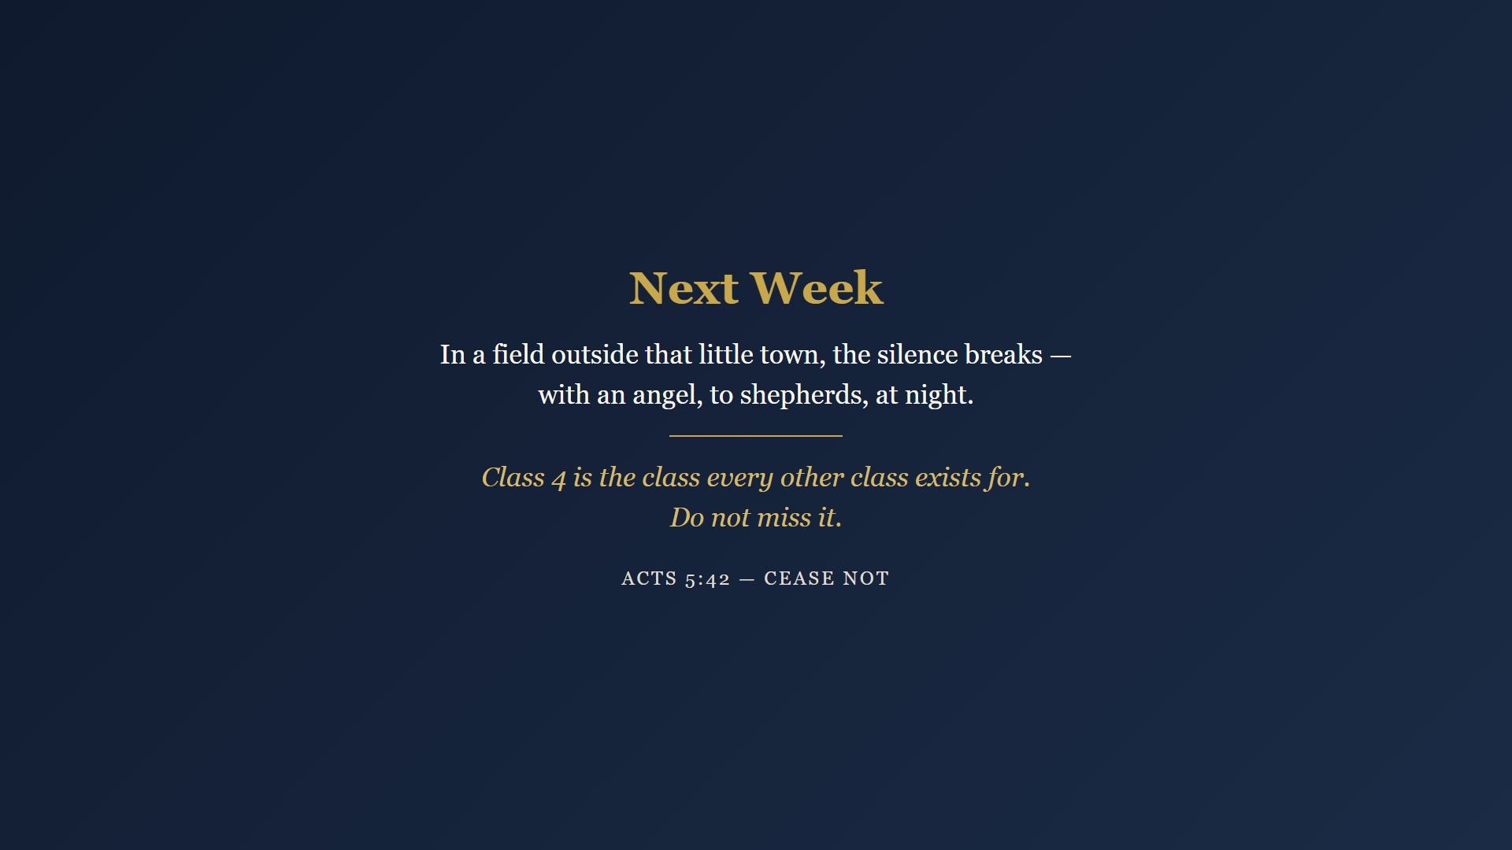
Notes:
Six days through six centuries. Day 4 is short on minutes and heavy on glory - Isaiah's throne room, the Child with four names, the Branch, the suffering Servant, and Psalm 22 beside it. Read it slowly, out loud if you can. Next week is the class every other class exists for. Closing prayer.

