Slide 1
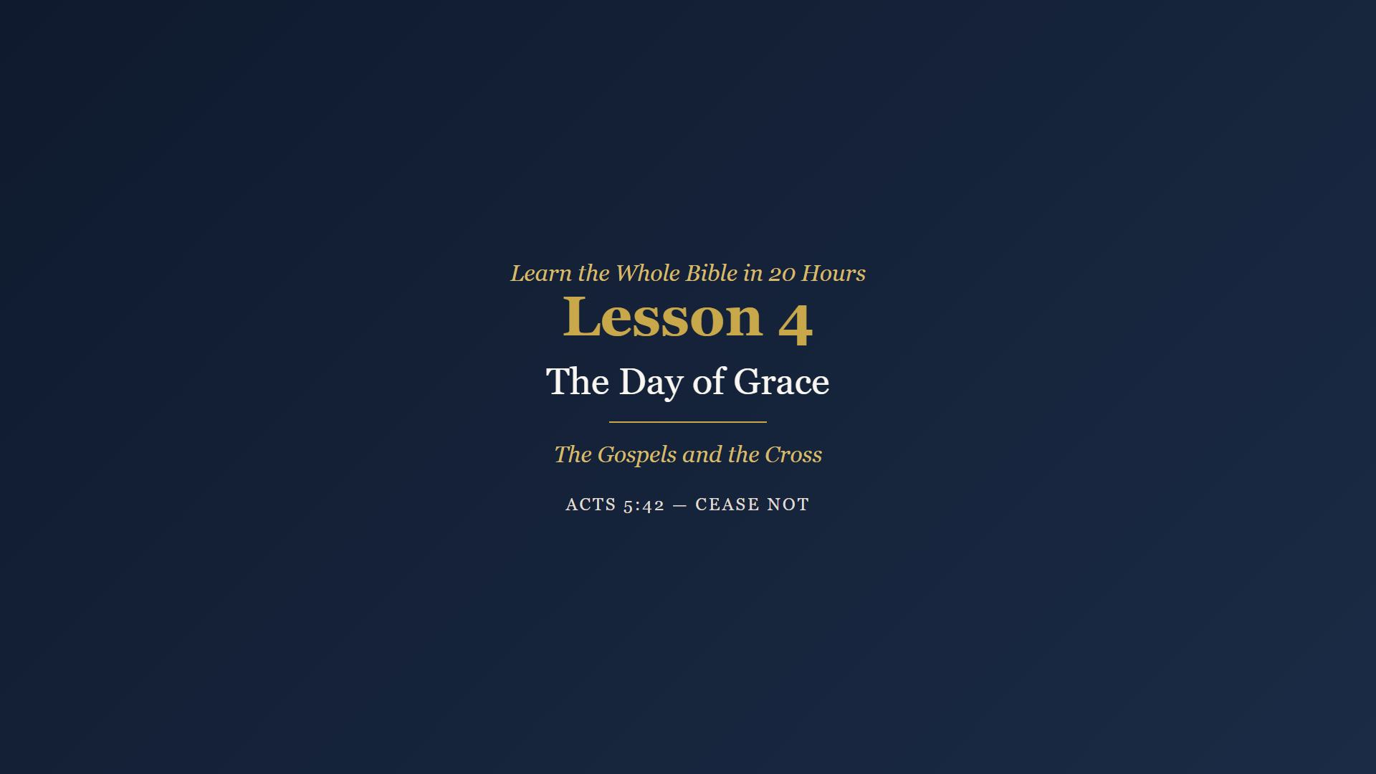
Notes:
Welcome. Review Week 3 - ask: what detail in Isaiah 53 or Psalm 22 surprised you most, knowing when it was written? Then pray. Today is the hinge of the whole Bible and of this course.

Slide 2
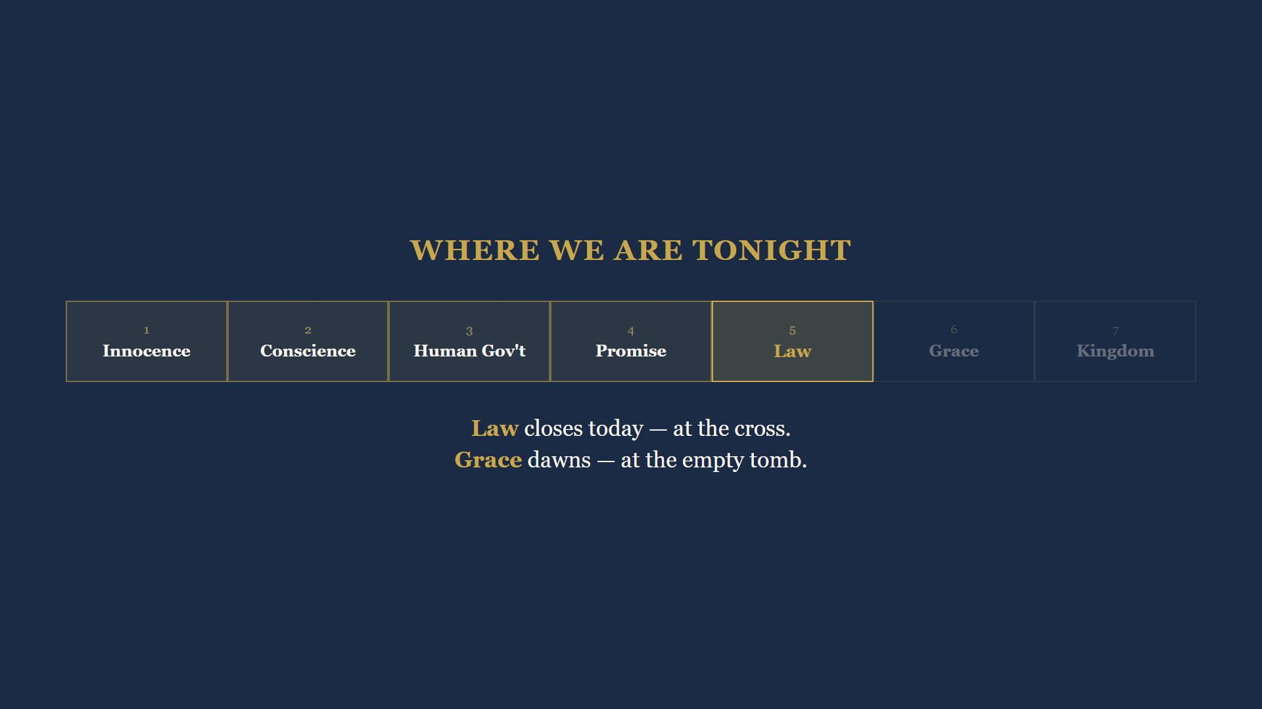
Notes:
Today is the hinge. Every road we have walked leads to this class. Law closes at the cross. Grace dawns at the empty tomb. Two boundaries in one lesson - it is the only class that does that.

Slide 3

Notes:
Four hundred years without a prophet. Then an angel tells an old priest his barren wife will bear a son - the Elijah-voice Malachi promised. Six months later Gabriel stands before a virgin in Nazareth.

Slide 4
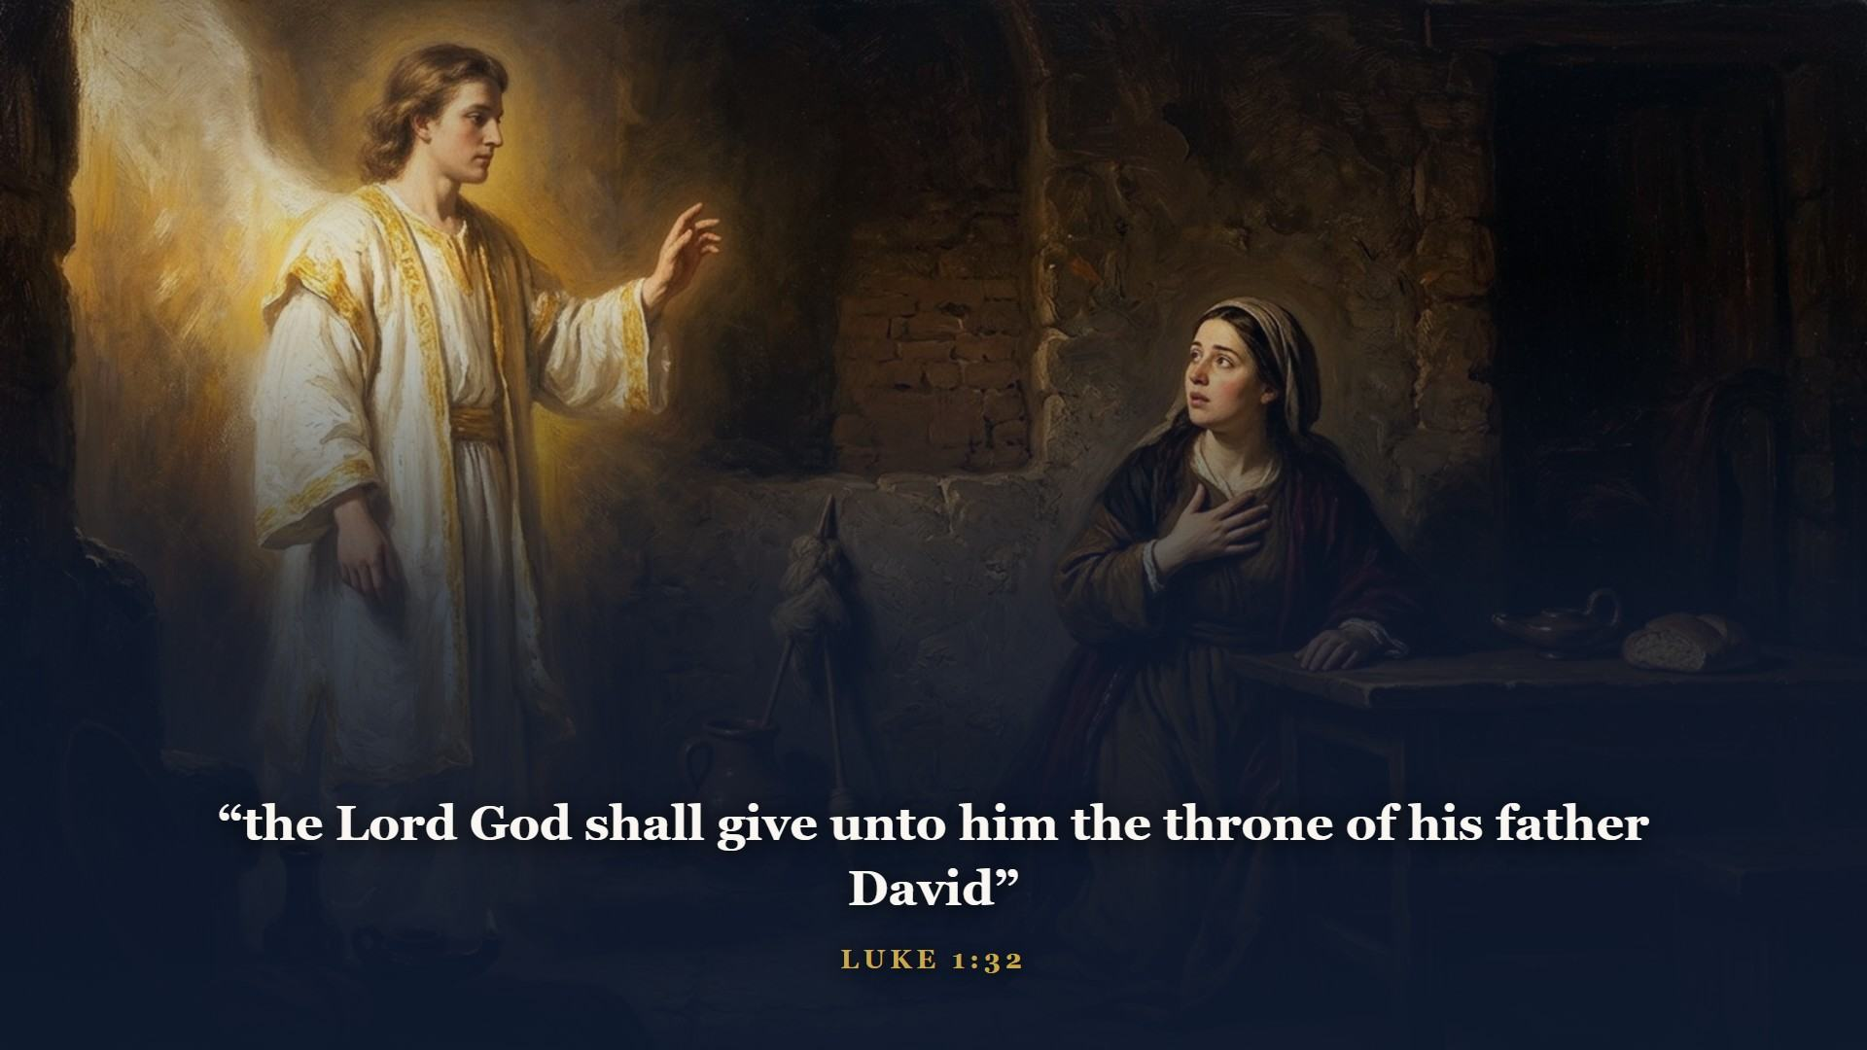
Notes:
Gabriel's words are stitched straight out of 2 Samuel 7. The Seed of the woman, the Seed of Abraham, the Son of David - every promise we have tracked for three classes, arriving in person.

Slide 5
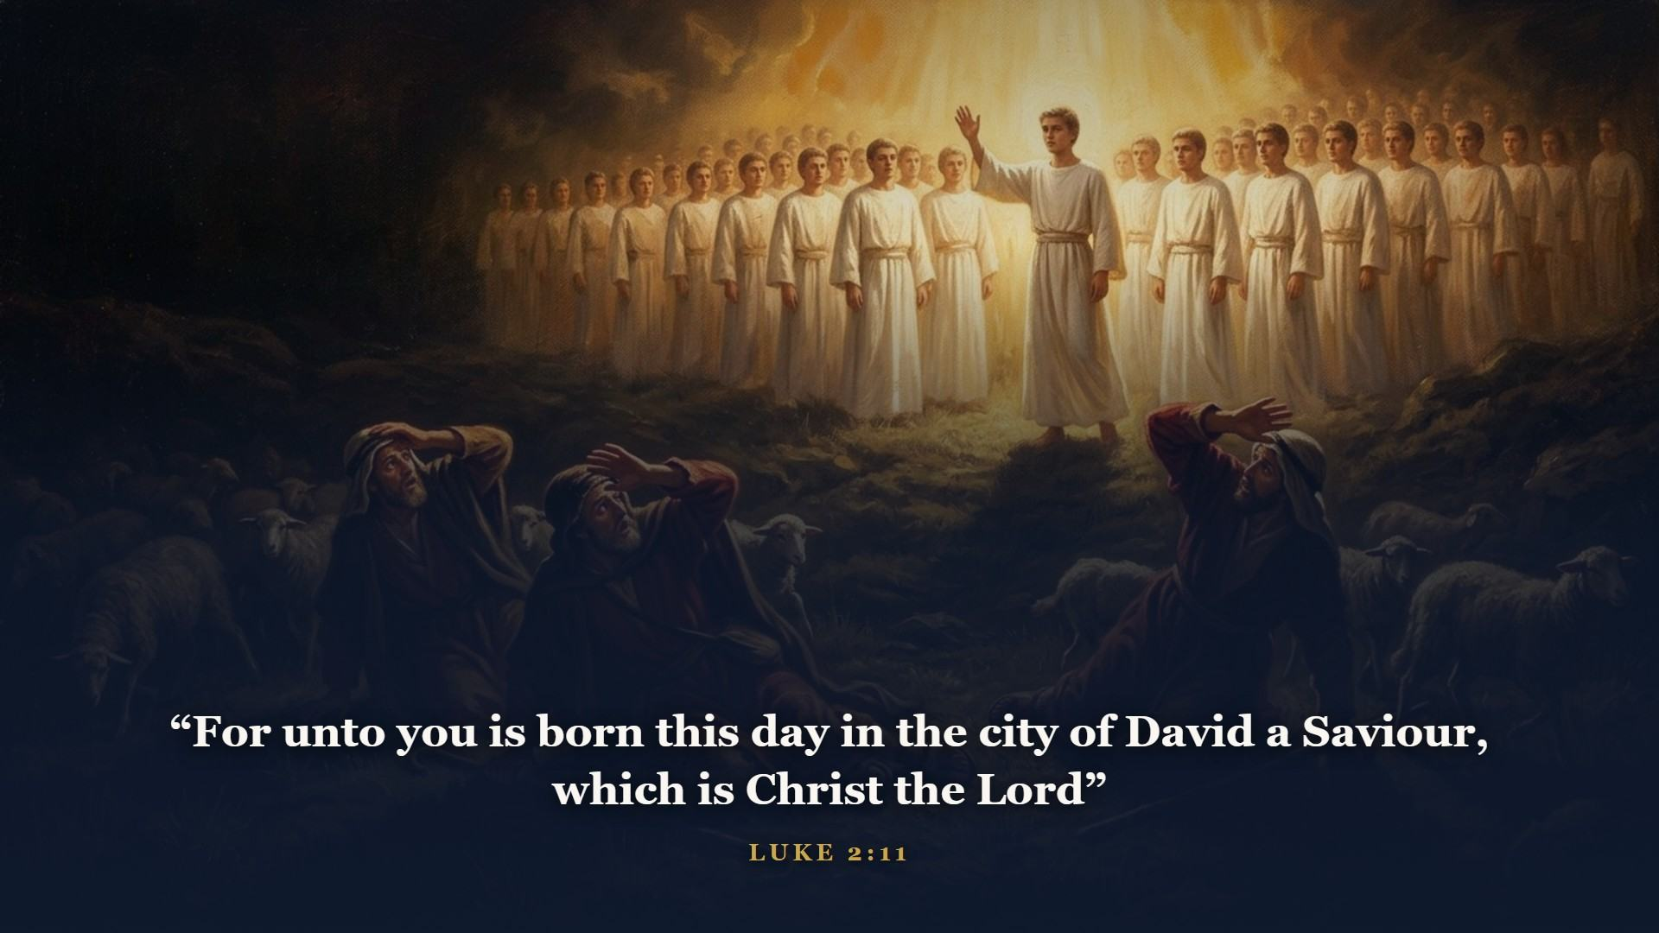
Notes:
Heaven could not keep quiet about it - and not to kings. To working men on a night shift. A SAVIOUR, that is His job. CHRIST, that is His office, the Anointed One. THE LORD, that is His identity. One verse, the whole announcement.

Slide 6
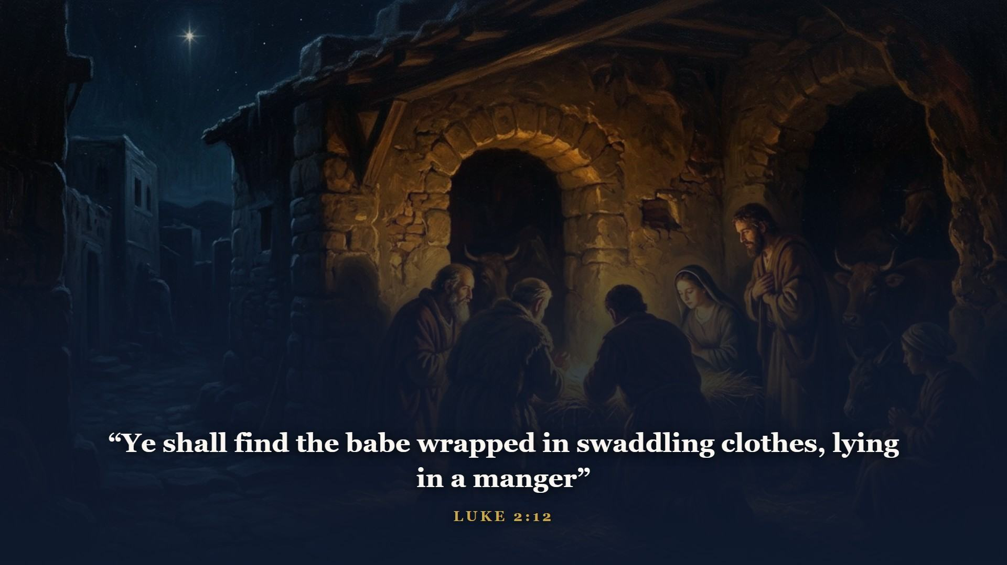
Notes:
In the city of David - Bethlehem, just as Micah wrote seven hundred years earlier.

Slide 7
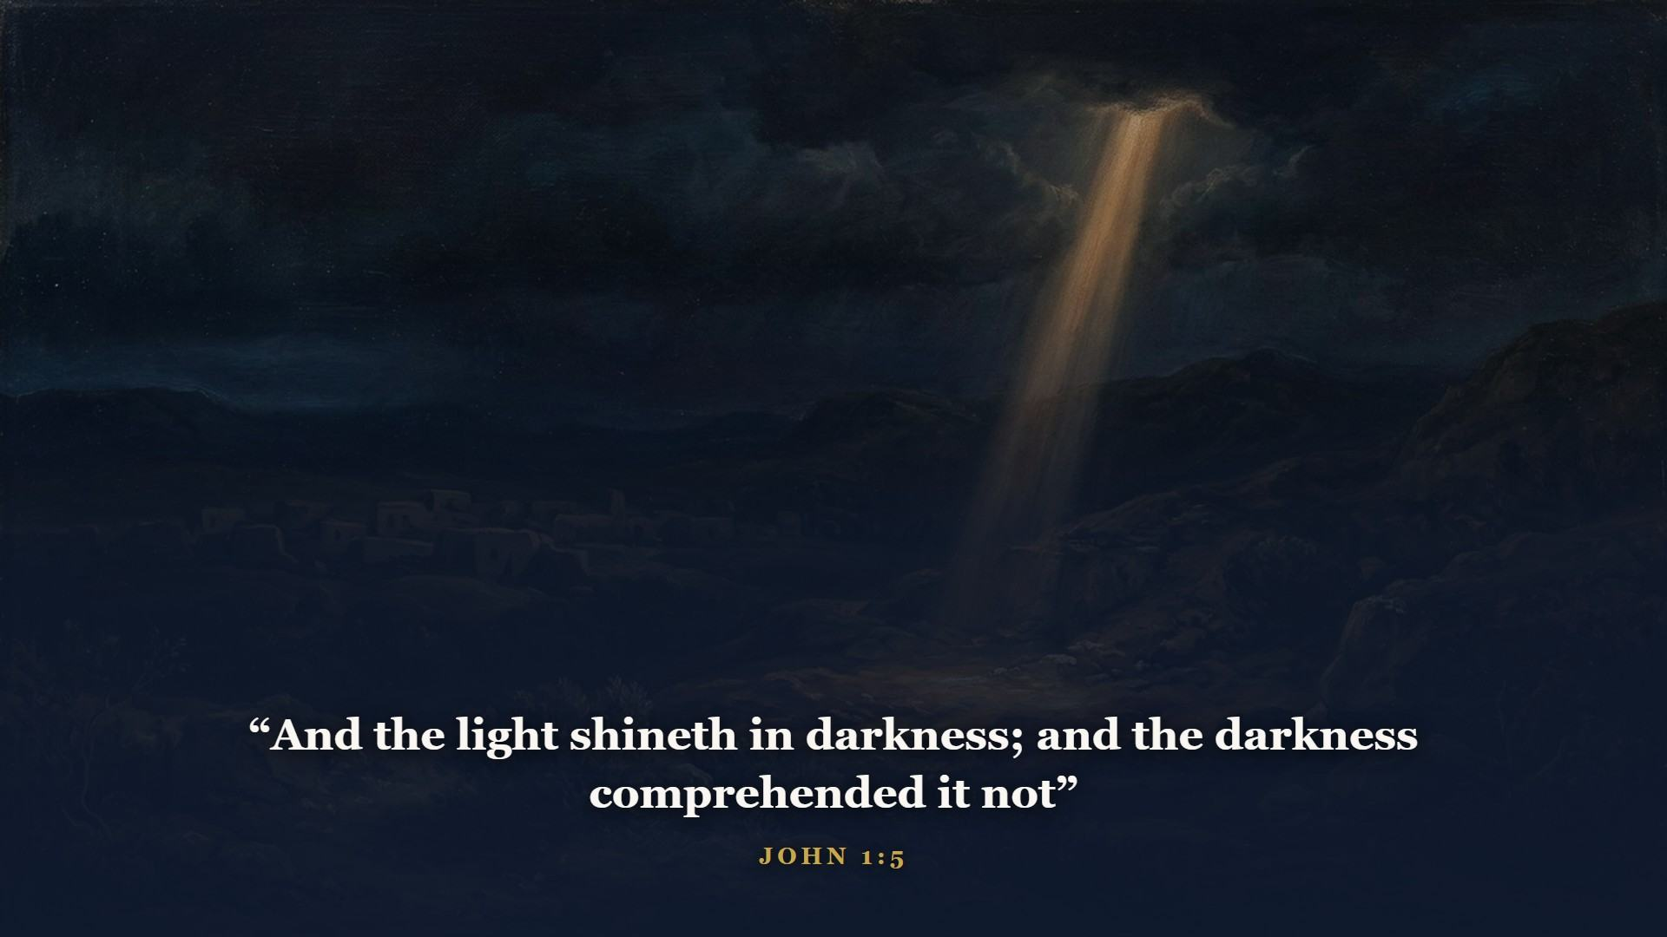
Notes:
But who exactly was lying in that manger? John pulls the camera all the way back - past Bethlehem, past Genesis 1:1. In the beginning was the Word, and the Word was with God, and the Word WAS God.

Slide 8
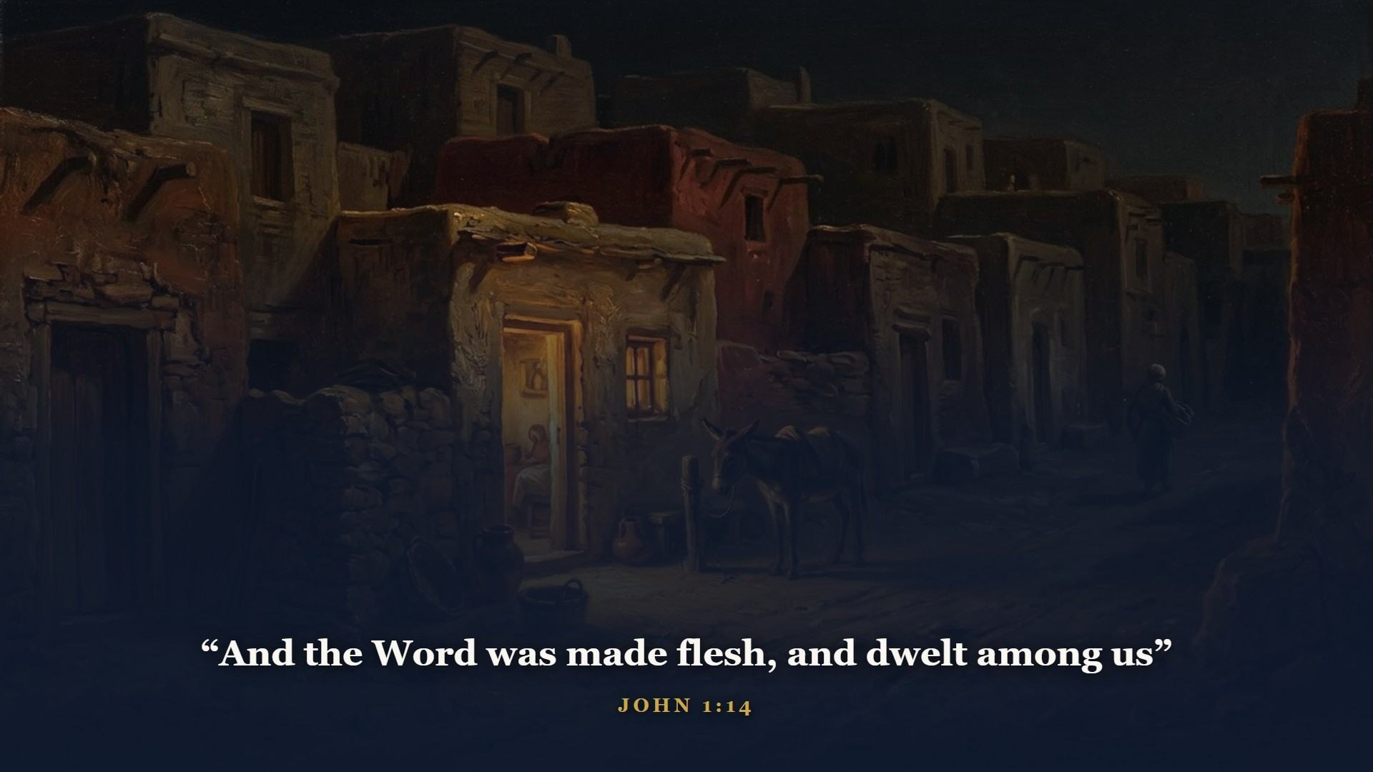
Notes:
The Creator of Genesis 1 took on a body in Bethlehem. The God who walked in Eden came down to walk dusty Galilee roads. And DWELT carries the idea of TABERNACLED - pitched His tent. There is the tabernacle of Class 2, fulfilled in a Person. Four Gospels, four portraits: Matthew the King, Mark the Servant, Luke the Son of man, John the Son of God.

Slide 9
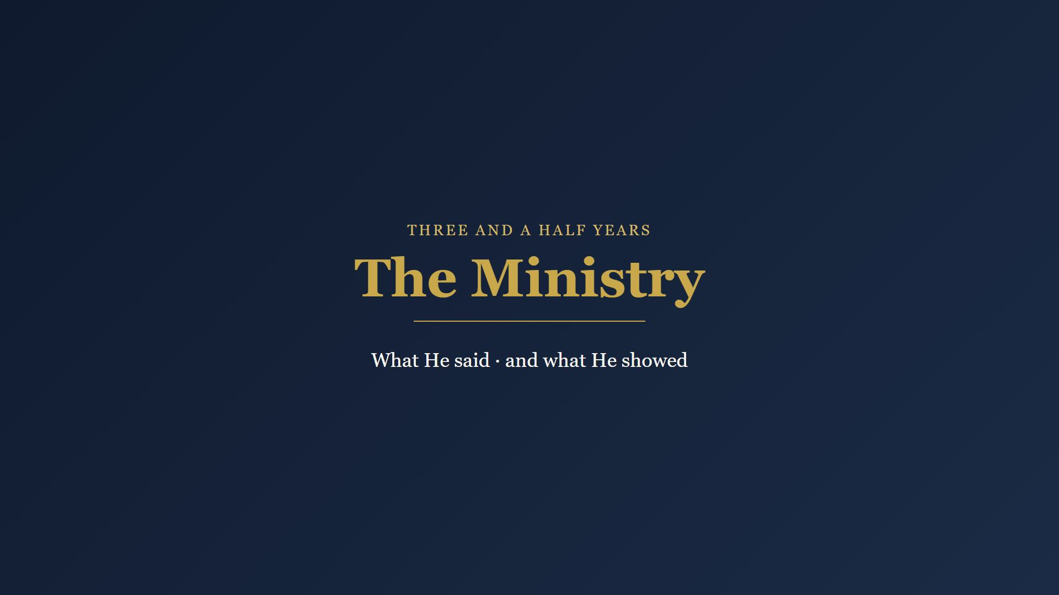
Notes:
Three and a half years. He did what no man ever did and said what no man ever said. The miracles were not stunts - they were credentials, exactly the works Isaiah said Messiah would do.

Slide 10
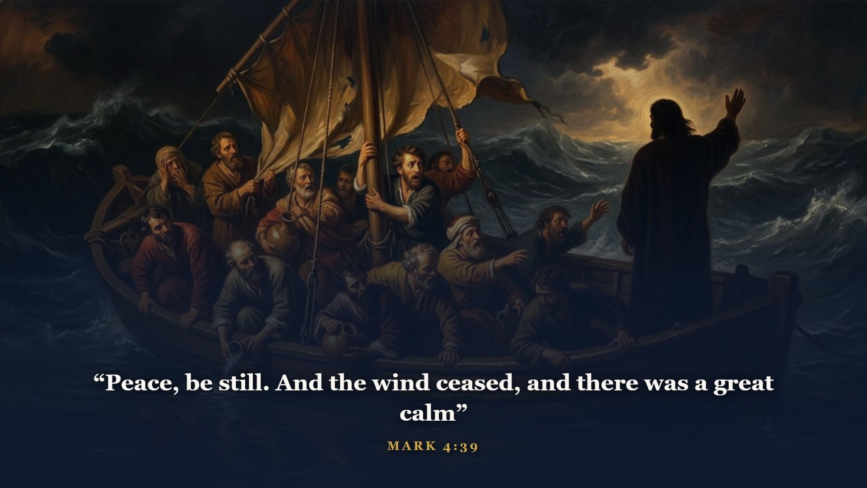
Notes:
Three words to a storm. The miracles were credentials and previews of the Kingdom He preached.

Slide 11
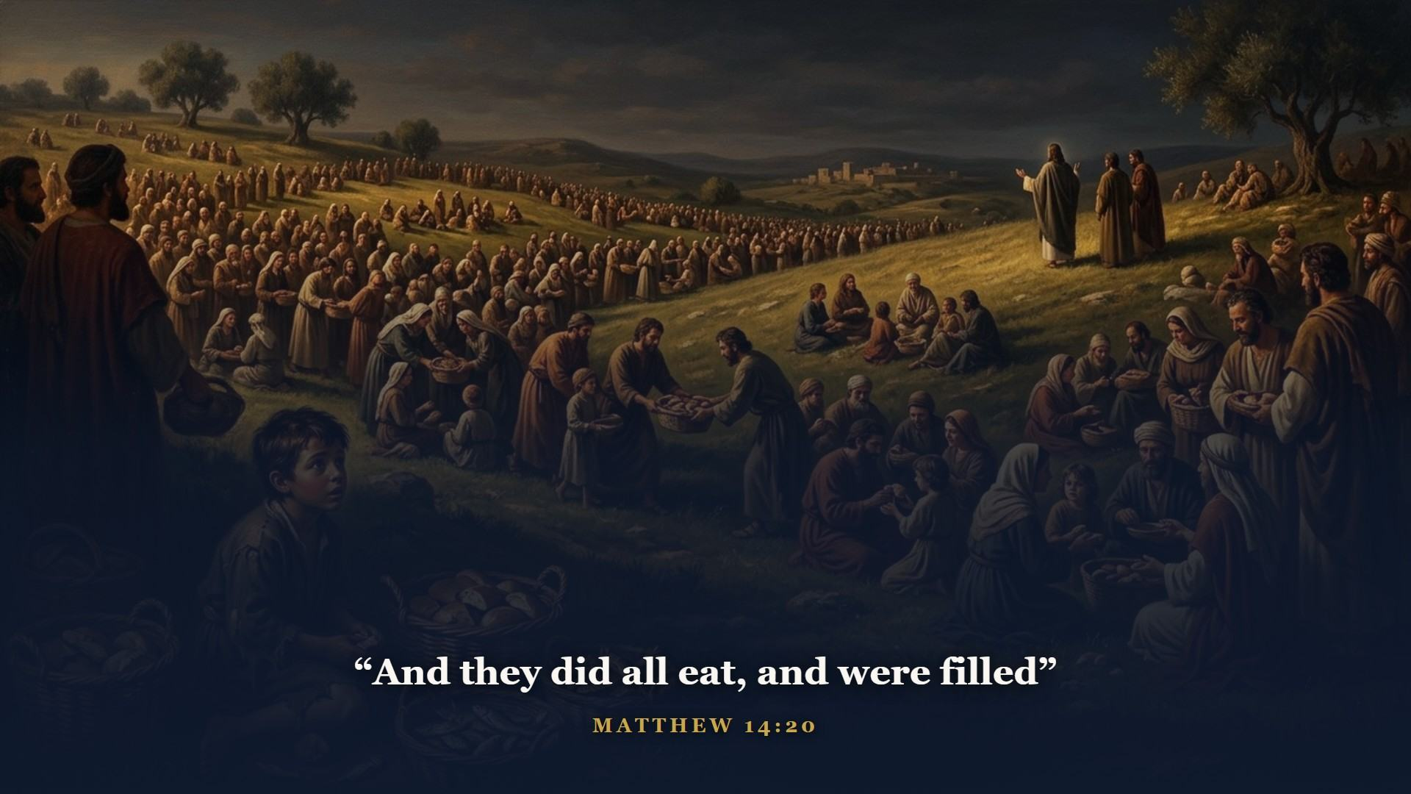
Notes:
Five thousand fed from a boy's lunch, with twelve baskets left over. He turned water to wine, stilled a storm, gave a blind man back the light.

Slide 12
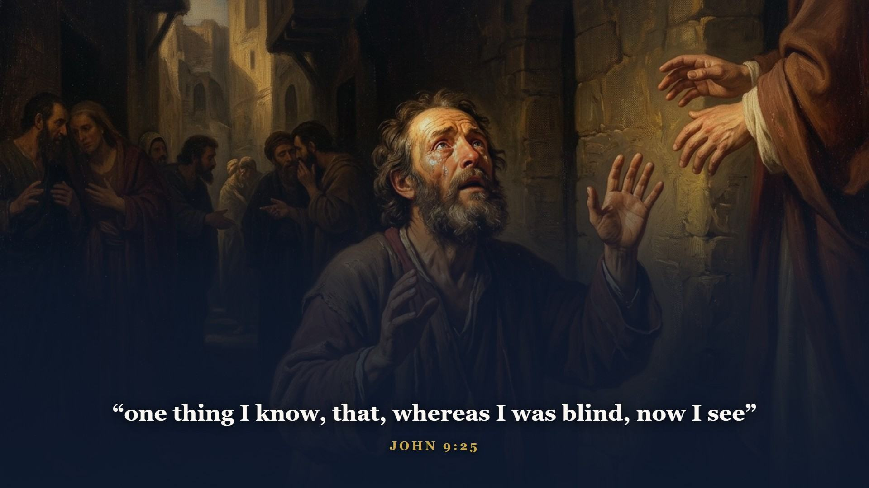
Notes:
The healed man's testimony under interrogation. He could not out-argue the theologians, but they could not talk him out of what had happened to him.

Slide 13
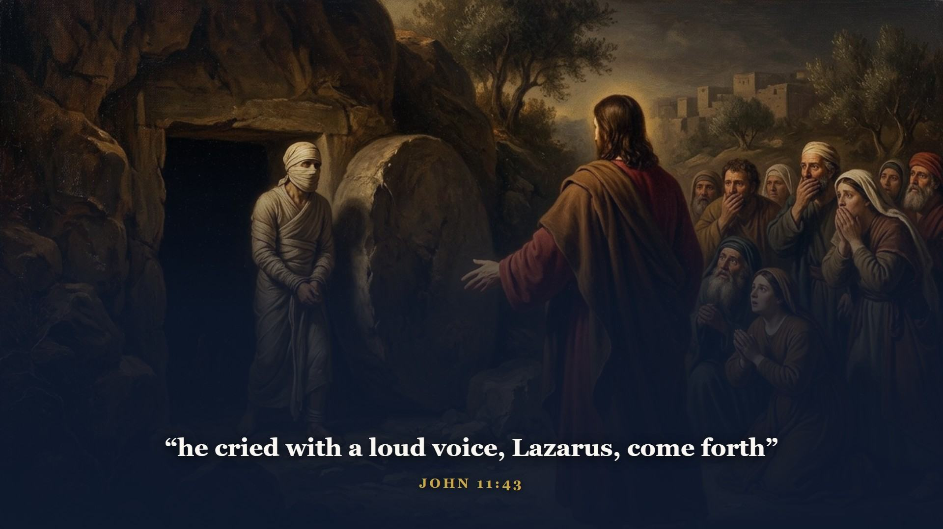
Notes:
A four-days-dead friend called out of his tomb by name. If He had not said the name, the whole graveyard would have come out.

Slide 14
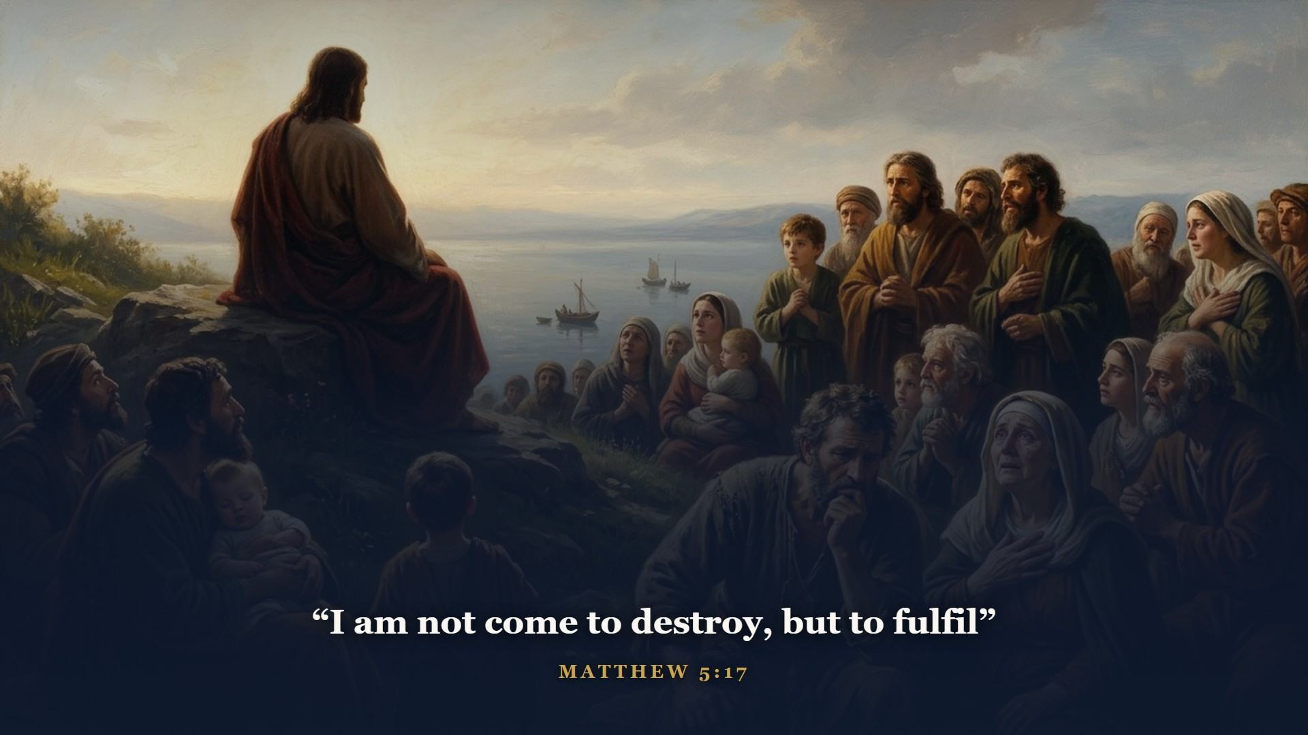
Notes:
His teaching cut deeper than any rabbi Israel had heard - aiming the Law past the hands and at the heart. Murder traced back to anger, adultery traced back to the look. Not destroy - FULFIL. Keep it perfectly, down to the motive, the only man who ever has or ever will. And here is why that matters infinitely: a Passover lamb had to be WITHOUT BLEMISH. A blemished substitute can die for nobody but himself.

Slide 15
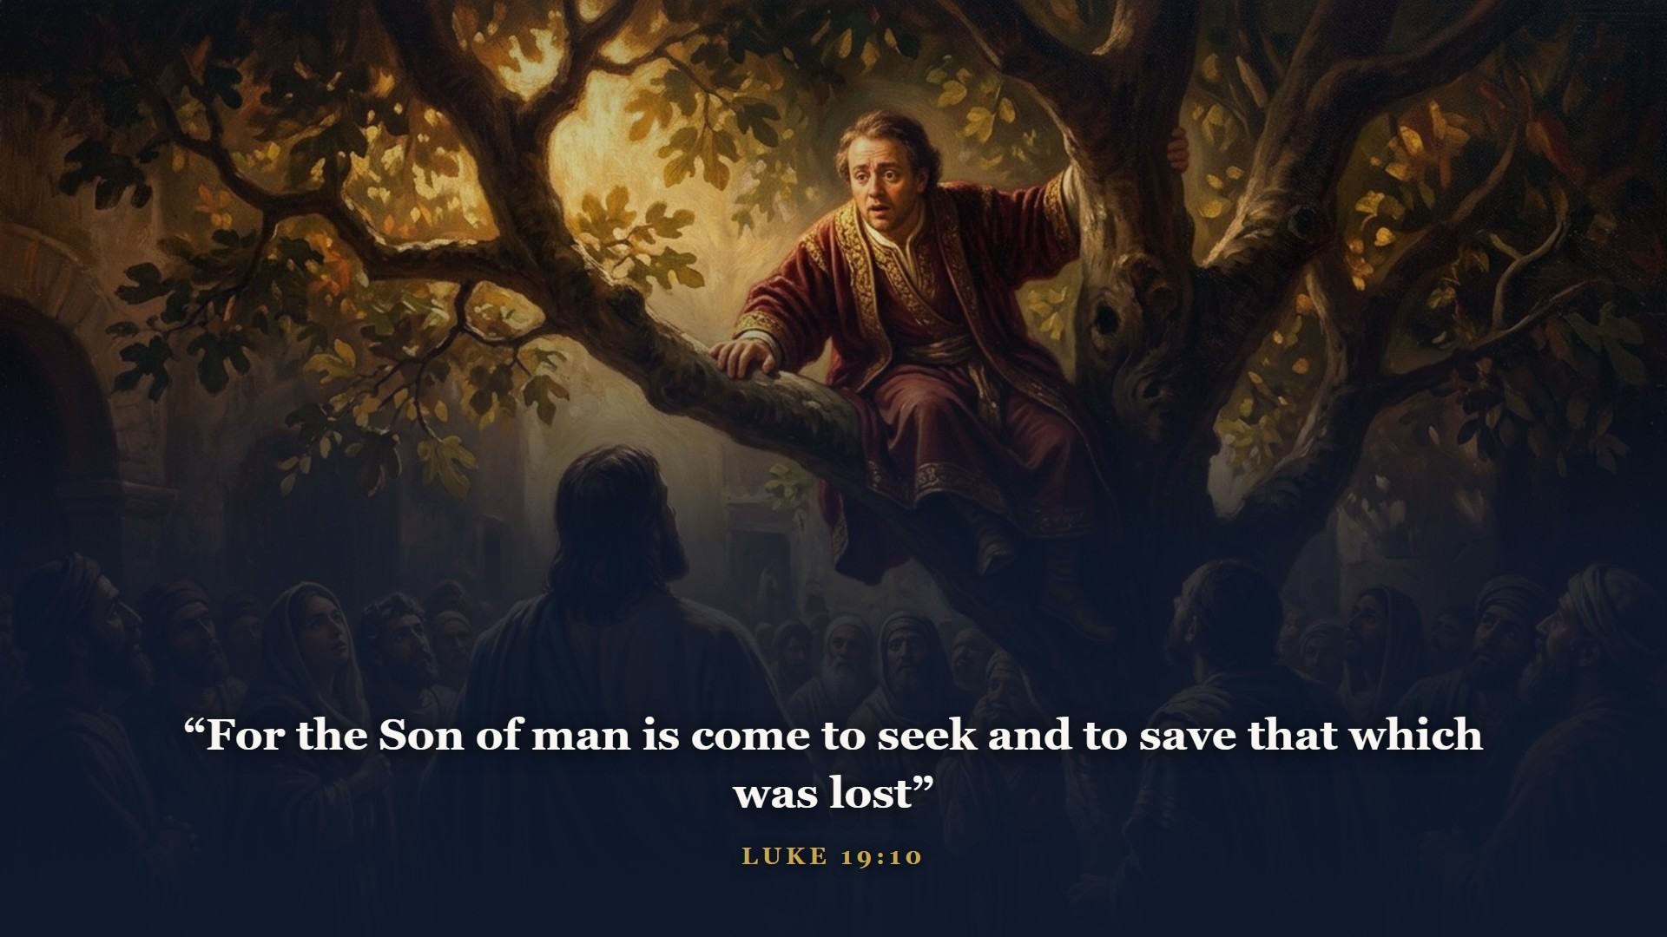
Notes:
His own mission statement, one sentence, standing in the house of a despised little tax collector. Not to admire the righteous - He said there would be no patients in His waiting room but sick ones.

Slide 16
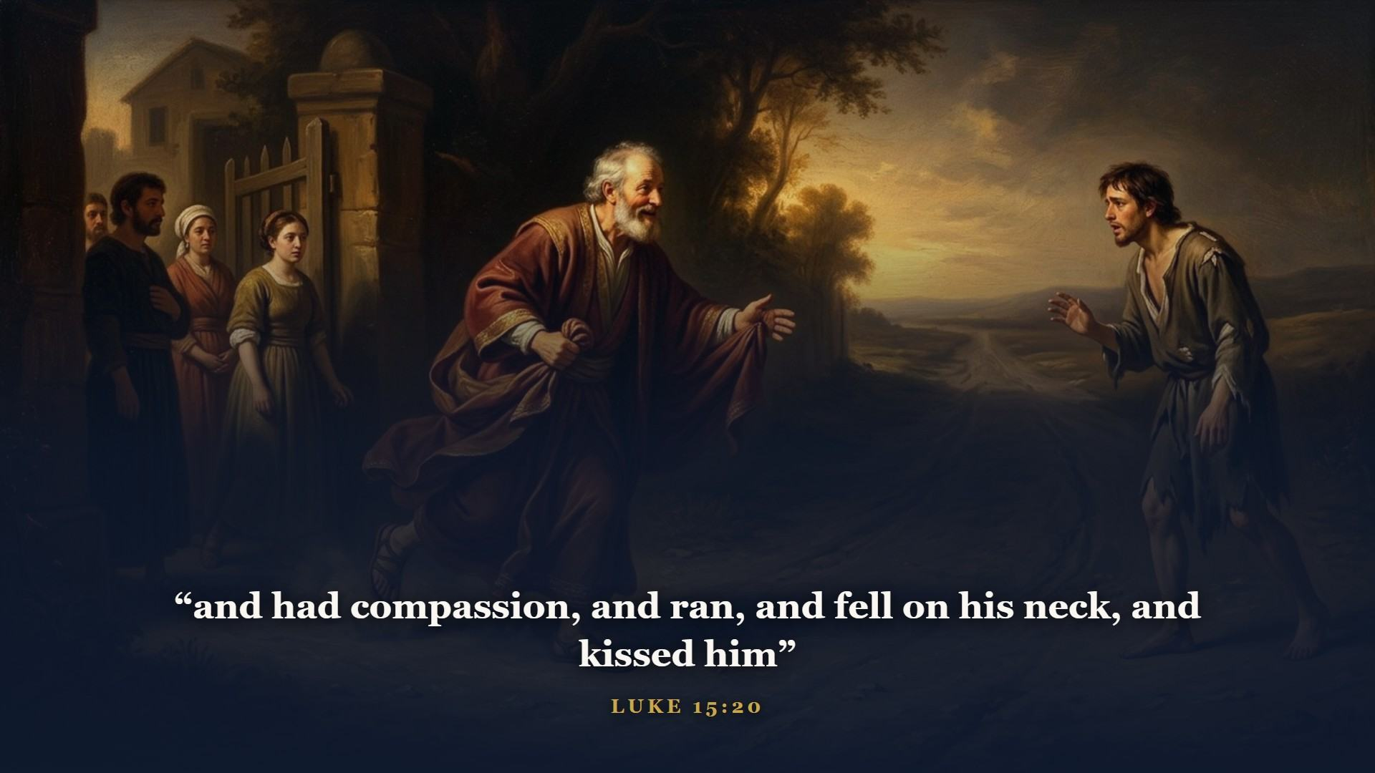
Notes:
Three stories in a row - a lost sheep, a lost coin, a lost son - every one ending in the same scandal: heaven throwing a party over one sinner that repenteth. The far country, the pig pen, and the father RUNNING. If you read Luke 15 dry-eyed you are tougher than I am.

Slide 17
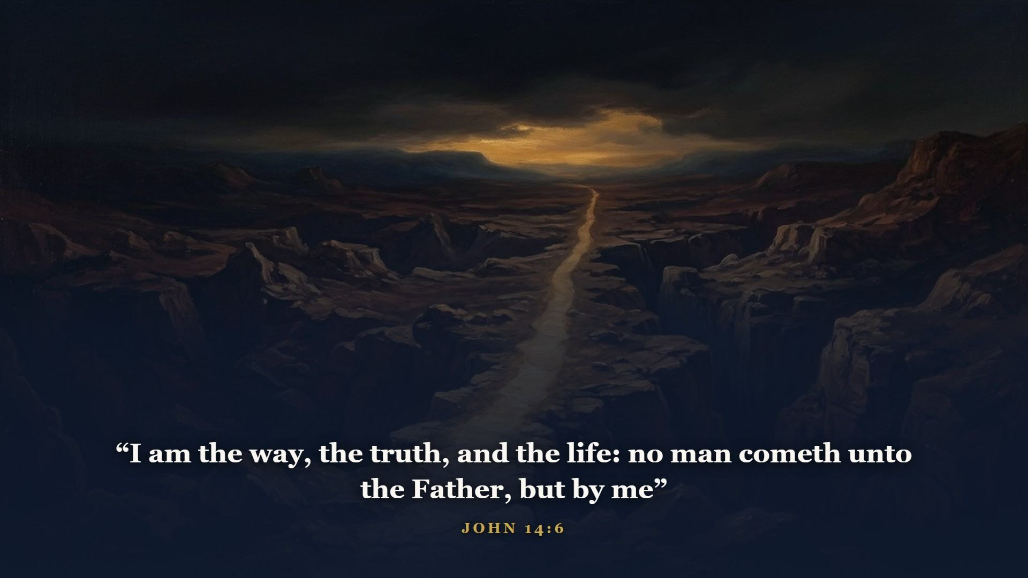
Notes:
Not A way. Not MY truth. I AM - the burning-bush name, on His own lips, again and again in John. Israel's leaders understood the claim perfectly. That is why they reached for stones - and why, in the end, they reached for a cross.

Slide 18

Notes:
It happened at Passover. Do not let that slide past as a calendar accident: at the exact feast when every family in Israel was selecting a lamb without blemish, Israel's leaders were examining the Lamb of God - and finding no fault in Him.

Slide 19
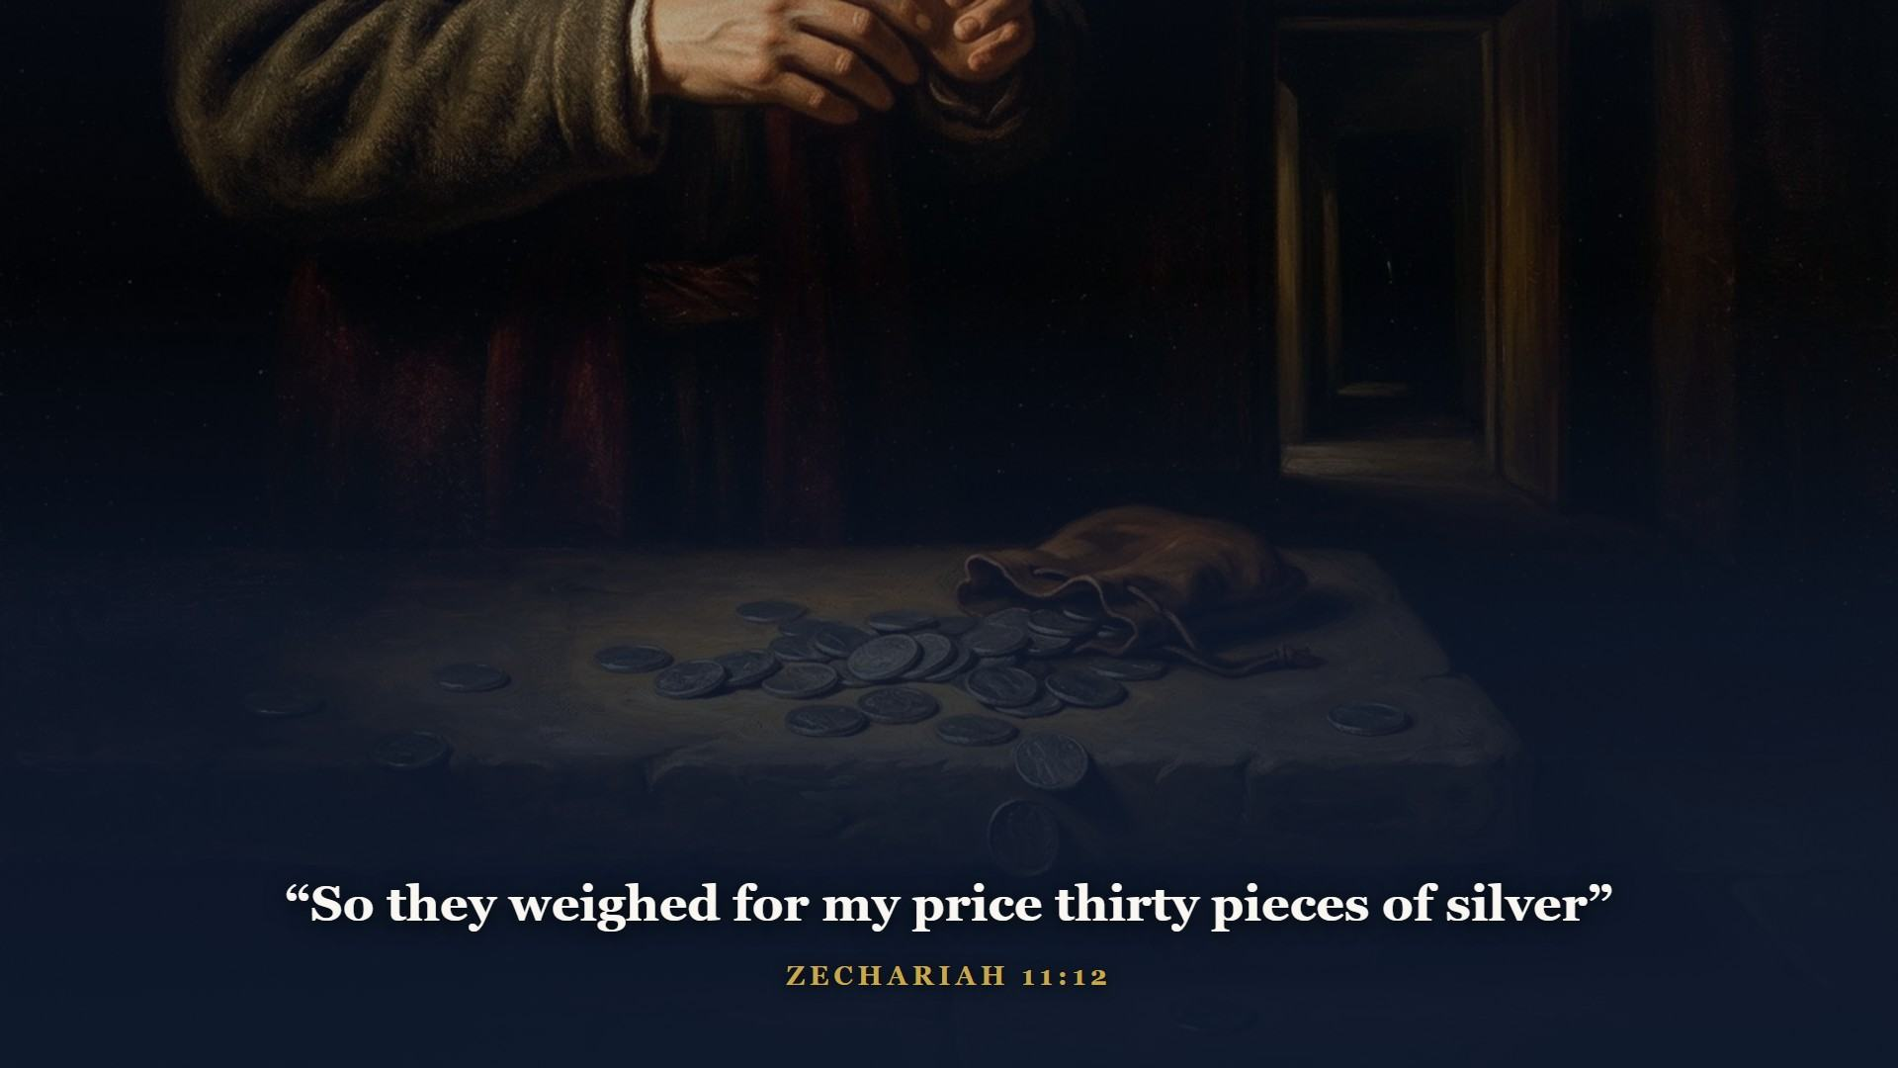
Notes:
Betrayed by a friend - and Zechariah priced it five hundred years early.

Slide 20
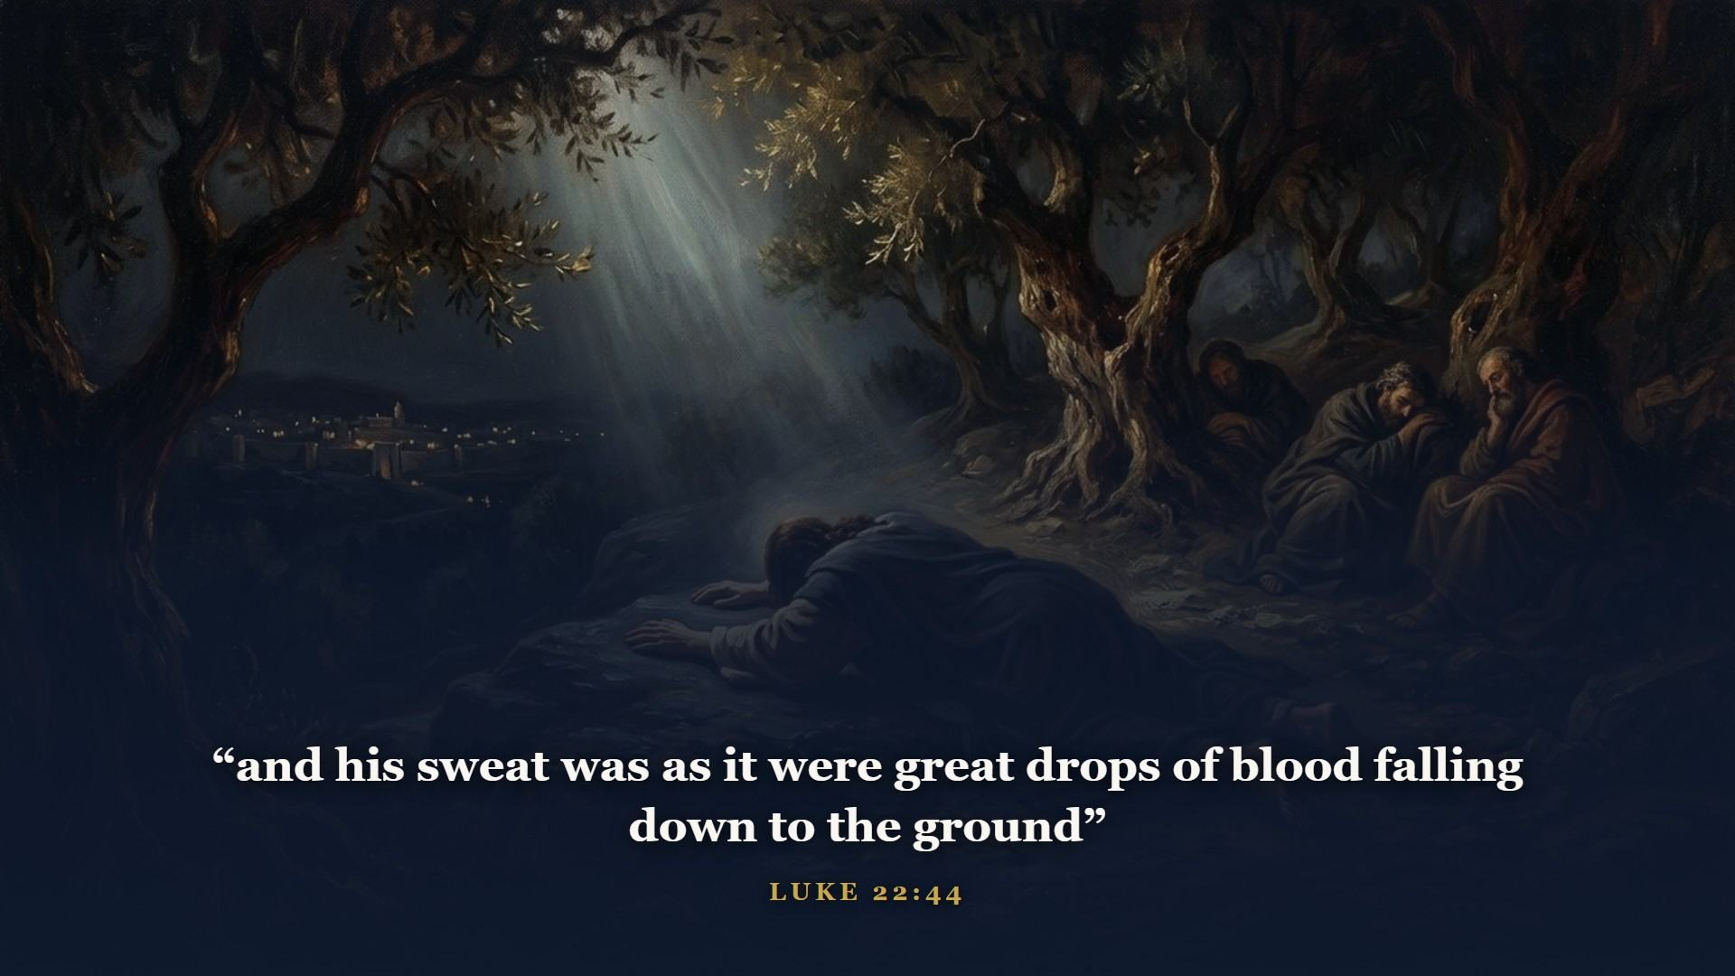
Notes:
Deserted by His men. The cup was not the nails; it was the iniquity of us all about to be laid on Him.

Slide 21
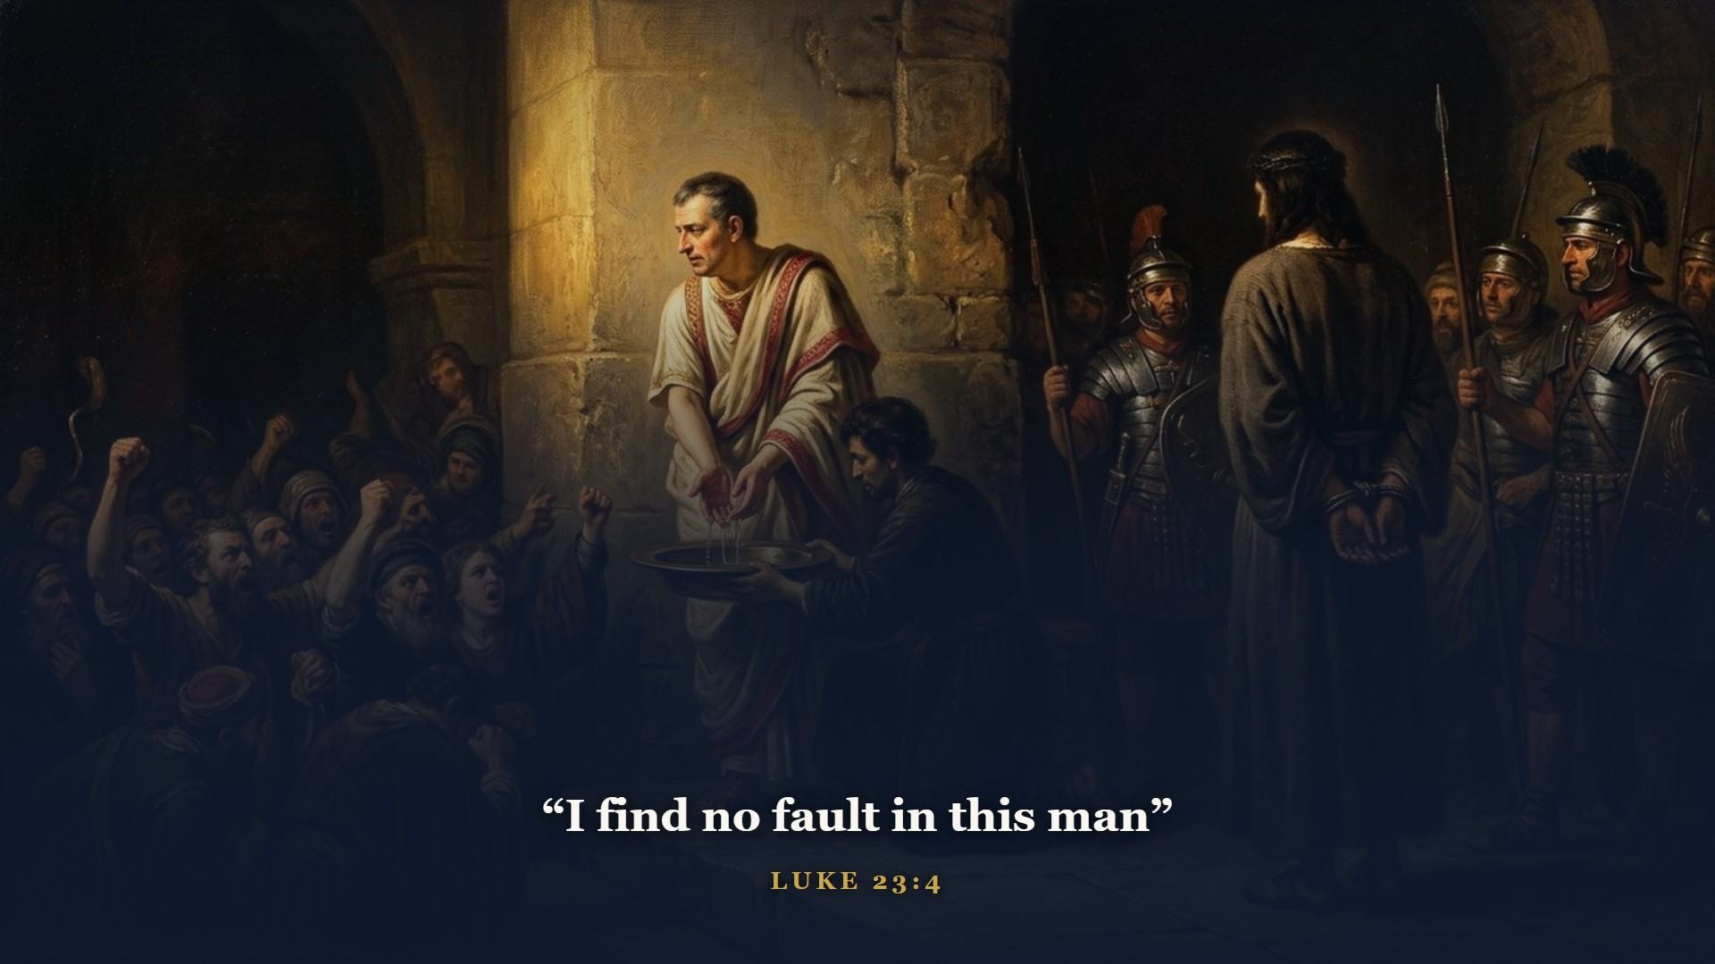
Notes:
Convicted on perjured testimony at an illegal night trial. Pilate said it three times - no fault. The lamb was examined and found without blemish, exactly as Exodus 12 required.

Slide 22
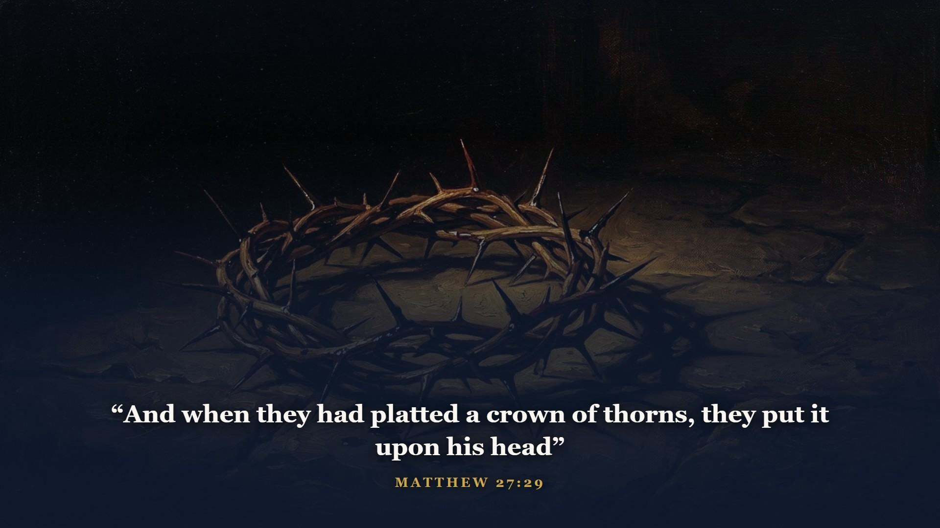
Notes:
Thorns - the very curse of Genesis 3, pressed onto the head of the One who came to lift it.

Slide 23
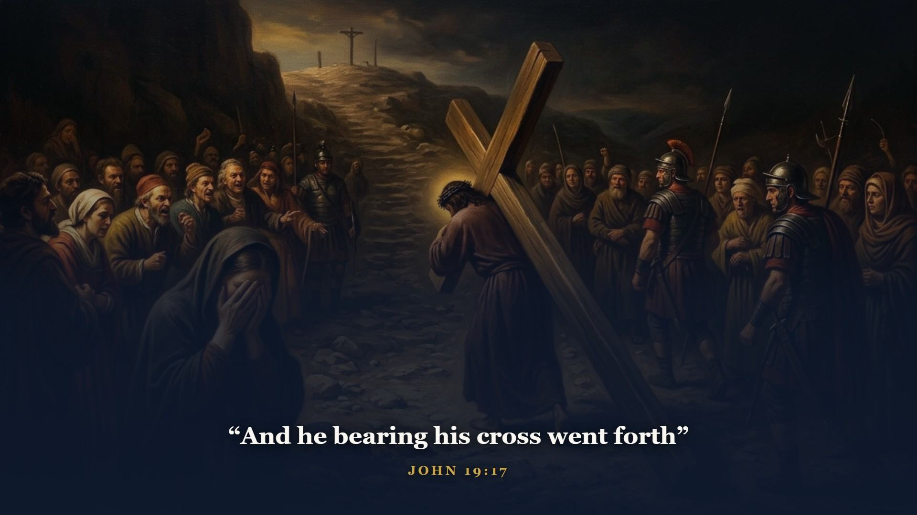
Notes:
Marched up the hill carrying the wood - like Isaac in Genesis 22. Except this time no voice from heaven stopped the offering, because this time the ram in the thicket WAS the Son.

Slide 24
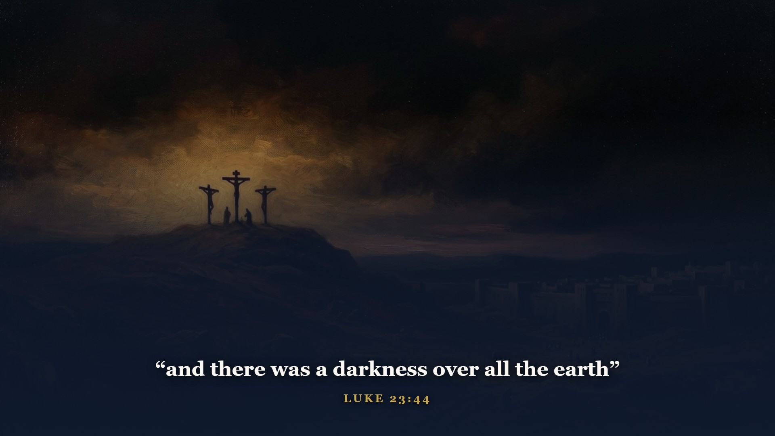
Notes:
From noon to three o'clock. Read Psalm 22 and Isaiah 53 beside Calvary - the pierced hands and feet, the mocking crowd wagging their heads, the gambling for His garments, numbered with transgressors, His grave with the rich. Written centuries in advance. The LORD hath laid on him the iniquity of us all.

Slide 25
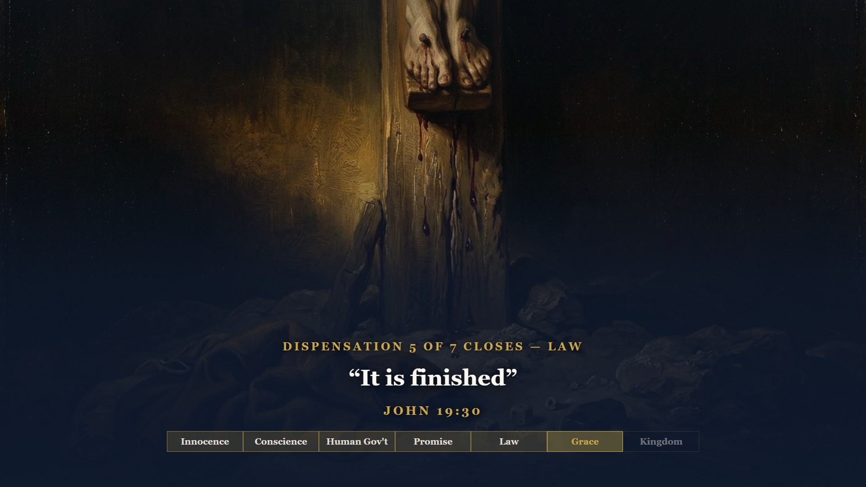
Notes:
One word in the Greek, three in English. Not I am finished - IT is. The debt, paid in full. The types, fulfilled - every lamb since Eden's gate retired in one afternoon. The Law's claim against sinners, satisfied to the last farthing.

Slide 26
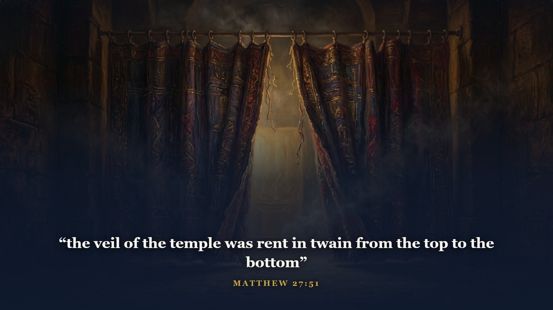
Notes:
At that very moment, across town. The thick woven wall we left hanging in Class 2 - the one that said KEEP OUT for fifteen hundred years. Not from the bottom up, as men would tear it. From the TOP down, as only God could. The way into the holiest is open.

Slide 27
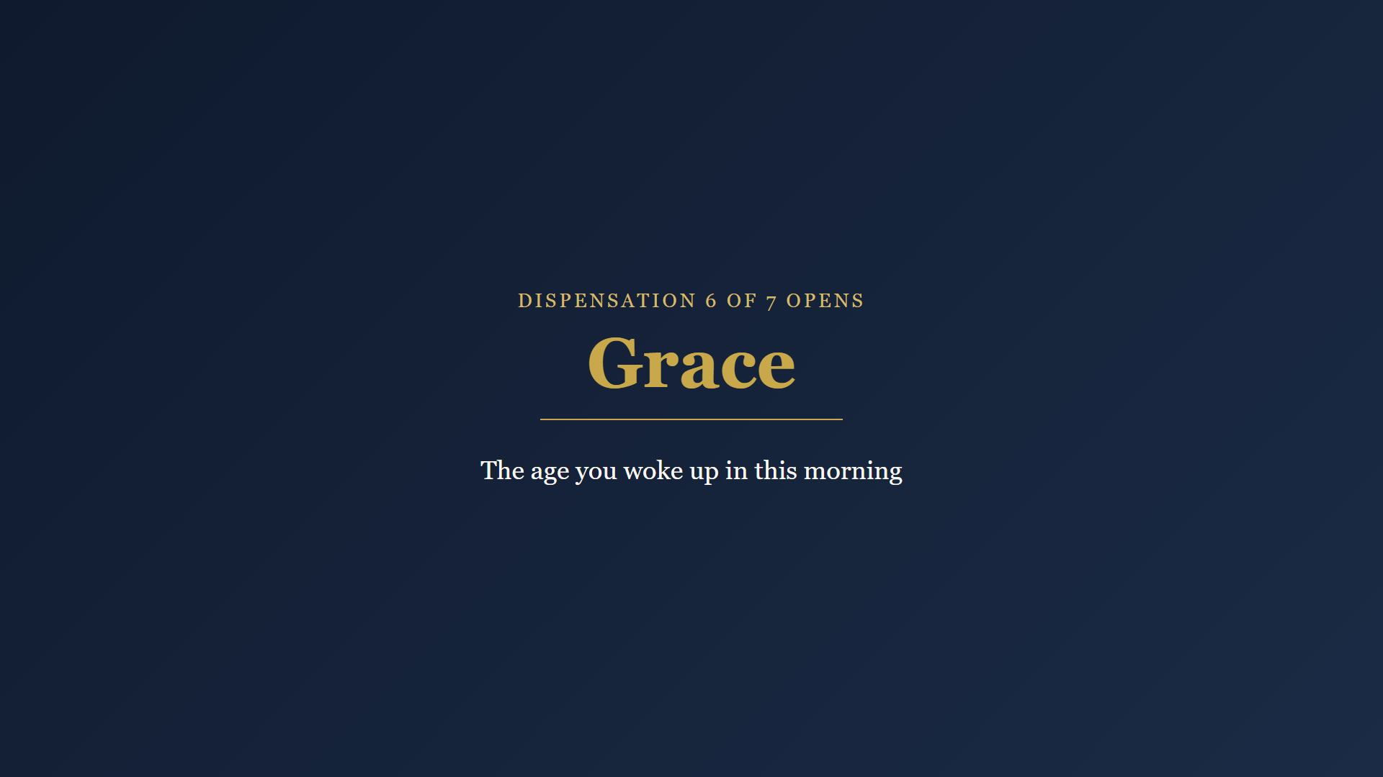
Notes:
They buried Him in a rich man's tomb - Isaiah 53:9, to the letter - sealed with Rome's stamp and Rome's soldiers. And then came the third day.

Slide 28
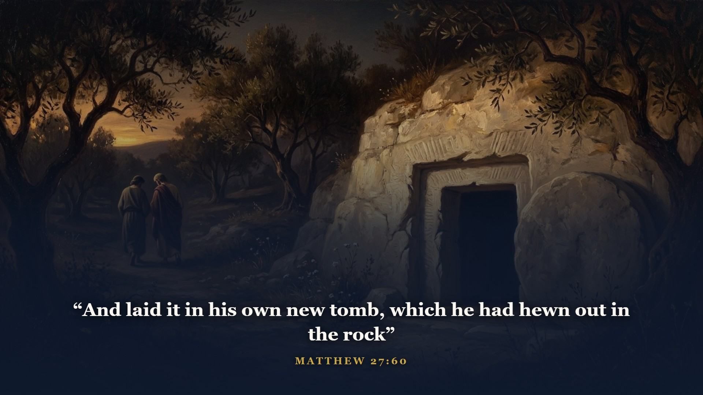
Notes:
A rich man's tomb - Isaiah 53:9, to the letter: he made his grave with the wicked, and with the rich in his death.

Slide 29
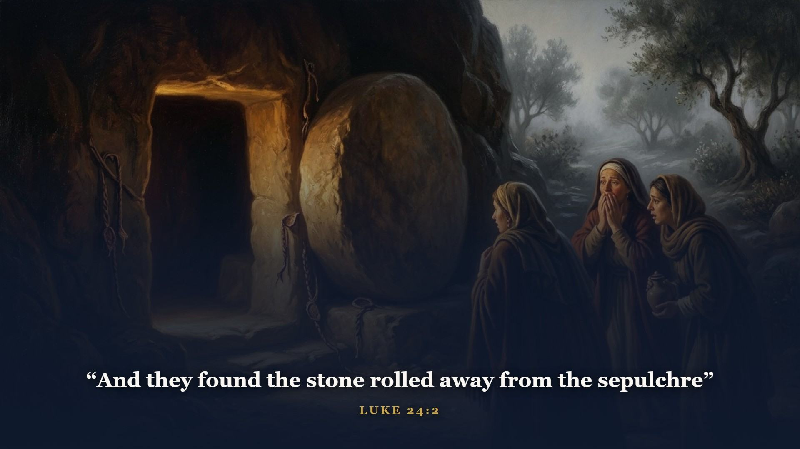
Notes:
Sealed with Rome's stamp and guarded by Rome's soldiers. It did not hold.

Slide 30
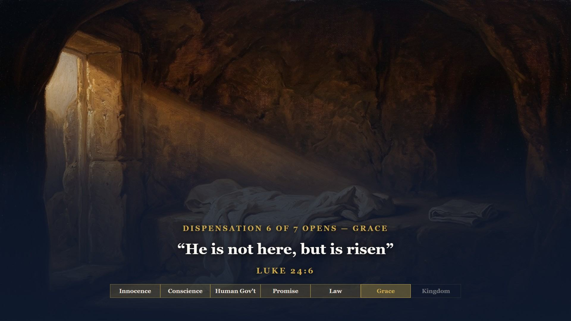
Notes:
Six words that split history in half. He showed Himself alive - to the women, to Peter, to two on the Emmaus road, to the ten, to Thomas, to five hundred brethren at once. Job's cry from Class 1 - I know that my redeemer liveth - stopped being a hope that morning and became a headline.

Slide 31
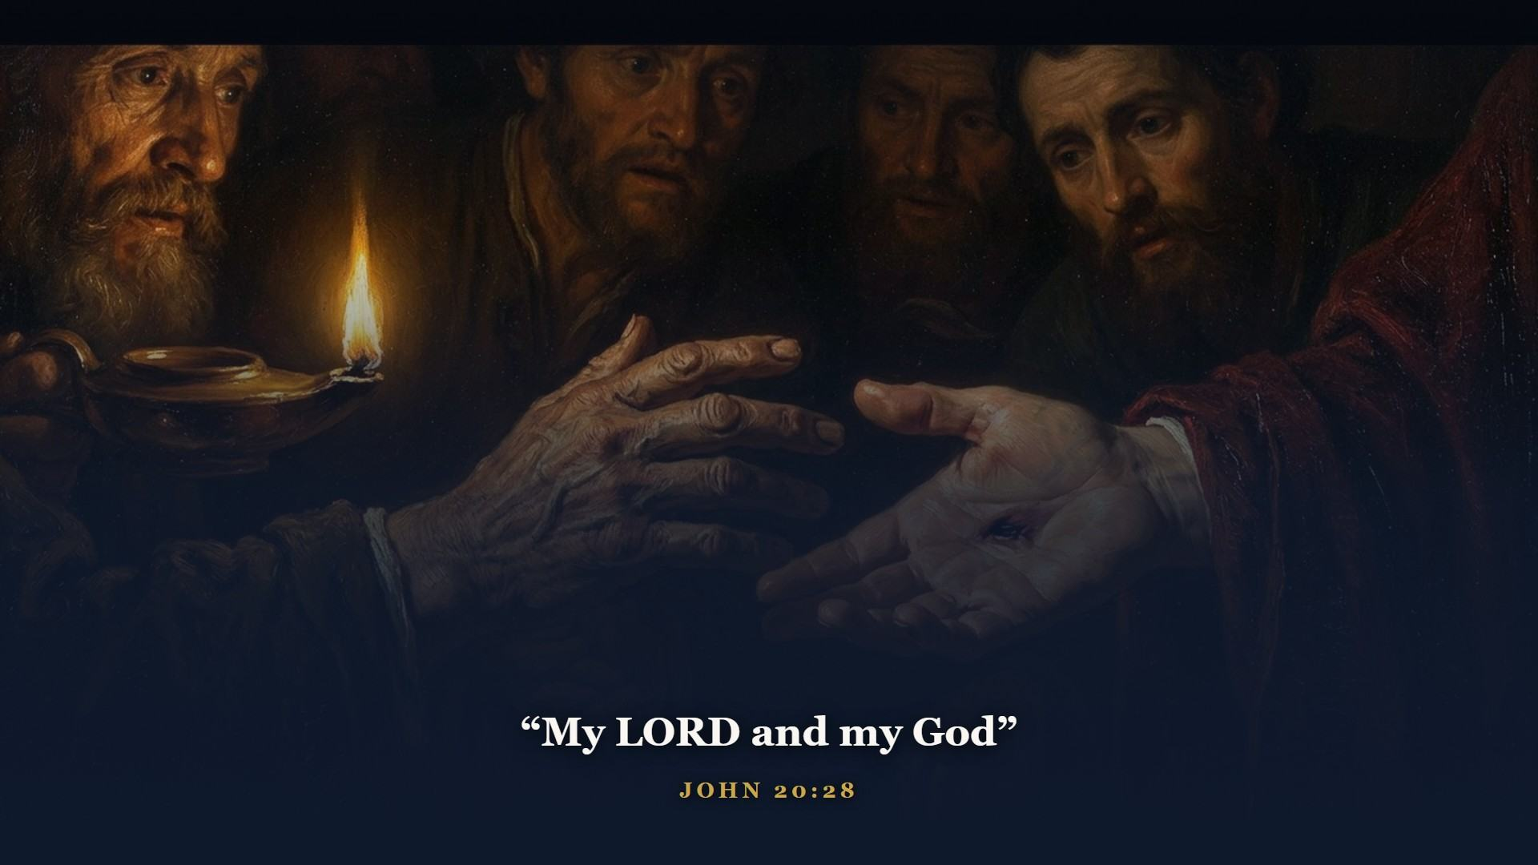
Notes:
Thomas hit his knees and said the only thing left to say. The scars were the evidence - and they are still the evidence.

Slide 32
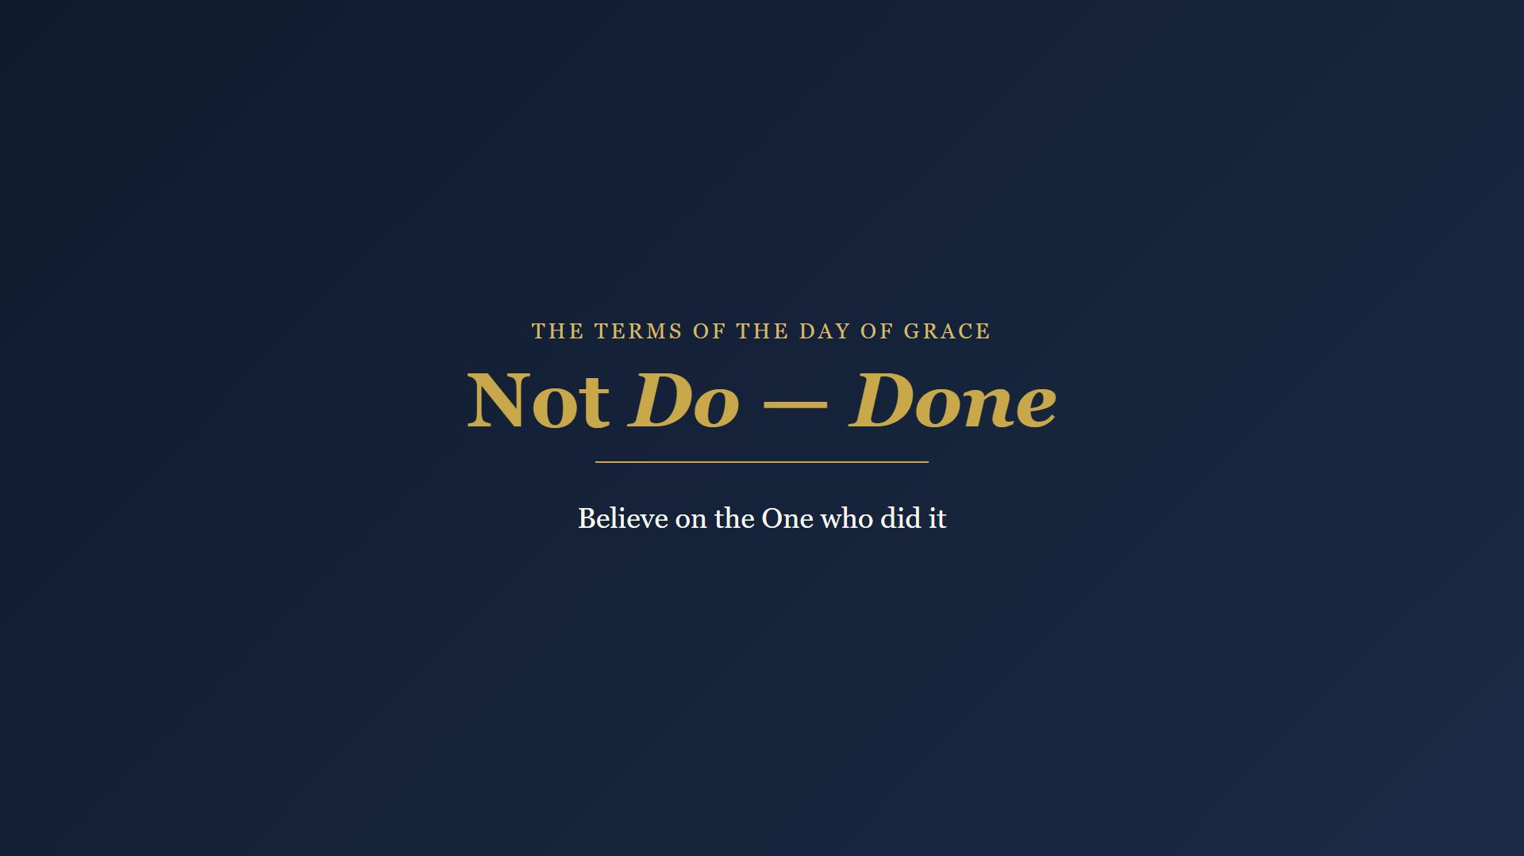
Notes:
Now do what this whole course was built to do: set the gospel of the Day of Grace in front of them as plainly as you know how. The terms are not DO - Sinai settled what man's we will do is worth. The terms are DONE.

Slide 33
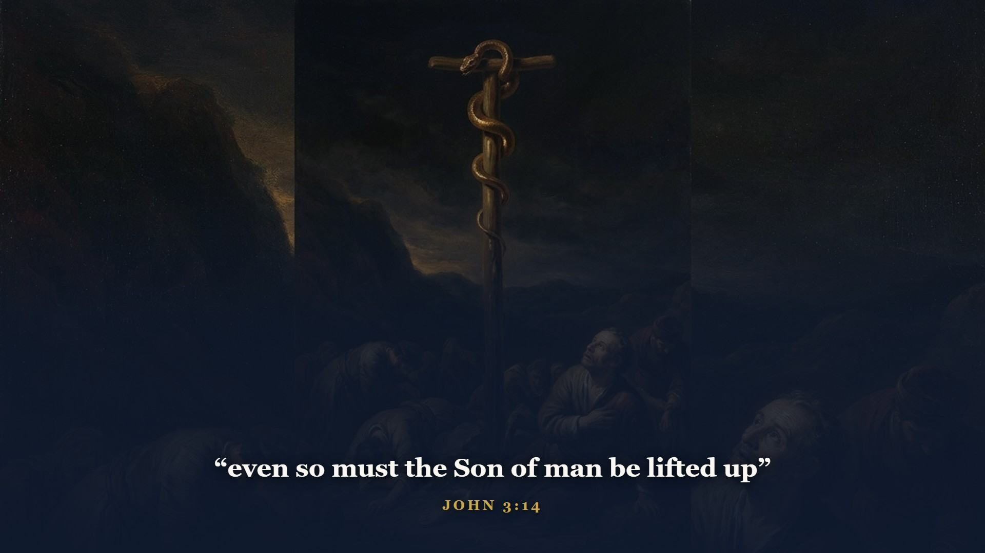
Notes:
Jesus reached back to Class 2 territory to explain it to a religious man named Nicodemus - the brass serpent in the wilderness, lifted on a pole, where one believing LOOK healed a snake-bitten Israelite. Not a work. A look.

Slide 34
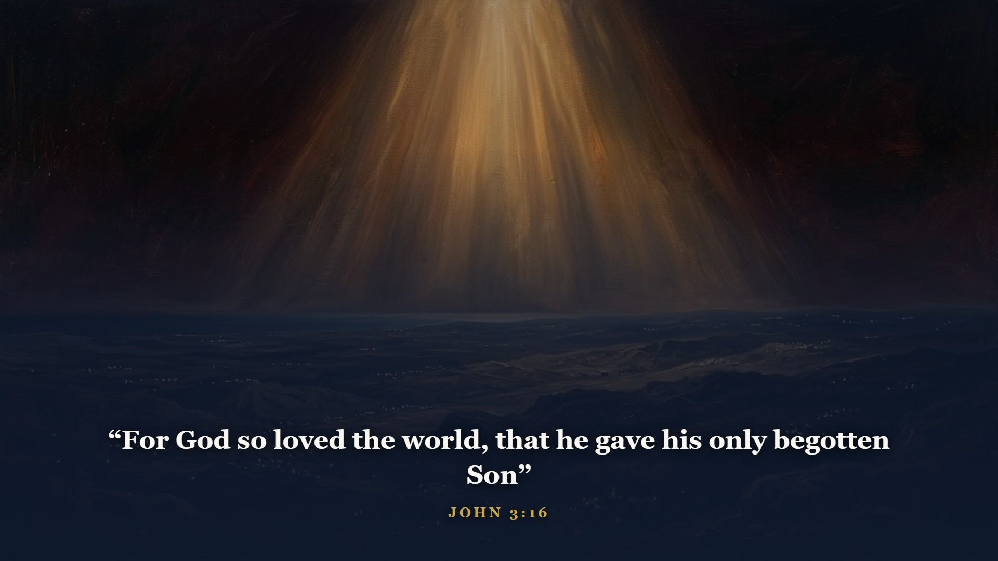
Notes:
That whosoever believeth in him should not perish, but have everlasting life. He that believeth on him is not condemned.

Slide 35
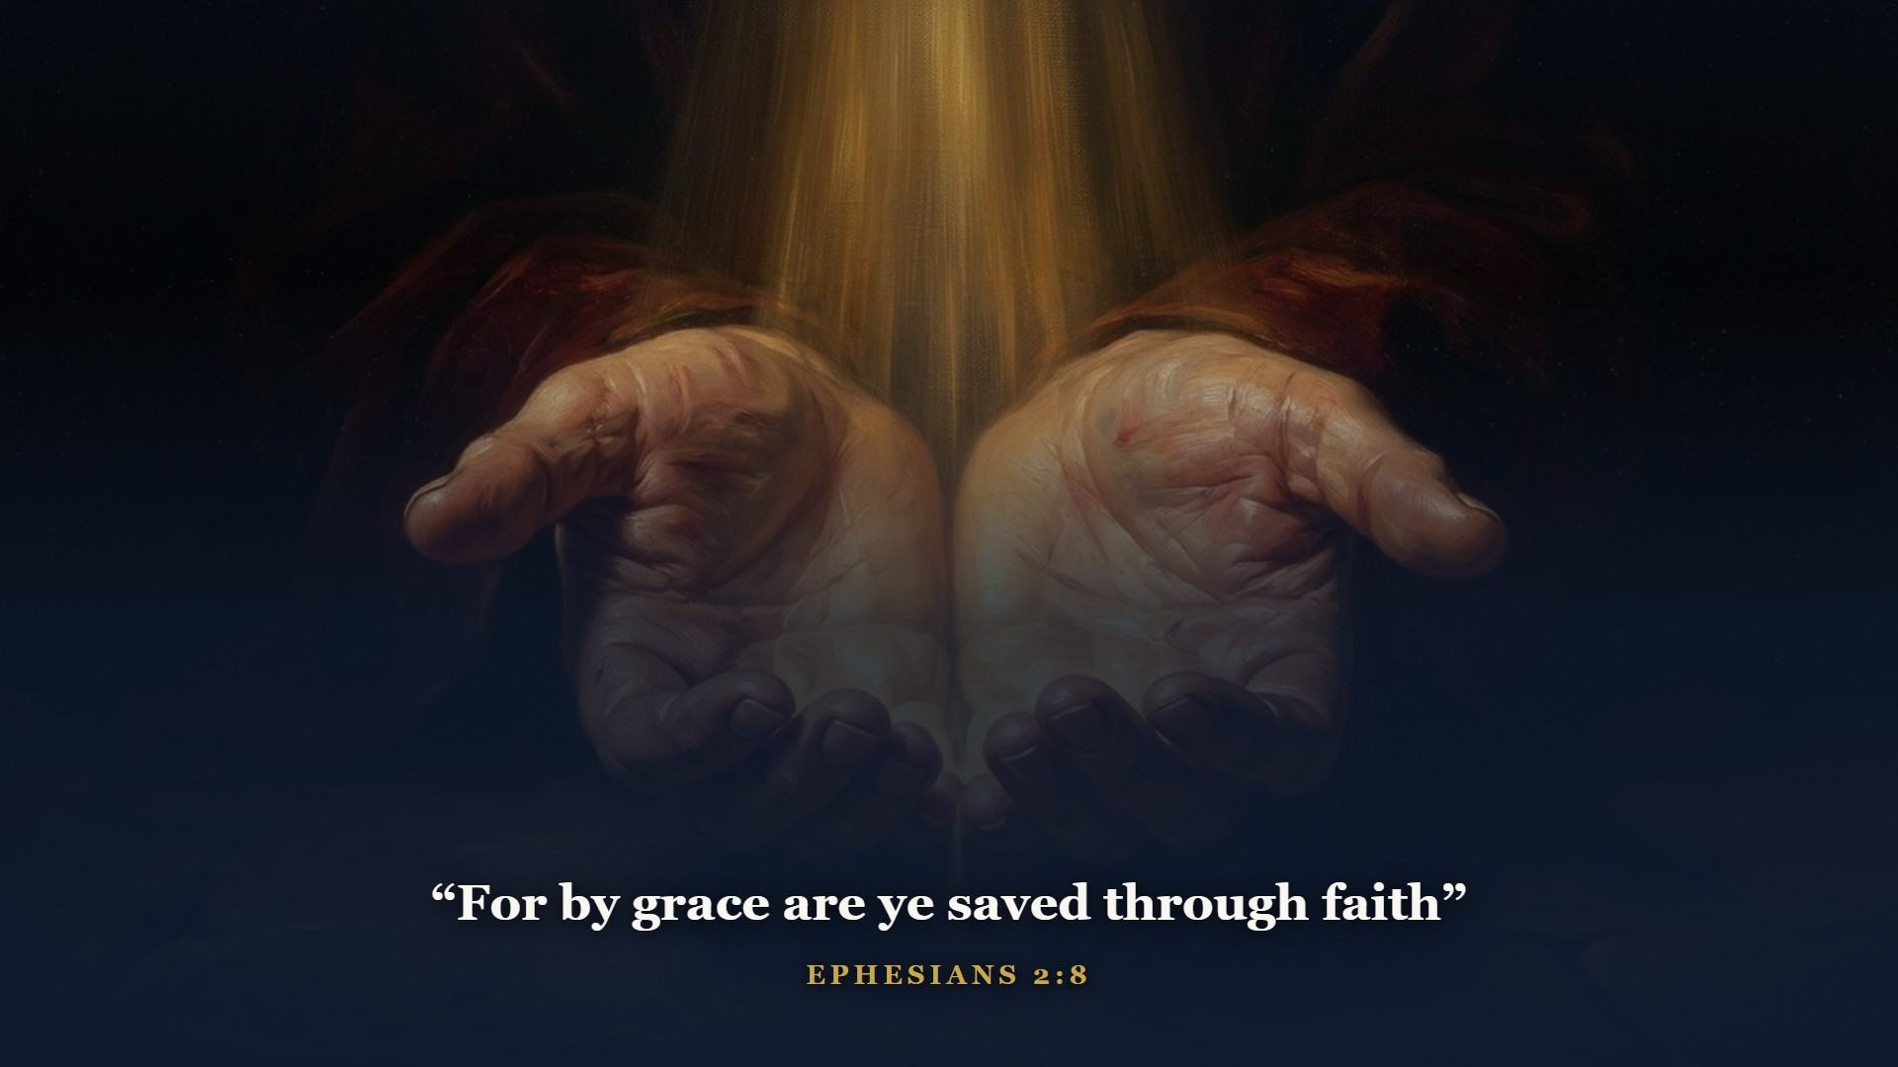
Notes:
And that not of yourselves: it is the gift of God. Not of works, lest any man should boast. The same way Abram was counted righteous in Genesis 15 - believing God - only now the promise has a name and a finished work. Not Christ plus church membership, not Christ plus baptism, not Christ plus your best efforts. Those have their place, and their place is AFTER, as fruit, never as payment. The blood is on the doorpost or it is not. Ask them plainly: is it applied to YOUR door? Invite anyone to speak with you after class.

Slide 36
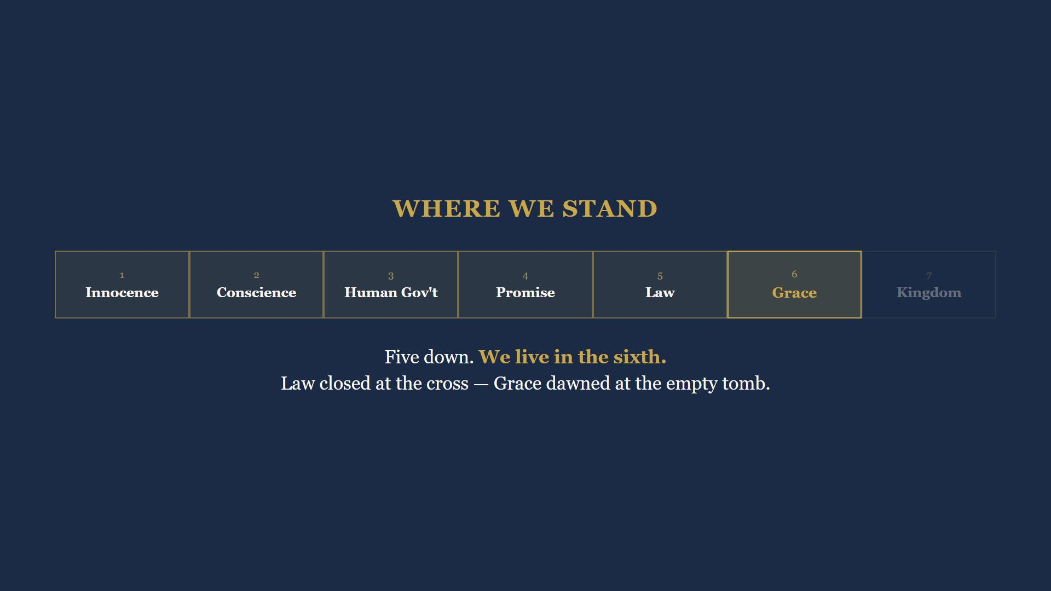
Notes:
Stand back and look at the hinge we just turned. Five dispensations down. We live in the sixth - the age you woke up in this morning.

Slide 37
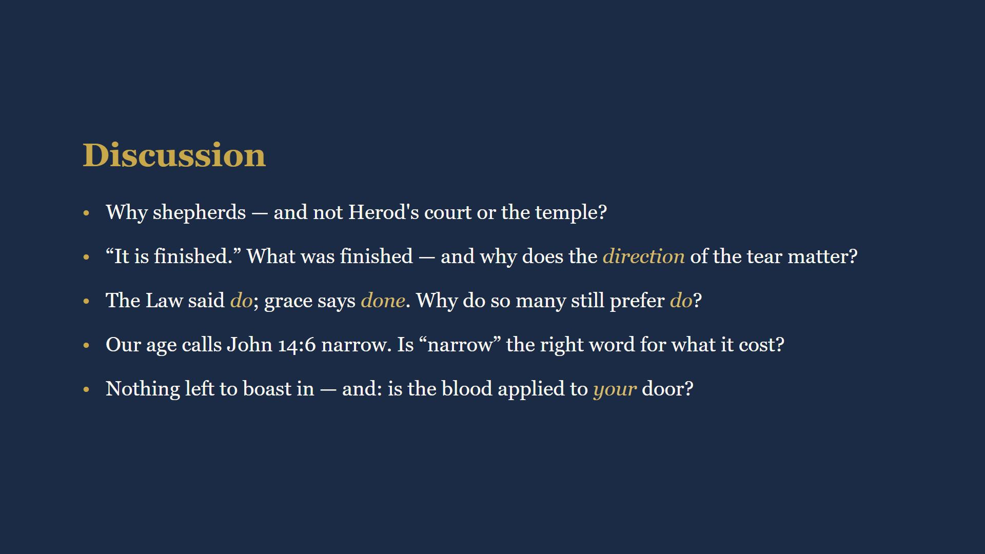
Notes:
15 minutes. Full wording in their workbooks. Q1: God announces to shepherds, not Herod - in character all through this Book. Q2: the debt was finished; the tear from the top means God opened it, not man. Q3: DONE is better news than DO for anyone who has honestly looked in the mirror. Q4: narrow is the wrong word for a door that cost that much to open. Q5: nothing left to boast in - and the personal question. Offer to talk privately after class.

Slide 38
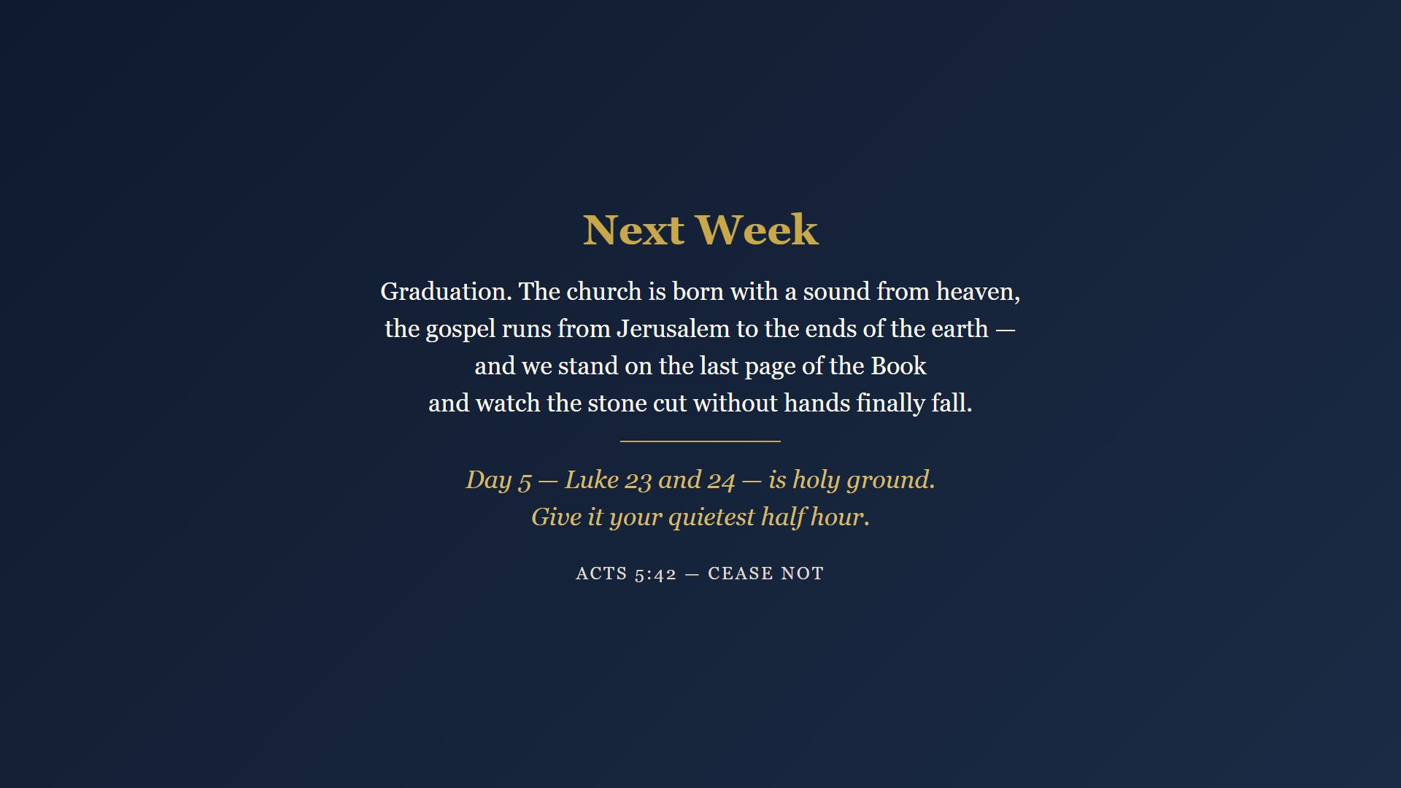
Notes:
Final week of readings, and the richest. Day 5, Luke 23-24, is holy ground - give it your quietest half hour. Next week is graduation: the church is born, the gospel runs to the ends of the earth, and we stand on the last page and watch the stone cut without hands finally fall. Closing prayer.

