Slide 1

Notes:
Welcome. Review Week 4 - ask: what did you notice reading the Bible's last chapter the same week you read the cross? Then pray. Today we finish the Book and the timeline. By the end of this hour they will have walked all seven dispensations, Eden to eternity.

Slide 2
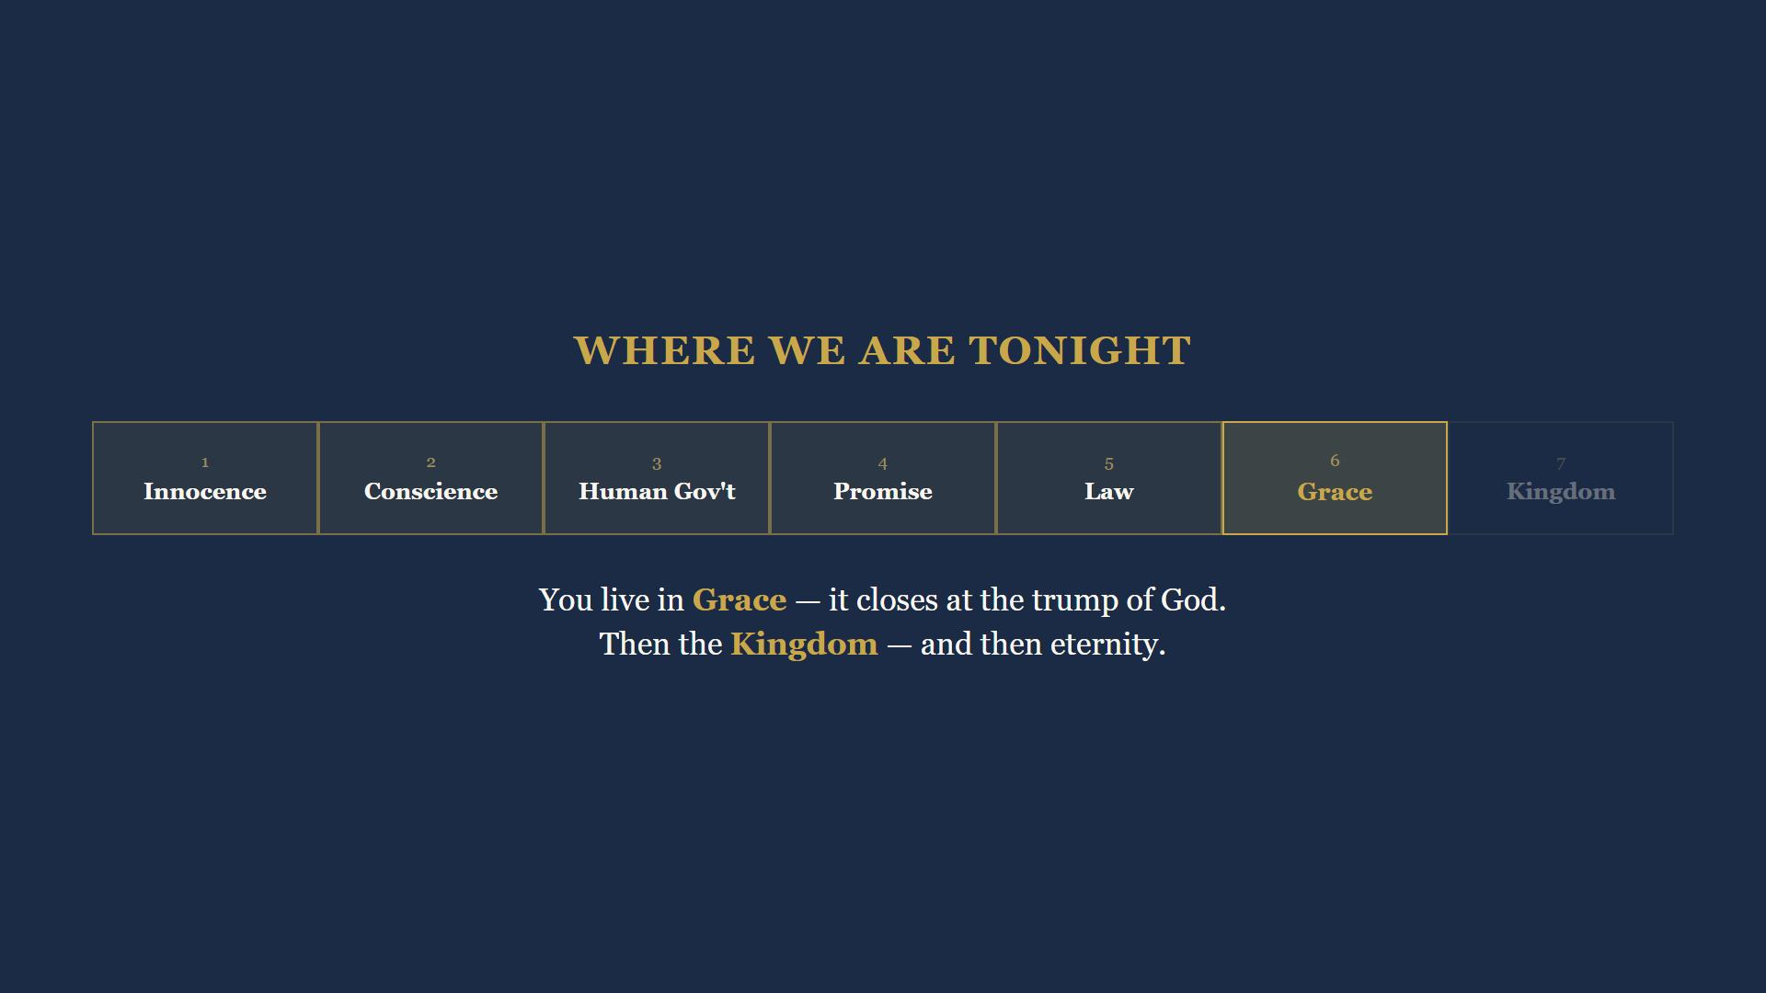
Notes:
You live in Grace. It closes at the Rapture. Then Kingdom - and then eternity. Today we finish the timeline.

Slide 3
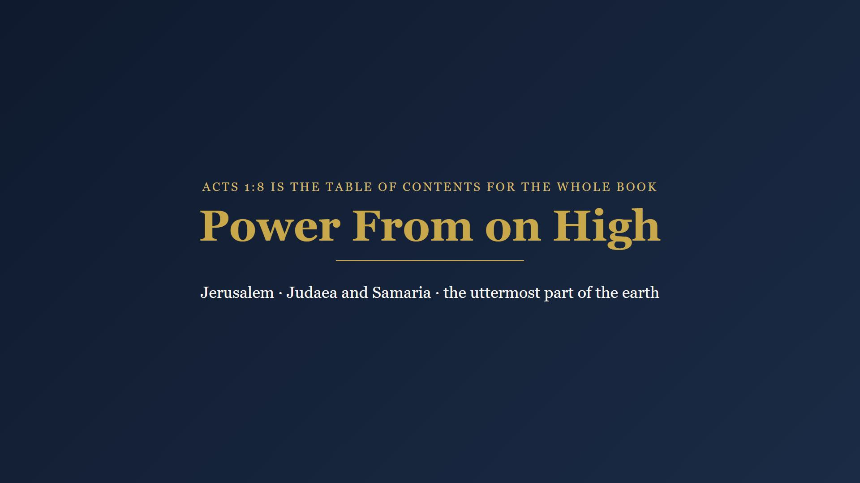
Notes:
Luke wrote a sequel - the Acts of the Apostles - and it opens on the Mount of Olives, forty days after the resurrection.

Slide 4
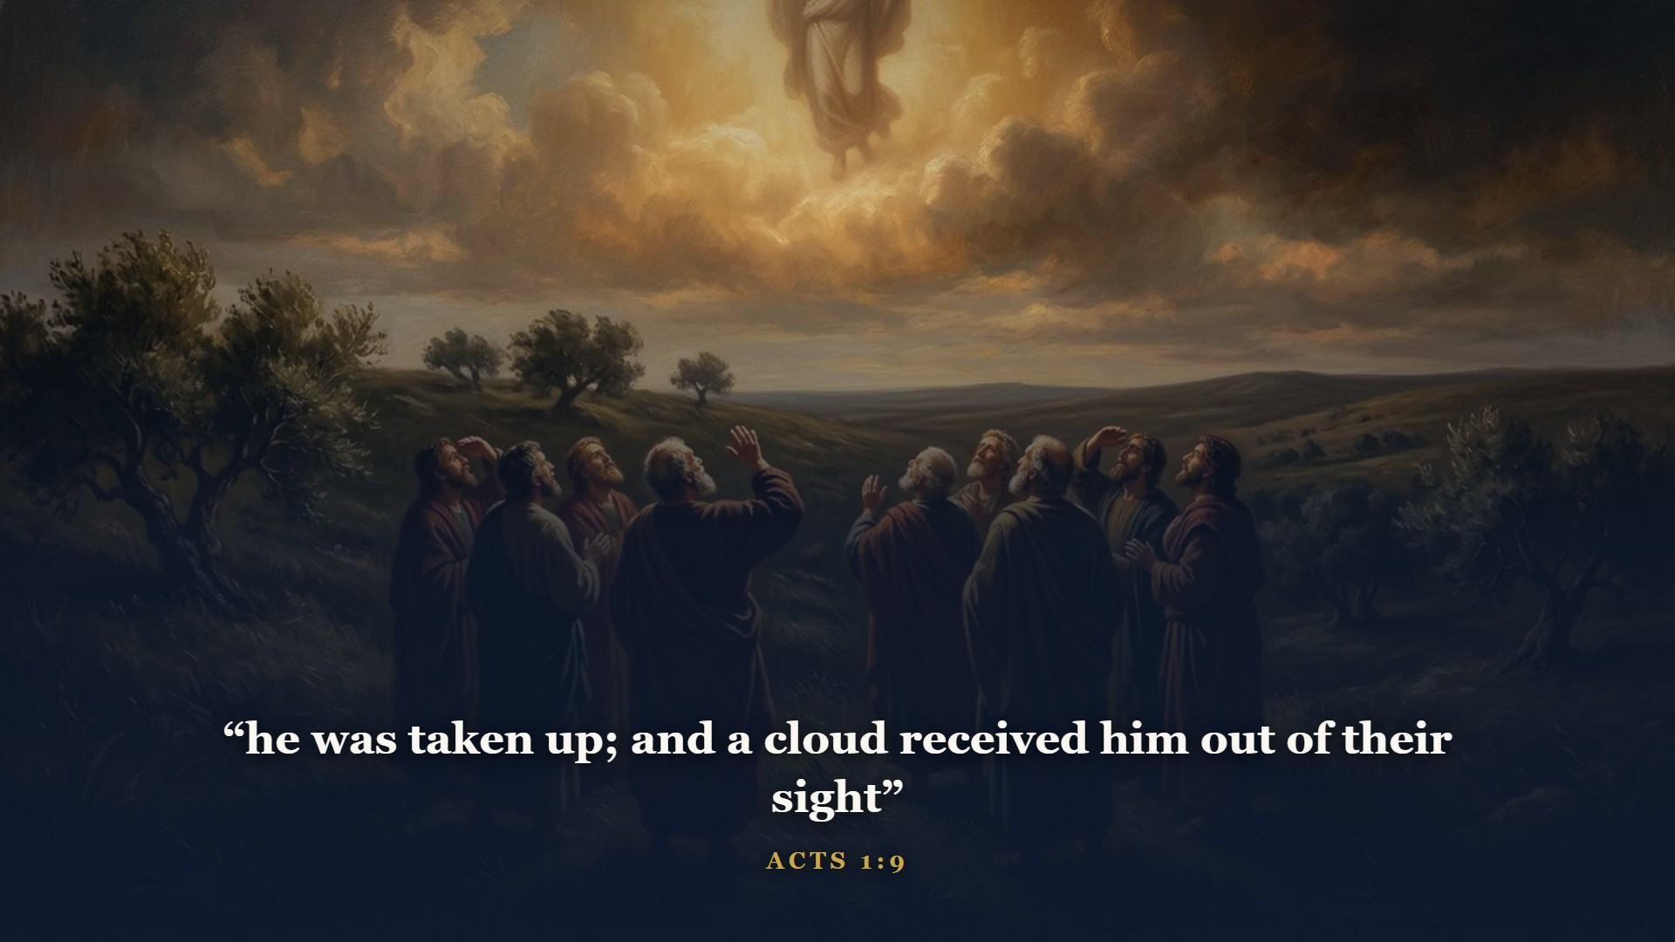
Notes:
Forty days after the resurrection, on the Mount of Olives. He gave His men their orders and then went home. Verse 8 is the table of contents for the whole book of Acts: Jerusalem chapters 1-7, Judaea and Samaria 8-12, the uttermost part of the earth 13-28.

Slide 5
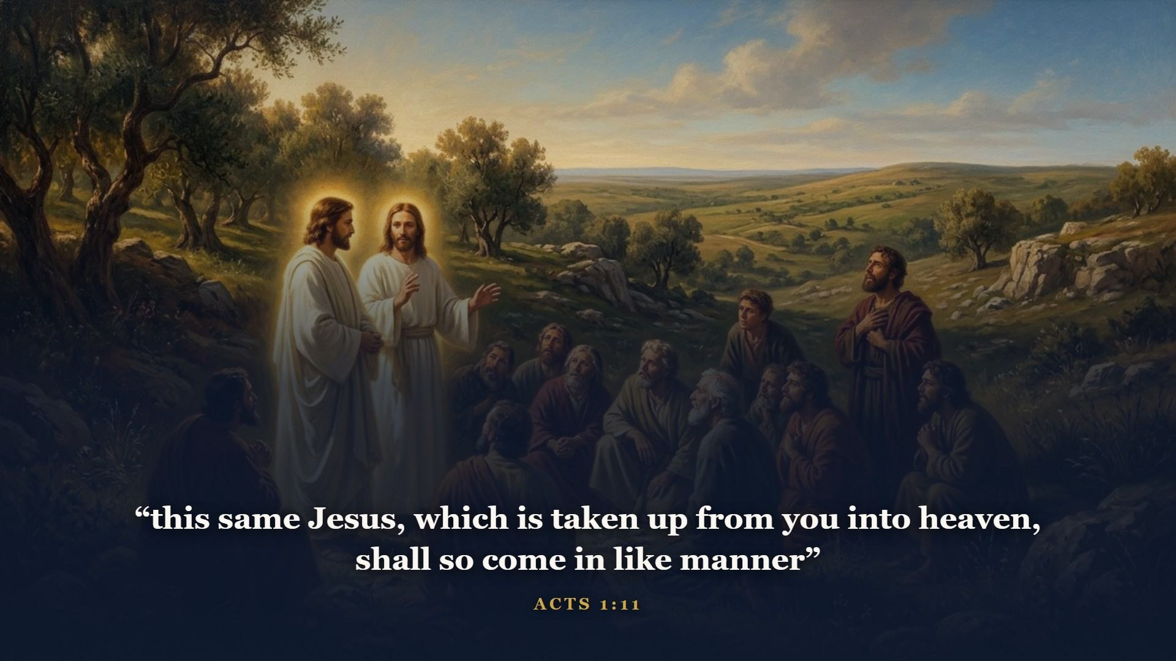
Notes:
Two angels - and notice, TWO MEN in white apparel. That is a promise we are going to collect on before this class ends. Same Jesus. Same manner. Same mountain.

Slide 6
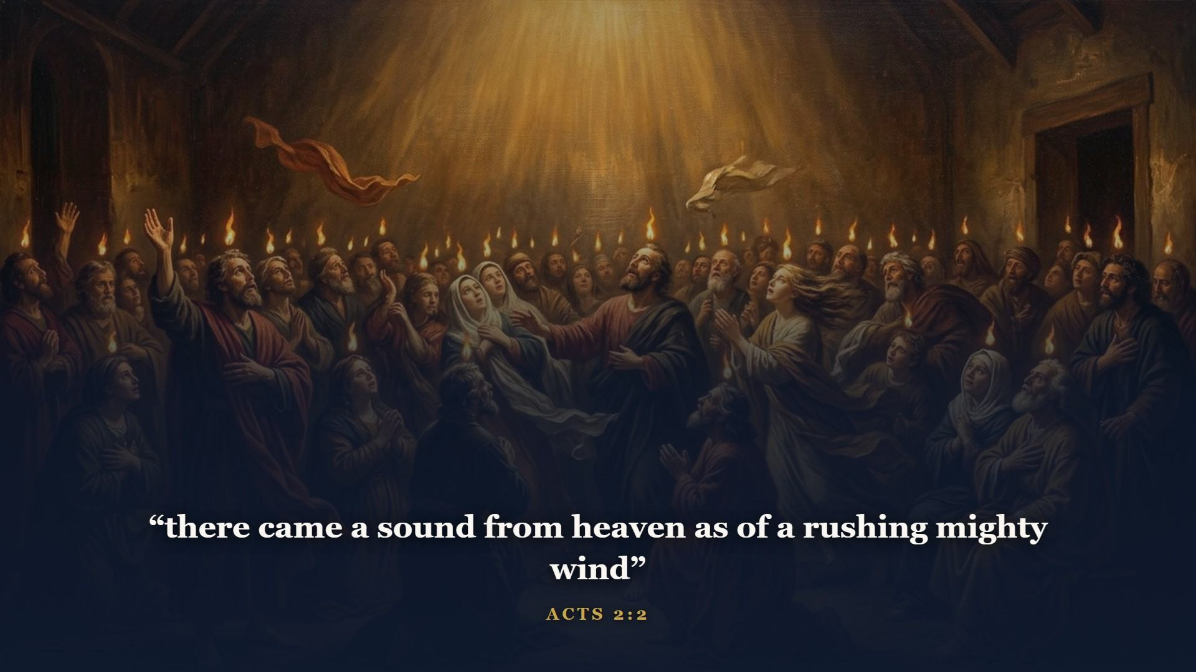
Notes:
Ten days later, at the feast of Pentecost - and the CHURCH was born. Not a building. The word means a called-out assembly: every blood-bought believer, Jew or Gentile, from Pentecost until the trumpet.

Slide 7
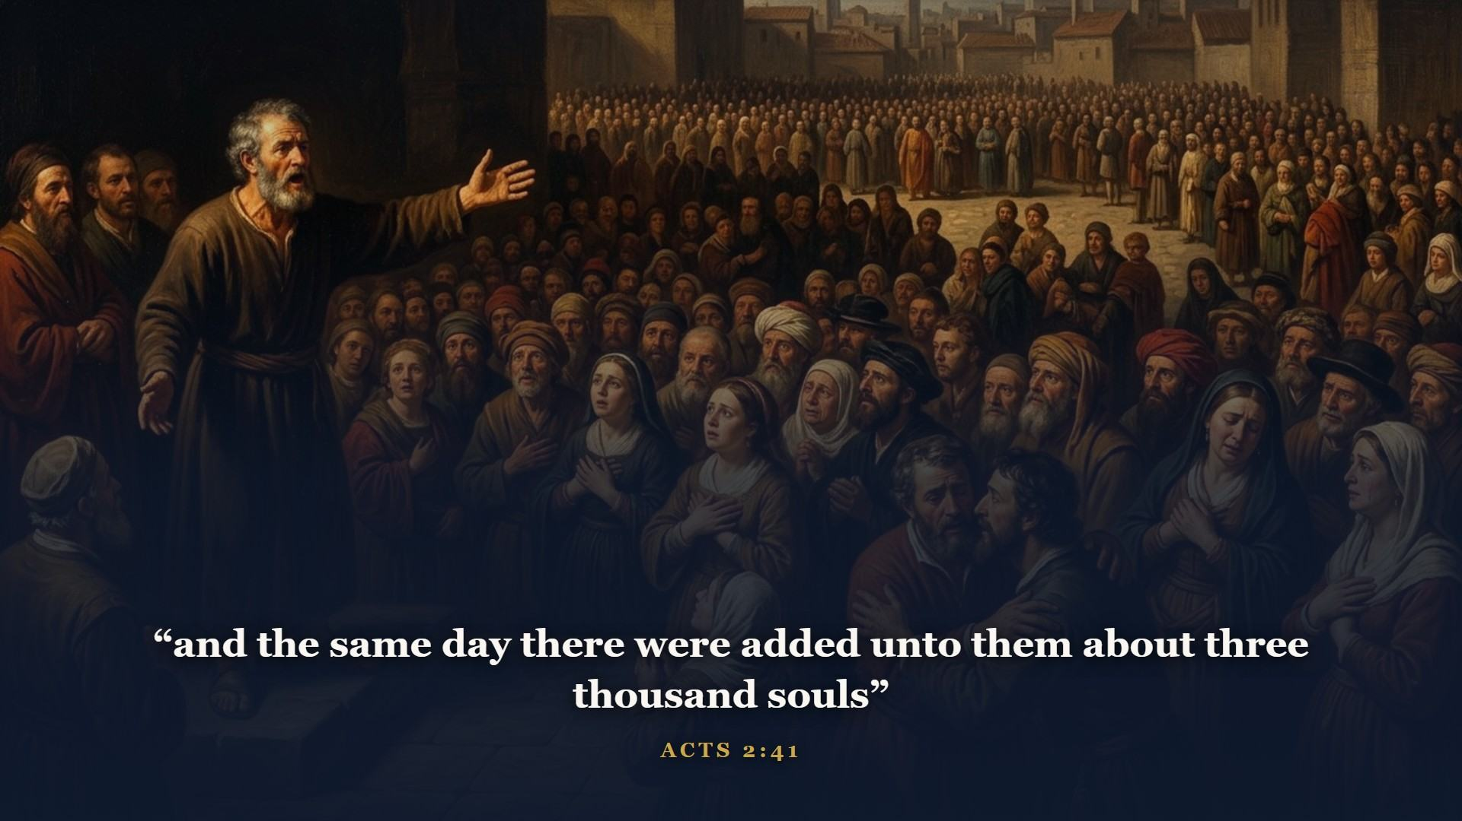
Notes:
Peter - the same man who folded before a servant girl seven weeks earlier - stood up and preached Jesus crucified and risen. Three thousand saved before sundown. The Day of Grace, which dawned quietly at the empty tomb, went public with a bang. And mark this for your timeline: the church is something NEW, not Israel under new management. God's promises to Israel are signed in His own I WILL. The church does not cash Israel's checks - she has riches of her own.

Slide 8
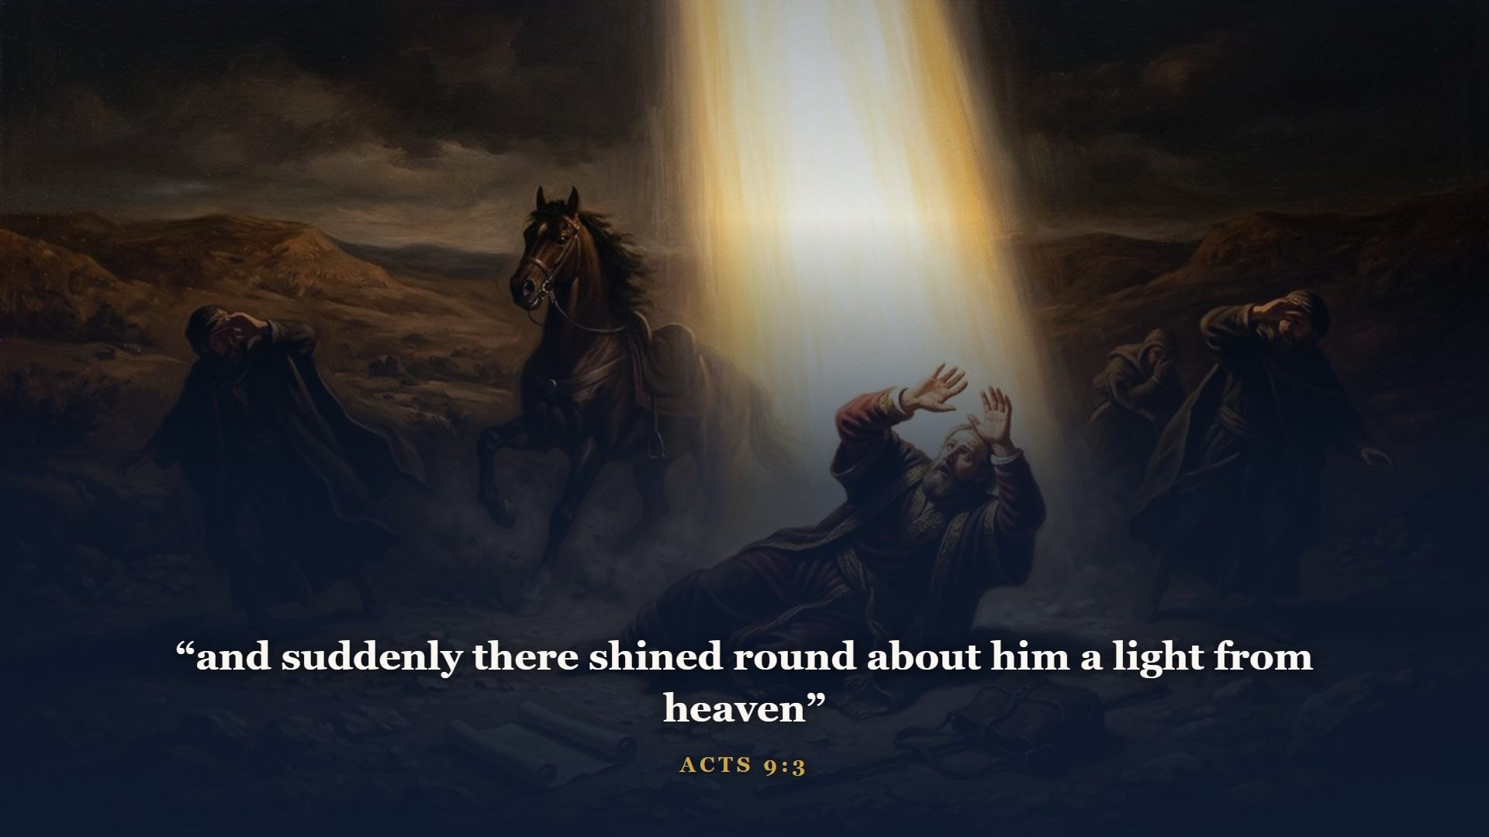
Notes:
The gospel jumped every fence men built around it. A persecutor named Saul of Tarsus got knocked flat by the glorified Christ Himself, and got up as Paul, the apostle to the Gentiles.

Slide 9
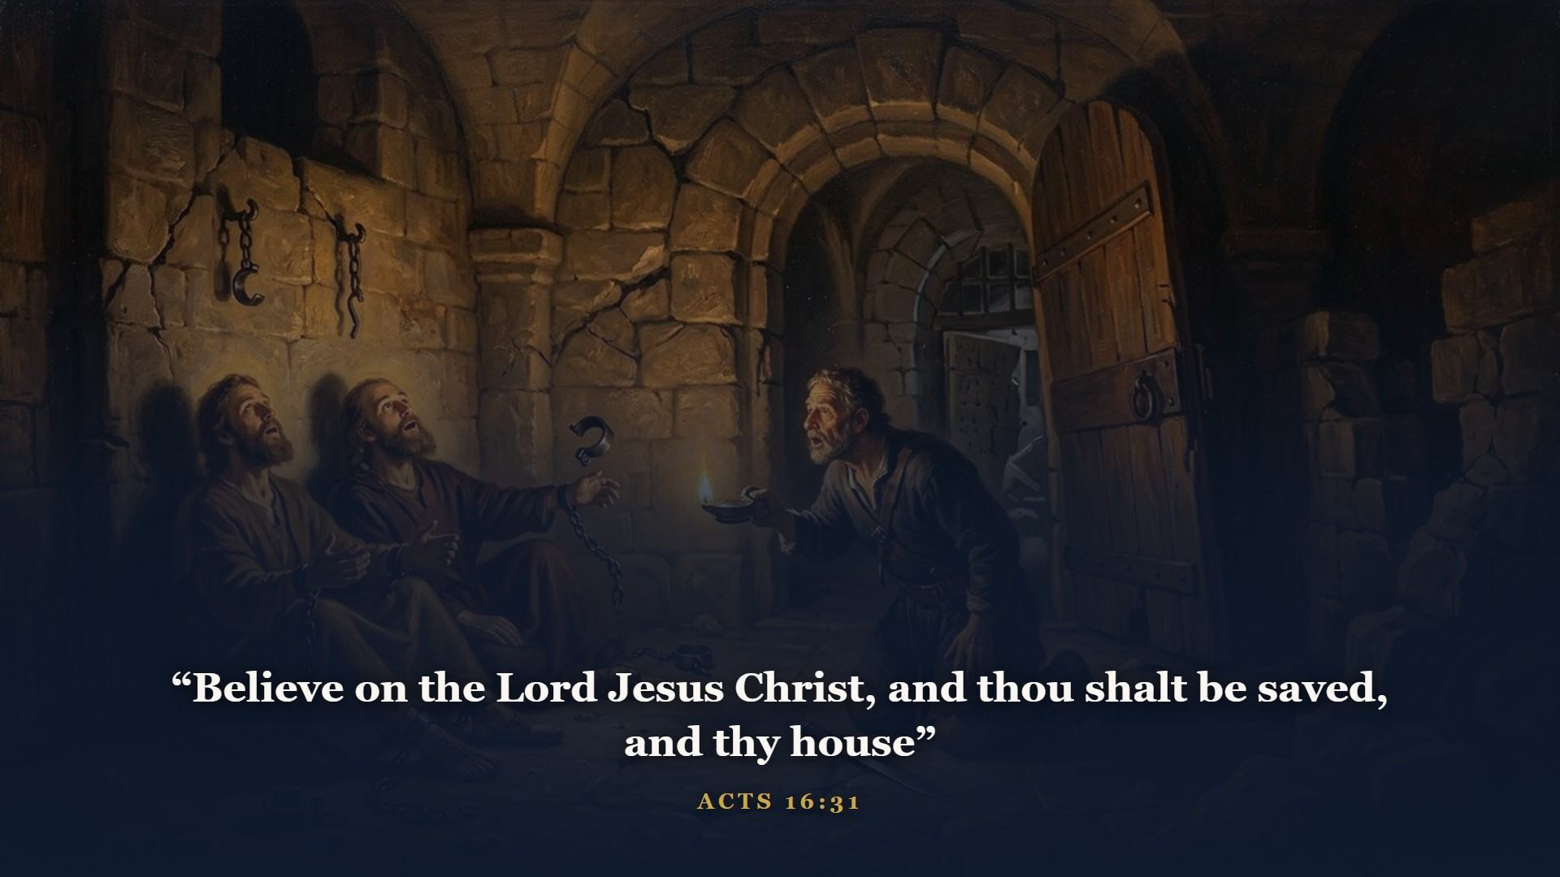
Notes:
Midnight in a Philippian jail - earthquake, open doors, a drawn sword. Sirs, what must I do to be saved? That is still the whole answer. It was the answer last week at the cross; it is the answer at graduation.

Slide 10

Notes:
Twenty-one letters. Here is the shelf map so they never blur together again. Paul to churches: Romans lays the foundation, Corinthians corrects a messy church, Galatians defends grace, Ephesians seats us in the heavenlies, Philippians sings from prison, Colossians crowns Christ. Paul to men: Timothy and Titus train pastors. General epistles: Hebrews through Jude.

Slide 11
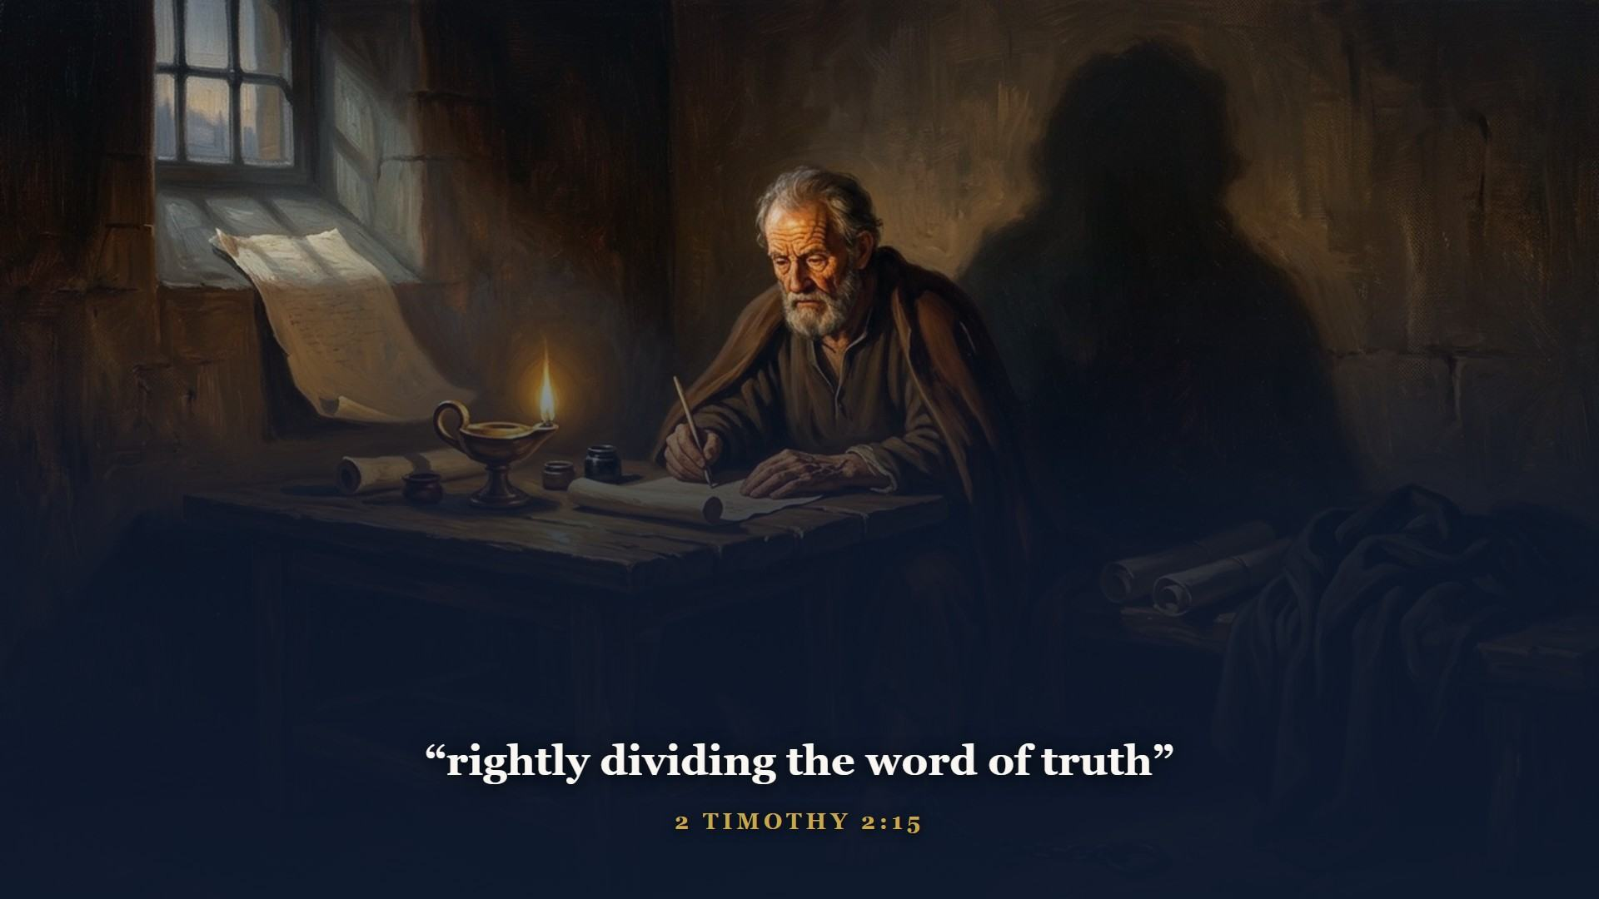
Notes:
There is your dispensational chart in a phrase. Cut the Word straight - know which mail is addressed to Israel, which to the church, which to the Kingdom - and the contradictions people claim to find in this Book evaporate. This is the verse on your graduation certificate.

Slide 12
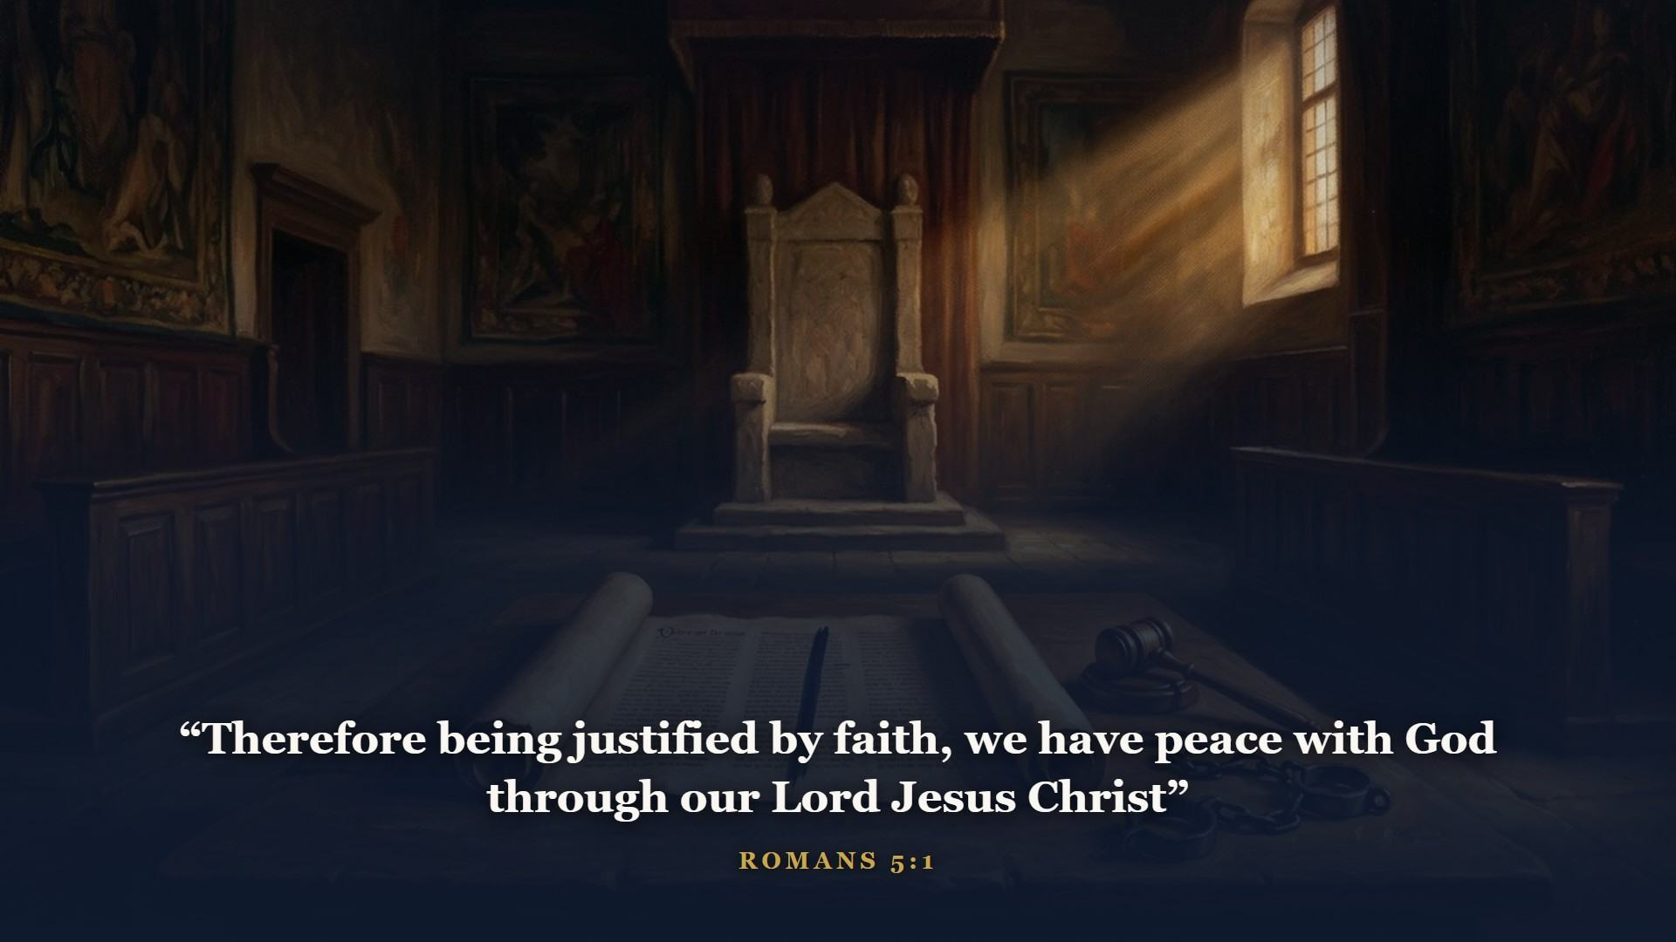
Notes:
Romans lays the foundation stone: how a guilty man is JUSTIFIED, declared righteous - exactly what Job asked in Class 1. Peace WITH God: the war is over, the verdict is in. And it rests on faith, just like Genesis 15:6 - Paul spends Romans 4 proving it from Abraham's own case.

Slide 13
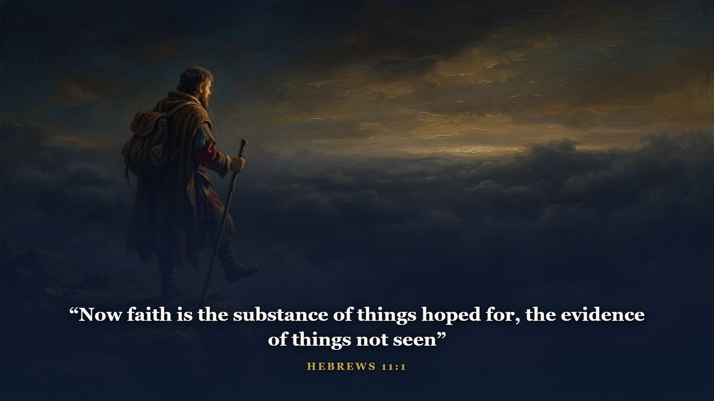
Notes:
Hebrews preaches to wavering Jewish believers that Christ is BETTER - better than angels, than Moses, a better priesthood, a better sacrifice. The whole tabernacle of Class 2 explained from heaven's side of the veil. Then chapter 11 marches Abel, Enoch, Noah, Abraham, Moses and Rahab past you in review - your Class 1 and 2 roster, every one saved the same way you are.

Slide 14
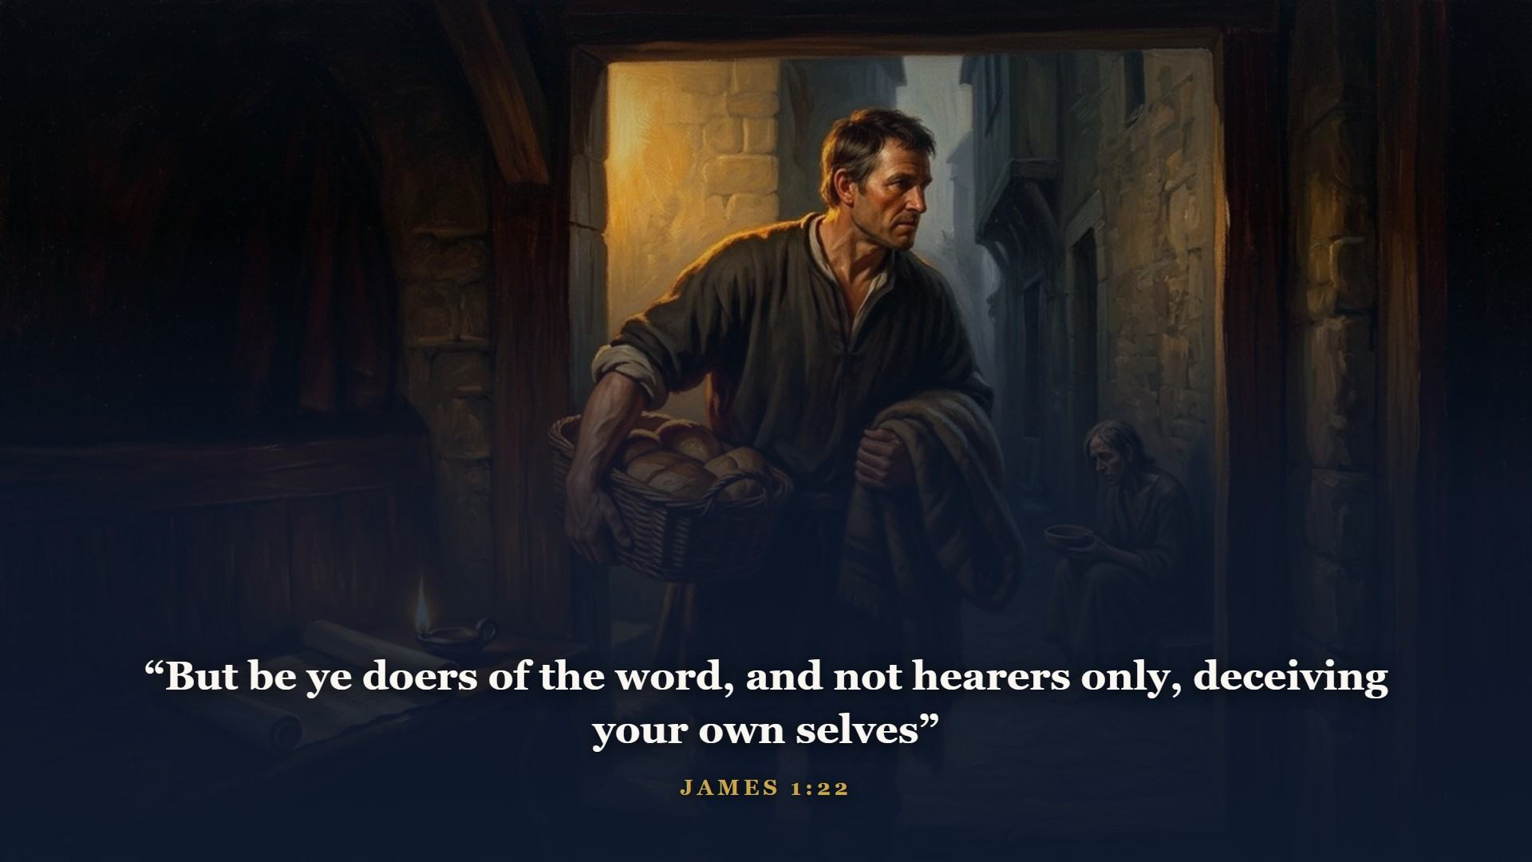
Notes:
James, the Lord's half brother, makes sure nobody mistakes real faith for a head full of right answers. Faith alone saves - and saving faith never stays alone. It rolls up its sleeves.

Slide 15
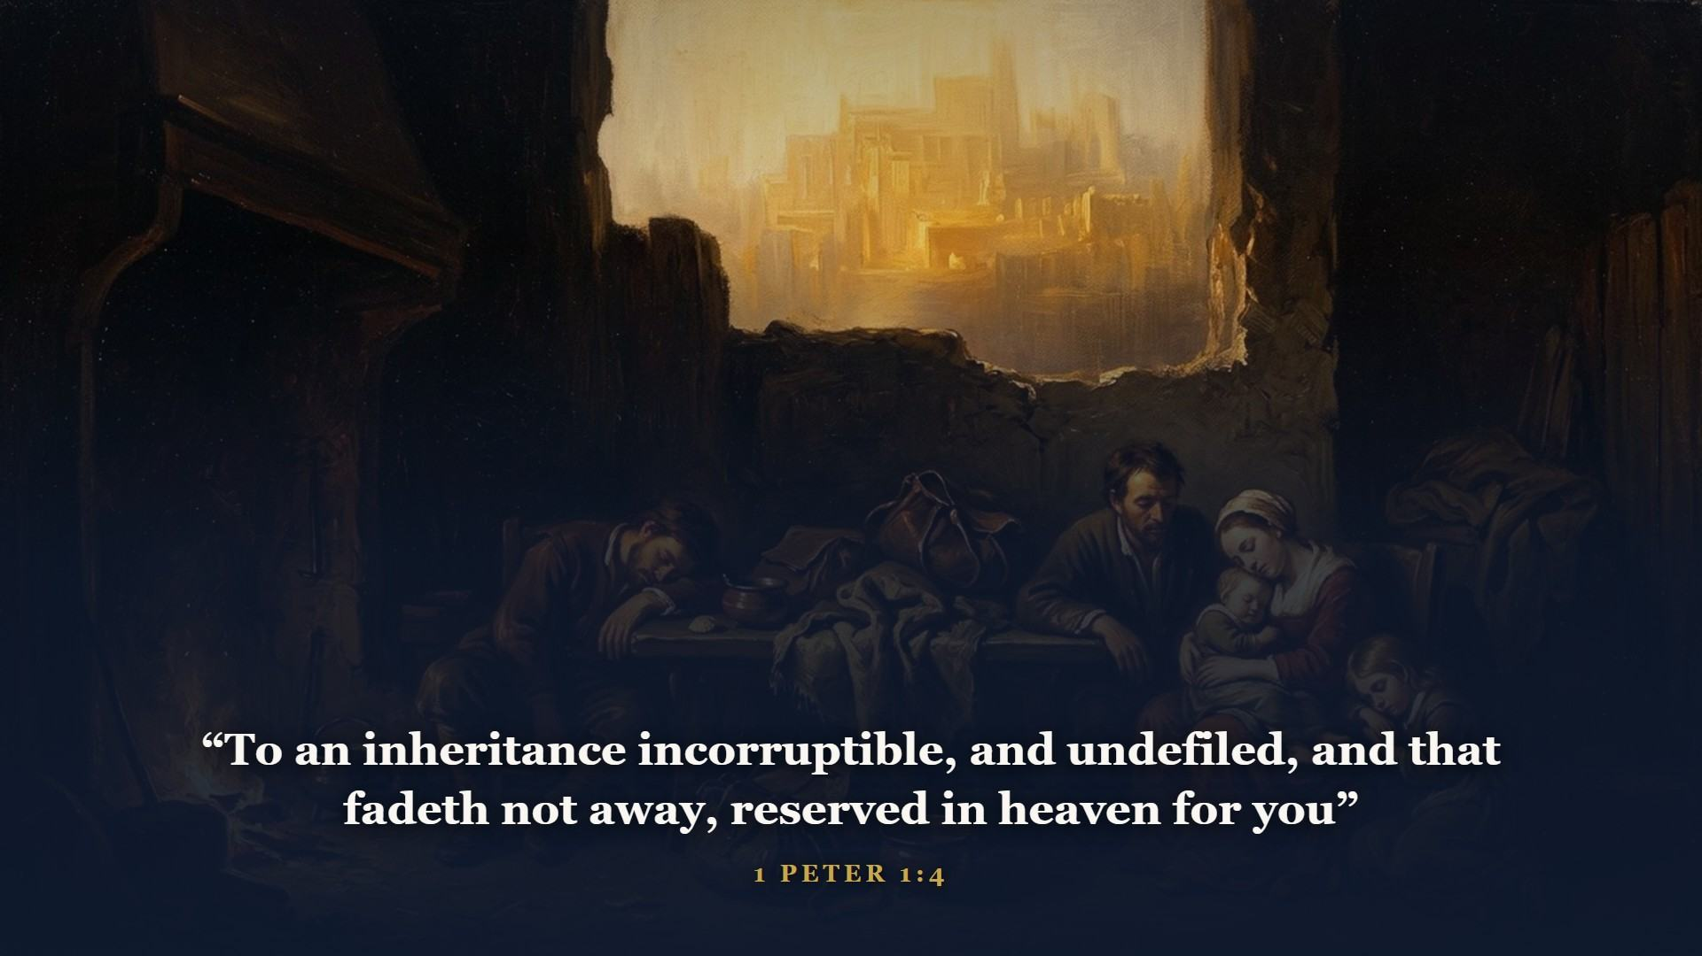
Notes:
Peter writes to scattered, suffering saints and lifts their eyes to an inheritance no thief or moth or stock market can touch. Begotten again to a LIVELY - a living - hope. Kept by the power of God. John's letters give the family birthmarks; Jude sounds the last alarm: contend for the faith.

Slide 16
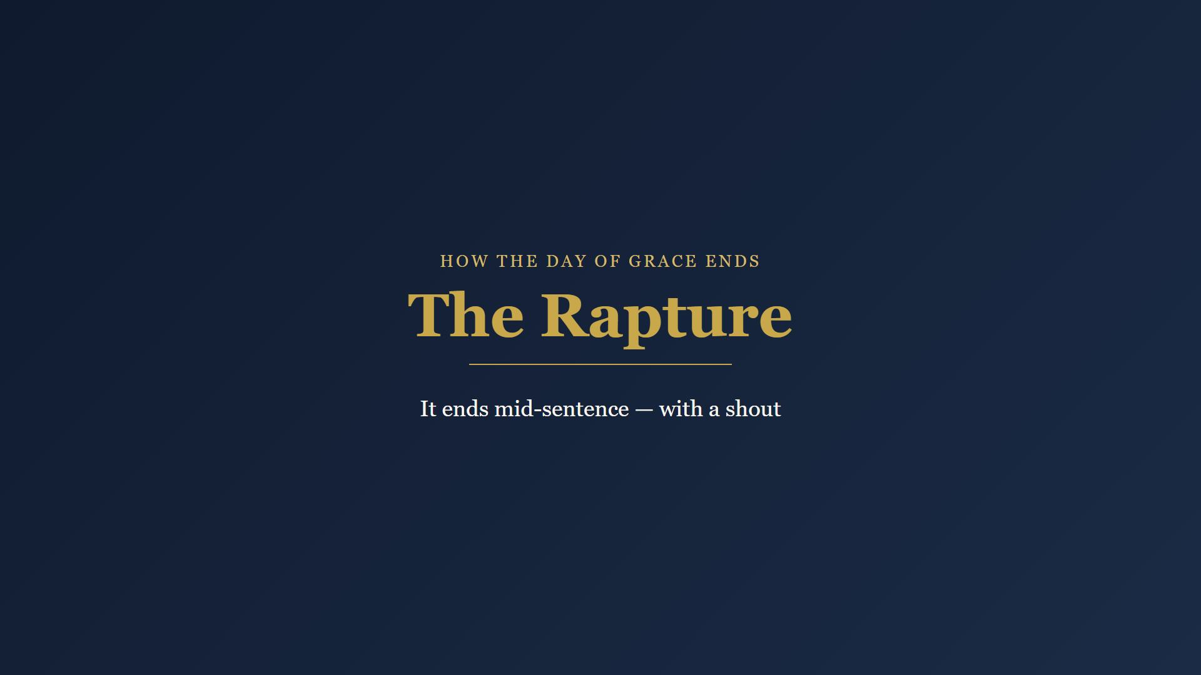
Notes:
Now lift your eyes from the shelf to the horizon. The church age does not run out with a whimper or a slow fade. It ends mid-sentence, with a shout.

Slide 17
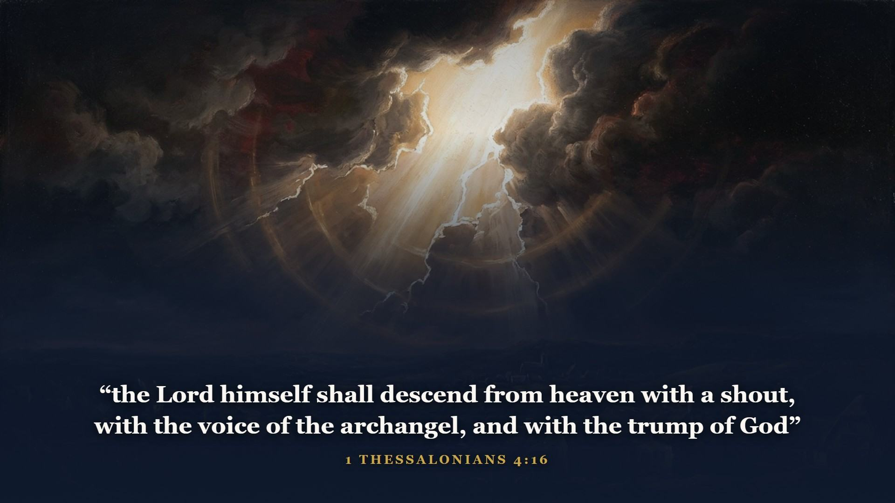
Notes:
Paul told the Thessalonians - young believers grieving their dead - exactly how. And the dead in Christ shall rise first.

Slide 18
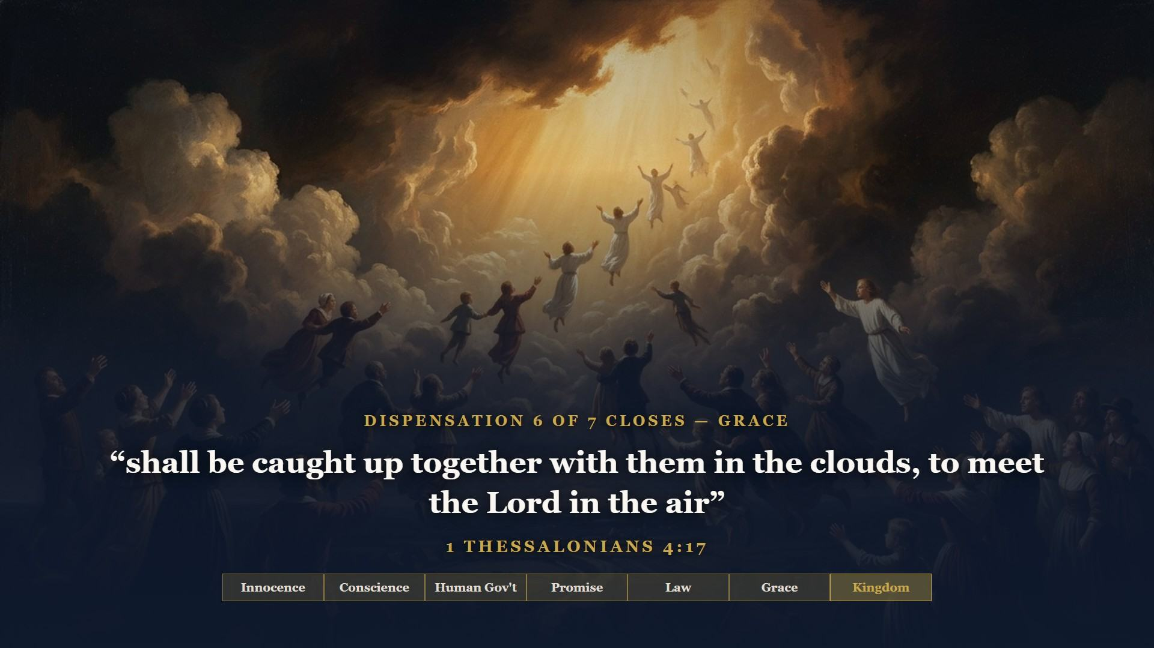
Notes:
RAPTURE comes from the old Latin Bible's word for caught up. PREVENT in verse 15 is the old word for PRECEDE - the living will not go ahead of the sleeping saints. This is the angels' Acts 1 promise beginning to pay out. And notice what it is given for: not date-setting, not panic - COMFORT. The dispensation of Grace closes the way it opened: with a resurrection.

Slide 19
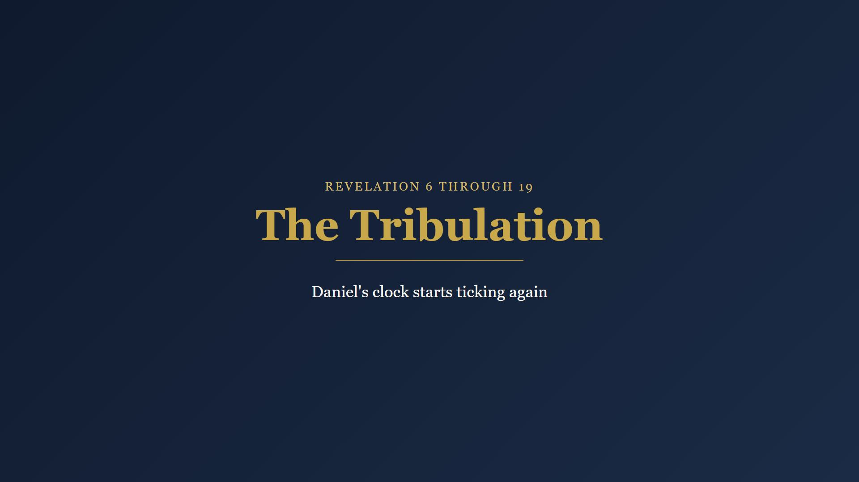
Notes:
With the church gone, God's prophetic clock for Israel - Daniel's clock, paused these two thousand years - starts ticking again. Seven years the prophets called the time of Jacob's trouble.

Slide 20
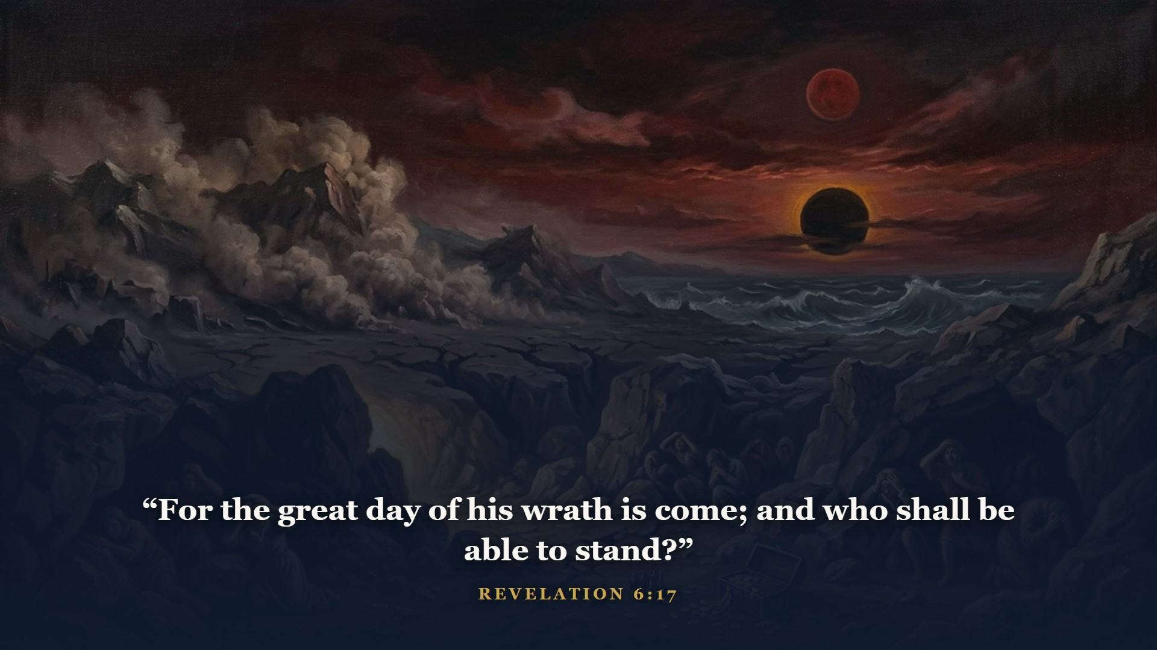
Notes:
Seals, trumpets, and vials of judgment. Heaven is not improvising one minute of it - you watched the prophets call empires in order. This is the same Author finishing the same outline.

Slide 21
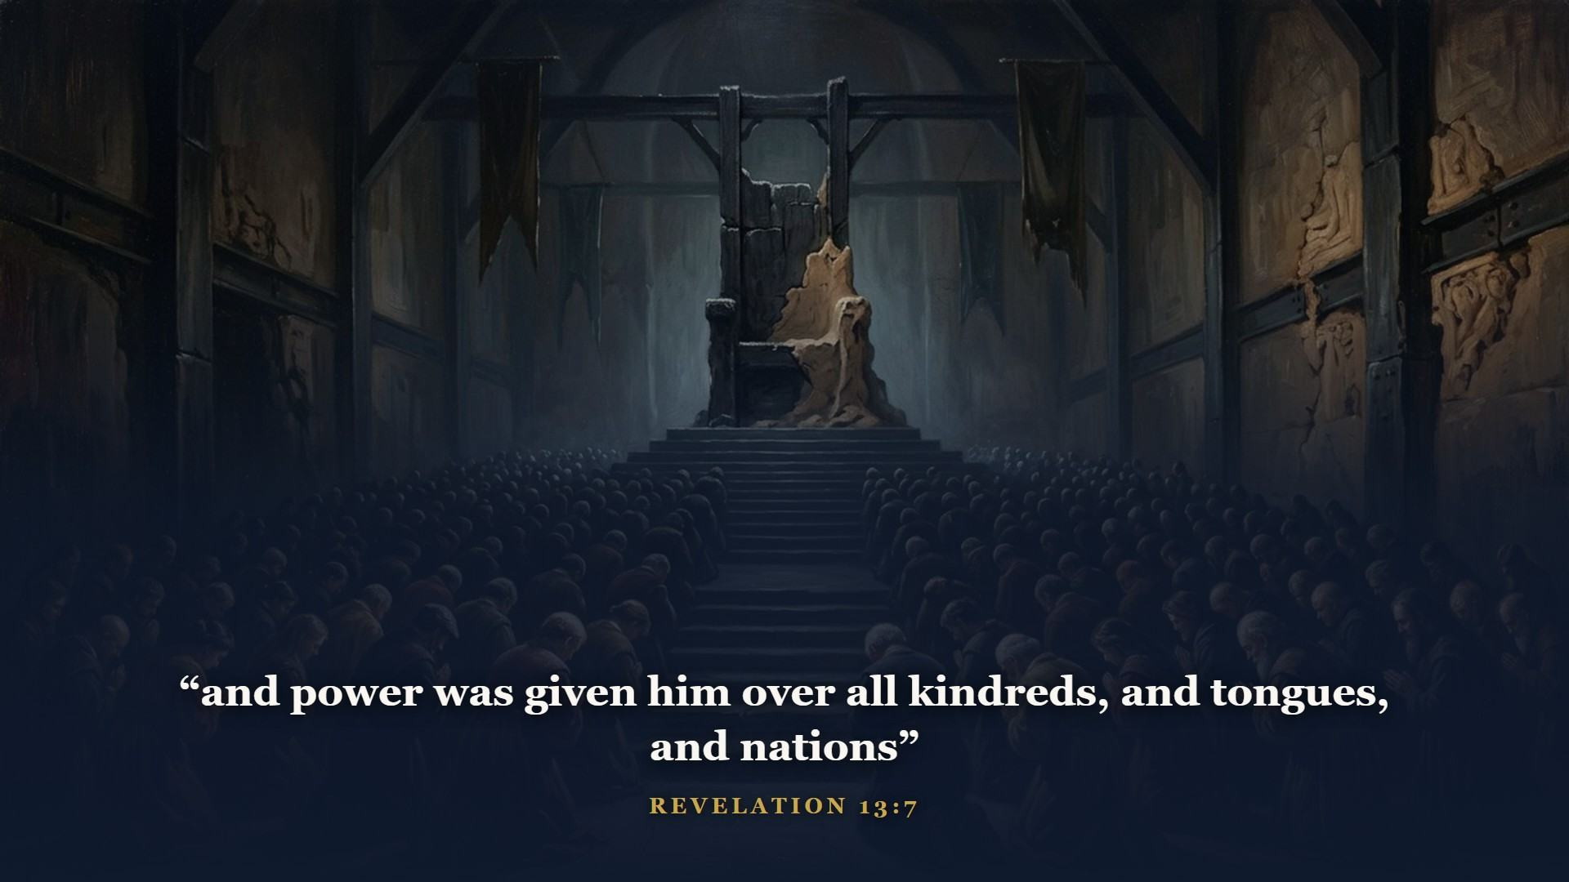
Notes:
A final world ruler the Bible calls the beast - the iron-and-clay toes of Daniel's statue assembling at last. Class 3 showed you the statue; here are the feet.

Slide 22
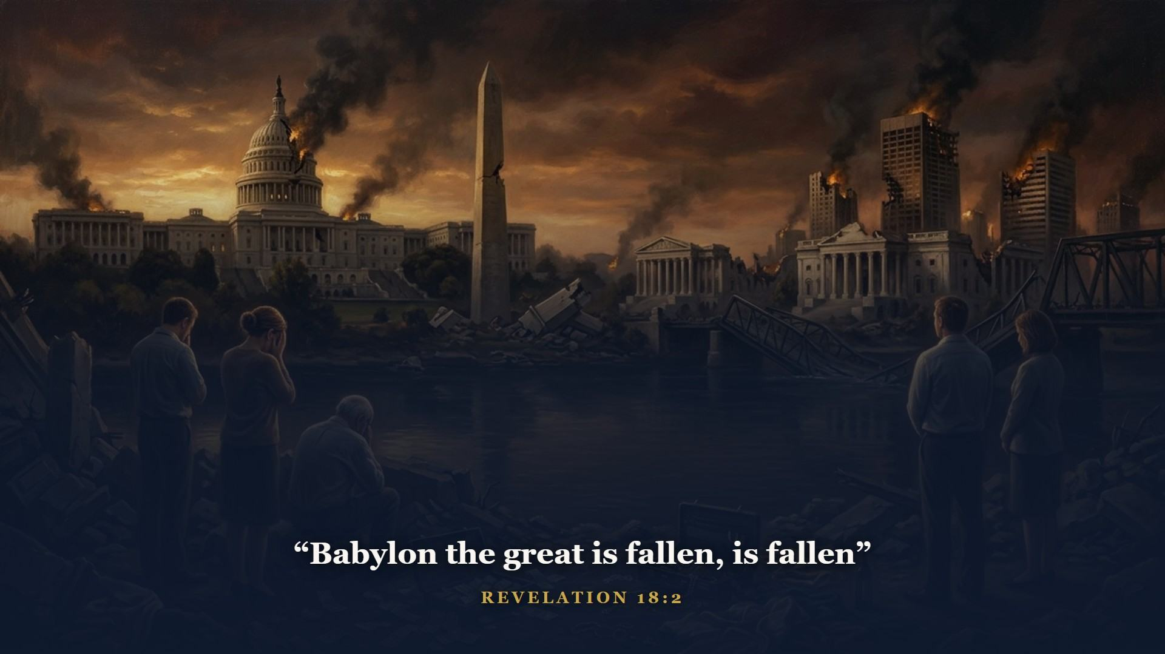
Notes:
Babylon's religion and Babylon's commerce, both judged. Babel started in Class 1 with let us make us a name. It ends here.

Slide 23
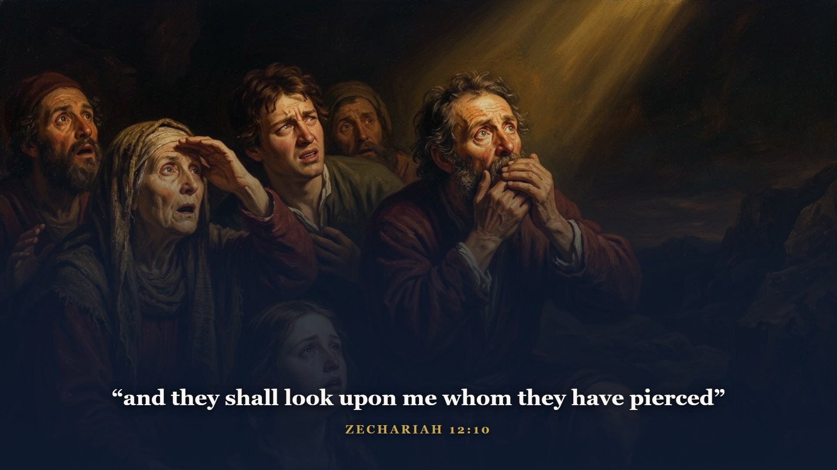
Notes:
A remnant of Israel sealed and brought through the fire - finally looking on Him whom they pierced. God never wrote them off.

Slide 24
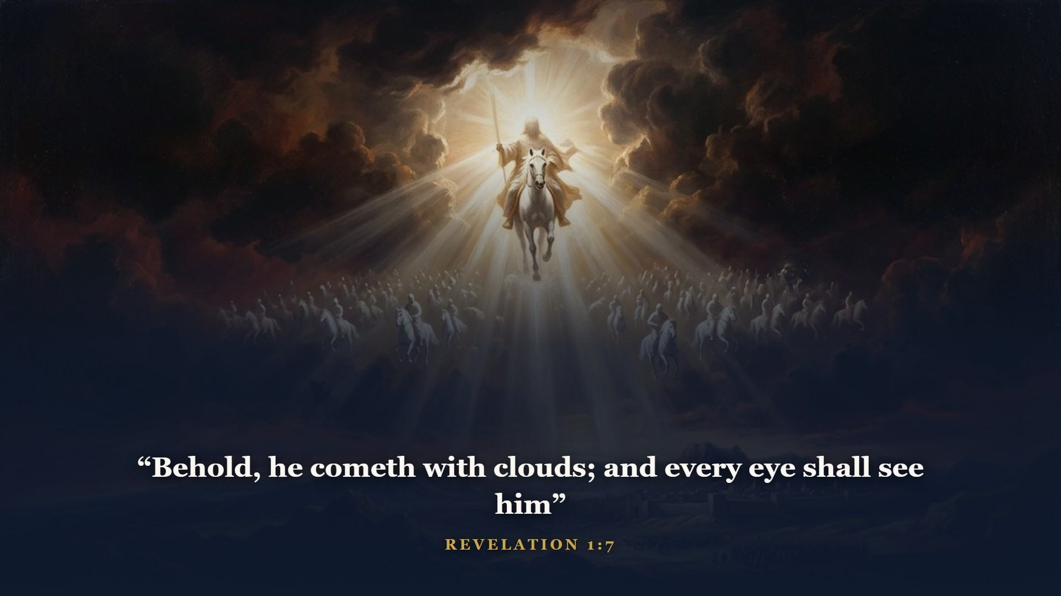
Notes:
The event every Old Testament prophet strained to see. Not a secret catching away this time - EVERY EYE. And they also which pierced him.

Slide 25
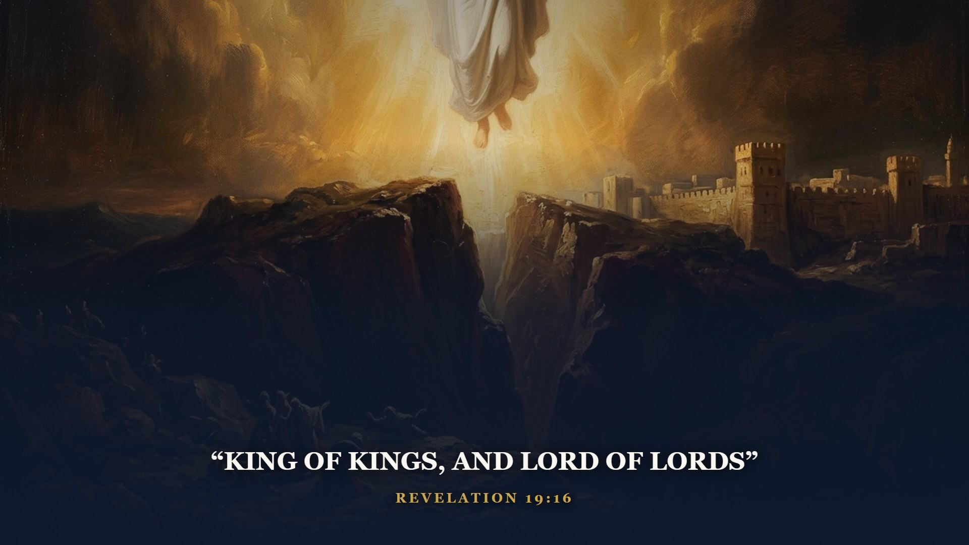
Notes:
Heaven opens and the King returns - to the Mount of Olives He ascended from, just as the two angels promised. The beast's armies are broken at Armageddon by the word of His mouth.

Slide 26
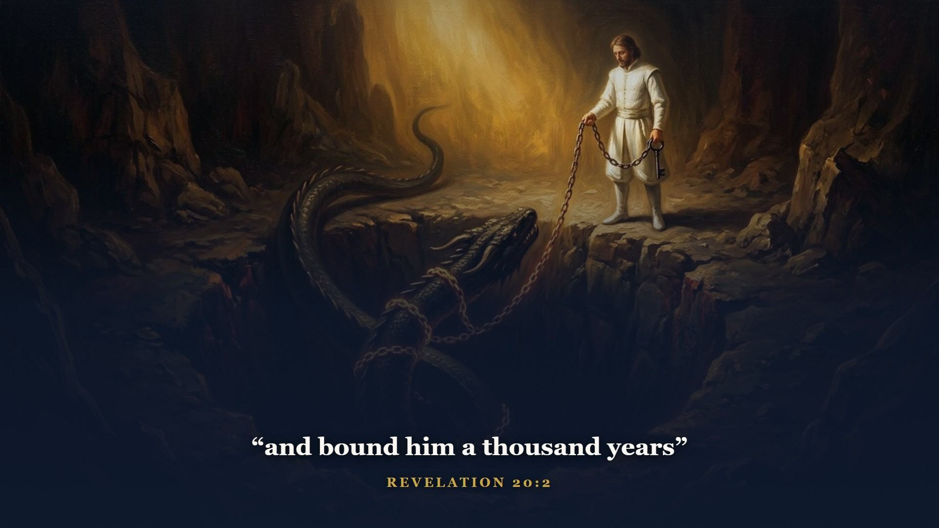
Notes:
Satan chained in the bottomless pit. For the first time since Eden, the tempter is off the board.

Slide 27

Notes:
Now, at last, the seventh dispensation. Everything God promised and man forfeited comes due at once.

Slide 28
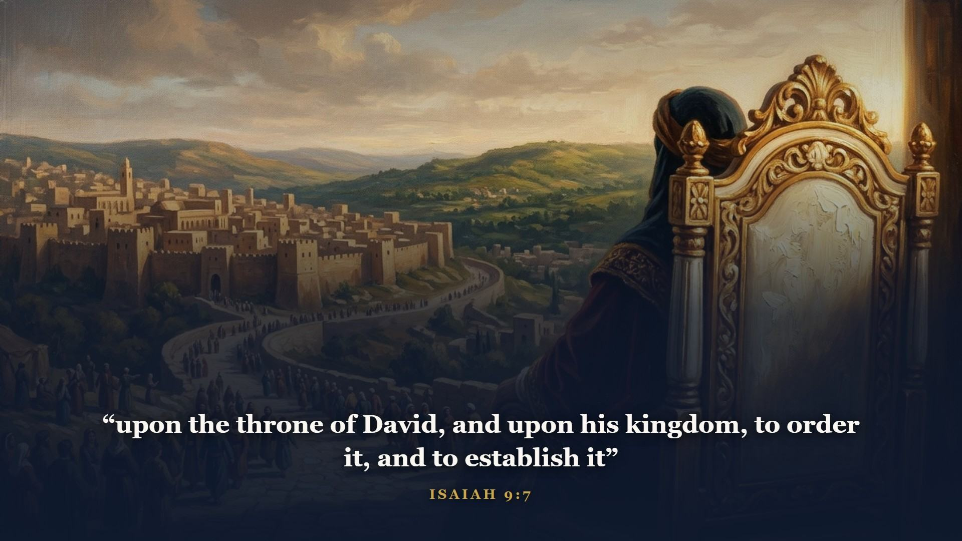
Notes:
The throne of David - promised in 2 Samuel 7, announced by Gabriel in Luke 1 - occupied, in Jerusalem, by David's greater Son, for a thousand years. Revelation 20 says so six times.

Slide 29
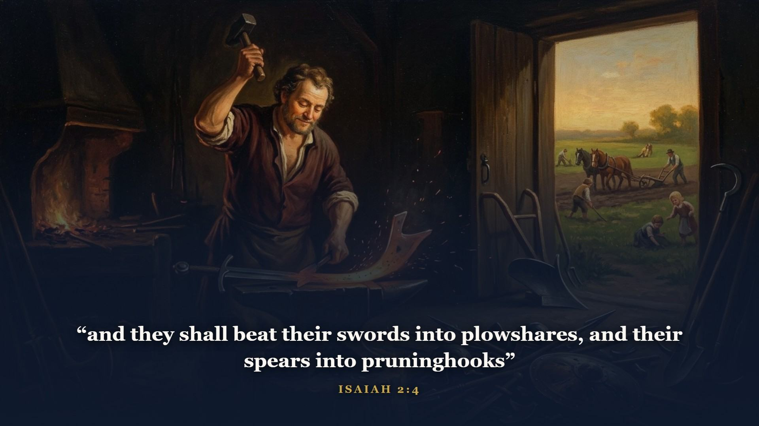
Notes:
Isaiah's Child with the government on His shoulder governs. Perfect King, perfect justice, a healed planet.

Slide 30
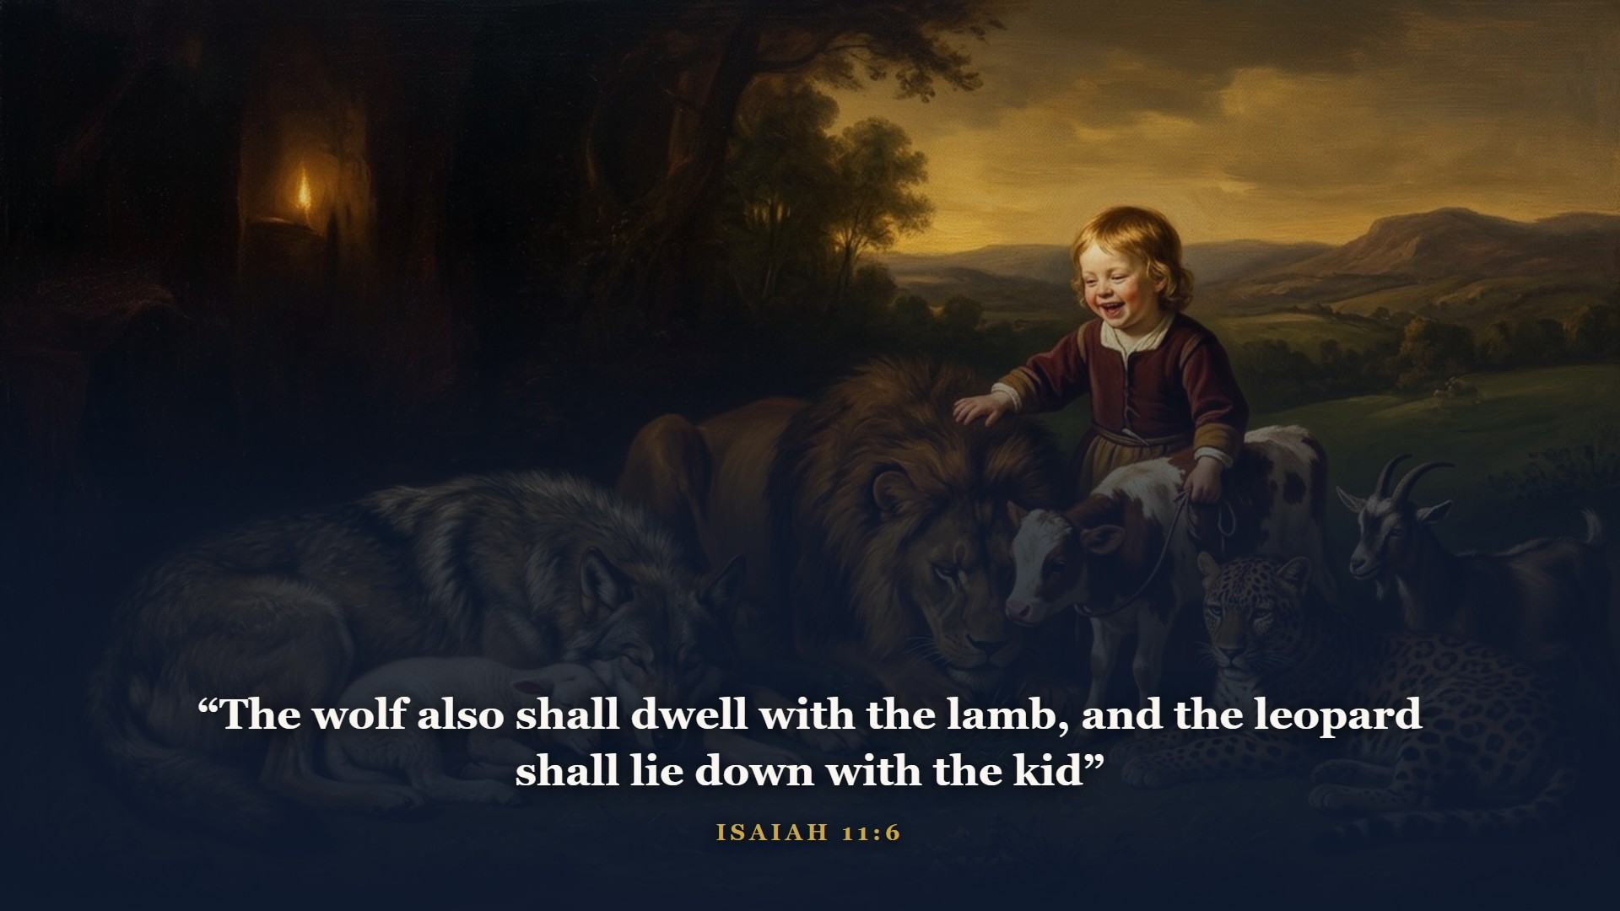
Notes:
The curse of Genesis 3 rolled back like a stone from a tomb.

Slide 31
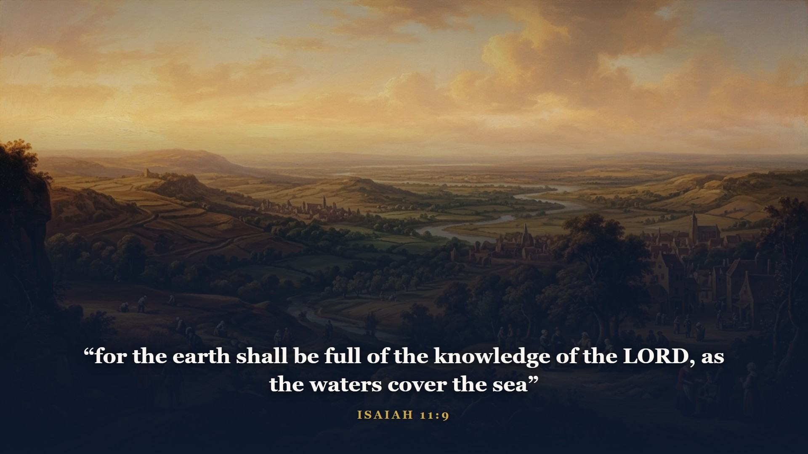
Notes:
Not a few pockets of light in a dark world. Saturated - the way water fills the sea.

Slide 32
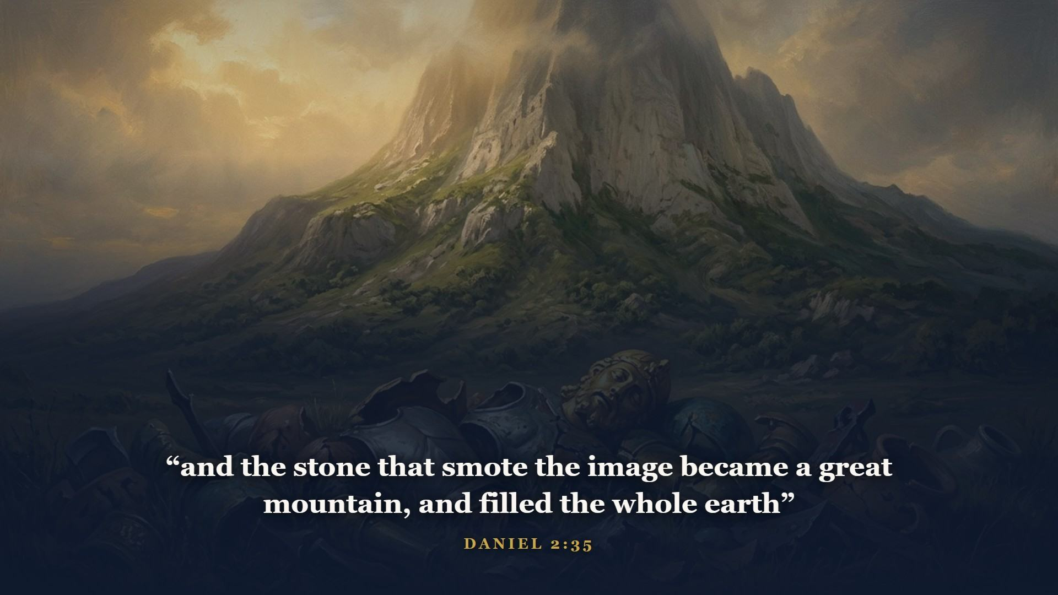
Notes:
There it is - the stone cut out without hands, from Class 3. We watched it hang over the statue for two thousand years. Here it lands, and grows, and fills the earth exactly as Daniel read it off Nebuchadnezzar's dream.

Slide 33
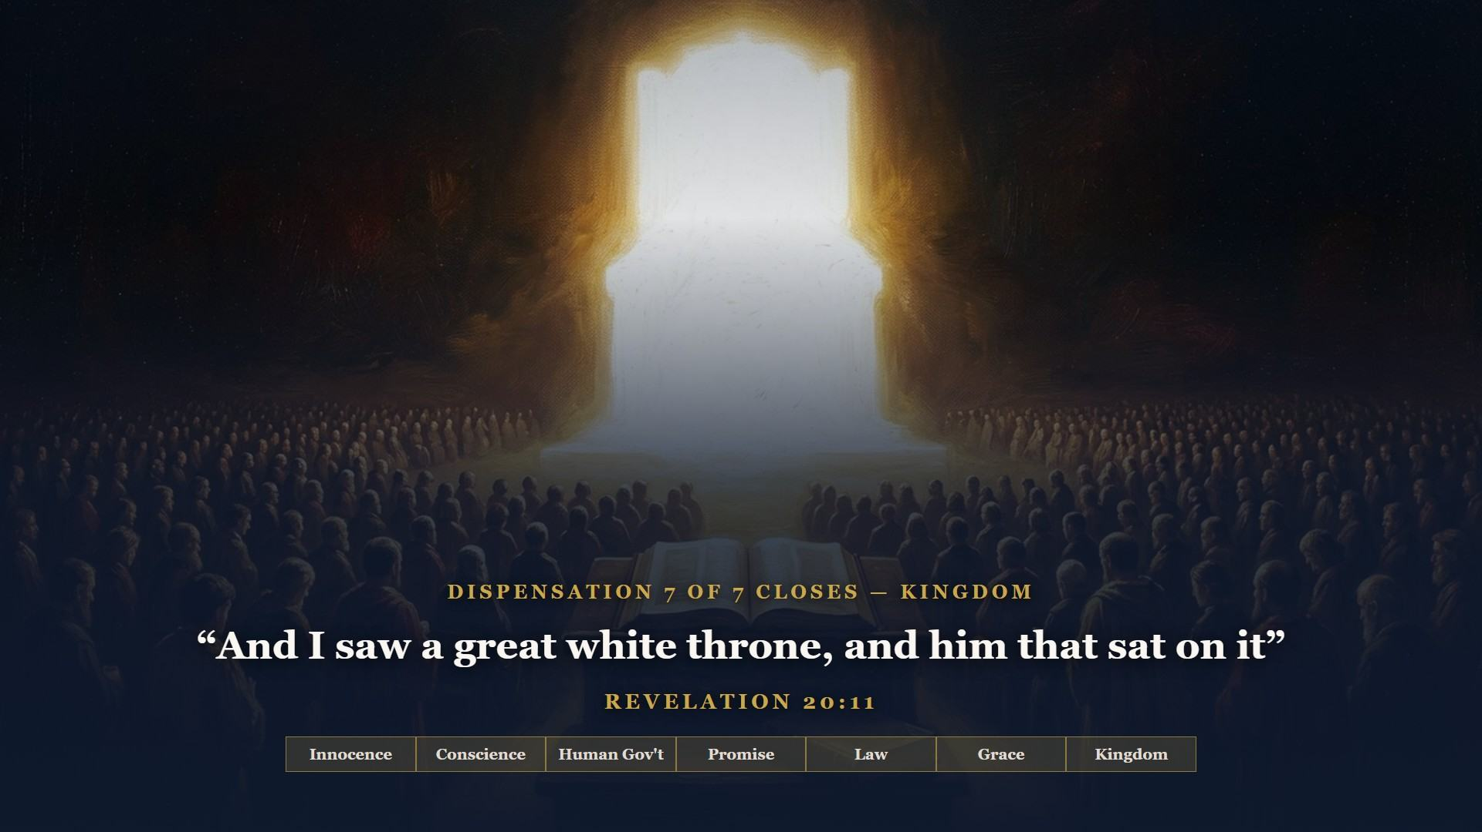
Notes:
At the end, Satan is loosed one last time - God leaves nothing untested - and he finds takers, with Eden-like conditions still warm around them. Fire from heaven ends it. Seven dispensations, seven tests, seven failures. The verdict of the whole Bible is in: the heart of man is the problem, and the grace of God is the only remedy there ever was. This is not a trial to determine guilt - it is a sentencing, ACCORDING TO THEIR WORKS, for everyone who insisted on standing on their works. One book decides the destination: the book of life. Make sure of your entry.

Slide 34
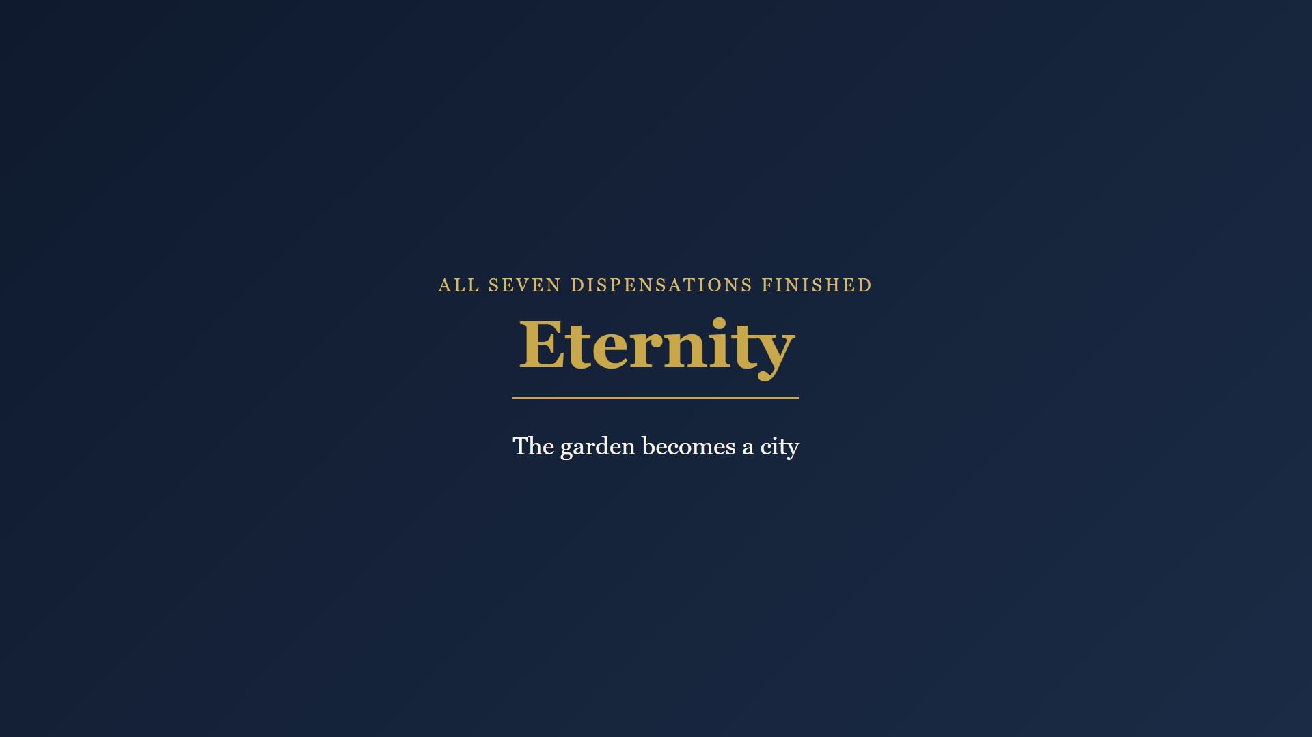
Notes:
And then John turns the last page, and there is no test on it at all - only grace, home at last.

Slide 35
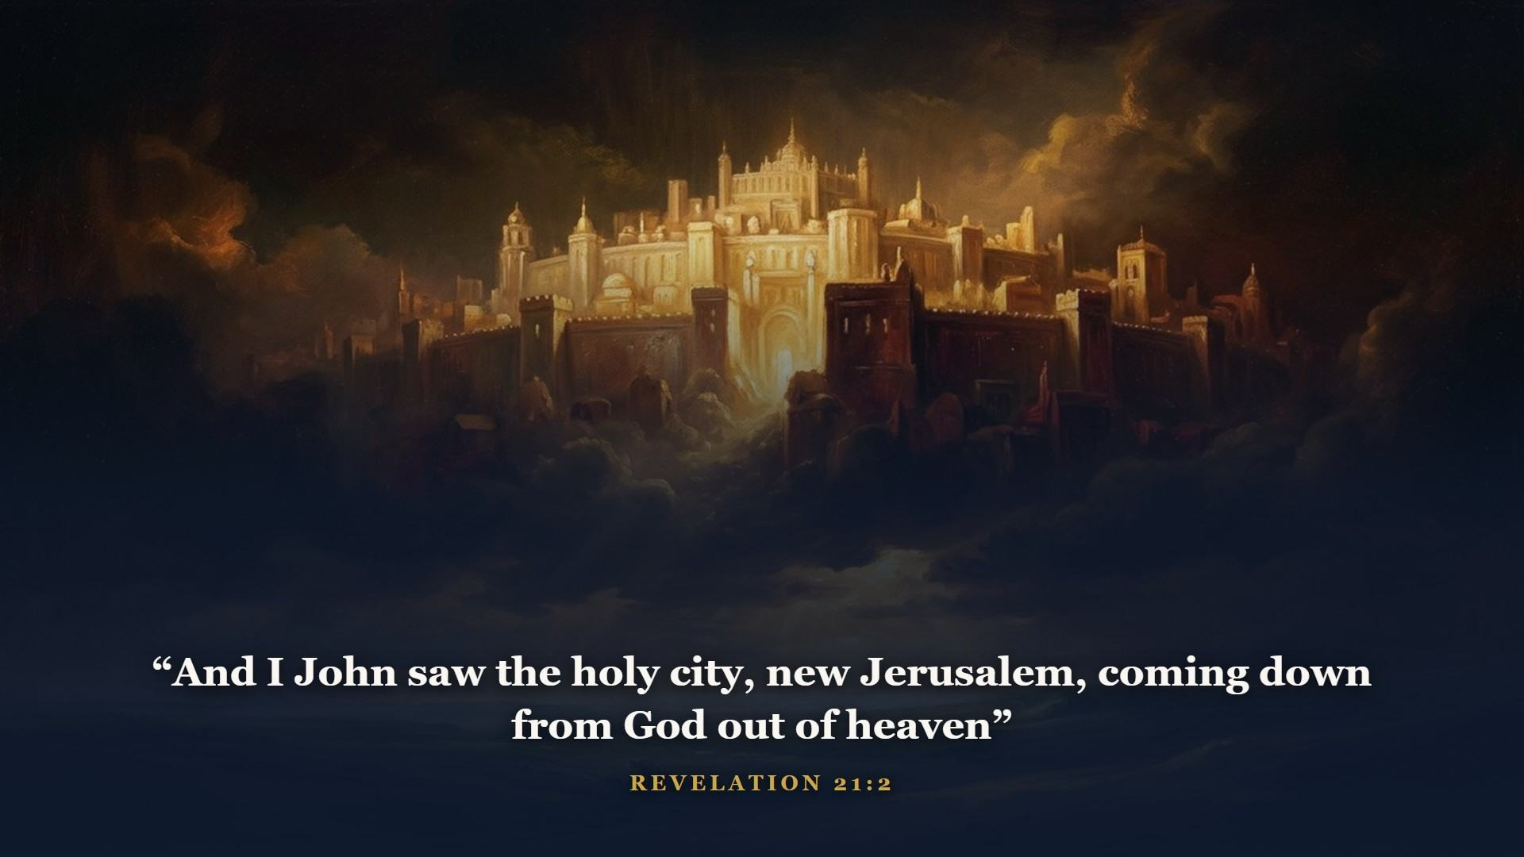
Notes:
Prepared as a bride adorned for her husband. Behold, the tabernacle of God is with men, and he will dwell with them.

Slide 36
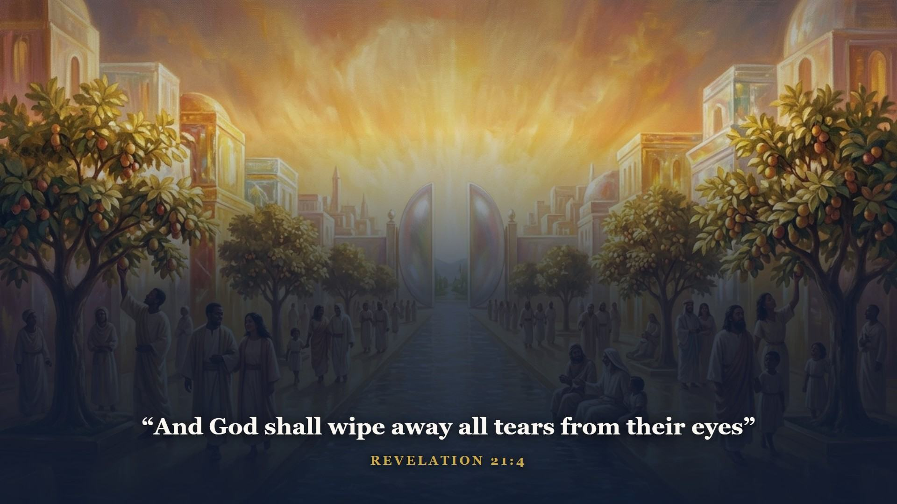
Notes:
Class 1 opened in a garden with a tree of life, a river, and God walking with man - and sin shut it behind a flaming sword. The Bible ends in a CITY with the tree of life, a river of water of life, and God dwelling with men forever - and nothing shuts it, for the gates are never closed. Eden is not just restored; it is outdone. Every tear, wiped by His own hand. IT IS DONE - the bookend to IT IS FINISHED.

Slide 37
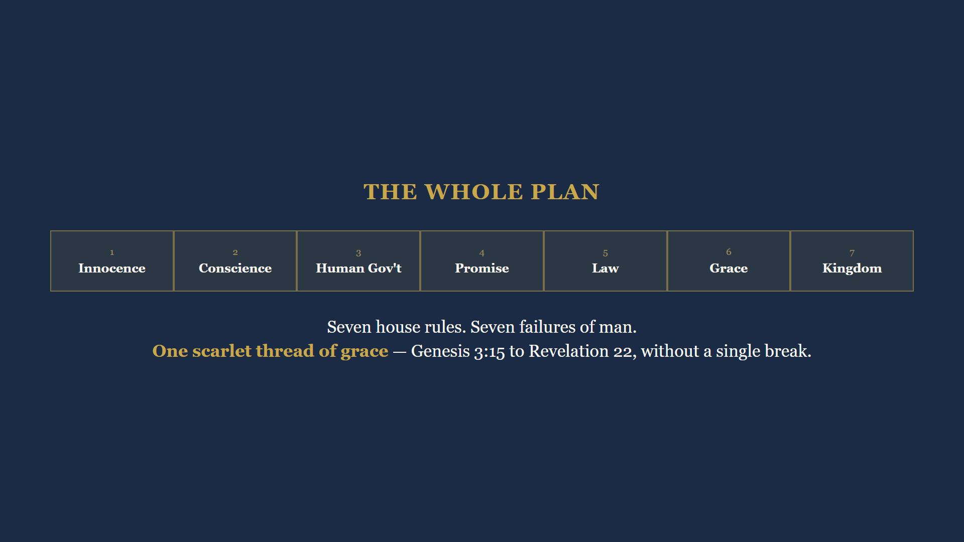
Notes:
Graduate, stand back and read the whole timeline you now own. Seven house rules. Seven failures of man. One scarlet thread of grace running through every age without a single break - Genesis 3:15 to Revelation 22.

Slide 38
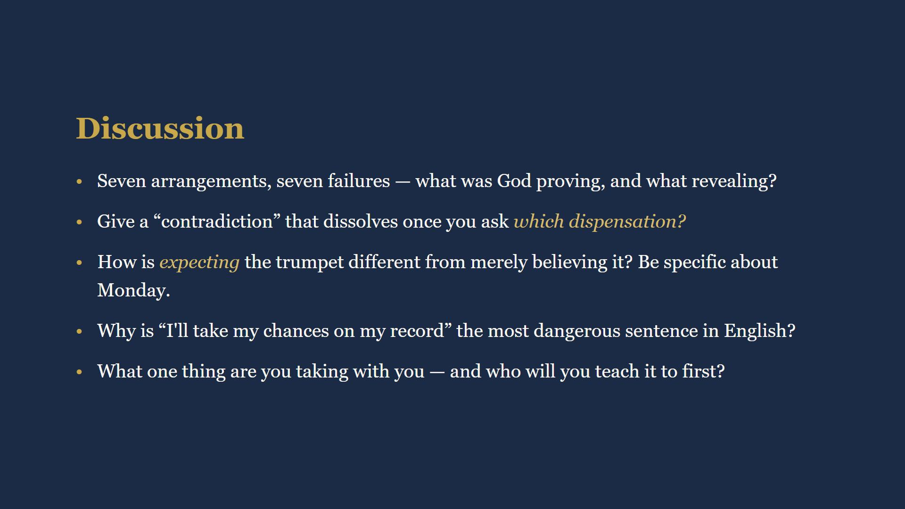
Notes:
15 minutes. Full wording in their workbooks. Q1: God proved man's heart is the problem and revealed His own grace as the remedy. Q2: rightly dividing dissolves apparent contradictions. Q3: expecting the trumpet changes Monday. Q4: I will take my chances on my record is the most dangerous sentence in English. Q5: what are you taking, and who will you teach?

Slide 39
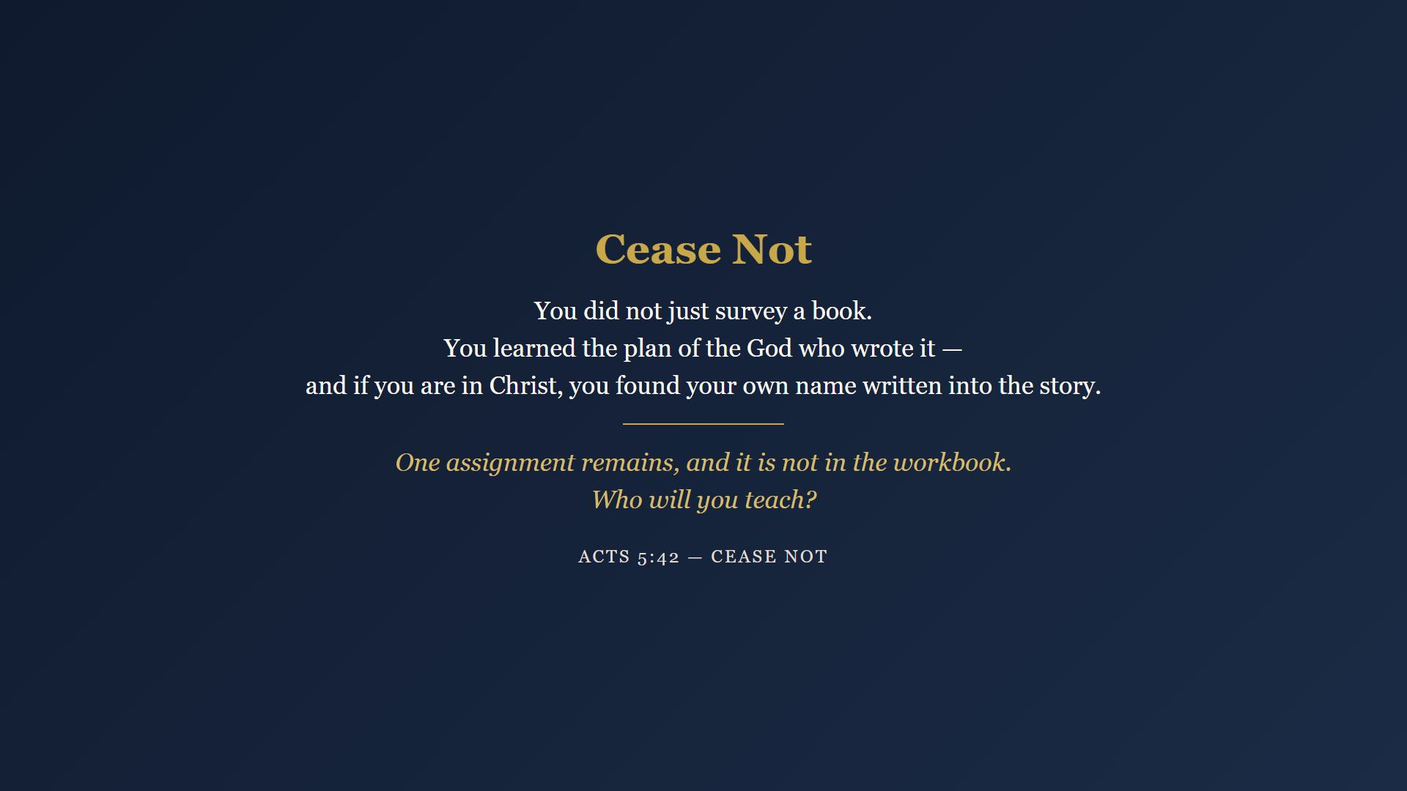
Notes:
Close with the graduation ceremony - a word over the class, the presentation and signing of certificates, and a closing prayer. The certificate carries 2 Timothy 2:15. They have earned the right to read it as workmen now.

